Slide 1

R Ladies November
https://bit.ly/2O25Q34

Slide 2
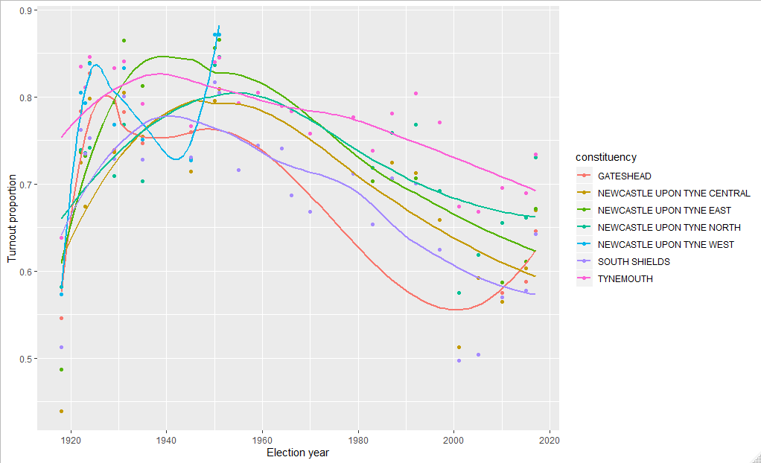
Voter turnout

Slide 3
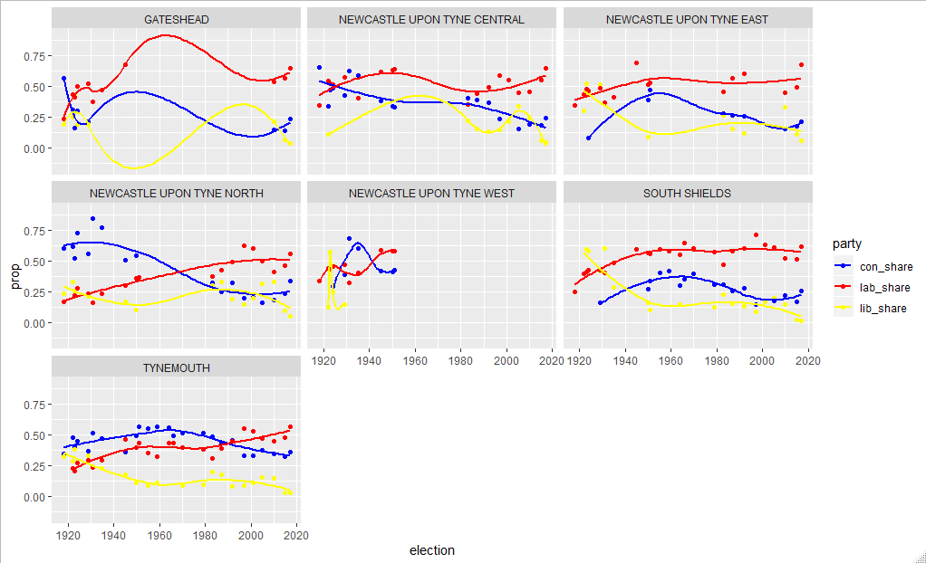
Party support

