Slide 1
Sales Analysis (2019)
https://www.kaggle.com/datasets/knightbearr/sales-product-data

Slide 2
Goals
Revenue Breakdown
Breakdown by region
Find top selling products
Find both most orders and most revenue
Find revenue by month
Sales Breakdown
Do certain time periods have higher average sales?

Slide 3

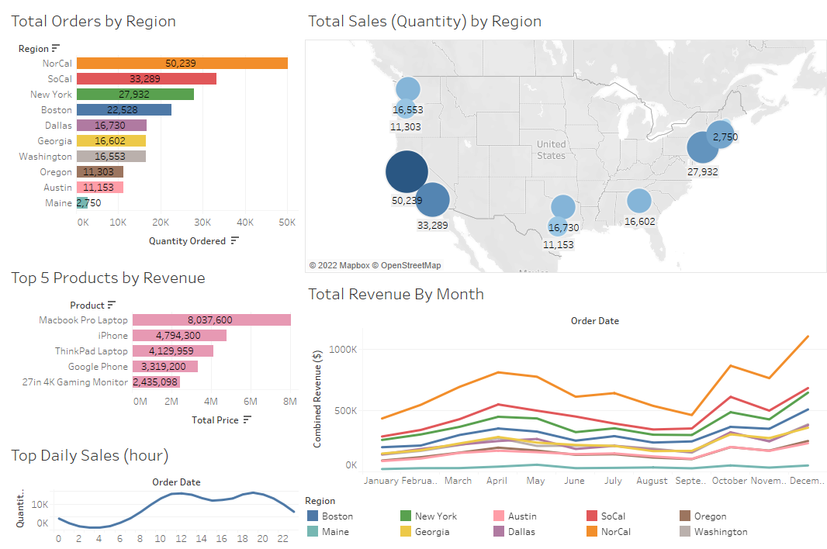
Top Sales Analysis
California is the largest market, followed by New England
Texas and the Pacific Northwest are doing well
The highest revenue is attained through products with high price tags
Daily sales are highest between 10AM-12PM and 6-8PM
Annual revenue peaks in April and the holiday season
None of the markets are growing/shrinking at a significantly different rate than any of the others

Slide 4
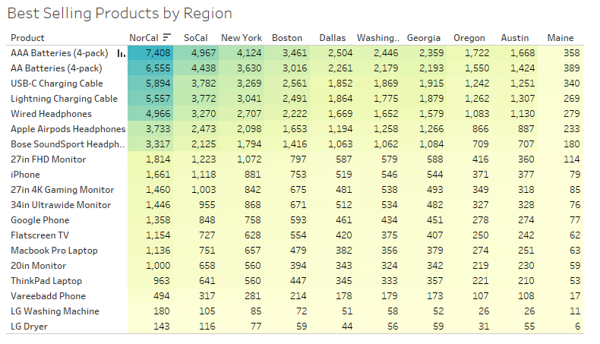
Top Sellers
While the largest revenue is from expensive products, the cheap ones have the largest number of sales

Slide 5
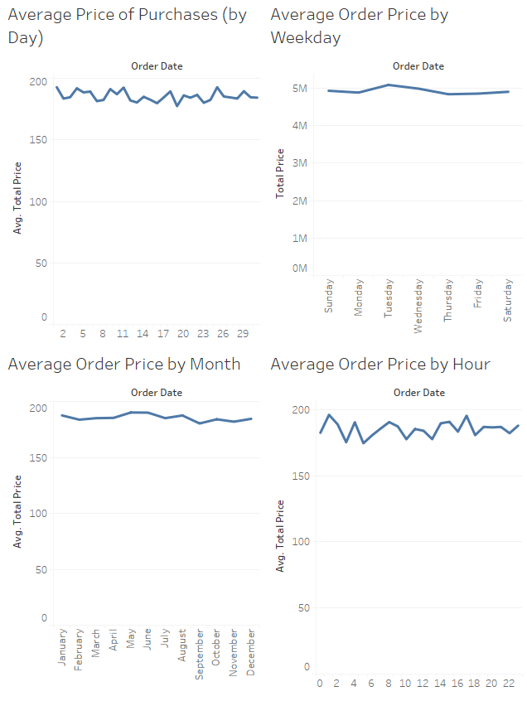
Average Order Price By Time
The average price of an order does not appear to significantly change based on the time of year, month, week, or day.

