Slide 1

Evaluation of ROS as an Addition to the W3C WoT by Marcus Wolf Schmidt July 3rd, 2020 W3C WoT Binding Templates Task Force Weekly Call

Slide 2
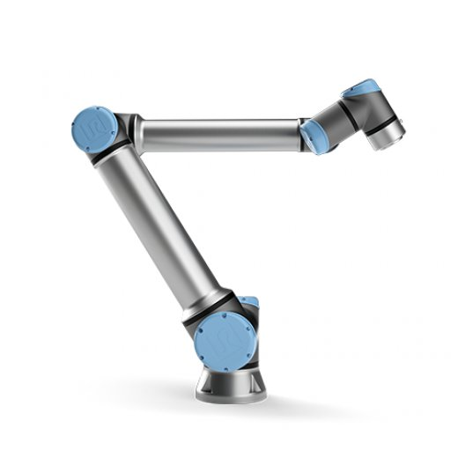
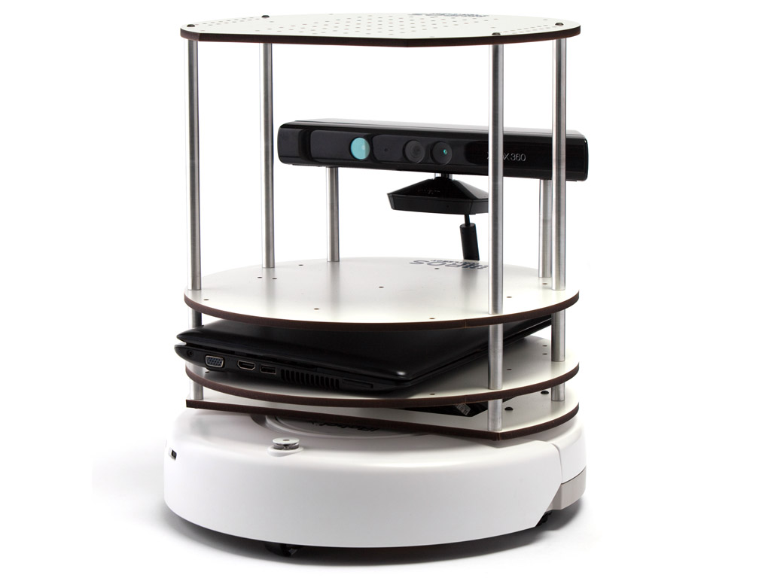
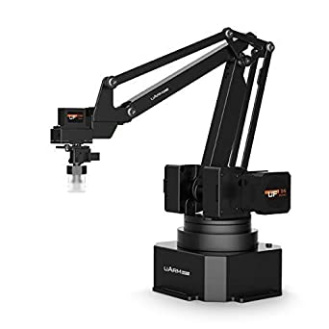

Slide 3
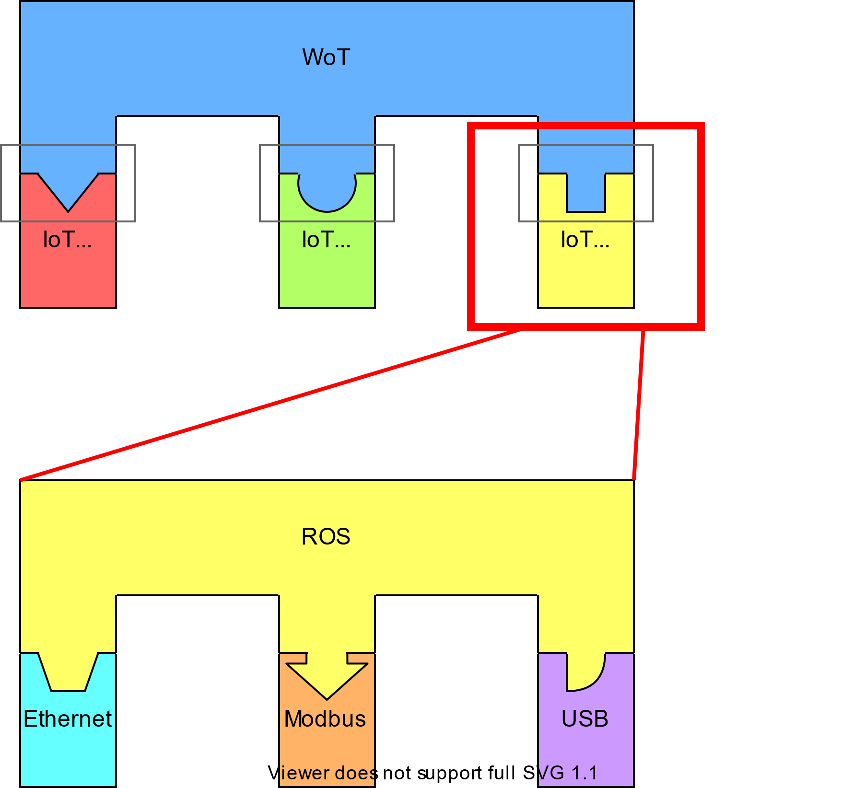





Robot Operating System (ROS)
Open Source middleware for robotics applications
Allows varies protocols to be used
(e.g. Ethernet, Modbus, USB)
Focus on reusability of code (like WoT scripting API)
Interest from the W3C WoT Working Group: GitHub Issue
WoT
HTTP
MQTT
ROS
ROS

Slide 4
ROS Nodes
Listener
Talker
ROS
Master

Slide 5
ROS Master Node
Only ONE per ROS environment
Helps Nodes find each other
Communicates over XMLRPC
Provides a parameter server

Slide 6
Simple ROS Nodes
Multiple Nodes per environment and device/robot
Nodes exchange data directly
Communicates over XMLRPC and other protocols
Nodes register themselves on the Master

Slide 7
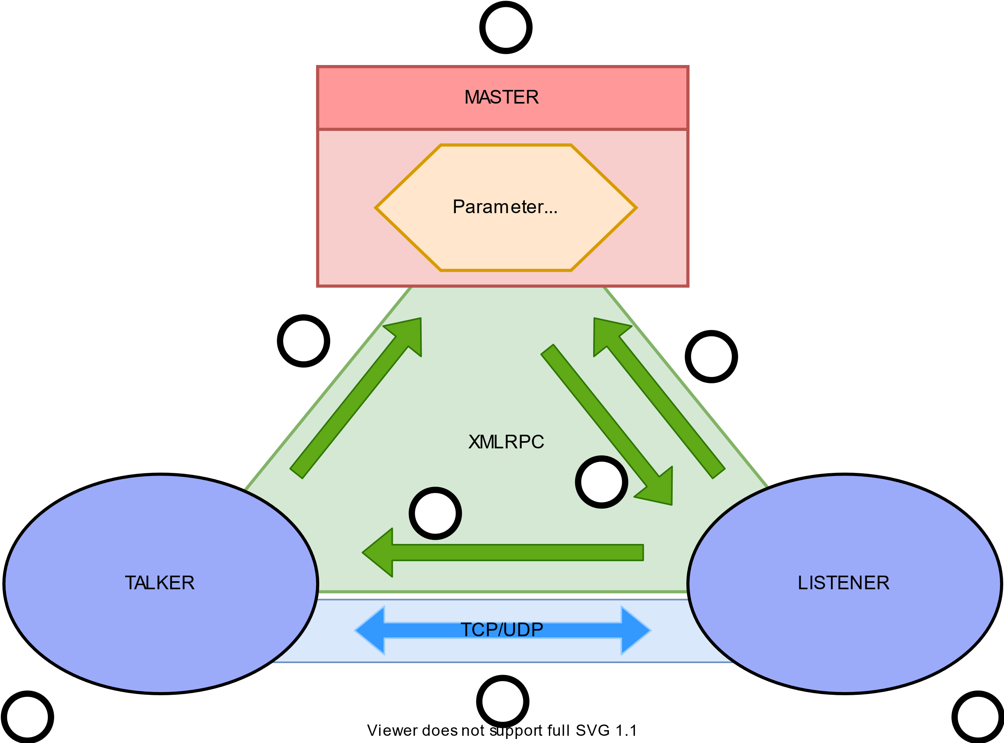



ROS Architecture
a
MASTER
Parameter
Server
2
1
3
4
TALKER
LISTENER
b
5
c

Slide 8
ROS and the W3C WoT
Publisher
Subscriber
Parameter Server
Services

Slide 9



W3C WoT Thing Description
Thing Description
readproperty
writeproperty
invokeaction
subscribeevent
observeproperty
ROS Mapping
Parameter Server
Publisher
Subscriber

Slide 10
What about Services
Publisher
Subscriber
Parameter Server
Services

Slide 11
Thing Description Vocabulary
1 {
2 "@context": ["https://www.w3.org/2019/wot/td/v1",
3 {“ros”:”http://www.example.org/ros-binding”}],
4 "title": "Uarm",
5 "properties": {
6 "location":{
7 "title":"Return location",
8 “type":"integer",
9 "forms": [{
10 "href":"ros.xmlrpc://192.168.0.100:11311/uarm/properties/location",
11 "contentType":"application/json",
12 "op":"readproperty",
13 “ros:methodName”:”getParam”
14 }]
15 }
16 },
17 "actions":{
18 “beep":{
19 "title":"Beep",
20 "forms":[{
21 "href":"ros.tcp://192.168.0.100:11311/uarm/actions/beep",
22 "contentType":"ROS/String",
23 "op":"invokeaction",
24 "ros:registerClass":"Publish"
25 }]
26 }
27 },
28 "events":{
29 "error":{
30 "title":"Error Event”,
31 "forms":[{
32 "href":"ros.tcp://192.168.0.100:11311/uarm/events/error",
33 "contentType":"ROS/String",
34 "op":"subscribeevent",
35 "ros:registerClass":"Subscribe"
36 }]
37 }
}
}

Slide 12
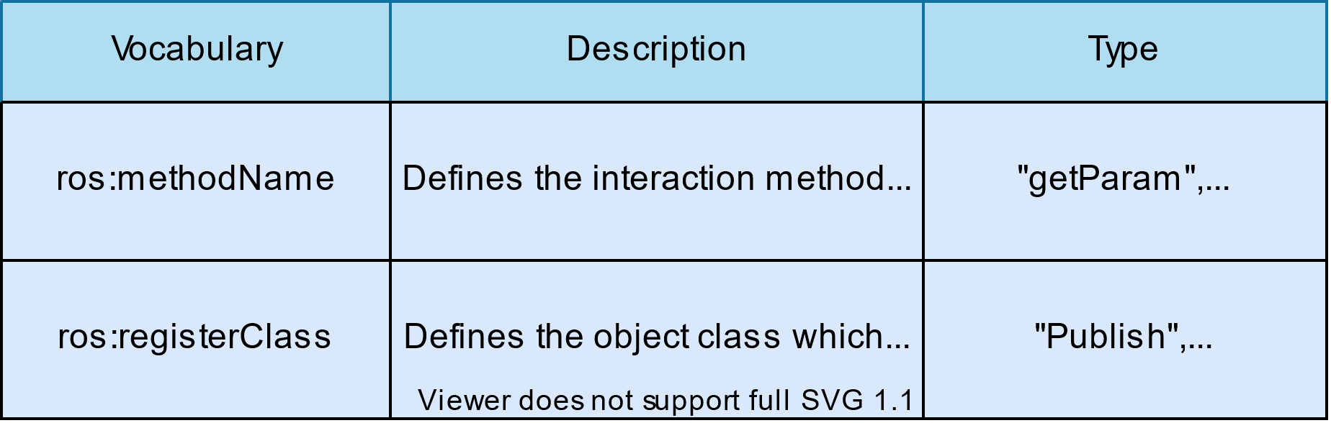






Vocabulary Table
“getParam“,“setParam“
“Publish“, “Subscribe“,(“Service“)

Slide 13
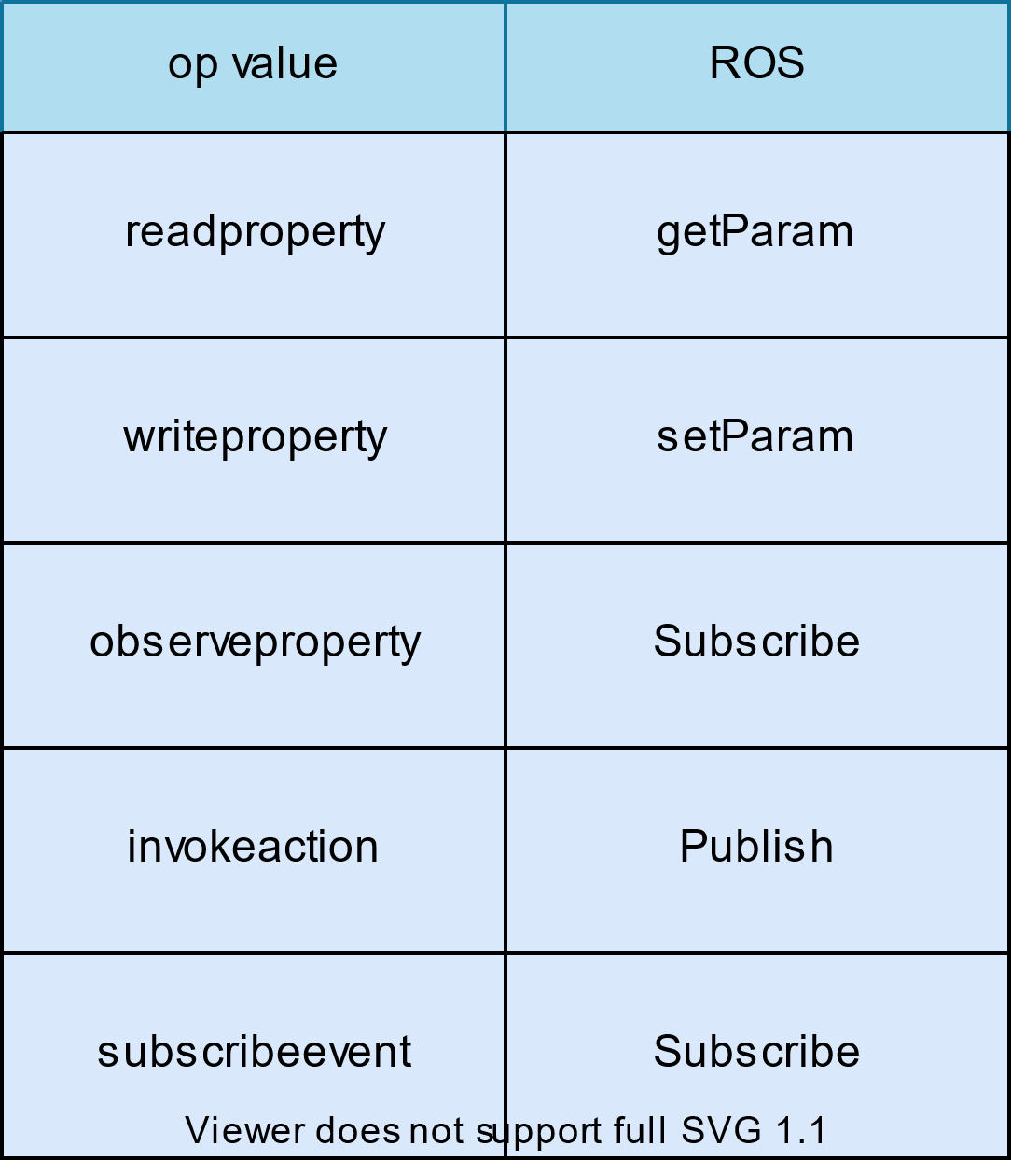



Vocabulary Mapping

Slide 14
Discussion
How to describe the ROS URI Scheme: HTTP or new URI Scheme
2. What contentType to choose: Relevant GitHub issue in Thing Description

Slide 15
Discussion Results (added after presenting)
1
XMLRPC
subprotocol
Instead of ros.xmlrpc://rosmaster in href of forms, we will use http://rosmaster and subprotocol:”ros.xmlrpc”
Reasoning behind:
Since the protocol over the wire is HTTP, this is more adequate
A subprotocol makes it easier to describe the protocol that happens over the payload, otherwise we would need specify the concrete payload mechanism that XMLRPC uses in the DataSchema of each interaction.

Slide 16
Discussion Results
2
contentType
application/xml
Instead of application/json in the contentType, we will use application/xml since the actual data on the wire is XML but the DataScheme allows us to properly describe the needed structure.

Slide 17
Discussion Results: Example TD
1 {"@context": ["https://www.w3.org/2019/wot/td/v1",
2 {“ros”:”http://www.example.org/ros-binding”}],
3 "title": "Uarm",
4 "properties": {
5 "location":{
6 "title":"Return location",
7 “type":"integer",
8 "forms": [{
9 "href":“http://192.168.0.100:11311/uarm/properties/location",
10 "contentType":"application/xml",
11 “subprotocol":“ros.xmlrpc",
12 "op":"readproperty",
13 “ros:methodName”:”getParam”
14 }]
15 }
16 },
17 "actions":{
18 “beep":{
19 "title":"Beep",
20 "forms":[{
21 "href":“http://192.168.0.100:11311/uarm/actions/beep",
22 "contentType":"ROS/String",
23 “subprotocol":“ros.tcp",
24 "op":"invokeaction",
25 "ros:registerClass":"Publish"
26 }]
27 }
28 },
29 "events":{
30 "error":{
31 "title":"Error Event”,
32 "forms":[{
33 "href":“http://192.168.0.100:11311/uarm/events/error",
34 "contentType":"ROS/String",
35 “subprotocol":“ros.tcp",
36 "op":"subscribeevent",
37 "ros:registerClass":"Subscribe"
38 }]
39 }}

Slide 18
Conclusion

Slide 19
Thank you for your attention

