Slide 1
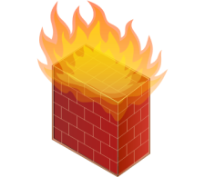
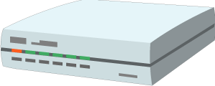

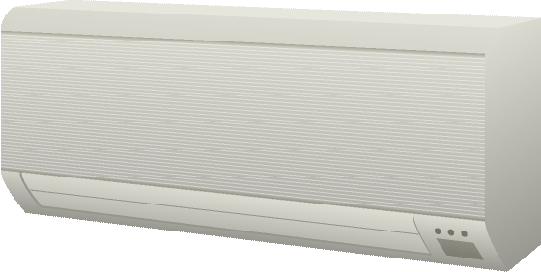


Cloud Mirror / Device Shadow
Integration Hubs
WoT Servient
App Script
Runtime Environment
WoT Servient
Resource Model
App Script
Protocol Bindings
Thing
Description
Runtime Environment
Resource Model
Standardized Scripting APIs
for Apps
Protocol Bindings
Semantic Models
Web Integration
Web Browser
WoT Servient
App Script
App Script
Runtime Environment
Thing
Description
Runtime Environment
Resource Model
Complementing
Existing Devices
and Platforms
Resource Model
Protocol Bindings
Protocol Bindings
Thing-to-Thing Interaction

