Slide 1
W3C WoT Retail Pseudo-devices
November 30, 2021

Slide 2
WoT and “Pseudo-devices”
“Pseudo-devices”:
Are normally fed data from video or audio input streams
Substitute computation resources for discrete devices
Allow a single stream to serve many purposes
Allow event clients to use standard interfaces
Often rely on high-performance edge computing
May improve privacy of data streams if kept local

Slide 3
Simple Schematic
Processor
Clients
Clients
Clients
Stream
Clients
WoT
Façade

Slide 4
TD: Cooler Door
title: CoolerVaultDoorSensorThingDescription
description: A cooler door interface that cooler door open situations.
properties:
sensorOnline:
initialSensorStateOn:
eventCounter:
observationPeriod:
eventCounterLimit:
maximumDoorOpenLimit:
maintenanceNeeded:
coolerVaultDoorSensorName:
batteryState:
actions:
resetSensor:
events:
outOfResource:
maintenanceEvent:
doorOpenPastLimit:
doorIsOpen:
batteryLow:

Slide 5
TD: EStop
title: Smart-EStop
description: A smart Estop that signals loss of dispenser operations.
properties:
eStopState:
eventCounter:
maintenanceNeeded:
eStopName:
initialState:
actions:
resetEStop:
events:
outOfResource:
maintenanceEvent:
stopEvent:

Slide 6
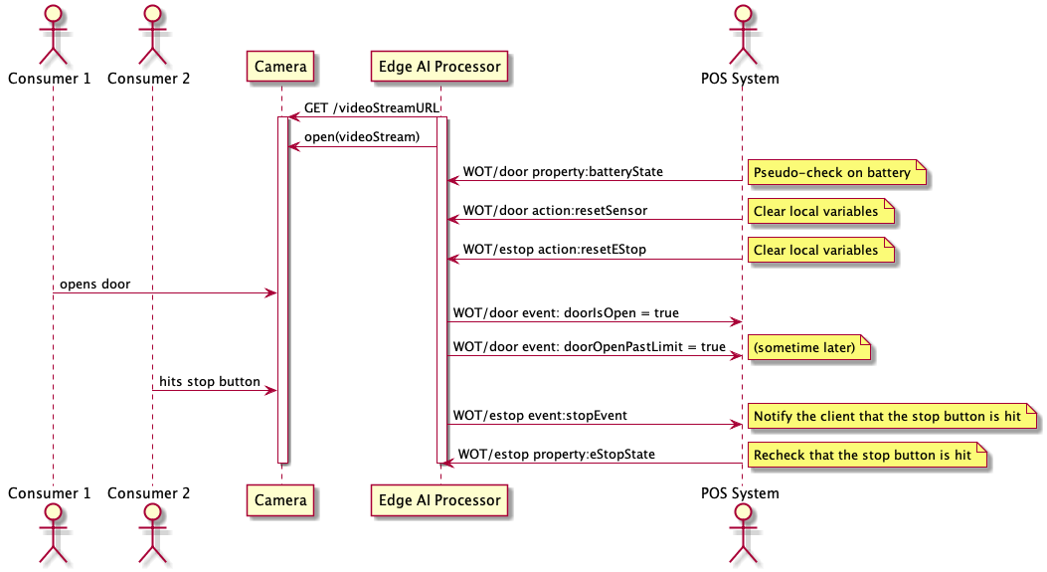
Pseudo-devices in action

