Slide 1
Conexxus IoT User Stories Priorities
November 9, 2021

Slide 2
Top Device User Stories
allStopButton (experience)
doorSensor (security, heat-map, food safety)
freezer , kitchenRefrigerator (food safety)
restroom device (safety)
lighting, canopyLightingControl (experience, security)
fountainDrinkIceMachine (experience, profit)
camera (basic data)

Slide 3
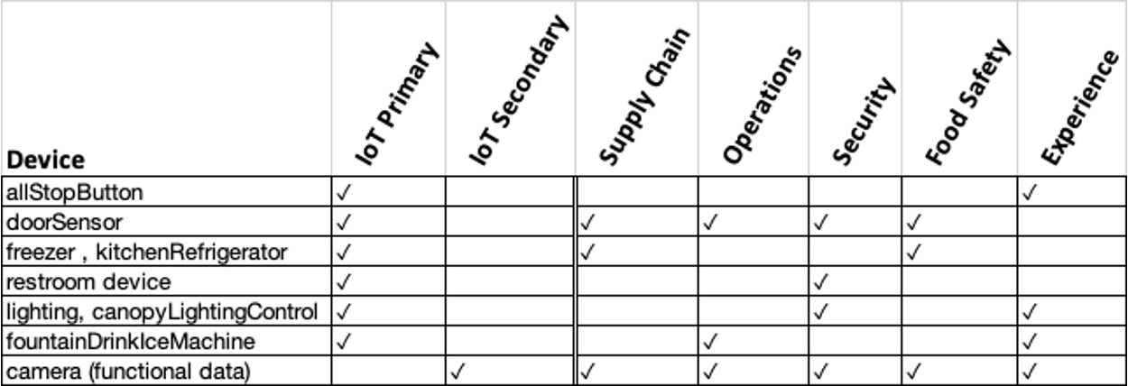
Device comparison

