Slide 1
Next Charter Detailed Planning Session Day 1
Sebastian Kaebisch
20 July 2023

Slide 2
Outline
Welcome & Logistics – 5min
Agenda plans for planning sessions (all) – 10min
PR cleanups – 45min
Working Mode & Timeline WoT 2.0 (Sebastian) – 45min

Slide 3
IRC + Wiki
Please join https://irc.w3.org/?channels=wot
Who takes the minutes today?
First h: MichaelM
Second h: MichaelK
Ege can do it for tomorrow
Wiki: https://www.w3.org/WoT/IG/wiki/Main_WoT_WebConf/2023_WoT_Next_Charter_Detailed_Planning

Slide 4
Detail Agenda Planning
Thuesday 20 June
Clean up charter detail PRs (all)
How to handle use cases and requirements?
Policy
WoT versioning
Async decission making
Public communication (e.g., Twitter tweets, …)
Wednesday 21 June
Progress check of some WoT main topics (max. 15min)
TD topics (Ege/MichaelK)
Should also discuss https://github.com/w3c/wot-charter-drafts/issues/59
Bindings (Ege/MichaelK)
Should also discuss https://github.com/w3c/wot-charter-drafts/issues/14
Thursday 22 June
Liaisons (Sebastian, Kaz; 60min)
WoT deployment (e.g., Smart Cities)
Other groups (e.g., JSON-LD, …)
Digital Twins IG (MichaelM)
Discovery (MichaelM; 1h)
Friday 23 June (optional)
Profile (Ben; 1h)
https://github.com/w3c/wot-charter-drafts/issues/80
Architecture 2.0 (MichaelM; 30min)
including Security (https://github.com/w3c/wot-charter-drafts/issues/57)
Working Mode & Timeline WoT 2.0 (30min; Sebastian)
Cont. policy decisions
Note:
Ben is only available today and on Friday
Please only give an overview of the TF topic
Avoid technical discussions or deep dives

Slide 5
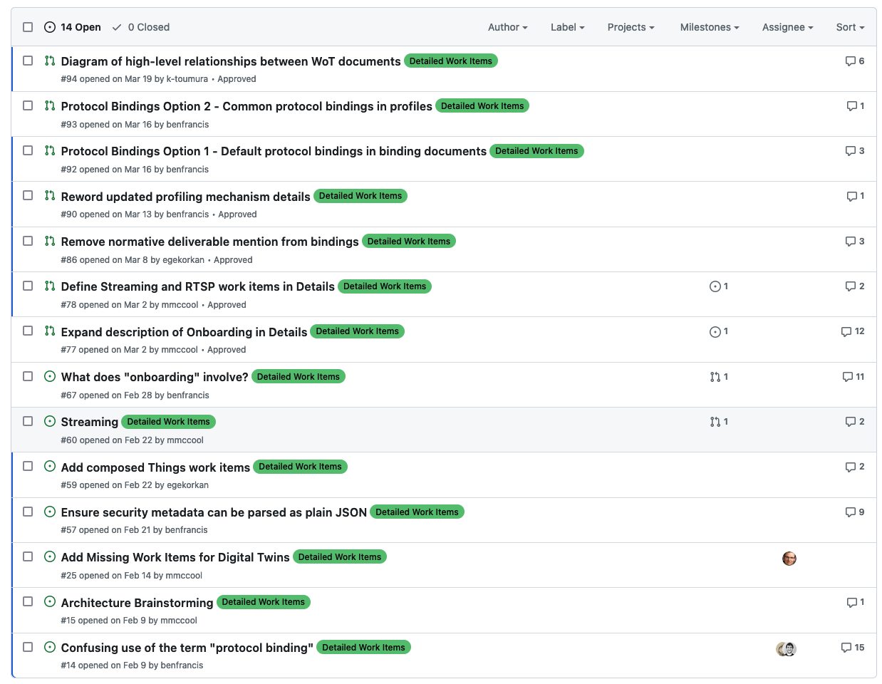
Clean up PRs
https://github.com/w3c/wot-charter-drafts/labels/Detailed%20Work%20Items

Slide 6
How to handle use cases and requirements? (Brainstorming)
MichaelM:
Propose to work botton – up
Introduce a feature first and explain which use case will need the feature
Propose to remove “requirements” from the Use Case document
Agree, should be a living document
Ben:
Suggest each deliverable has its own requirements
Requirements can be extended/changed over the time (should be not frozen)
Ege:
agree with Ben
But, what does the question mean? E.g., do we continue the use case TF?
Kaz:
UC document should be more relevant for industry needs
High level use case should be used to derive features
Sebastian:
Missing balance when a UC is needed. Does each feature needs a justification based on a specific UC?
There are obviously features where a specific UC description would be overhead

Slide 7
Policy
Brainstorming where we need a clear policy
Decisions on editors
How to handle the inputs from CG
Which functions can be delegated to the chairs only
WoT versioning
Async decision making → Ben has already a proposal; follow-up discussion in this PR
Public communication (e.g., Twitter tweets, …)
Selection of the chairs
→ Charis will prepare PRs with sample policies for the corresponding topics
→ Group can discuss on those PRs

Slide 8
Async decision making
We should find a mode when people can not attend the meetings
Ben:
is always a call needed to merge PR?
Makes only sense when there is controversial PR
Normative changes needs approval of all editors
MichaelM:
When there is no objection, we can merge
When someone objects, joining the meeting is necessary
Would support to have policy that is valid for all TFs
Kaz:
Some people have problems with async discussions
Mizushima:
We need to clarify the consensus process
Ege:
Do we have overall policy or will each deliverable have own policy?

Slide 9
Following slides are planned for 23 June

Slide 10
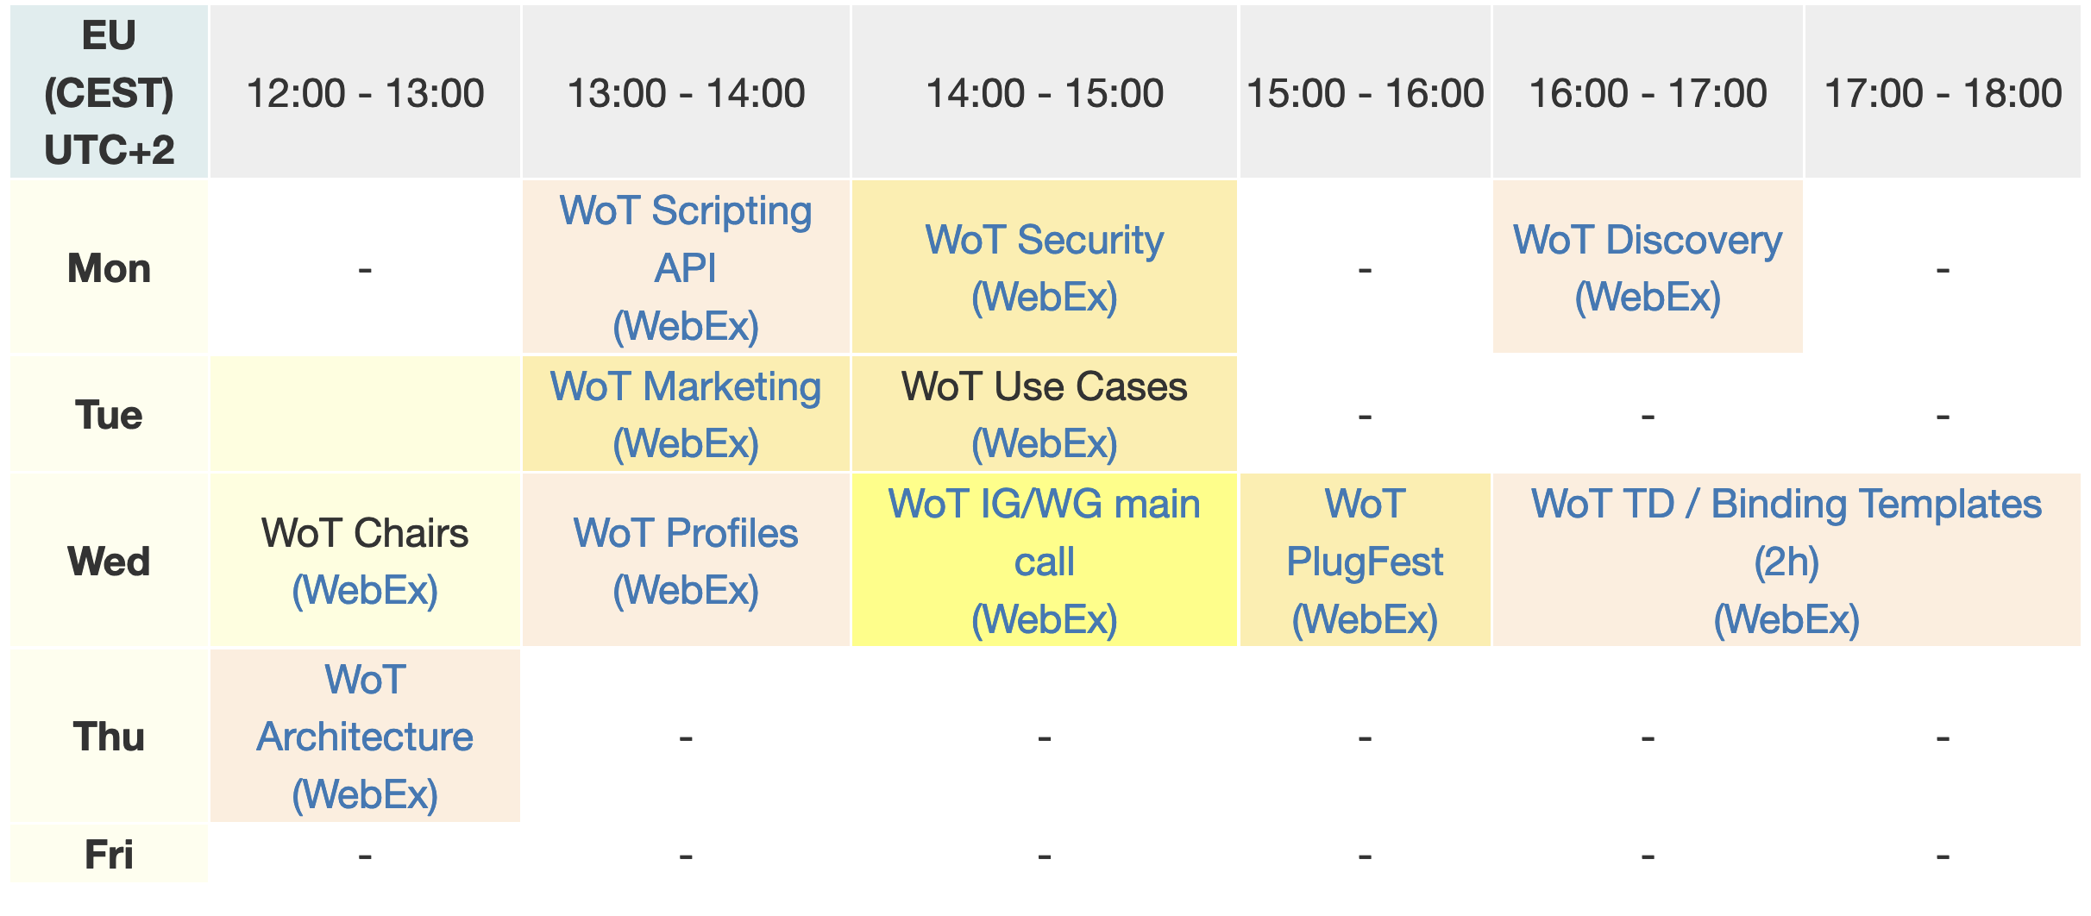
Reducing WoT Calls in the Week Current Situation

Slide 11
What should be new / changed Proposal I / II
WoT 2.0 meetings should take place in time zones convenient for all (e.g., get more participants from Japan)
TFs with REC deliverables should not be processed in parallel → everyone should concentrate only on one deliverable → increase the participation numbers of the REC based calls
TFs call with Note deliverables should only have calls every 2 weeks
Increase async process, pre-work should already happen on github (calls should be used to give an overview what happen on github and finally decide on PRs) → Marketing call already follows this approach
Share the agenda one day before the meeting that includes the list of issues / PRs
Main call every 2 weeks only?
Optimize calendar: We should have max. 4 calls in one week

Slide 12
What should be new / changed Proposal II / II
If needed, a use case or liaison-based call can take place by a pre-defined meeting time (e.g., once a month)
Since we do not have someone who can drive the Profile TF, we should pause Profil or transform it as Note document
Architecture may also considered as Note deliverable in the future (as already discussed in the past and recommended by TAG)
Define feature Milestones in each deliverables

Slide 13
Roadmap WoT 2.0 Deliverables (Draft)
REC
Note
TPAC F2F
WoT Event?
WoT API
Note + Liaison
Security
F2F meeting
OPC UA Binding
Matter Binding ?
BACnet Binding
WoT Architecture
WoT Profile 1.0?
WoT Discovery 2.0
CR Candidate
WoT Thing Description 2.0
CR Candidate
Start charter Q3 2023
Q1 2024
Q3 2024
End 2024
End charter Q3 2025

Slide 14
Proposal Schedule Week 1
TD 2.0
Binding Call
Chairs
Main
REC
Note

Slide 15
Proposal Schedule Week 2
TD 2.0
API
REC
Security
Testing (optional)
Note
IG Call

Slide 16
Proposal Schedule Week 3
TD 2.0
Binding Call
Chairs
Main
REC
Note

Slide 17
Proposal Schedule Week 4
TD 2.0
API
Security
Testing (optional)
Use Case / Liaisons (optional)
REC
Note
IG Call

Slide 18
Resources and Contacts
https://www.w3.org/WoT
Dr. Michael McCool
Principal Engineer
Intel
Technology Pathfinding
michael.mccool@intel.com
Dr. Sebastian Kaebisch
Senior Key Expert
Siemens
Technology
sebastian.kaebisch@siemens.com

