Slide 1

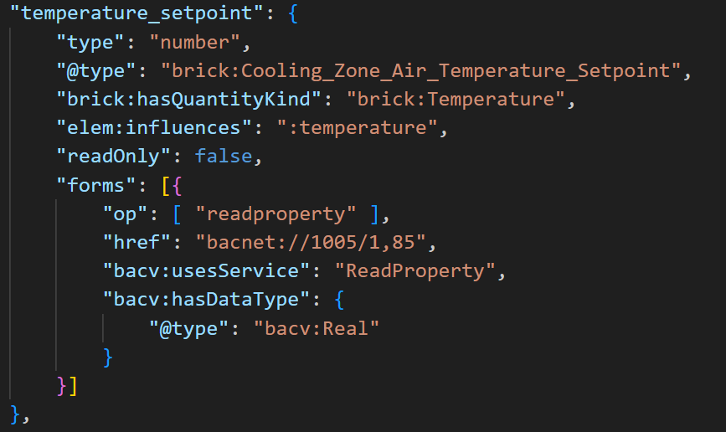
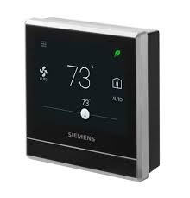
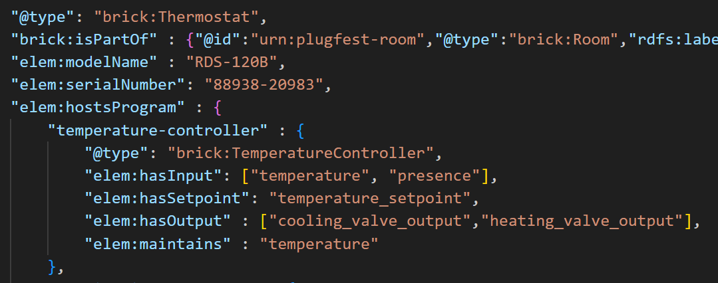
Physics-infused Things
Background/Motivation:
Things happen in Things
What does it do physically?
How are the properties, actions, and events
related to variables in the physical environment?
Why: We want autonomous agents to use the TDs
What does this Smart Thermostat do?
It operates the heating system to maintain room temperature
It operates the ventilation fan to maintain air quality
This knowledge is opaque to machines.
Idea: Use TD as the vehicle to tell the story

