Slide 1
One Year* Update: Using LinkML in Web of Things Specifications
W3C TPAC 2024 Breakout
September 25 2024
Ege Korkan, Mahda Noura

Slide 2

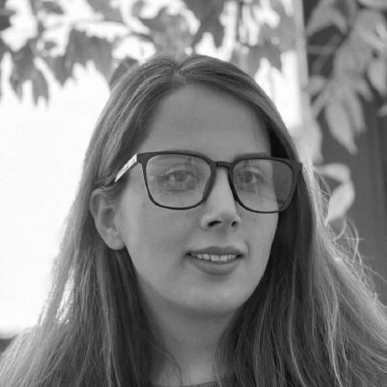
Session Chairs
Ege Korkan
Email: ege.korkan@siemens.com
GitHub: @egekorkan
Mahda Noura
Email: mahda.noura@siemens.com
GitHub: @mahdanoura

Slide 3
Logistics
W3C Calendar Entry | Session Proposal on GitHub
Please all join IRC at https://irc.w3.org/?channels=%23linkml-wot
Then type present+ to check in.
Type q+ to raise hand
We will take minutes there manually.
Scribe will be Michael McCool
Quickly introduce yourself before speaking (now if there are not too many people)
These slides are public. Link.
The session is not recorded.

Slide 4
Participation Policies
Antitrust and competition policy
W3C acts in a pro-competitive way that is ensured by this document.
Positive Work Environment at W3C: Code of Ethics and Professional Conduct
Promote high standards of professional practice to ensure a positive work environment
Health Rules
Masks and tests are optional. Stay in your room and attend virtually if you do not feel well.

Slide 5
Bringing some Context
Nature of this session:
Brief presentation
Discussion
Goal:
Share experience
Required background:
Basic understanding of JSON-LD, Ontologies, Schema languages

Slide 6
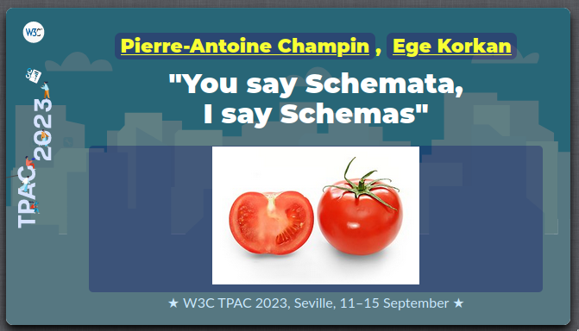
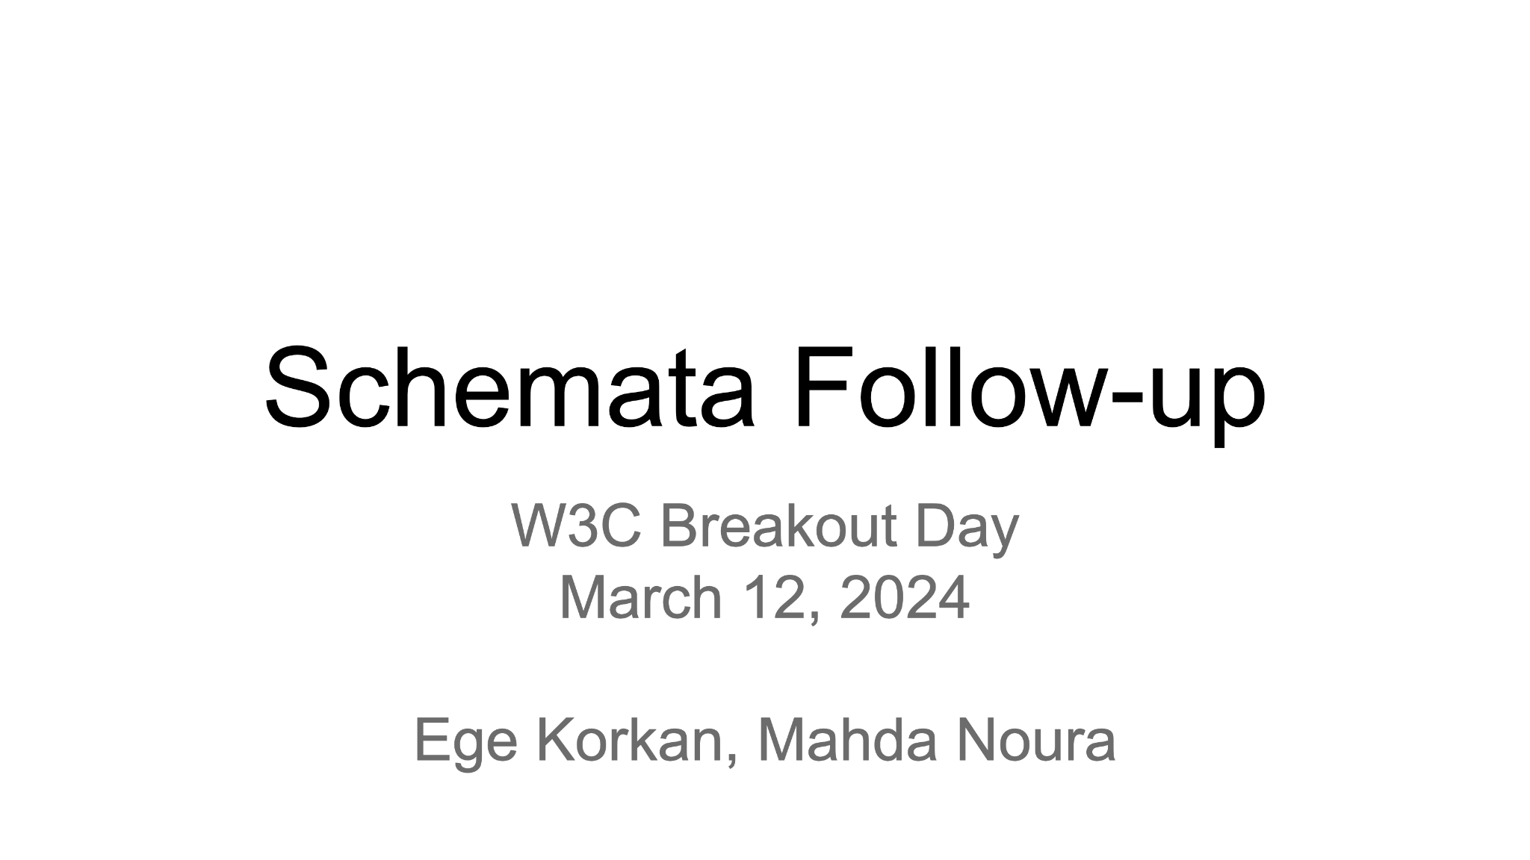

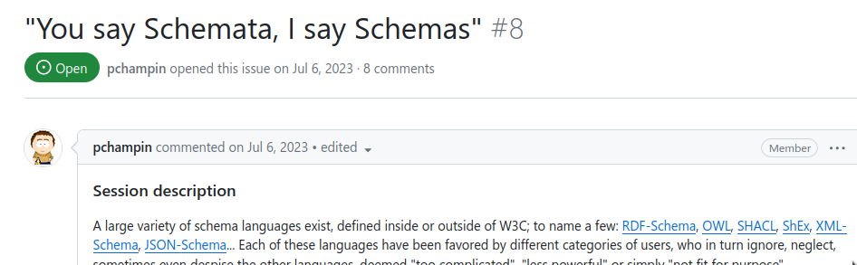
Have we met before?
Were you in the previous session of this?
If not, please write "new" in IRC :)

Slide 7
In case you haven't been there
Resources from TPAC2023:
Introduction from Pierre-Antoine Champin: https://perso.liris.cnrs.fr/pierre-antoine.champin/2023/TPAC-Schemata/
Web of Things TD Use Case from Ege Korkan: https://github.com/w3c/wot/blob/main/PRESENTATIONS/2023-09-tpac/2023-09-13-Breakout-Schemata-TD_Single_Source_of_Truth.pdf
Minutes: https://www.w3.org/2023/09/13-schemata-minutes.html
Quick Summary

Slide 8
In case you haven't been there
Resources from Breakout Day 2024:
Slides: https://docs.google.com/presentation/d/193OFcFaxD0GqrRuOggwZe5eorgL1C1Epe2cAYN3JEkk/edit?usp=sharing
Minutes: https://www.w3.org/2024/03/12-schemata-discussion-minutes.html
Quick Summary

Slide 9
Use Case of Thing Description Task Force
Web of Things TD Task Force needs to manage the following:
Spec document, which contains vocabulary terms and information model
Ontology documents
SHACL shapes
JSON Schema
Type and Class Definitions (for now only TypeScript)
Test cases
Examples
All of them need publication procedure.
Soon, each binding in a registry will need the same and anyone should be able to do it…

Slide 10
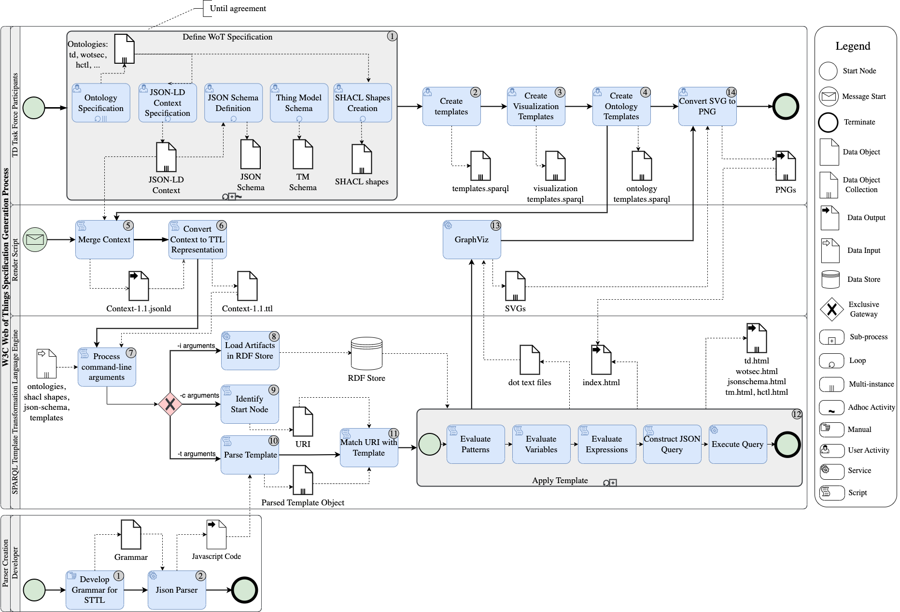
What we were doing so far

Slide 11
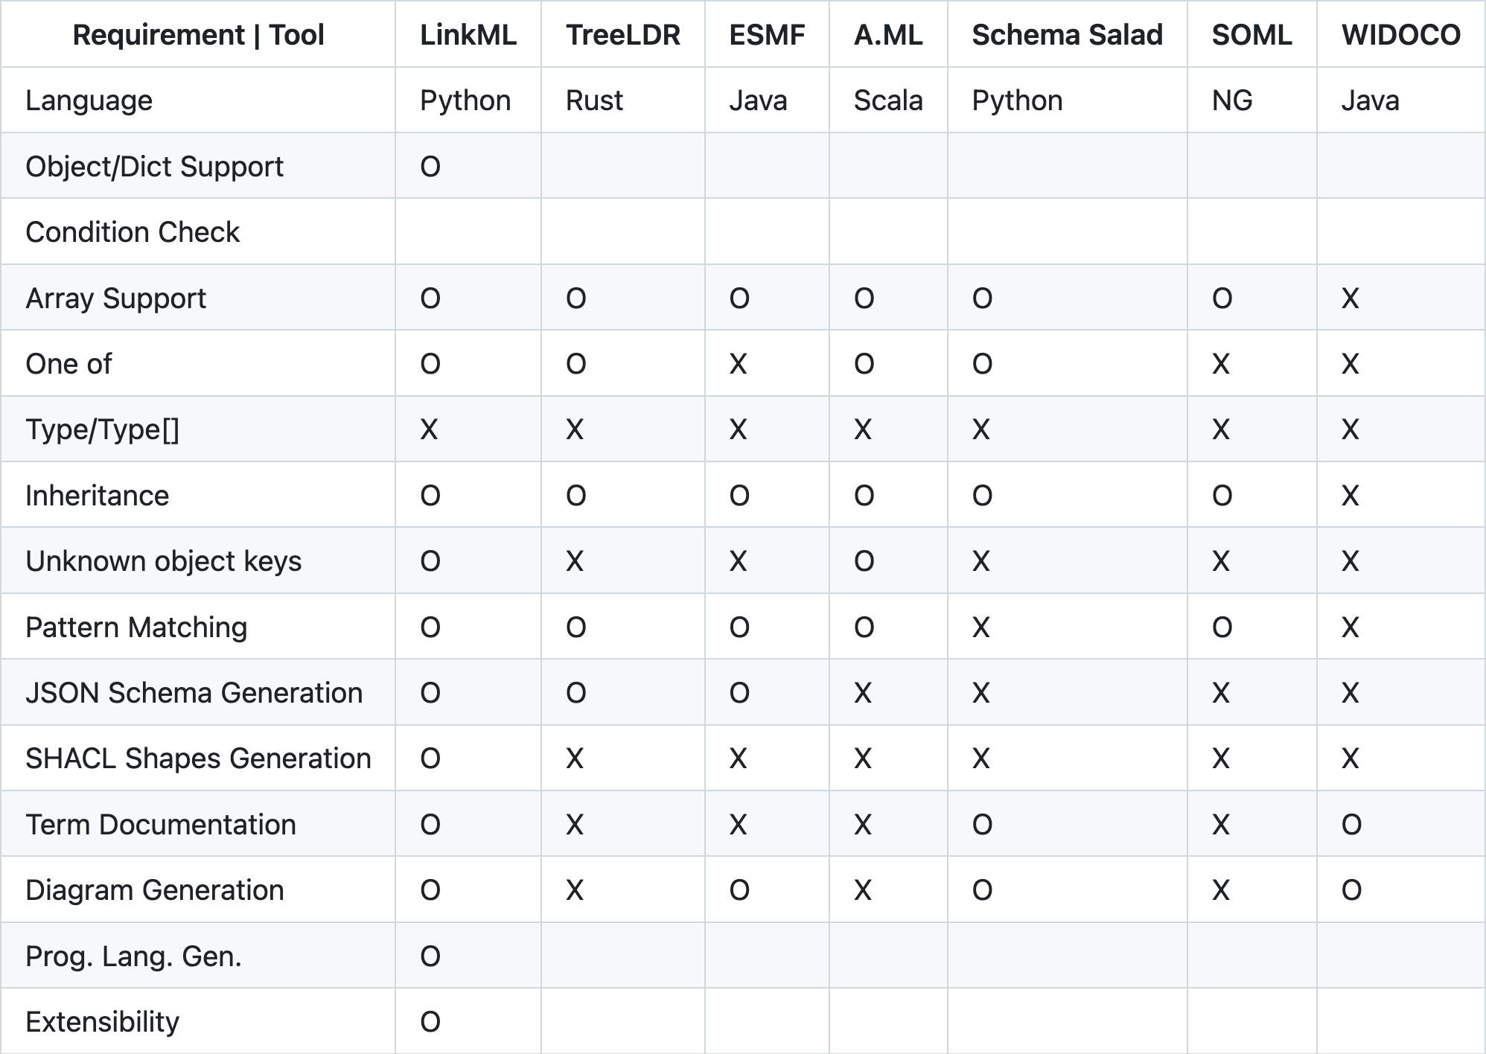
Before and Now
Previously, we discussed possible technologies to use, presented an analysis
Now we are on our path to adopting LinkML! Let’s see what we have found out after 6 months…

Slide 12
Switch to Mahda

Slide 13
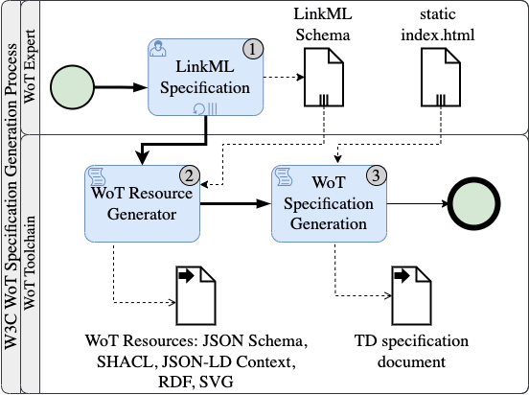
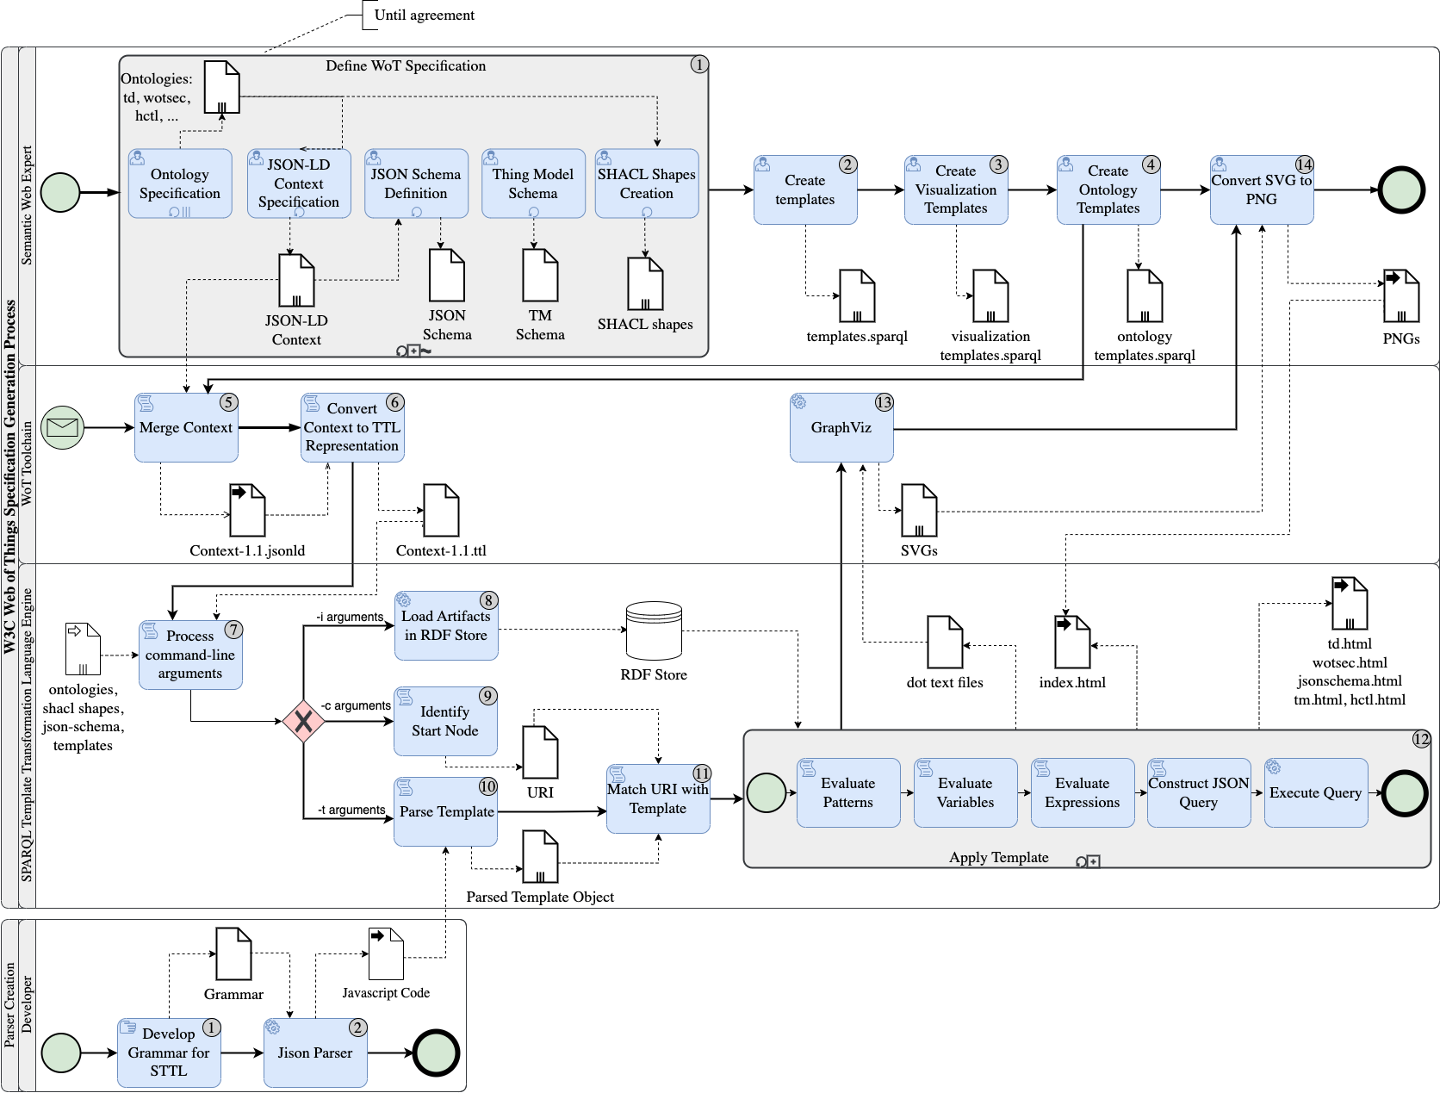
Vision
Transitioning from multiple sources to a single source-of-truth with LinkML schema
Transitioning from manually crafting WoT artifacts to full automation with LinkML generators

Slide 14


WoTIS - Web of Things Integration Schema
Step 1: Clone the repo: https://github.com/w3c/wot-thing-description-toolchain-tmp
Step 2: Install uv package manager
Step 3: Install the package by:

Slide 15
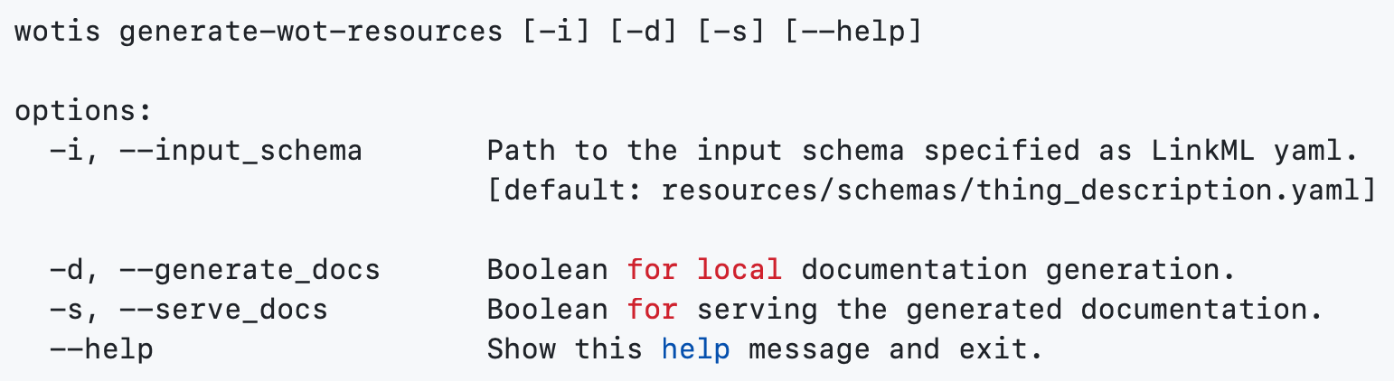
CLI Usage
Note: The HTML generation does not use the W3C style yet. Customization options will be included in the future.

Slide 16
Live Demo: Putting WoTIS to Work

Slide 17
Realizing the Vision through Post-Processing
LinkML Generators provide a strong foundation, but…
Post-Processing is still required to ensure:
Consistency between generated and hand-written WoT artifacts
Customizations to meet specific domain requirements

Slide 18
What More Do We Need from LinkML?
Natively support modeling JSON LD multi-language strings
Scoped JSON-LD contexts
Require open mappings for Class attributes
Support for JSON-LD arrays and containers
Best practices for modeling JSON-LD keywords
Improved representations of URI, CURIE and URIORCURIE types beyond the string type
Schema name collision resolution - currently multiple schemas that have the same name are merged, even though they refer to different elements
Contribution support on LinkML code architecture to lower the barrier

Slide 19
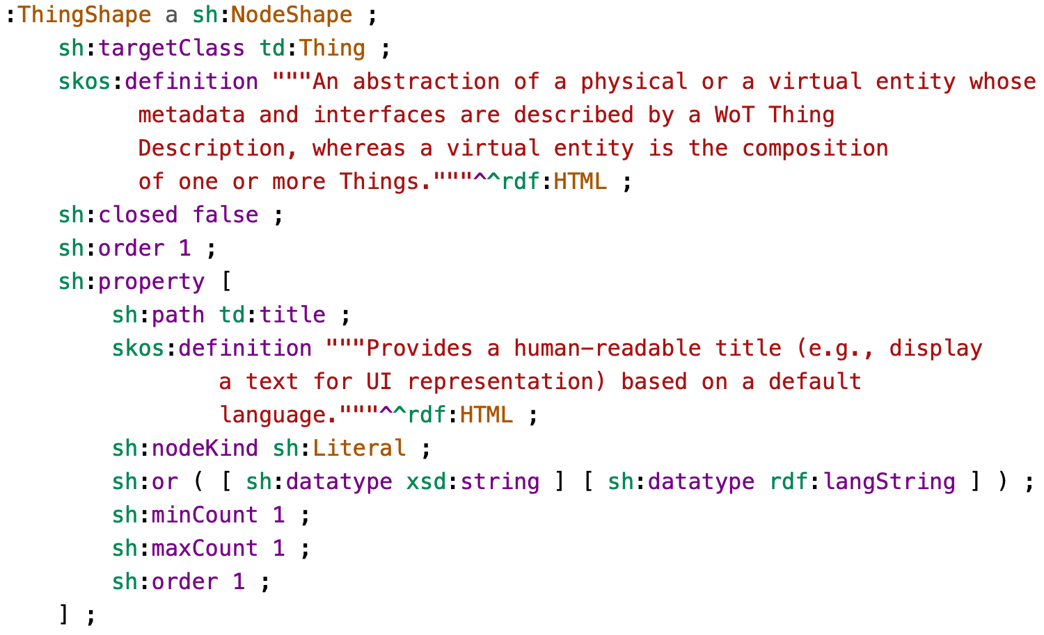
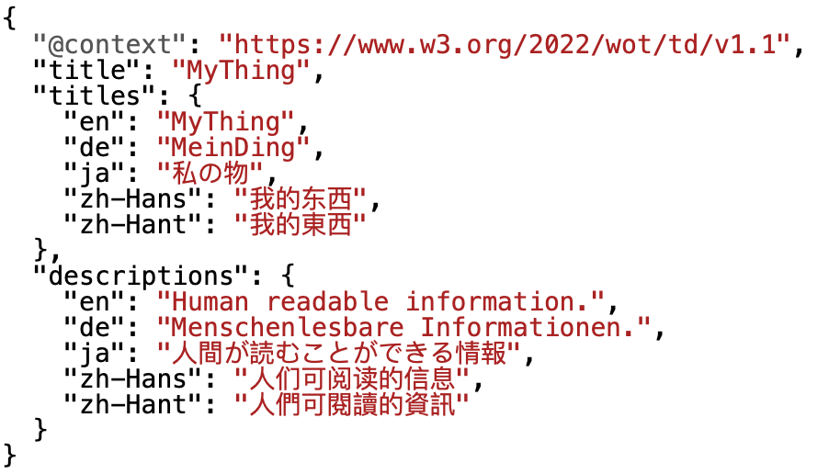
Multi-language Strings

Slide 20
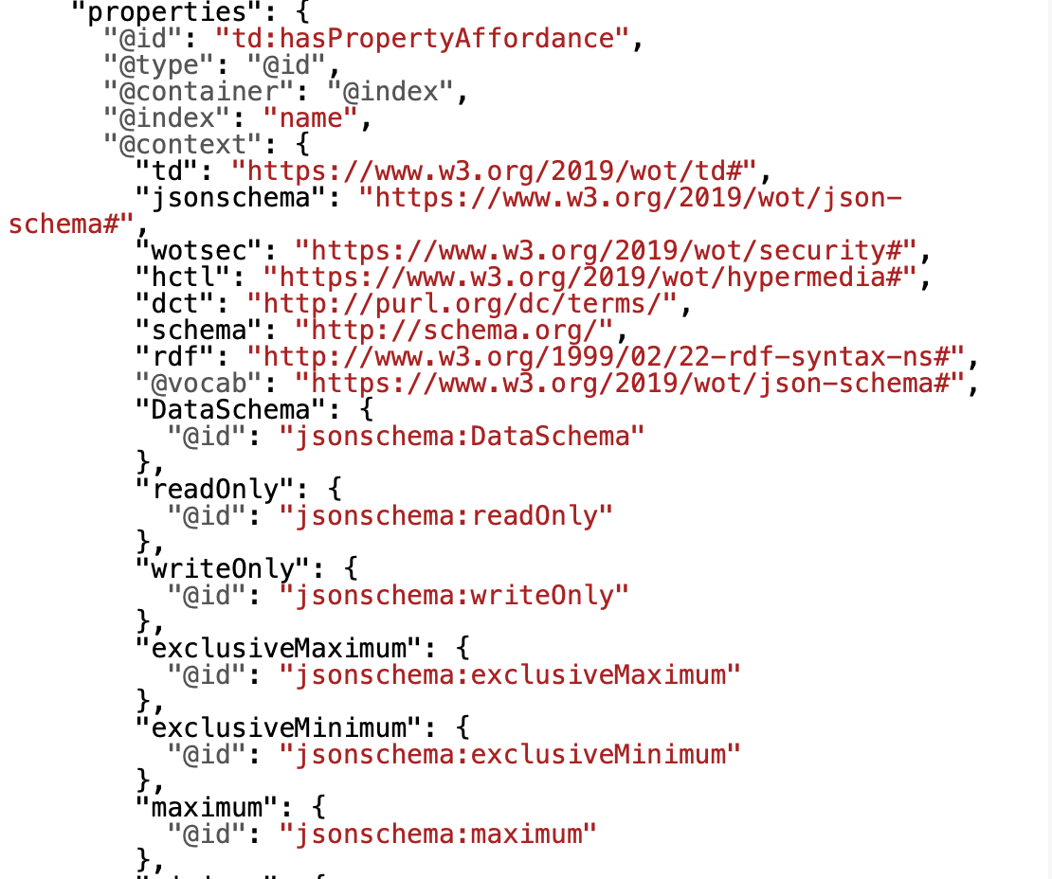
Scoped JSON-LD Context

Slide 21
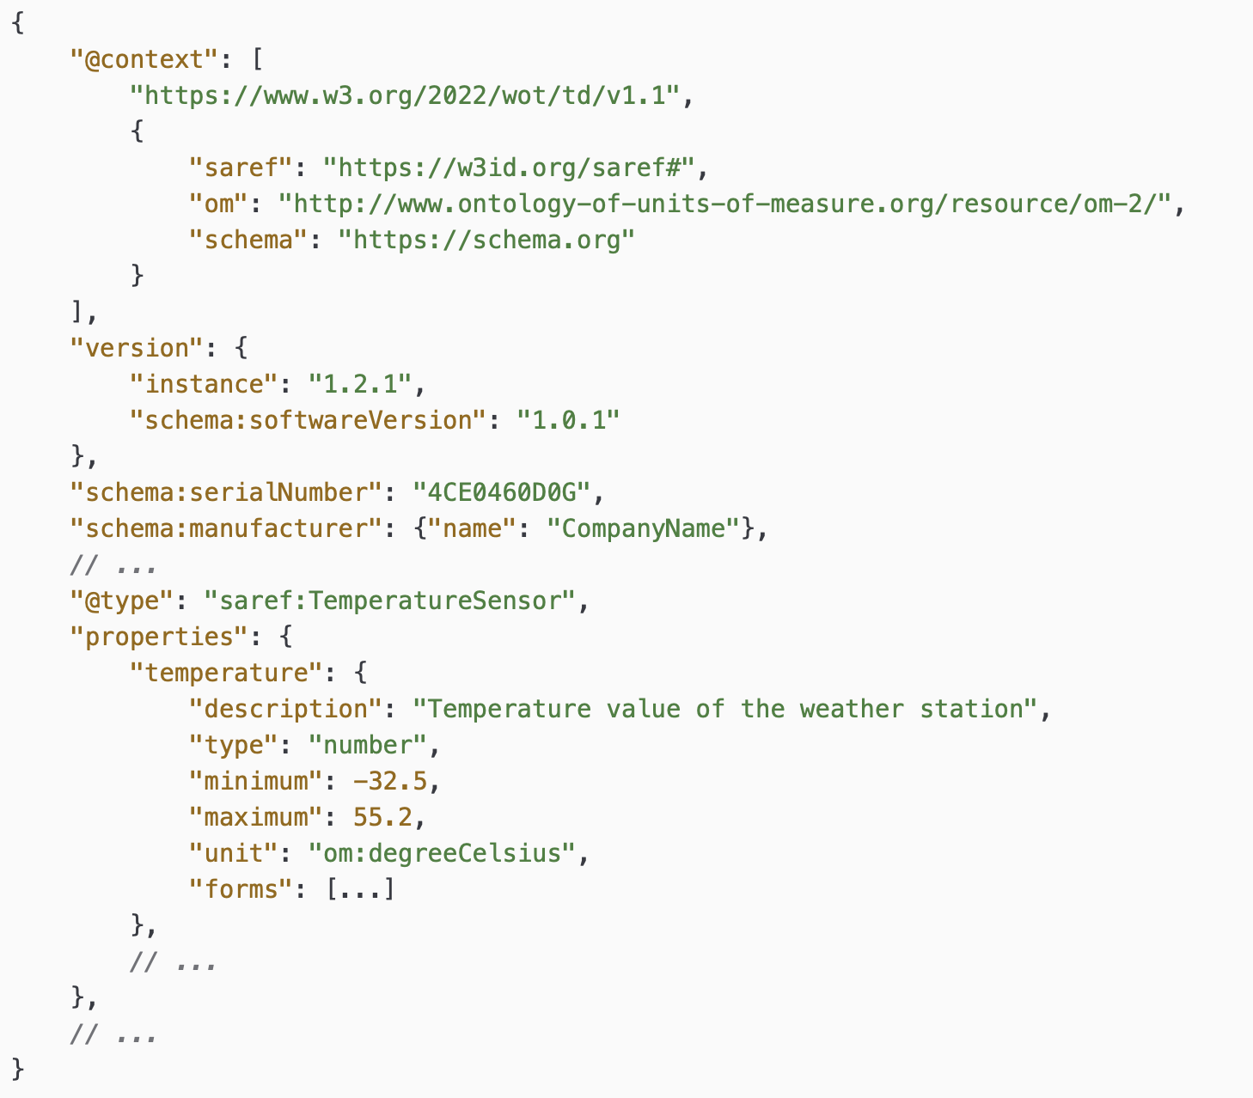
Thing Description Context Extension & Semantic Annotations
How This Works in Other Models:
JSON Schema: Achieved by setting "additionalProperties": true
SHACL: Managed by using "closed": false
Limitation in LinkML
LinkML does not currently support modeling TD context extensions and allowing for external vocabulary integration.
https://github.com/linkml/linkml/issues/2238

Slide 22
What More Do We Need from LinkML?
Natively support modeling JSON LD multi-language strings
Scoped JSON-LD contexts
Require open mappings for Class attributes
Support for JSON-LD arrays and containers
Best practices for modeling JSON-LD keywords
Improved URI, CURIE, URIORCURIE types beyond string type
Schema name collision resolution - currently multiple schemas that have the same name are merged, even though they refer to different elements
Contribution support on LinkML code architecture to lower the barrier

Slide 23
Overall Experience
LinkML supports diverse schema definitions, suitable for simple & complex models
Easy-to-use LinkML generators
Good community engagement in issue discussions
Lack of comprehensive documentation for complex use cases
Provided error messages are in most cases not helpful
High effort for correct slot selection for specific use cases
Incomplete feature implementation often requires workaround

Slide 24
LinkML Long-Term Outlook
Schema verbosity and maintenance
Schema inflexibility sometimes results in defining intermediate classes
RDF-like mental model still necessary, subject-predicate-object
The LinkML model must be refined for individual generators can be time-consuming when multiple generators are incorporated
Continued efforts to strengthen the community
Notes:
The LinkML model must be refined for individual generators like ShEx, JSON Schema, SHACL, and JSON-LD, ensuring all necessary details for generating each artifact are incorporated, which can be time-consuming with multiple generators

Slide 25
Where should the discussion continue?
LinkML Meetups (Stay tuned!)
WoT WG (contact Ege Korkan (ege.korkan@siemens.com) to join the calls for this toolchain work)

Slide 26
Feedbacks and Whiteboard
Vladimir: Electrical CIM/CGMES wants to transition from Enterprise Architect to LinkML, but just starting. Discussion at https://github.com/Sveino/Spec4CIM-KG/issues/9

Slide 27
Check-out (to be extended in the end of the meeting)
A summary before the discussion ends:
Main points of discussion, consensus, or disagreement?
Discussion
What are the next steps?
Further work on the usage of LinkML
Reach out to DID TF
Who is responsible for carrying them out? (Could be a person from the session, or a group where work is ongoing, a new community group, the staff, etc.)
TD TF of the WoT WG

