Slide 1
Next Charter Detailed Planning Session Day 1
Sebastian Kaebisch
20 July 2023

Slide 2
Outline
Welcome & Logistics – 5min
Agenda plans for planning sessions (all) – 10min
PR cleanups – 45min
Working Mode & Timeline WoT 2.0 (Sebastian) – 45min

Slide 3
IRC + Wiki
Please join https://irc.w3.org/?channels=wot
Who takes the minutes?
Wiki: https://www.w3.org/WoT/IG/wiki/Main_WoT_WebConf/2023_WoT_Next_Charter_Detailed_Planning

Slide 4
Detail Agenda Planning (tbd)
Thuesday 20 June
Clean up charter detail PRs (all)
Working Mode & Timeline WoT 2.0 (Sebastian)
Wednesday 21 June
WoT Versioning?
TD topics?
Bindings?
Thursday 22 June
Discovery ?
Liaisons ?
Friday 23 June (optional)
Profile?
Note:
Please only give an overview of the TF topic
Avoid technical discussions or deep dives

Slide 5
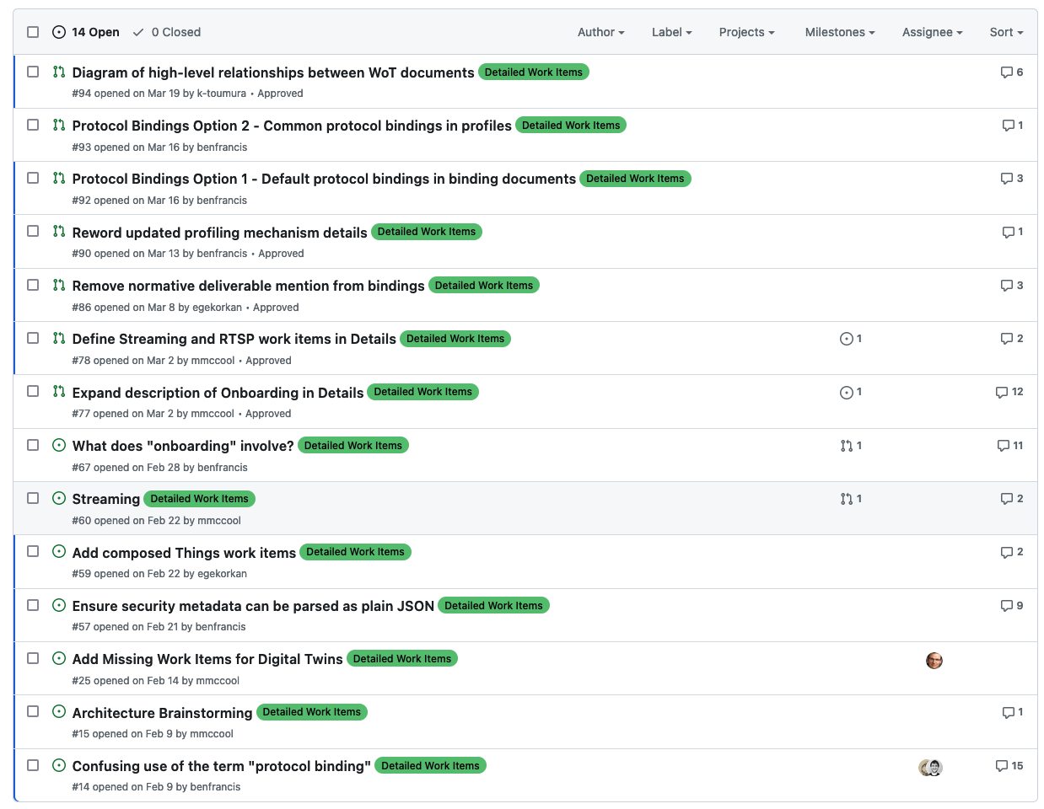
Clean up PRs
https://github.com/w3c/wot-charter-drafts/labels/Detailed%20Work%20Items

Slide 6
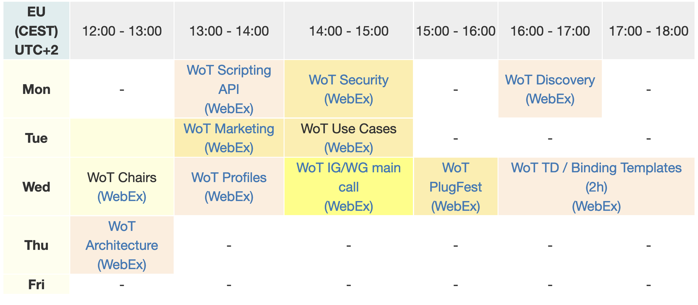
Reducing WoT Calls in the Week Current Situation

Slide 7
What should be new / changed Proposal I / II
WoT 2.0 meetings should take place in time zones convenient for all (e.g., get more participants from Japan)
TFs with REC deliverables should not be processed in parallel → everyone should concentrate only on one deliverable → increase the participation numbers of the REC based calls
TFs call with Note deliverables should only have calls every 2 weeks
Increase async process, pre-work should already happen on github (calls should be used to give an overview what happen on github and finally decide on PRs) → Marketing call already follows this approach
Share the agenda one day before the meeting that includes the list of issues / PRs
Main call every 2 weeks only?
Optimize calendar: We should have max. 4 calls in one week

Slide 8
What should be new / changed Proposal II / II
If needed, a use case or liaison-based call can take place by a pre-defined meeting time (e.g., once a month)
Since we do not have someone who can drive the Profile TF, we should pause Profil or transform it as Note document
Architecture may also considered as Note deliverable in the future (as already discussed in the past and recommended by TAG)
Define feature Milestones in each deliverables

Slide 9
Roadmap WoT 2.0 Deliverables (Draft)
REC
Note
TPAC F2F
WoT Event?
WoT API
Note + Liaison
Security
F2F meeting
OPC UA Binding
Matter Binding ?
BACnet Binding
WoT Architecture
WoT Profile 1.0?
WoT Discovery 2.0
CR Candidate
WoT Thing Description 2.0
CR Candidate
Start charter Q3 2023
Q1 2024
Q3 2024
End 2024
End charter Q3 2025

Slide 10
Proposal Schedule Week 1
TD 2.0
Binding Call
Chairs
Main
REC
Note

Slide 11
Proposal Schedule Week 2
TD 2.0
API
REC
Security
Testing (optional)
Note
IG Call

Slide 12
Proposal Schedule Week 3
TD 2.0
Binding Call
Chairs
Main
REC
Note

Slide 13
Proposal Schedule Week 4
TD 2.0
API
Security
Testing (optional)
Use Case / Liaisons (optional)
REC
Note
IG Call

Slide 14
Resources and Contacts
https://www.w3.org/WoT
Dr. Michael McCool
Principal Engineer
Intel
Technology Pathfinding
michael.mccool@intel.com
Dr. Sebastian Kaebisch
Senior Key Expert
Siemens
Technology
sebastian.kaebisch@siemens.com

