Slide 1
Thing Description 2.0
Sebastian Kaebisch
14 September 2023

Slide 2
Agenda Overview
Summarizing planned activity: 20mins (Sebastian)
Bindings Registry: 20mins (Ege)
Manageable Actions (Asynchronous, queriable etc.): 5mins (Koster)
Q&A: 30mins (Sebastian)

Slide 3
TD Document Structure Today
TD 1.1 REC includes - Thing Models - Security scheme definitions
Explains the mechanism
HTTP Binding Note
Labels:
Binding Template Note
Modbus Binding Note
Metadata
MQTT Binding Note
…

Slide 4
Planned Restructuring
TD 2.0 REC includes - Thing Models - Binding Template mechanism
- Security scheme mechanism
Eg., ECHONET, OPC UA, BACnet, …
Modbus Binding Note
HTTP Binding Note
X Binding
…
…
Labels:
Metadata
Security Scheme related X
Security Scheme related Modbus
Security Scheme related HTTP
External SDO
…
…

Slide 5
Planned Topics for 2.0 Overview
Full overview: https://w3c.github.io/wot-charter-drafts/wot-wg-2023-details.html

Slide 6
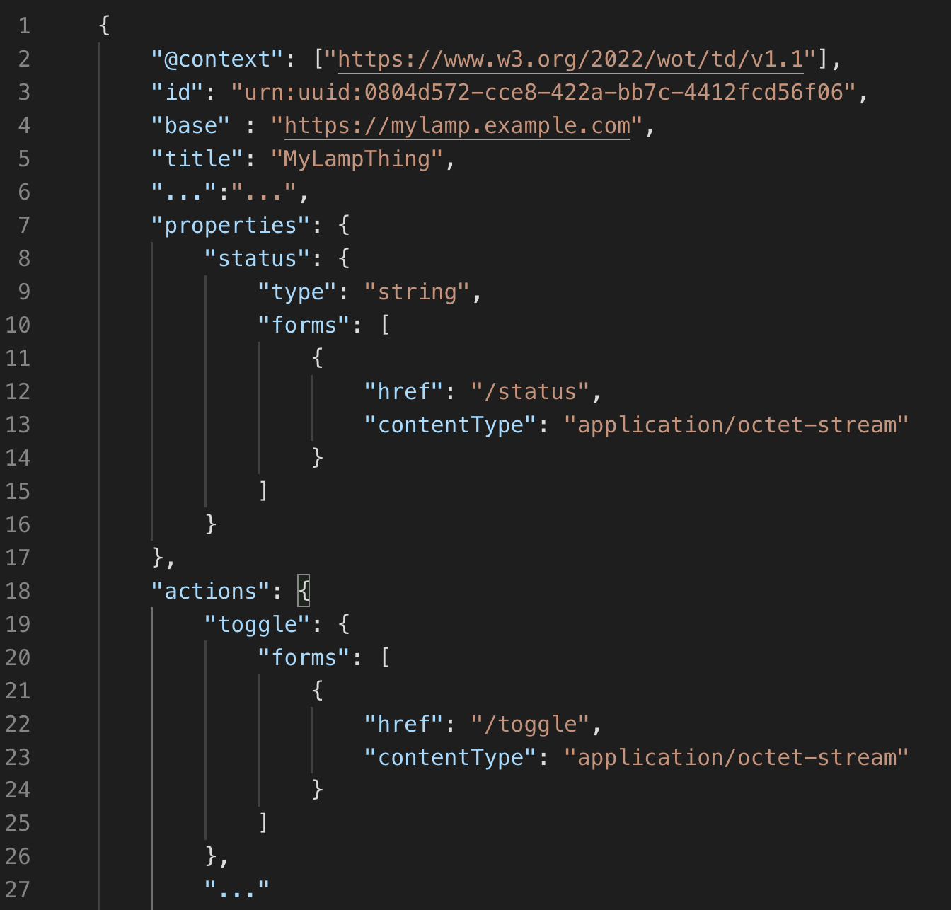
Initial / Common Connection Description
Currently there is no predefined place to provide init & common protocol specific descriptions, e.g.,
contentType used for each interaction
endian, baudrate, etc.
→ Provide a place (e.g., "endpoint") at TD top level that manages initial / common protocol setups

Slide 7
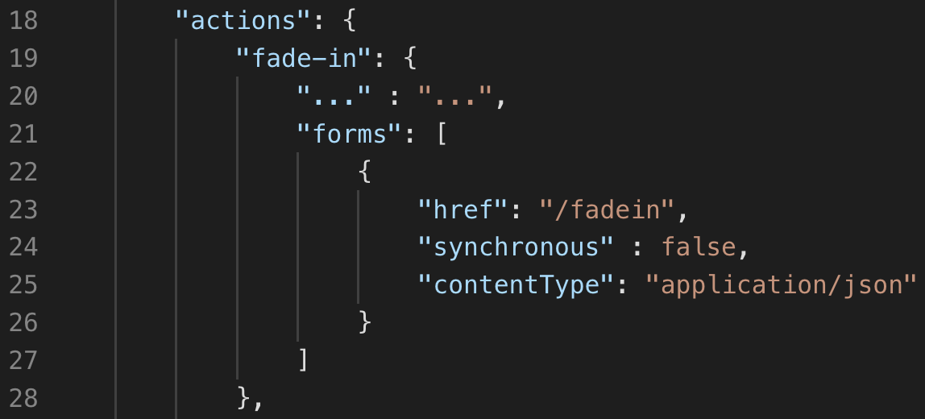
Manageable Actions
Currently it is unclear how to handle async actions, e.g.,
What is the status of the actions (still running, completed, interrupted, etc)?
→ Propose a mechanism how action status can be quired and be described in the TD

Slide 8
Much More Topics
Canonicalization, e.g., comparing TDs if they are equal or not
Signing, e.g., can I trust the TD
Timeseries, e.g., how to generalize timeseries concepts in TD
TD Linting, e.g., how to specify Linting Rules within TDs
Bindings, e.g., extend the set of official protocol supports

