Slide 1

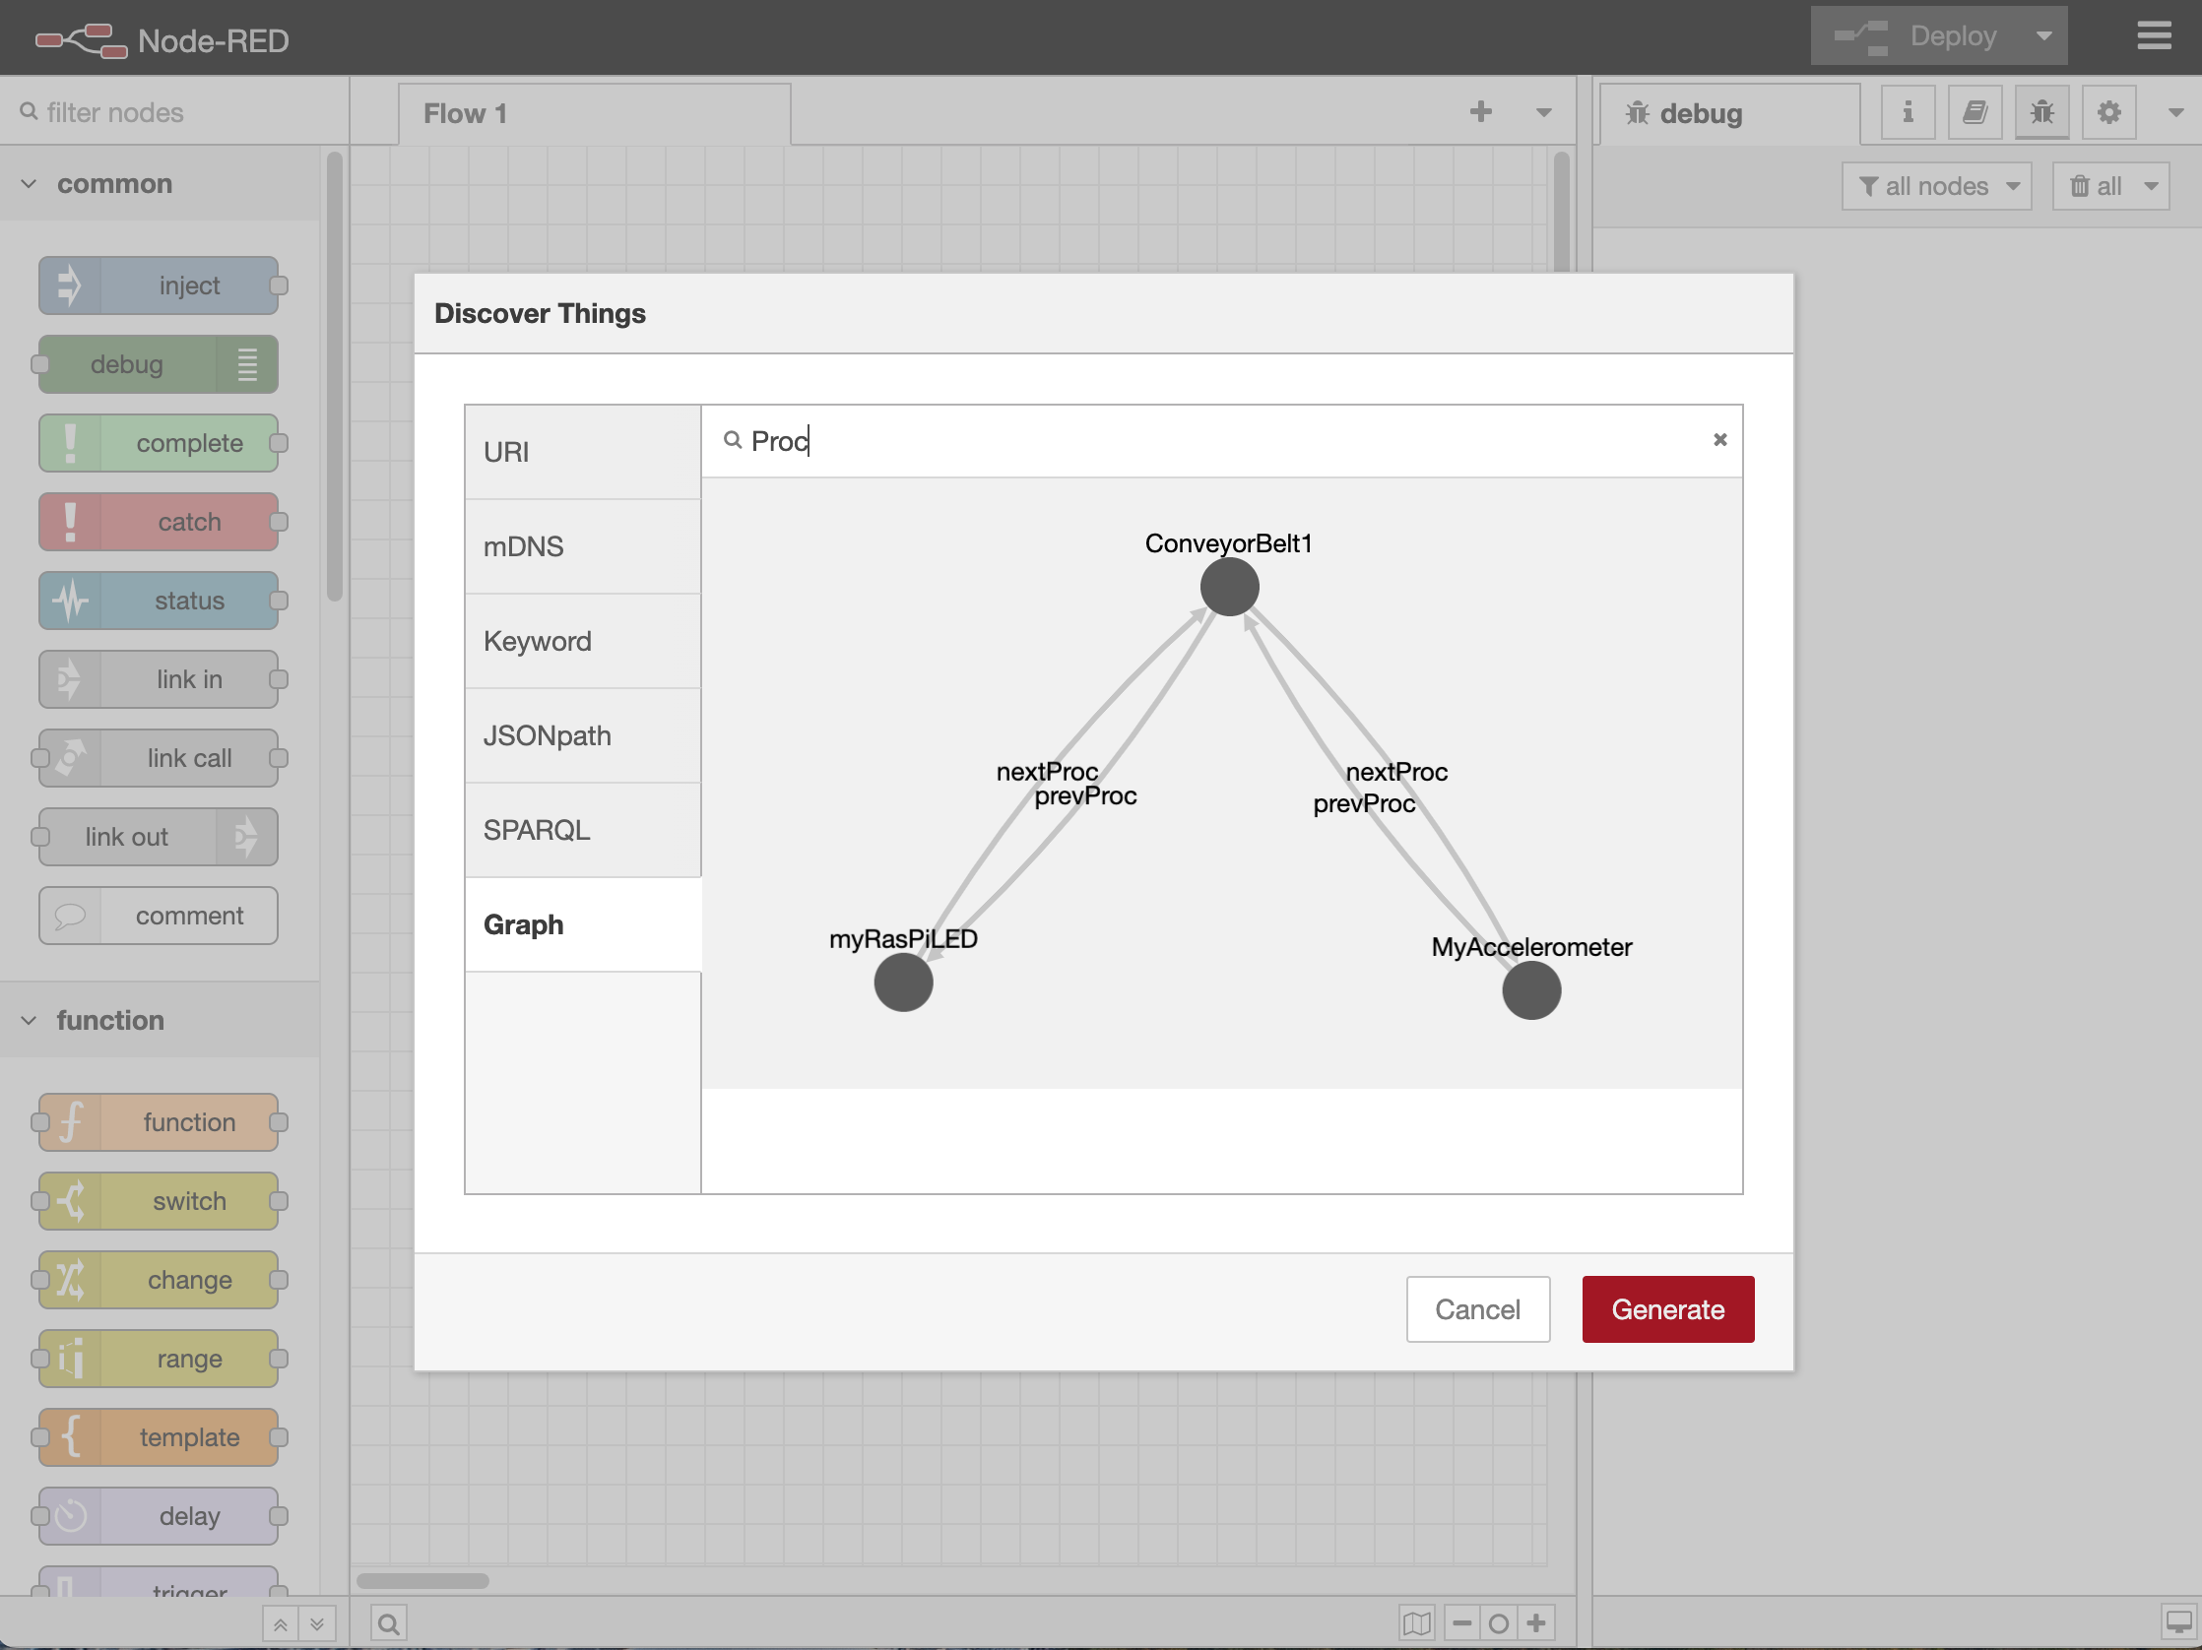

Thing Description Browser / Enhancer for rapid application development
Thing Description Browser
Background/Motivation:
We are researching to improve productivity in the factory by attaching various sensors and display devices to provide rapid feedback to frontline workers.
For rapid system development, we collect necessary information in the form of Thing description, and use with low-code programming tools.
What can be seen:
Thing Description Browser / Enhancer: Collects and displays information on Things at the site using the WoT Discovery mechanism.
Node Generator: Integrating WoT with Node-RED, low-code programming environment.
Using TDD as a knowledge base for device integration
TD
Directory
Visualize
Enrich TDs
based on collected data
TD Collector/
Enhancer
Low-code development tools
TD/Data collection
Deployment
Cloud
Retain contents, functions orchestration
Dashboard
Analyze, Monitoring,
Setting
APPs
Cyber
MEC (Multi-access Edge Computing)
AI Analysis, Realtime judgment
APPs
Synchronize
Network (5G, LTE, WiFi, etc)
Edge Controller
Data acquisition, Feedback based on situation and worker level
APPs
Video,
Sensor
Rapid
feedback
Video, Sound,
Signal, etc.
Physical
Cloud
Retain contents, functions orchestration
Dashboard
Analyze, Monitoring,
Setting
Using TDs as knowledge base for device integration
Cyber
Thing Browser
MEC
AI Analysis, Realtime judgment
APPs
TD
Directory
Visualize
Synchronize
Network (5G, LTE, WiFi, etc)
Enrich TDs
based on collected data
TD Collector/
Enhancer
Edge Controller
Data acquisition,
Feedback based on situation and worker level
Low-code development tools
Video,
Sensor
Rapid
feedback
Video, Sound,
Signal, etc
TD/Data collection
Physical
Deployment

