Slide 1

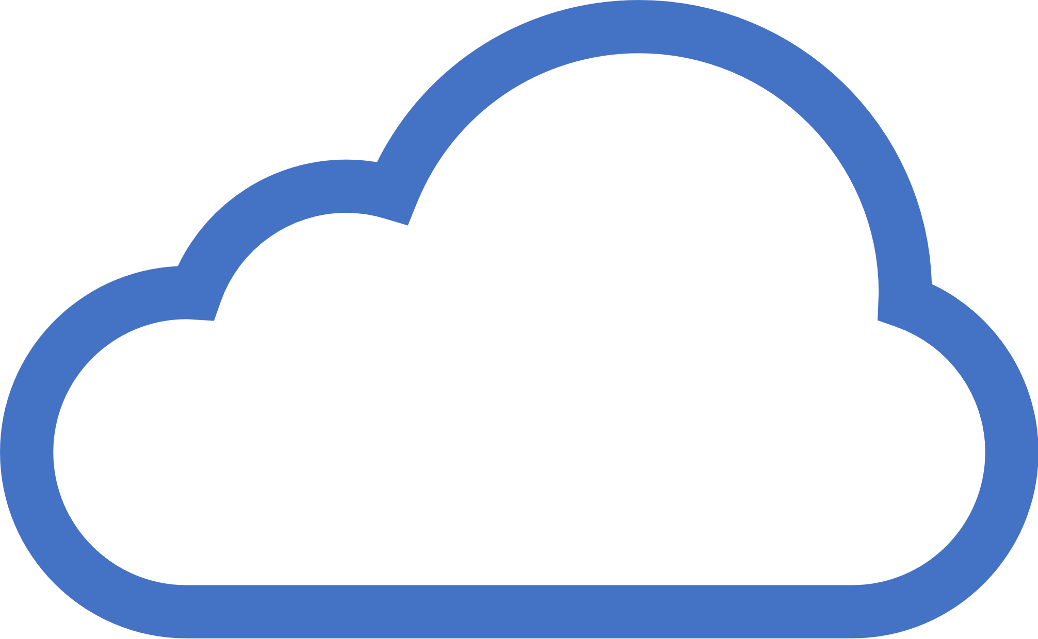

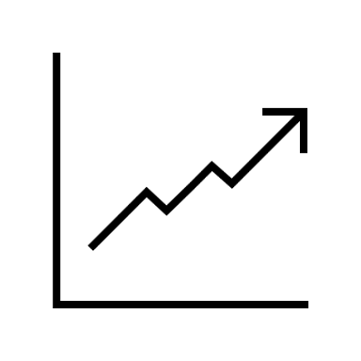
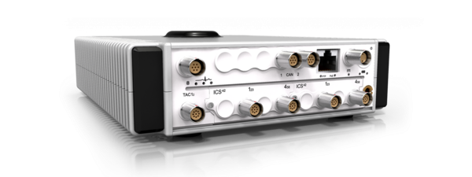
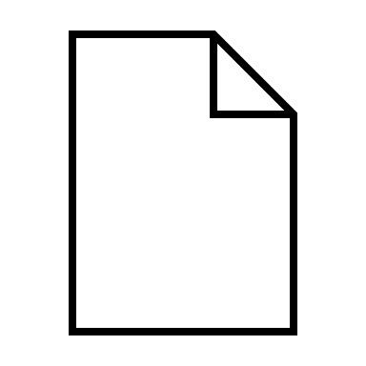


Cloud-based distributed NVH Data Acquisition using Web of Things
Background/Motivation:
Edge Framework for automated NVH measurements and cloud processing
Integration of arbitrary data sources via a generic data models using WoT TDs
What can be seen:
Measurement device “MicroQ” connected to cloud via an automatically generated WoT TD
Live preview of the data stream, implemented by Vignesh Venkatasubramanian as part of the WoT PlugFest 2024
Storage
Streaming Service
Edge Streaming Client
NATS
Generated WoT TD
MQTT
Live Visualization
NATS Server
WoT PlugFest 2024

