Slide 1
WoT and SDW Joint Meeting
Michael McCool
27 September 2024
TPAC 2024

Slide 2
Agenda
Speaker: Michael McCool, WoT/Intel (30m)
Spatial discovery and spatial metadata in TDs
Relationship to FIWARE and NGSI-LD
Speaker: Rob Atkinson, SDW/OGC (30m)
SDW re-charter
GeoDCAT deliverable
potential for related WoT profiles
FIWARE model examples
see https://github.com/smart-data-models/SmartCities
Discussion (30m)

Slide 3




W3C Web of Things (WoT)
W3C Working Group goal: Adapting web technologies to IoT
Already published: Thing Description (TD) metadata format
TD describes the available interactions (network API) of a Thing
New deliverables in progress, including Discovery
How does a potential user obtain the TD for a Thing?
App
App
App
App
App
App
WoT API
WoT API
WoT API
{ properties, actions, events }
MQTT
KNX
TLV
ECHONET
Bearer
EXI
HTTP
OAUTH2
WS
XML
MQTT
KNX
TLV
ECHONET
Bearer
EXI
JSON
Modbus
CBOR
OPC-UA
API Key
HTTP
OAUTH2
CBOR
WS
XML
BACnet
AMQP
JSON
Modbus
BACnet
OPC-UA
API Key
AMQP

Slide 4
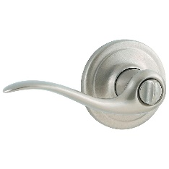
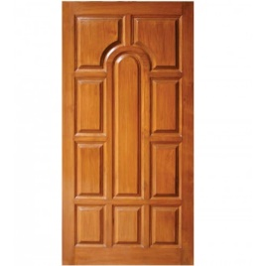

Descriptive Interoperability: TDs
WoT Architecture
Constraints
"Things" must have a TD
Must use URIs, IANA media types, etc.
Thing Description Affordances
Describes WHAT the possible choices are
Describes HOW to interact with the Thing
WoT Thing Description (TD)
{
"@context": [
"https://www.w3.org/2022/wot/td/v1.1",
{ "iot": "http://iotschema.org/" }
],
"id": "urn:dev:org:32473:1234567890",
"title": "MyLEDThing",
"description": "RGB LED torchiere",
"@type": ["Thing", "iot:Light"],
"securityDefinitions": {
"default": {"scheme": "bearer"}
},
"security": ["default"],
"properties": {
"brightness": {
"@type": ["iot:Brightness"],
"type": "integer",
"minimum": 0,
"maximum": 100,
"forms": [ ... ]
}
},
"actions": {
"fadeIn": {
...
Pull
Handle = Affordance
What?
How?
Door = Thing
Open
Turn

Slide 5


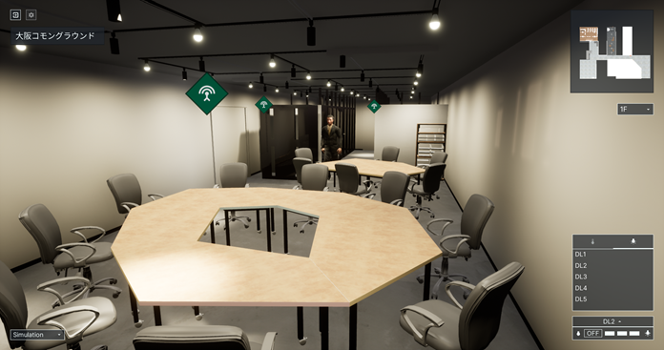
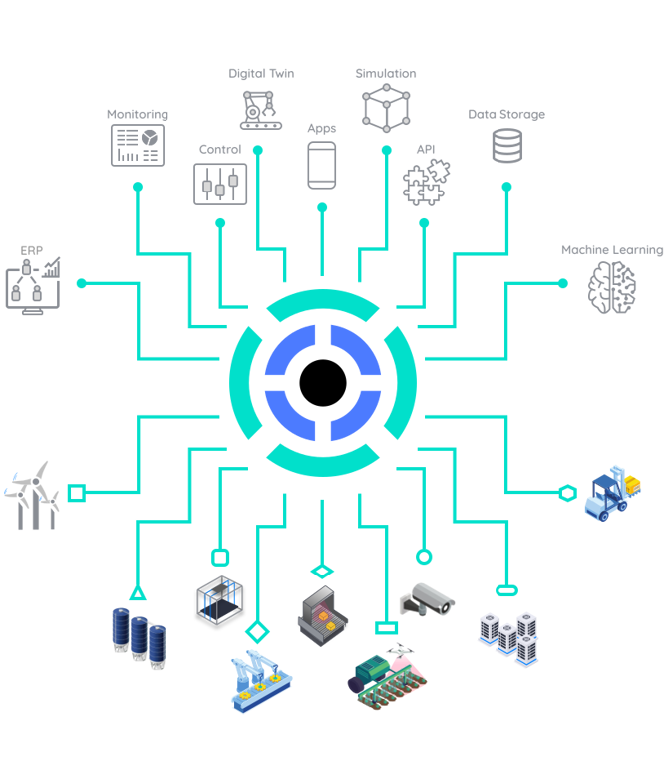
Applications
https://new.siemens.com/global/en/products/buildings/automation/desigo.html
https://www.evosoft.com/en/digitalization-offering/saywot/
Siemens
Desigo CC – BIM
Say WoT!
https://www.takenaka.co.jp/news/2021/05/02/
Takenaka Corporation
CGLL Platform - BIM
https://www.eclipse.org/ditto/2022-03-03-wot-integration.html
Bosch
Eclipse Ditto - Digital twin
https://netzo.io/
Netzo
IoT Data Hub
Dashboards

Slide 6
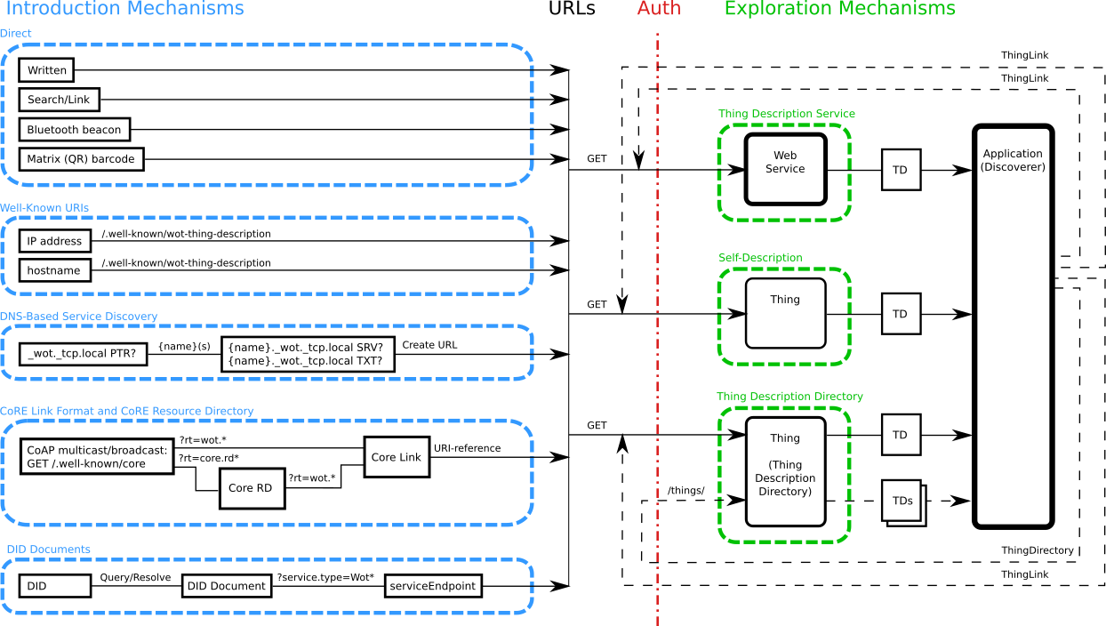
Discovery

Slide 7
Key Geospatial Data Issues in TDs
Location data may be static or dynamic
→ Use links to identify source of data
Use link to point at source of location data
Link can point to self, e.g. current TD, for static location data
Link can point to affordance, e.g. a property, for dynamic location data
Link can point to another TD if location data provided by another Thing
Location data can have various representations and options
Coordinate-based (e.g. latitude/longitude)
Semantic (e.g. room/floor in a building)
Optional data (e.g. velocity, elevation)
→ Use semantic annotations to identify fields in data
Time of last update may be important
→ Optional last-update field/semantic annotation

Slide 8
Example TDs using Geolocation
Simple static installation, using schema.org
Static installation, using modular (proposed) geolocation ontology
Dynamic installation, using internal geolocation resource
Dynamic installation, using separate geolocation service
Dynamic installation, geolocation service
Discovery extensions:
Spatially-aware introduction mechanisms (e.g. ext. DNS-SD or DID)
Query mechanisms for Directories (GeoSPARQL and/or JSONPath ext.)

Slide 9
Goals/Proposal
Identify Geospatial information
In TDs (static)
Available from Things directly (dynamic)
Find TDs using Geospatial search
Geospatial queries in Discovery
Note:
Currently we don’t even have a mandatory query language in WoT Discovery (waiting for JSON Path to get finalized…)
WoT Discovery update deferred to next charter (waiting for TD 2.0 to be finalized…)
Also want to align with NGSI-LD binding (in progress)
→ Proposal: work on data model (1) first, publish Note for incubation and testing, consider geospatial Discovery (2) in next round of standardization.

Slide 10
ETSI ISG CIM
ETSI: https://www.etsi.org/
ISG CIM:
https://www.etsi.org/committee/cim
Industry Specification Group (ISG) cross cutting Context Information Management (CIM)
Deliverable of interest: NGSI-LD
Context Information Management (CIM): NGSI-LD API
“aims to enable applications to discover, access, update and manage data and context information from many different sources”
Related stakeholders:
FiWare: https://www.fiware.org/
https://fiware-datamodels.readthedocs.io/en/stable/ngsi-ld_howto/

Slide 11
Liaison Activity
Simple Liaison Established
Kazuyuki “Kaz” Ashimura as contact
Bi-weekly calls planned starting October 14
Open to all WoT IG/WG members
Draft goals: wot: proposals/liaisons/ngsi-ld.md
“… evaluate the potential of using W3C WoT Things Models for the description of NGSI-LD entity types as well as specifying how default WoT Things Descriptions can be derived from WoT Things Models using the NGSI-LD API as the form to interact with Things.”
Potential for an “NGSI-LD API binding” with applicability to FiWare
Applicable especially to Smart City and Smart Building use cases

Slide 12
Discussion

Slide 13
Resources and Contacts
https://www.w3.org/WoT
Dr. Michael McCool
Principal Engineer
Intel
Technology Pathfinding
michael.mccool@intel.com
Dr. Sebastian Kaebisch
Senior Key Expert
Siemens
Technology
sebastian.kaebisch@siemens.com

