Slide 1






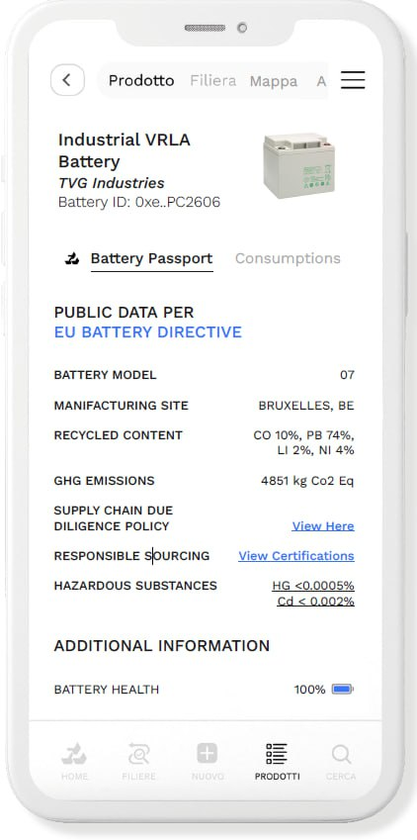
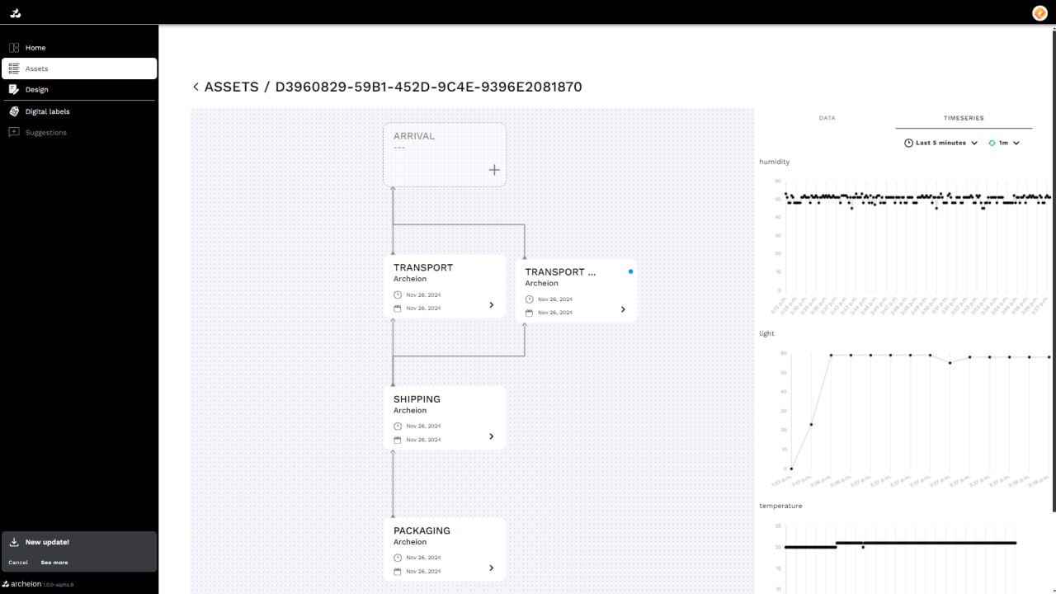
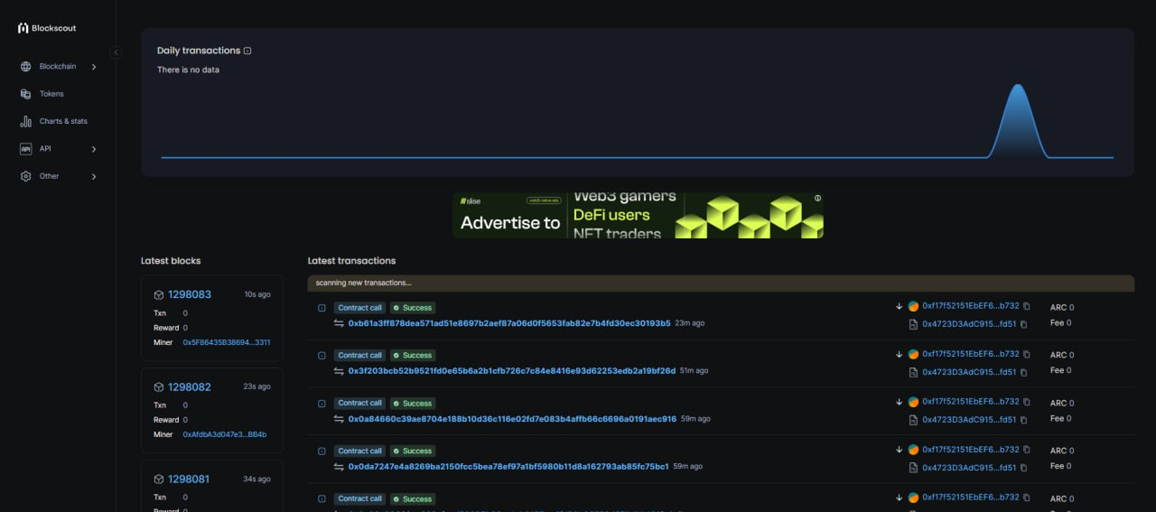
IoT Live Data for Digital Product Passport (DPP) and EaaS
Background/Motivation:
Companies are faced with increasingly intricate supply chain management challenges. Regulatory pressure and consumer demands for transparent production processes are forcing the adoption of more effective, accurate and interconnected internal traceability practices.
The DPP is a solution tailored to these needs.
What can be seen:
Integration of WoT, edge computing, and Archeion hybrid cloud (Web3/Web2) tracking system.
IoT sensors on each machine feed data to edge nodes for processing, generating events that are selectively sealed in a shared blockchain.
DATA COLLECTOR AND AGGREGATOR
Anomaly Detection
Equipment Usage
Archeion Blockchain
Blockchain Explorer
Mobile
Desktop
This slide has been designed using resources from Flaticon.com
Notes:
Tracking equipment usage, performance, and sustainability transparently

