Slide 1












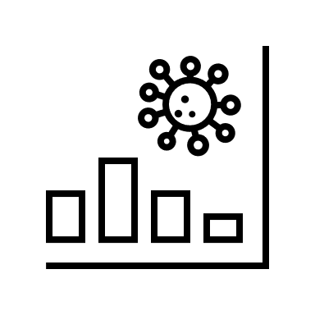
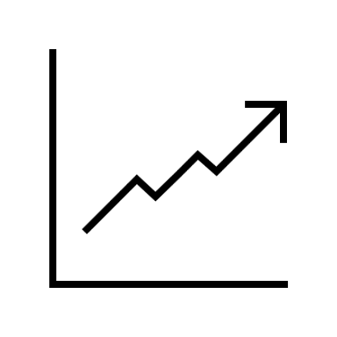




Cloud-based distributed NVH Data Acquisition using Web of Things
Background/Motivation:
Location-independent, unattended continuous operation of instruments for the acquisition of dynamic NVH data
Automated NVH data processing all the way to report or trend analysis
Integration of arbitrary data sources via a generic data model
Transfer of the data model and other necessary information via WoT Thing Descriptions
What can be seen:
Measuring instrument “MicroQ” connected to cloud via an automatically generated WoT TD
Fully automatic, time-controlled storage of measurements in PAK cloud
Live preview of the data stream, implemented by Vignesh Venkatasubramanian as part of the WoT PlugFest 2024 Vignesh.Vaidyanathan@hololinked.dev
Message Broker
Data Hub
Edge
Control
Analysis
Processing
AI
Contact
Martin.Schlaffer@mbbm-vas.com
Oliver.Speidel@mbbm-vas.com
Müller-BBM VAS GmbH
Helmut-A.-Müller-Straße 1 - 5
82152 Planegg
Phone +49 89 264860-259
www.mbbm-vas.com

