Slide 1
Pre-Meeting OPC UA / W3C WoT Joint Activity
1 July 2022

Slide 2
Agenda
Welcome & Scope of the Meeting (2min)
IRC: https://irc.w3.org/?channels=wot-<tbd>
Short round of introduction (10min)
Proposed Idea: OPC UA Binding for OPC UA
Current status of collaboration
Proposed next steps
Questions

Slide 3
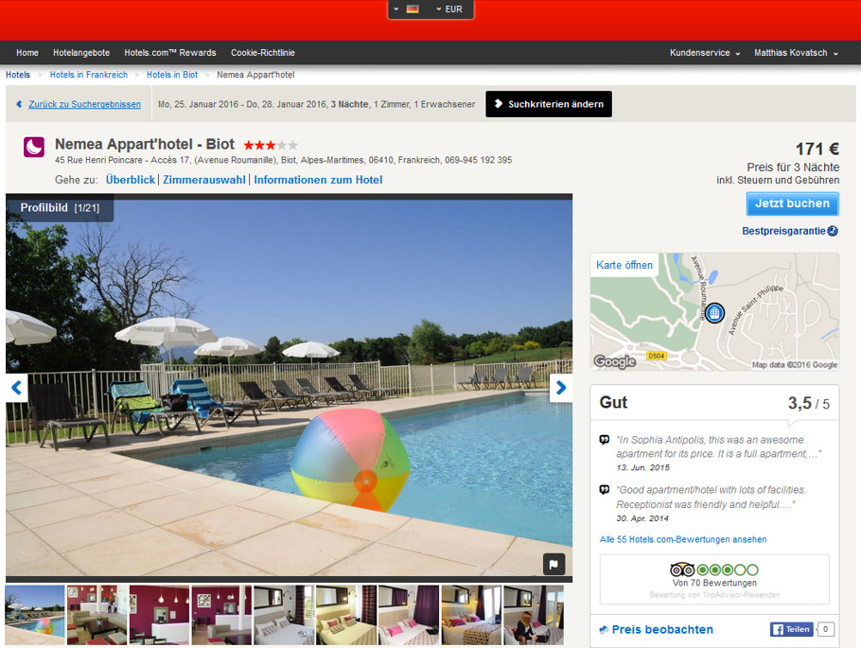

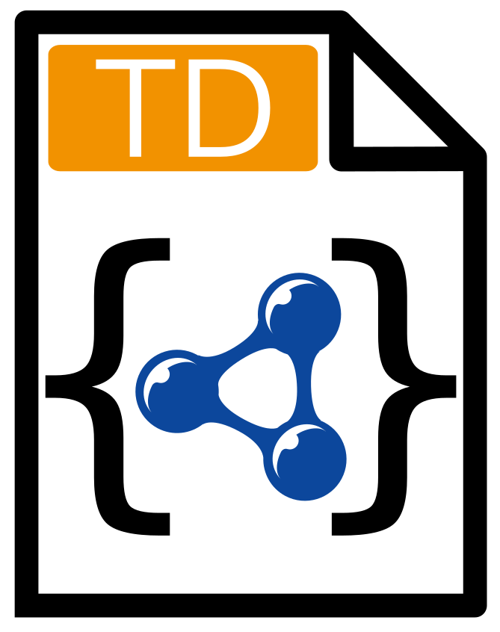
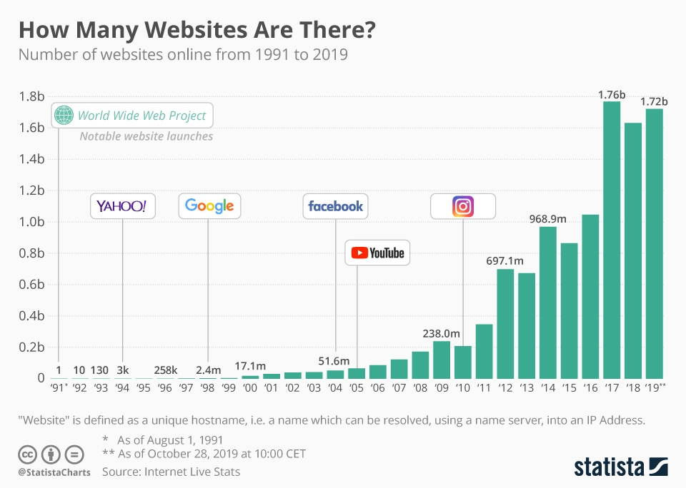
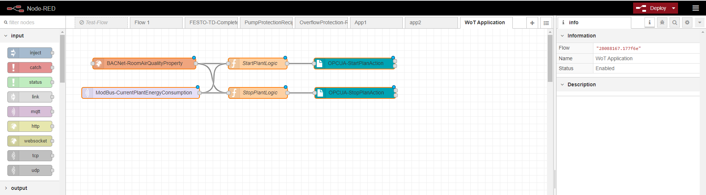






Motivation
The Web and its standardized technology building blocks are established in our daily life and in many businesses. Example:
W3C Web of Things (WoT) – Standardized technology building blocks for IoT as enablers to reuse established Web paradigm Example:
WoT TD
Modbus binding
WoT TD
BACnet binding
WoT TD
HTTP binding
WoT TD
OPC binding
OPC-UA
TD=Thing Description

Slide 4
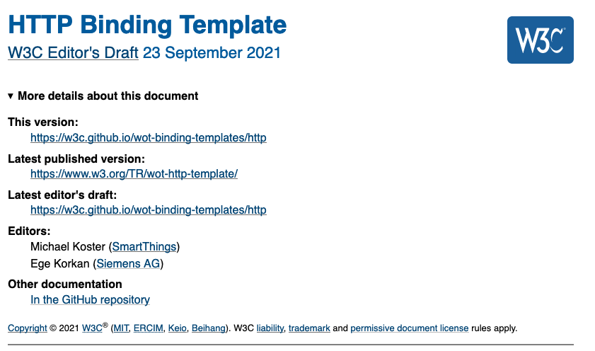
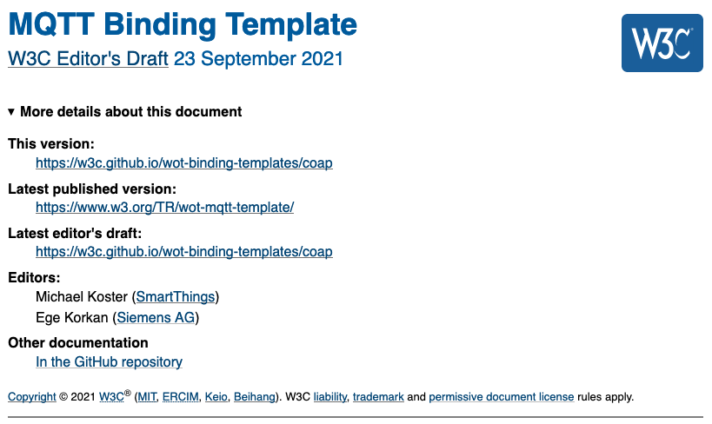
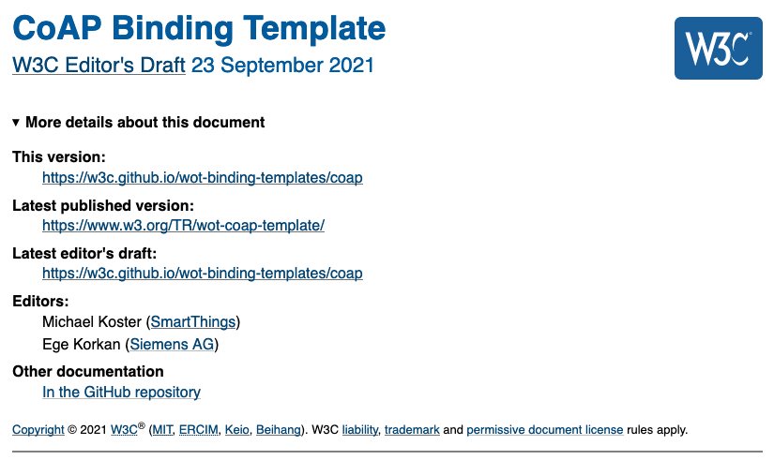
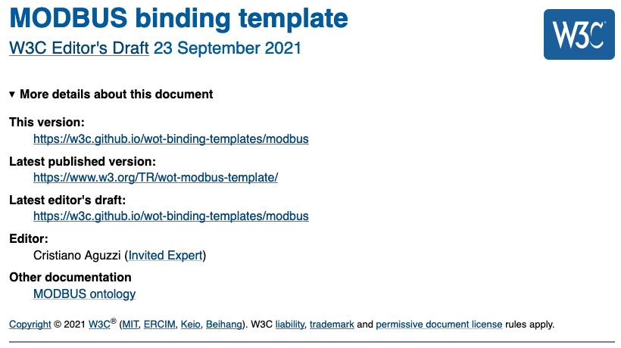
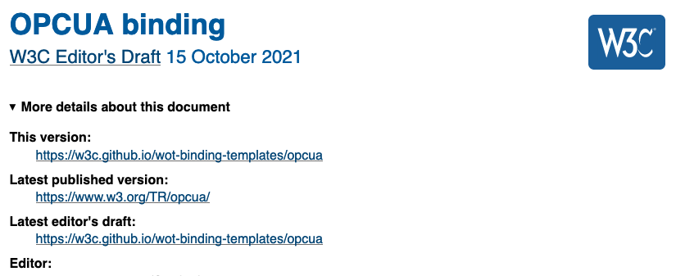

What is Missing?
Defines formally how the forms in the TD should be set up for OPC UA based endpoints. →Not existing yet!
idea / proposal

Slide 5


Proposed Idea
Setup new OPC UA companion specification
defines OPC UA Binding Ontology for having metadata available for communication and security definition (namespace already exists for UA data modeling)
guideline to transform UA NodesetFile to Thing Description (and vice versa)
Setup new W3C Binding for OPC UA
Provide formal approach how TD forms should be designed for UA based endpoints based on OPC UA Binding Ontology (similar with, e.g., HTTP)
organize PlugFest and design scenarios to evaluate working assumptions
Technical discussion: https://github.com/w3c/wot/pull/1020

Slide 6
Current status of collaboration
Since April 2016 official liaison [1]
Exchange idea with W3C CEO (Jeff Jaffe) about an official OPC UA Binding as joint activity with OPCF (end of 2021)
Presented idea at OPCF TCB Meeting in Feb 2022
OPCF members voted positive to start this joint activity
created Multi-Organization Cooperation Agreement (MOCA) document
Exchange again with W3C CEO about the status:
If there is a detailed technical plan, the Memorandum of Understanding between OPCF and W3C should be renewed
include joint activity in the new upcoming W3C WoT Charter (WoT 2.0)
[1] https://opcfoundation.org/news/opc-foundation-news/w3c-and-opcf-to-integrate-opc-ua-into-the-web-of-things/

Slide 7
Proposed Next Step
Schedule meeting between OPCF representative (TCB members) and W3C WoT Chairs + staff - scope the technical plan as content for MoU (e.g., shall we also address discovery topic)
Exchange result within W3C (WoT liaison team + CEO) and OPCF
Setup MoU and sign it until TPAC 2022

Slide 8
Questions

Slide 9
Backup

Slide 10


Describe any Thing’s Interface with a TD The “index.html” for Things – A common language based on JSON-LD / RDF
{ "@context": [ "https://www.w3.org/2019/wot/td/v1", { "saref": "https://w3id.org/saref#" } ], "@type": "Thing", "id": "urn:dev:ops:13473-temp-12", "title": "Temperature", "securityDefinitions": { "scheme": ”oauth2" },
…. "properties" : { "value": { "type": "number", "minimum": "-40.2", "maximum": "48.4", "unit": "Celsius", "@type": "saref:Measurement”, "forms": [{ "href": “http://192.168.0.1/temp", "contentType": "application/json”, …
}]}}}
{ "@context": [ "https://www.w3.org/2019/wot/td/v1", { ”eclass": " "https://www.eclasscontent.com/owl/v11.1"}], "@type": ["Thing", "eclass:0173-1#01-AKE162#016"], "id": "urn:dev:ops:42473-engine-12", "title": "Engine", "securityDefinitions": { "scheme": "basic" },
…. "properties" : { "status": { "enum":["ON", "OFF", "ERROR"], "forms": [{ "href":"modbus+tcp://192.168.0.2:502 ... }]
}, "speed": {...} }, "actions": {…} ”events": {…} }
Retrofit existing devices/interfaces

Slide 11
WoT Binding Templates – Uniform Documentation of IoT Protocols
"properties": {
... "forms": [
{
"op": "readproperty",
"href": "https://myled.example.com:8080/livingroom/lamp/status",
"contentType": "application/json",
"htv:methodName": "GET"
}
…
HTTP
MQTT Broker address
"events": {
... "forms": [
{
"op": "subscribeevent",
"href": "mqtt://mybroker.example.com:1883/livingroom/lamp/criticalCond",
"contentType": "application/json",
"mqv:controlPacketValue": "SUBSCRIBE"
}
…
MQTT
MQTT Topic
"actions": {
... "forms": [
{
"op": "invokeaction",
"href": "coaps://myled.example.com:5684/lr/l/fi",
"contentType": "application/ocf+cbor",
"cov:methodName": "POST",
"cov:options": [ {
"cov:optionNumber": 2053, /// OCF-Content-Format-Version
"cov:optionValue": "1.1.0"
} ]
CoAP
CoAP header settings

Slide 12
WoT Binding Templates – Uniform Documentation of IoT Protocols (cont.)
"properties": {
... "forms": [
{
"op": "readproperty",
"href": "modbus+tcp://127.0.0.1:60000/1/",
"contentType": "application/octet-stream;byteSeq=BIG_ENDIAN;length=4",
"modbus:function": "readHoldingRegisters", "modbus:address": 40001,
"modbus:quantity": 2, "modbus:pollingTime": 500 }
…
Modbus
"properties": {
... "forms": [
{
"op": "readproperty",
"href": "mbus+tcp://127.0.0.1:8182",
"contentType": "application/octet-stream",
"mbus:unitID": 3, "mbus:offset": 1, "mbus:timeout": 2000
} ]
M-Bus
Not yet formally defined!
Alternative addressing possible (e.g via browse path)
"properties": {
... "forms": [
{
"op": "readproperty",
"href": "opc.tcp://localhost:26543/ns=3;s=\"Case_Lamp_Variable\"",
"contentType": "application/x.opcua-binary",
"opc:method": "READ"
}
…
OPC UA
…

Slide 13
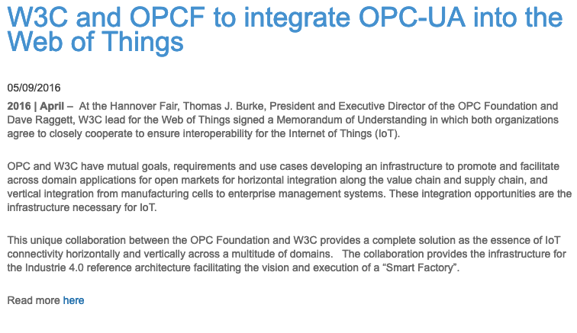
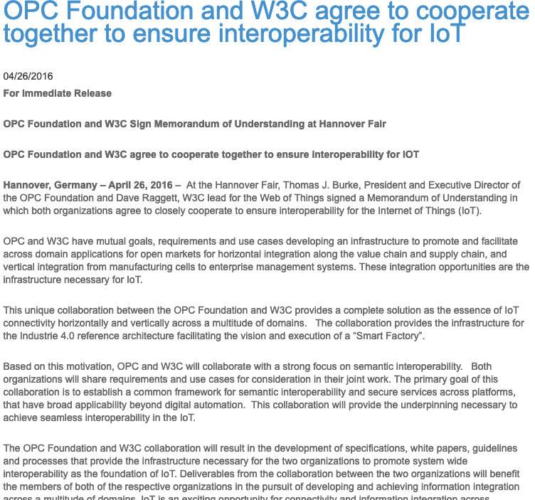
Liaison & Memorandum of Understanding between W3C WoT and OPC-UA
https://opcfoundation.org/news/opc-foundation-news/w3c-and-opcf-to-integrate-opc-ua-into-the-web-of-things/
https://opcfoundation.org/news/press-releases/opc-foundation-and-w3c-agree-to-cooperate-together-to-ensure-interoperability-for-iot/

Slide 14
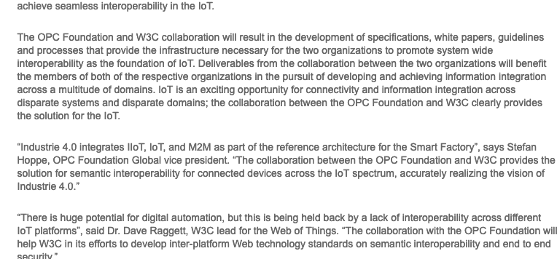
Collaboration Work

Slide 15

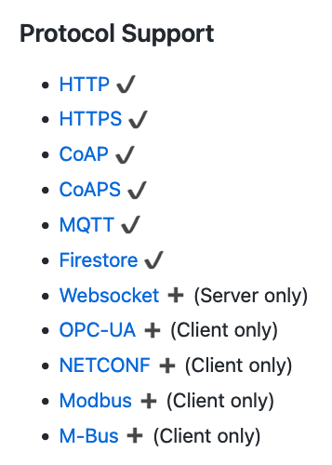
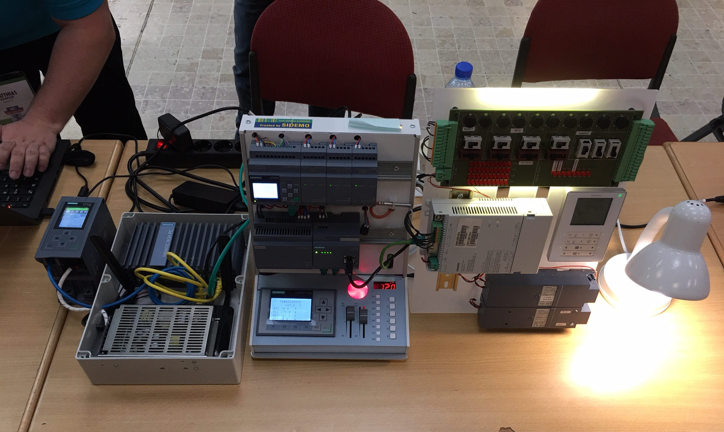
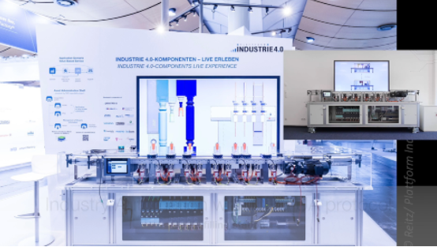

Experiences in WoT PlugFest
Example:
TPAC 2018, Lyon
based on
WoT Event 2019, Munich
Coming soon: OPC-UA P/S

