Slide 1
Use Cases
Tomoaki Mizushima
26 September 2024
TPAC 2024

Slide 2
Outline
What is Use Cases
The Use Case Template
How to use the Use Case Template

Slide 3
What is Use Cases
Use Case Task Force
Each Task Forces
Stakeholders
Use Case
Use Case
Use Case
Analysis
Requirements
Documents
Notes
Use Case
Use Case Template
Requirements Template

Slide 4
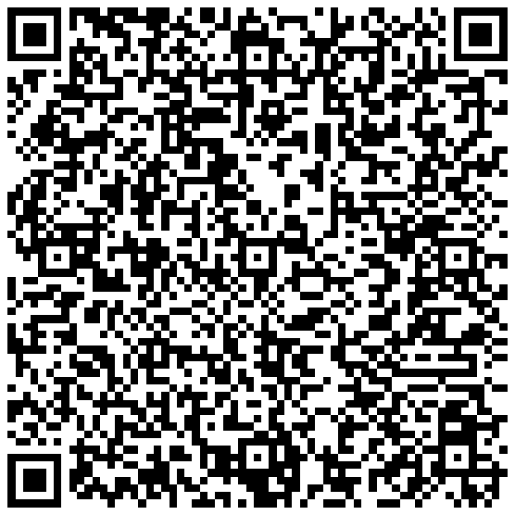
The Use Case Template
The Use Case Template is a form for stakeholders to submit their use cases.
Stakeholders can submit their use cases using Github's Issue Template feature.
Item
Background
Domain or Industry
Introduction
WoT Usage
Technical Environment
Problem
Problem
Expectation
Solution Proposal
Other
Comments
QR Code for the Use Case Template URL

Slide 5
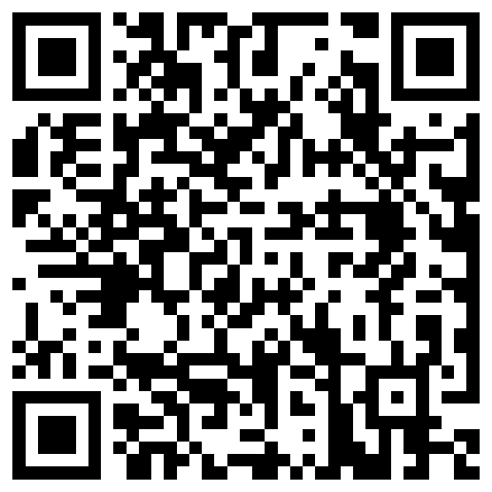
How to use the Use Case Template
Step-1: Please access to WoT Usecases repository
(https://github.com/w3c/wot-usecases).
Step-2: Please push a tag of “Issues”.
Step-3: Please push “New issue”.
Step-4: Please push “get started” of “Use Case Proposal for Gaps”.
Step-5: Please write a use case into the Use Case template.
Step-6: If you have some questions, Please push “Open a blank issue” and make a new issue.
QR Code for the Use Case repository URL

Slide 6
Trial by the TD Task Force
TD Task Force wants to use the Use Case process to turn “worthy” issues into use cases
Three trials were done so far.
Daniel Peintner: Writing to a Property Request returns a response. Link
Jan Romann: Simplifying security descriptions. Link
Luca Barbato: Profiles for converging interoperability. Link
Experience Summary: We need to be able to extract the scenario, user story. Something more high-level to motivate the work on it. We should hold back the technical solution in the first level or step.
More on this in tomorrow’s TD session. Slides link

