Slide 1
Thing Description, Profiles and Bindings
TPAC 2024 - WoT WG
Ege Korkan, Michael Koster, Luca Barbato
These slides are public. Link.

Slide 2
Agenda
Overall Progress (10 mins + 5 mins Q&A)
Use Cases Extraction from Issues (25 mins)
Relationship between Bindings and Profiles (25 mins)
Reports from Breakouts and JSON-LD Meeting (10 mins)

Slide 3
Overall Progress

Slide 4
Overall Progress
Less features and more “getting ready”
Under the hood
Resource Management (wot-resources)
Errata Handling
Toolchain and LinkML
Refactoring
Binding Templates Core -> TD
Management and Organization
Project Management
Resource Versioning Discussions
Registry Discussions
Feature Discussion:
Reusable Connection Container
Data Mapping
Degraded Consumption / Gradual Enhancement
Bindings:
Improved CoAP and Modbus Bindings
New BACnet Binding
WoT Week Targets:
Reusable Connection Container
Bindings + OPC UA Binding First Version
Untested features of TD like additionalResponses etc.

Slide 5
Use Case Extraction from Issues

Slide 6
Use Case Extraction from Issues
Idea: We have received many issues to TD and Binding Repositories, which are significant enough to be treated as use cases. So let’s do that.
Already Done: Sorting almost 300 issues to find the “worthy” ones as whole TF
Link to worthy TD Issues
Link to worthy Binding Issues

Slide 7
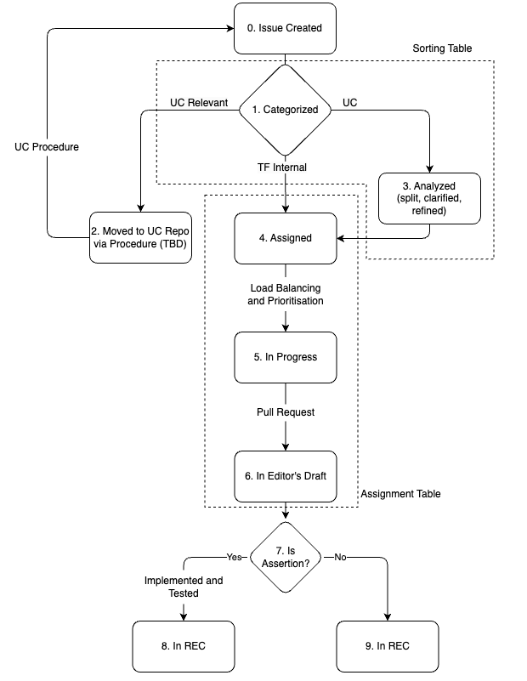
Handling future issues

Slide 8
Three Use Case Extractions Trials
Goal: Test the new use case template as the TD TF to formulate use cases from issues in the TD repository
Daniel Peintner:
Writing to a Property Request returns a response
Link
Jan Romann:
Simplifying security descriptions
Link
Luca Barbato:
Profiles for converging interoperability
Link

Slide 9
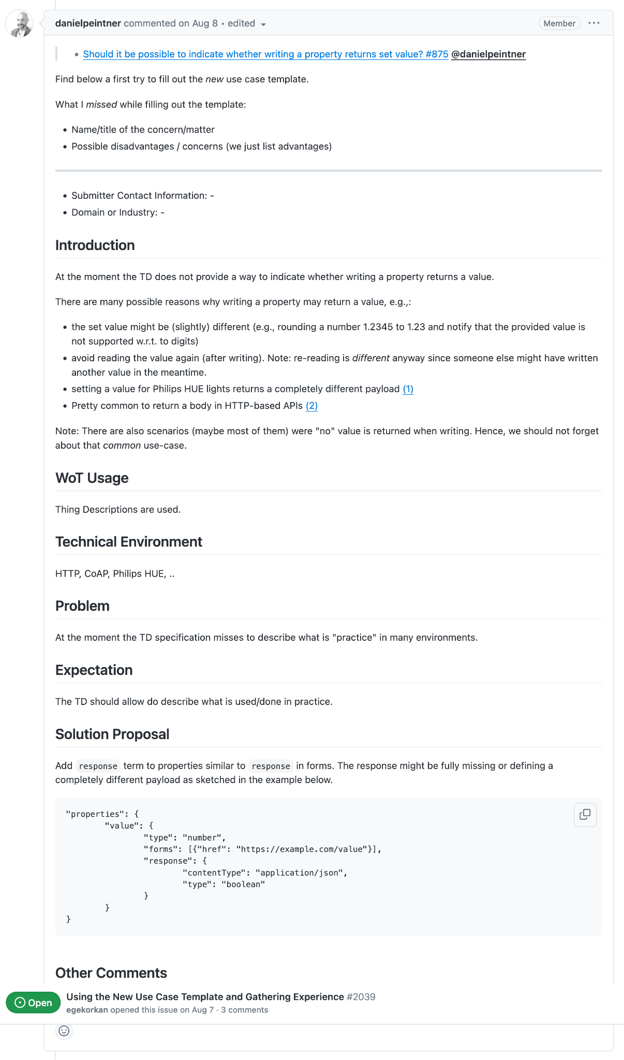

Slide 10
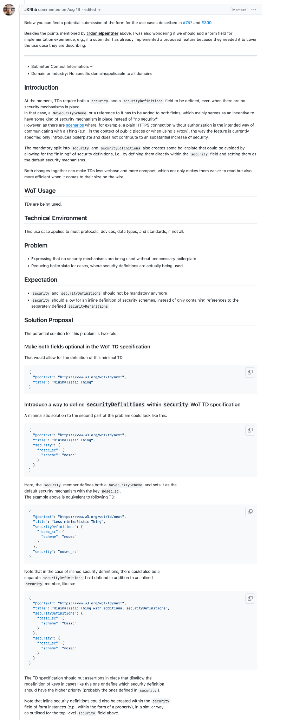

Slide 11
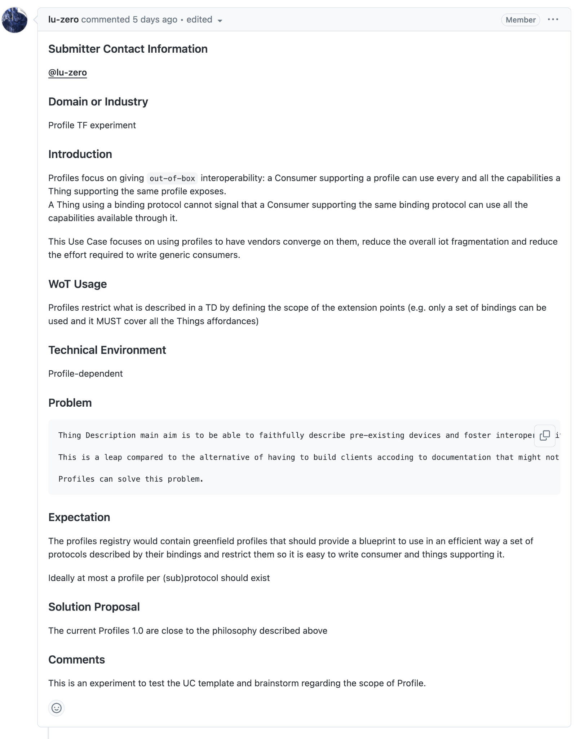

Slide 12
Overall Experience with the Process
We need to be able to extract the scenario, user story. Something more high-level to motivate the work on it. We should hold back the technical solution in the first level or step.

Slide 13
Slides from McCool

Slide 14
Relationship between Bindings and Profiles

Slide 15
Profiles outside of WoT: Bluetooth
In order to use Bluetooth, a device must be compatible with the subset of Bluetooth profiles (often called services or functions) necessary to use the desired services. A Bluetooth profile is a specification regarding an aspect of Bluetooth-based wireless communication between devices.
Examples:
Headset
Human Interface Device: mouse, keyboard, etc.
Health Device Profile
Generic Attribute Profile: discovery related

Slide 16
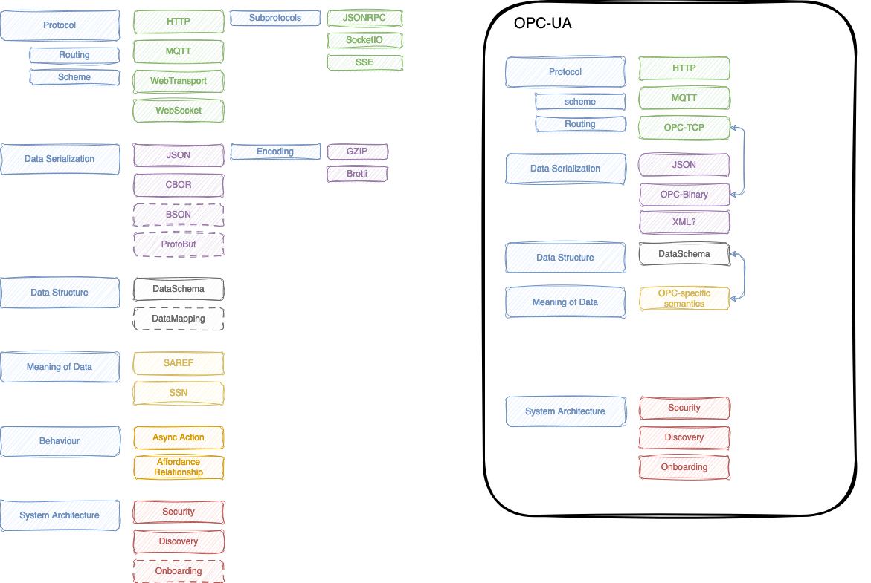
How much can we constrain?
From https://github.com/w3c/wot-profile/issues/416

Slide 17
Relationship between Bindings and Profiles
Profiles provides "out of box" interoperability warranties
It restricts what a compliant TD can use regarding Bindings (and other extension points)
Even it can restrict to subsets of a Binding (Meeting: Need to define what means a restriction and what is a subset and provide examples. How much extra information or ontology is allowed?)
Bindings extend the TD, Profiles restrict the TD
Not the core vocabulary
Open questions
Semantic interoperability included?
E.g. Temperature is a number? With which Unit?
Profiles as way to "onboard" external ecosystems? (when just a protocol is not enough)
E.g. Matter Profile for WoT, OPC UA Profile etc.
Profiles as a way to enforce some way to converge on a subset of protocols?
E.g. Greenfield profiles targeting newcomers

Slide 18
Reports from Other Meetings

Slide 19
Report from LinkML Breakout
https://www.w3.org/events/meetings/e5cb0ff4-1696-4367-b9fe-9e74c5034dd3
Not very good attendance
Overall good feedback and appreciation of work
Other SDO Groups, such as Electrical CIM/CGMES, are transitioning to LinkML
Further meetings with LinkML Community is being planned

Slide 20
Report from Registry Breakout
https://www.w3.org/events/meetings/bf75e0c9-c534-4ccf-988e-0e720f5280ff/
Not very good attendance
Florian Rivoal, co-editor of the process document, was there. Recommended opening issue at the Process CG to find a place for the best practices and tag him, fantasai (other editor) and PLH.
https://github.com/w3c/Guide/issues/247
Our feedback that the process is too open is by design
No changes are planned for the registry track

Slide 21
Report from JSON-LD Meeting
https://www.w3.org/2024/09/26-wot-minutes.html#t11
JSON-LD update to include RDF-Star
CBOR-LD will use a registry of contextes to compress
YAML-LD will be done but it is a superset of JSON anyways. No conversion of comments
Cris: There is commentable JSON used in places like VS Code.
Luca: https://json5.org/ is an alternative but not a standard.
Canonicalization discussion: Any decision etc? -> None
@type issue needs a follow-up with Mahda
JSON Schema discussion: Any decision etc?
From W3C PoV: If the standard is stable enough, it can be normatively referenced. What is stable enough?
VC JSON Schema is in CR phase.

