Slide 1
WoT WG/IG Outreach
Sebastian Kaebisch
15 September 2023

Slide 2
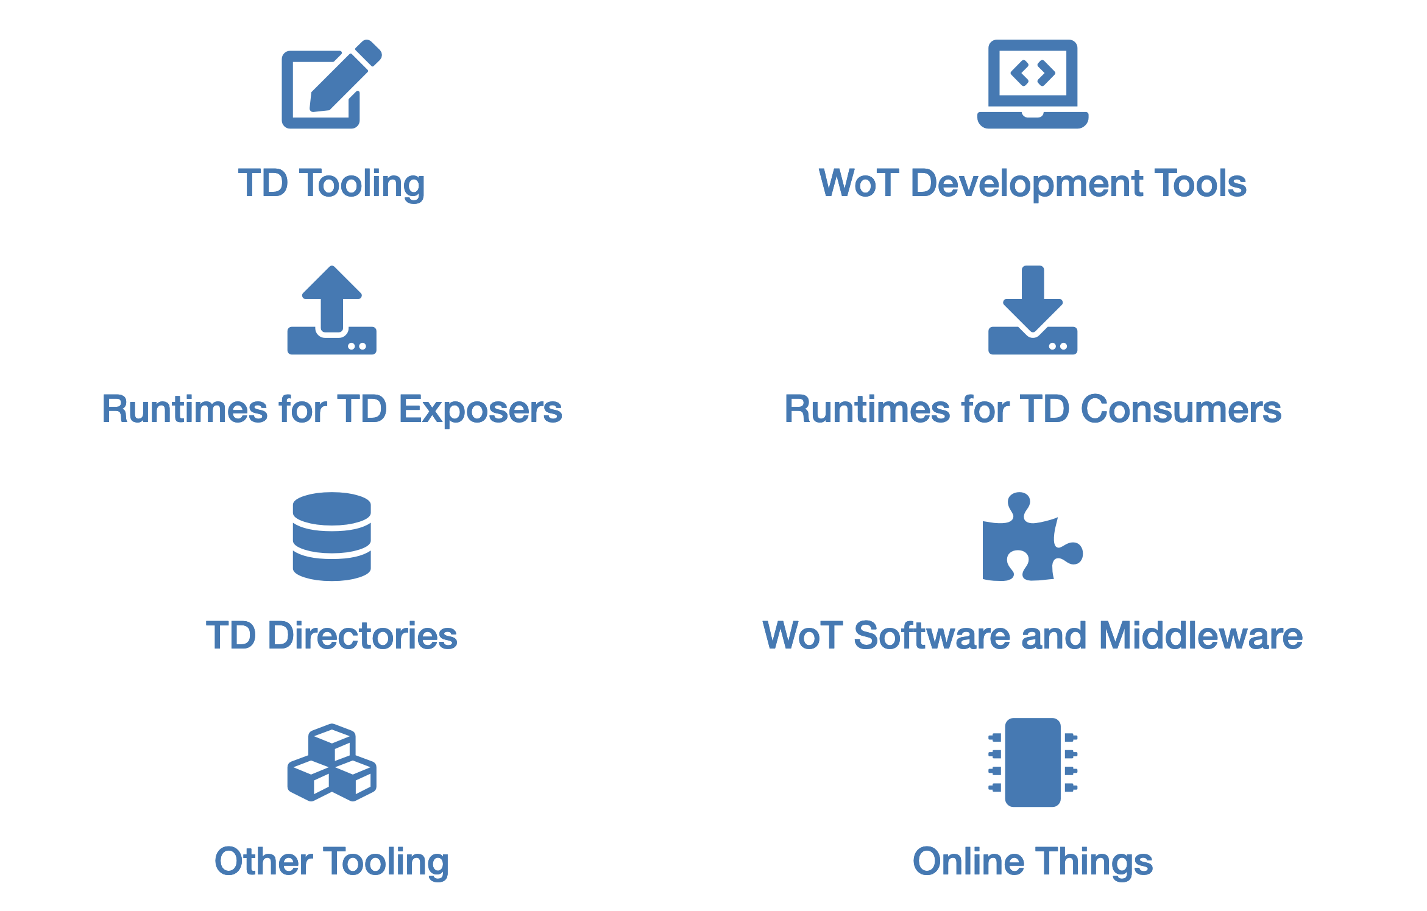
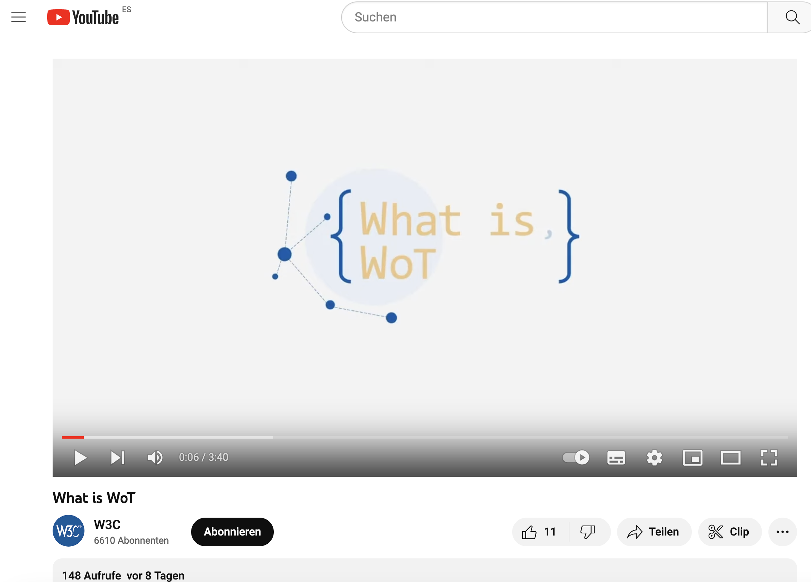
WoT Status Quo
W3C just finalized WoT 1.1
growing number of open source implementations
https://www.w3.org/WoT/developers/
growing market/commercial adoptions
Takanaka, Fujitsu, Siemens AG, evosoft, Sick AG, Deutsche Telekom AG, Schaeffler, Bosch, Microsoft, ELCO Industry Automation, …
growing community
WoT & Japanese WoT CG
New developer channels (e.g. Discord)
youtube channels for explainers and tutorials
Blogs, hands-on tutorials, …
…

Slide 3
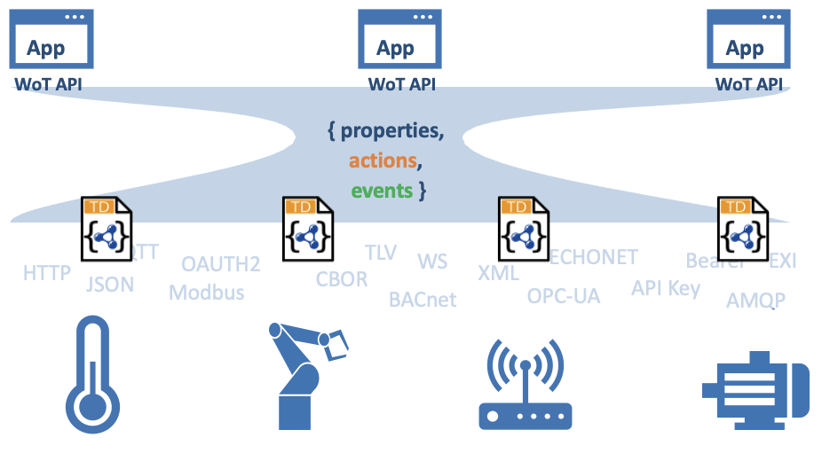
WoT Attractions
WoT is not a protocol and also does not offer domain/application data models!
WoT provides technology building blocks like the TD and the binding concept, which allow to easily reflect existing IoT approaches and describe them on a common standardized basis → existing IoT systems do not have to be changed, WoT can be used as a complementary solution → increase interoperability in the IoT → benefit of established web technologies & their tools/libs

Slide 4
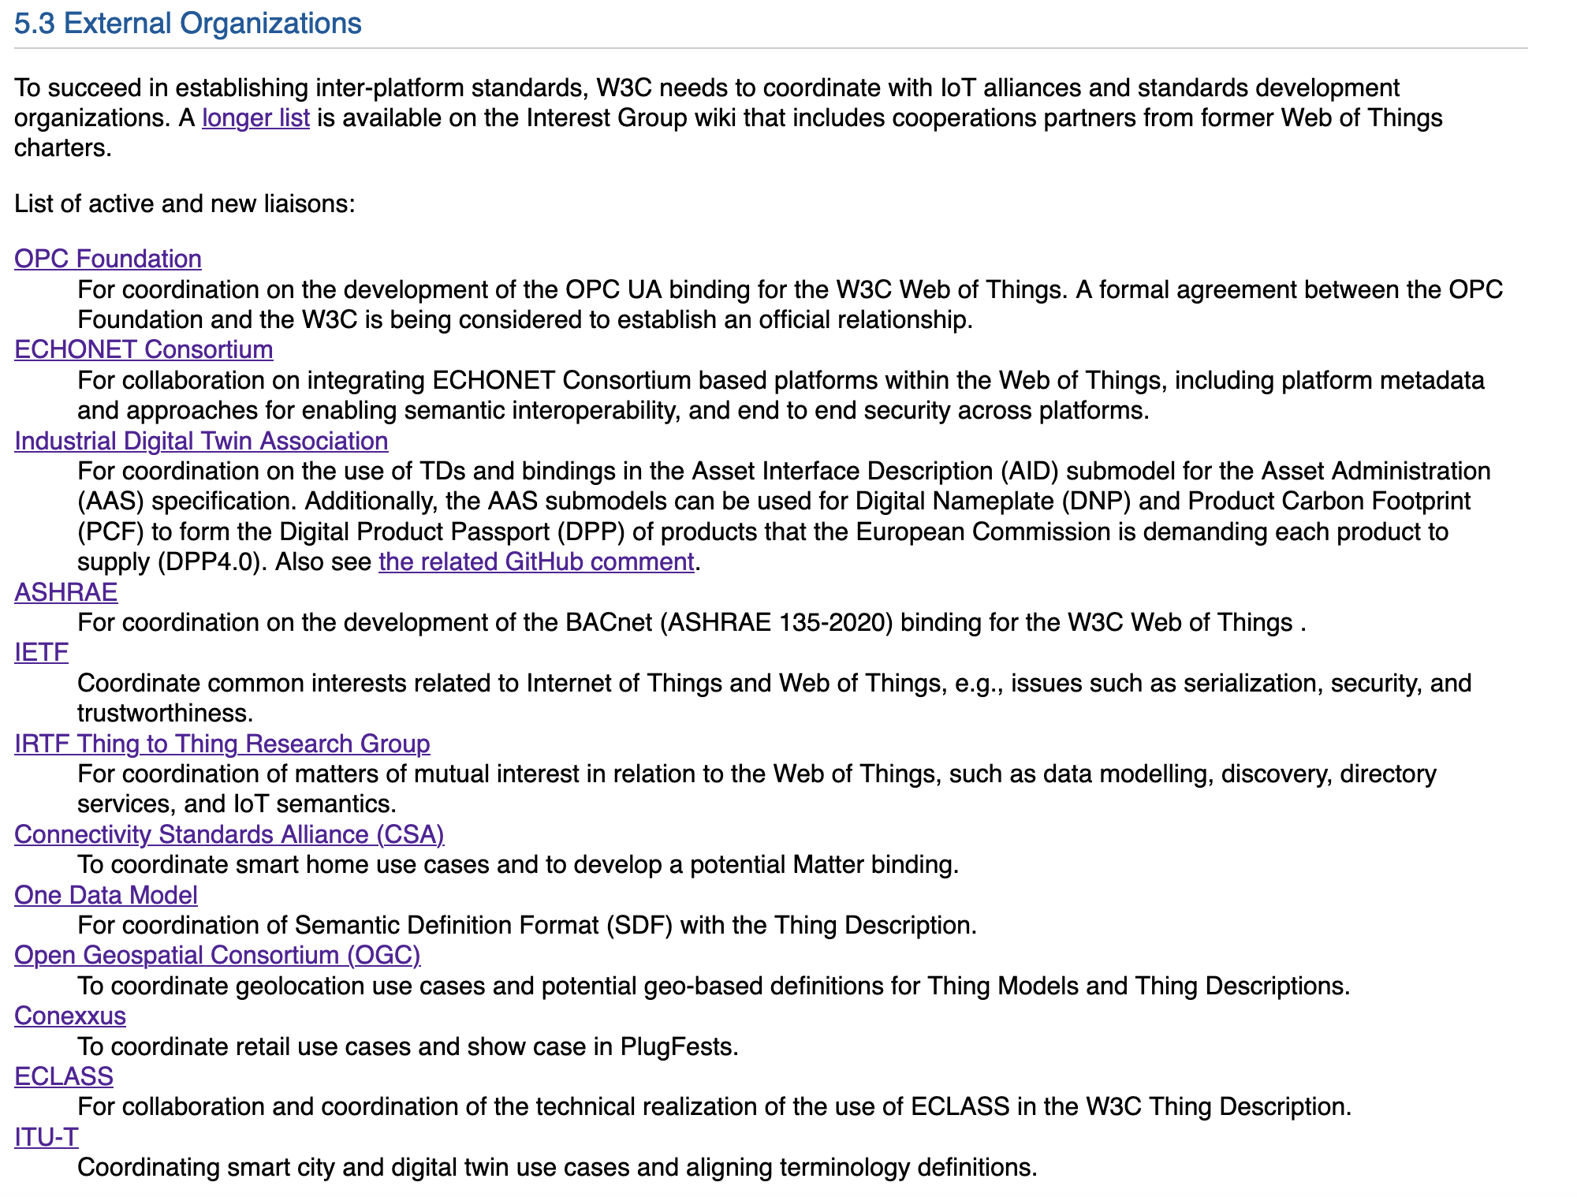
Support WoT Addoption by SDO Collerberations
https://www.w3.org/2023/08/wot-wg-2023-draft.html

Slide 5
New Document Organization in WoT 2.0 Will Simplify WoT Adoption
TD 2.0 REC includes - Thing Models - Binding Template mechanism
- Security scheme mechanism
Eg., ECHONET, OPC UA, BACnet, …
Modbus Binding Note
HTTP Binding Note
X Binding
…
…
Labels:
Metadata
Security Scheme related X
Security Scheme related Modbus
Security Scheme related HTTP
External SDO
…
…

Slide 6
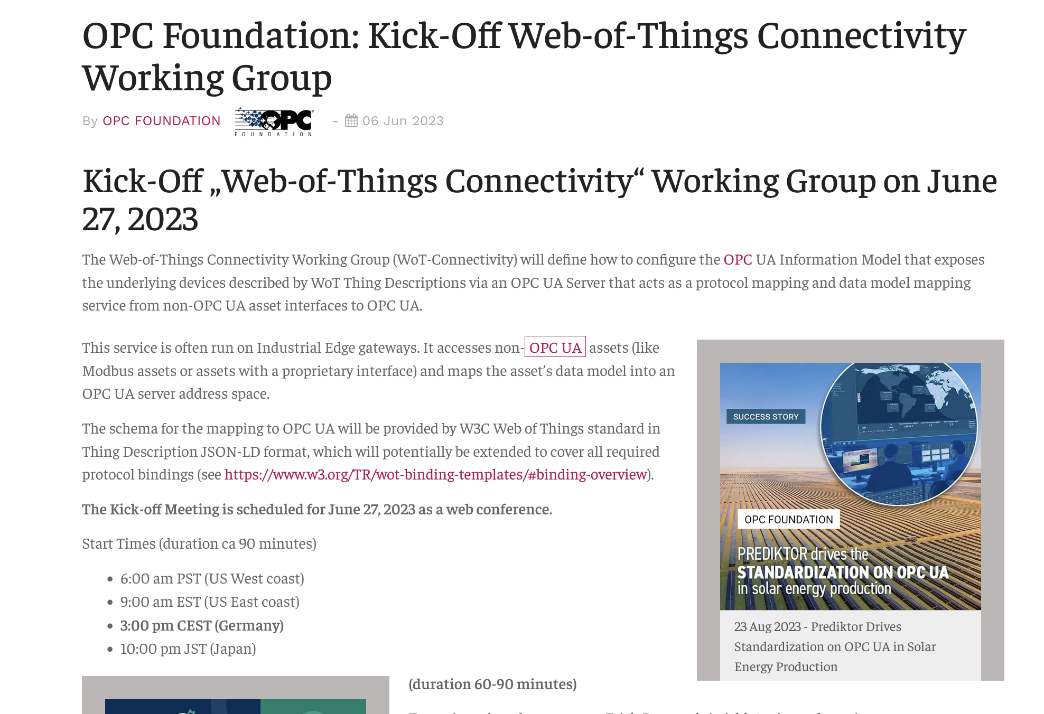
Latest WoT Adoptions: OPC Foundation
https://www.rfid-wiot-search.com/opc-foundation-kick-off-web-of-things-connectivity-working-group

Slide 7
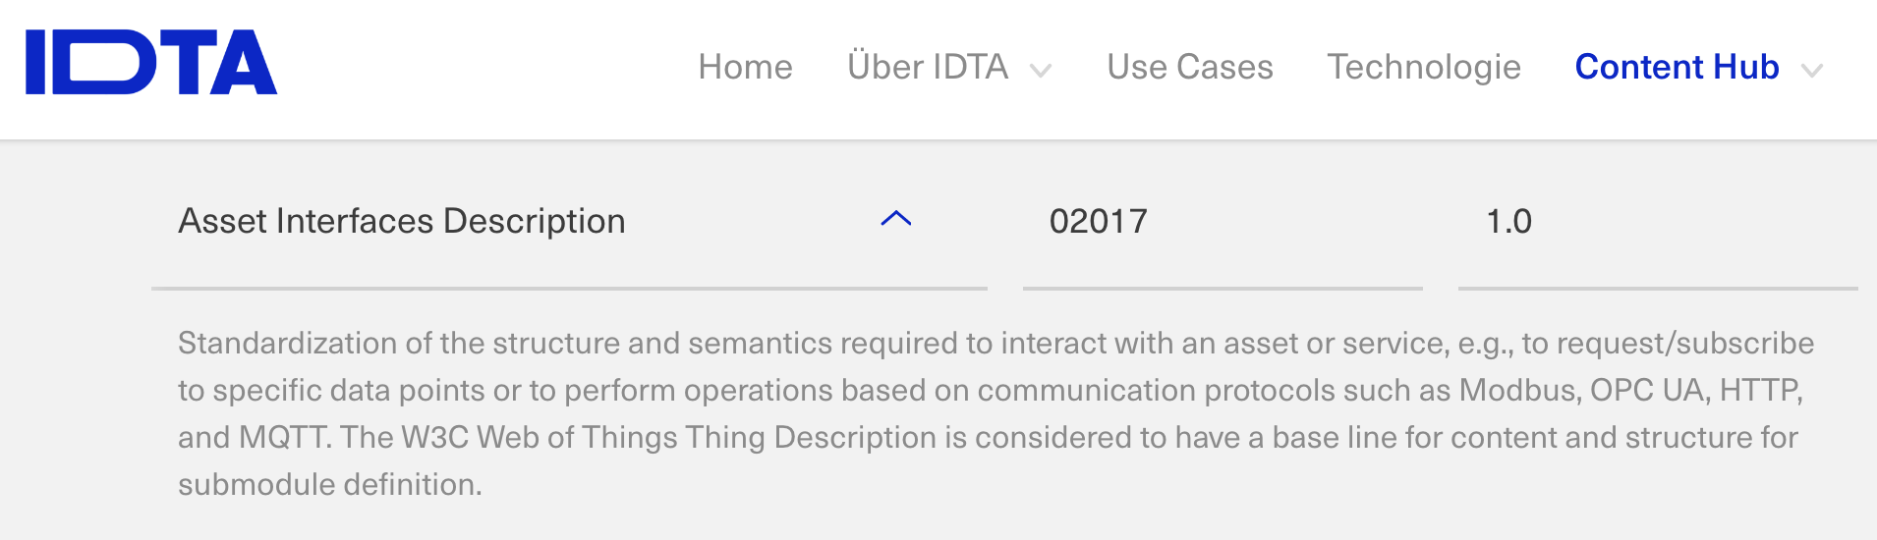
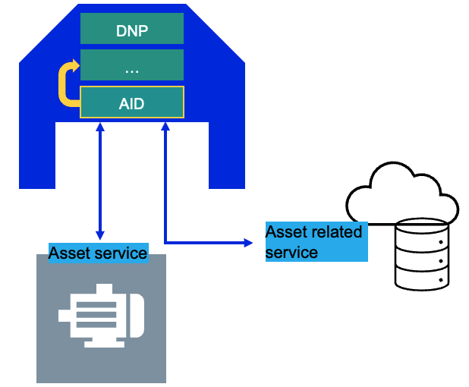

Latest WoT Adoptions: Asset Administration Shell
Asset Administration Shell (AAS) is an industrial digital twin implementation currently being standardised by IEC 63278
AAS allows to specify submodels that provides specific information of an asset
there is a Submodel specification Asset Interface Description (AID) that allows to describe Asset’s interface or Asset’s related service based on WoT Thing Description https://industrialdigitaltwin.org/

Slide 8
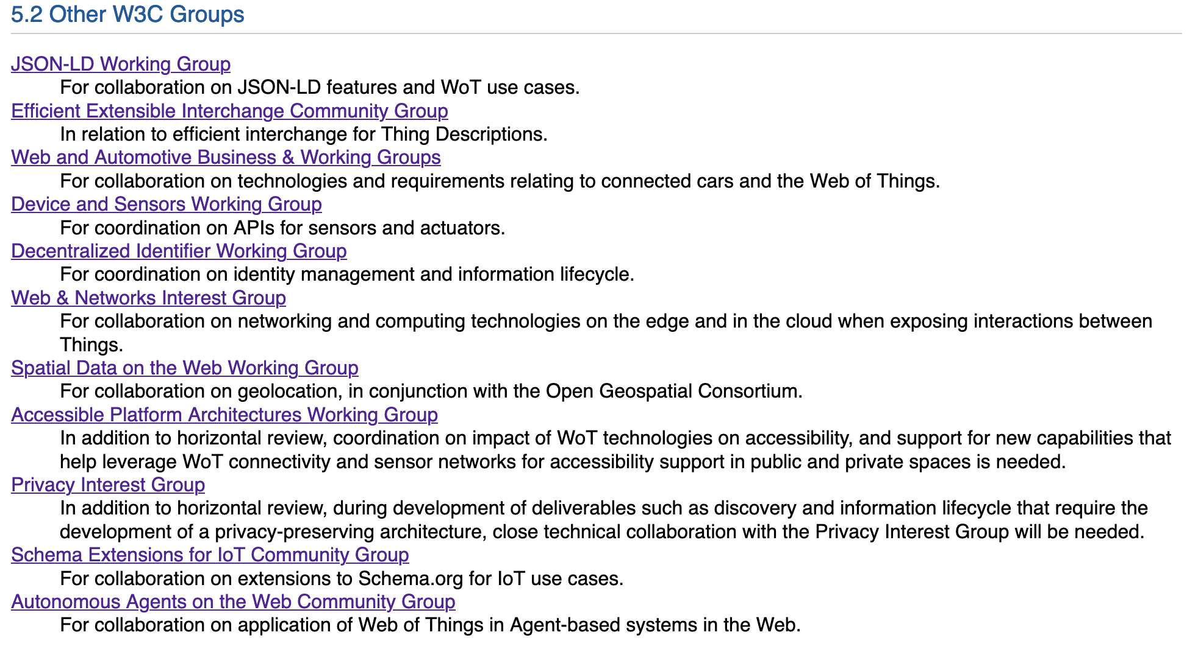
W3C collaborations to improve WoT technology & extend WoT related Use Cases
https://www.w3.org/2023/08/wot-wg-2023-draft.html

Slide 9
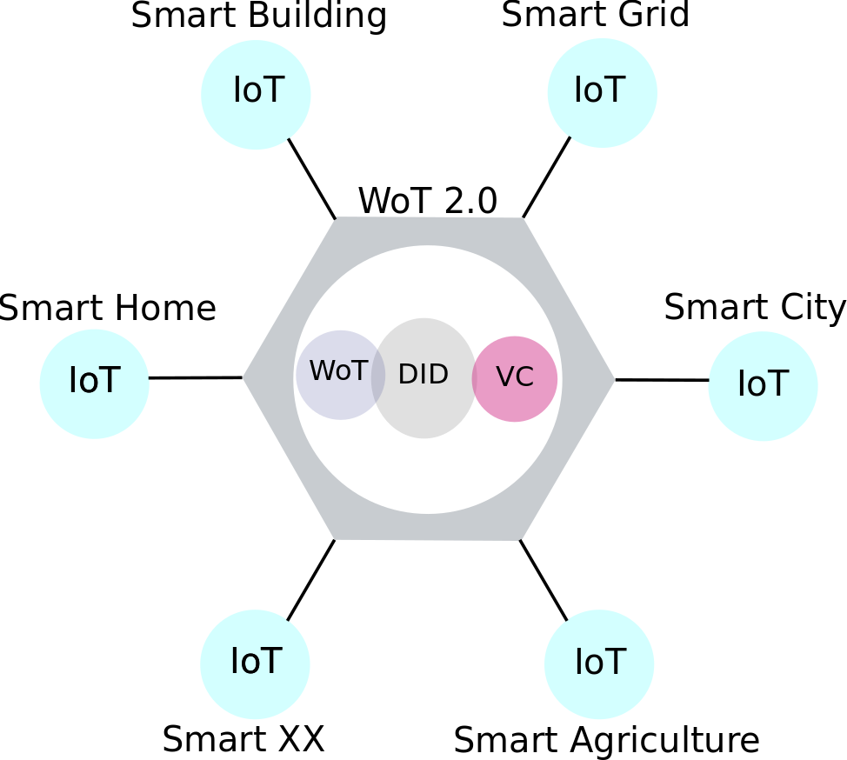
Latest WoT discussions in W3C Web-based Digital Twins for Smart Cities Interest Group
https://w3c.github.io/smartcities-workshop/draft-charter/index.html

