Slide 1
Registries for W3C Specifications
W3C Breakout Day
March 12, 2024
Jan Romann, Ege Korkan

Slide 2
Logistics
W3C Calendar Entry | Session Proposal on GitHub
Please all join IRC at https://irc.w3.org/?channels=%23registries
Then type present+ to check in.
Type q+ to raise hand
We will take minutes there manually.
Scribe will be X
Quickly introduce yourself before speaking (now if there are not too many people)
These slides are public. Link.
The session is not recorded.

Slide 3
Participation Policies
Antitrust and competition policy
W3C acts in a pro-competitive way that is ensured by this document.
Positive Work Environment at W3C: Code of Ethics and Professional Conduct
Promote high standards of professional practice to ensure a positive work environment
Health Rules
Masks and tests are optional. Stay in your room and attend virtually if you do not feel well.

Slide 4
Bringing some Context
Nature of this session:
Brief presentation
Discussion
Why:
After a successful breakout day on 12th of March 2024, we identified the need to share our experiences as the W3C community.
Goal:
Obtain more knowledge from others
Find a place within W3C for this type of discussion
Required background:
Rough understanding of standardization process at the W3C

Slide 5
Anyone not aware about the registries in general? Write “reg” in IRC
If none, skip to slide 9

Slide 6
What is a Registry in General
A list
Really, that is all

Slide 7
Examples
IANA registries are well-known:
Media Types
URI Schemes
WebSocket subprotocols
Language subtag
W3C has also adopted its own registry mechanism

Slide 8
Registries and W3C RECs?
Normally all W3C REC Track documents cannot be changed at all after publication.
So even if we want to update a list, it becomes cumbersome.
Result: Registry mechanisms found in different SDOs, adapter for W3C process

Slide 9
Analysis by the WoT WG
Why did we do an analysis?
WoT WG wants to have a binding registry as communicated in the charter:
“enable the integration of WoT into other ecosystems and communities”
W3C registry mechanism is very open by design. Each group needs to add the rules, and we should be more knowledgeable first.
Only 3 registries so far (not a lot of experience as W3C):
WebCodecs Codec Registry
Alternative and Augmented Communication (AAC) Symbol Registry
TTWG Registry Boilerplate and DAPT Registry Section

Slide 10
What did the WoT WG do?
Analyzed both W3C and IANA processes
Custom W3C Registries (before the official mechanism)
Official W3C Registries + TTWG Boilerplate
Some IANA registries (URI schemes, Media types, WebSockets)
Extracted and compared important procedures
Documented the analysis at https://github.com/w3c/wot/tree/main/registry-analysis
Of course, open to feedback as with all our documents
And thanks to the last breakout, we could extend this with the registry experience from TTWG
Started specifying Registry Rules at https://github.com/w3c/wot-binding-templates/blob/egekorkan-patch-4/registry-requirements.md (will be merged to main branch soon)

Slide 11
Comparison and Summary of Findings
 | IANA | W3C Custom | W3C Official | TTWG Boilerplate
Submission Process | Varies: email, web form | Varies: email, PR, web form | Varies: GitHub issue, liaison | Issue or Email
Modification Process | Changes are allowed per RFC 8126. Removal not | In some cases, entries can be removed, some prefer deprecation | Not possible to remove or deprecate (theoretically possible) | Provisional to final. Deprecation is possible, deletion not
Review | Common review policies | Custom (Editors, WG Consensus) | Custom (Liaison, WG consensus) | WG Decision Process
Guidelines | RFC 8126 (can be extended per document) | Per-Document | Process Document (must be extended per document) | Boilerplate Checklist

Slide 12
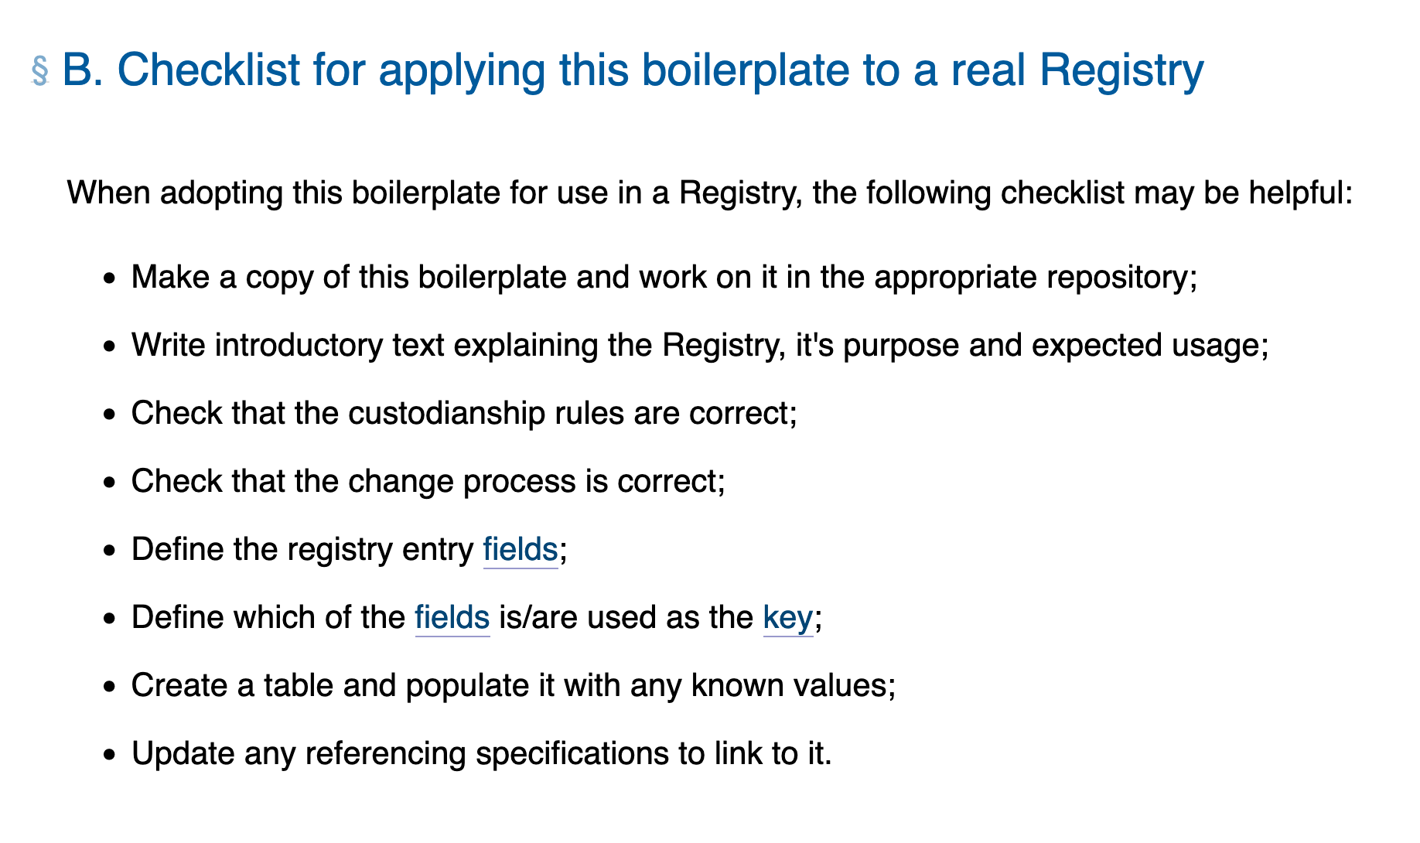
TTWG Checklist

Slide 13
Summary of Status at W3C
Despite the process document, the registry concept is still very custom per document and needs considerations from each WG, which is intended.
More exchange between the groups and developing best practices will be necessary for a wider/easier adoption of the registry mechanism.
TTWG Boilerplate and Checklist + WoT WG Analysis as a starting point?
If so, where should this live?

Slide 14
Feedbacks and Whiteboard

Slide 15
Archive

Slide 16
W3C Reports with Official Registry Mechanism
Analyzed the following:
WebCodecs Codec Registry
Alternative and Augmented Communication (AAC) Symbol Registry
TODO

Slide 17
Open Discussion
TTWG Inputs (from Nigel):
https://github.com/w3c/ttwg/tree/main/boilerplate/registry -> Not to impose but used as an example -> Not approved yet
https://github.com/w3c/ttwg/discussions/241 -> This contains the different issues they have thought of
https://www.w3.org/TR/dapt/#registry-section -> needs to be included in analysis
Guide document would be a place for best practices
MiniApps (from Xiaoqian)
+1 for information exchange

Slide 18
Check-out (to be extended in the end of the meeting)
A summary before the discussion ends:
Main points of discussion, consensus, or disagreement?
Consensus on more exchange between groups
What are the next steps?
Incorporating into the Guide Document if possible.
Including registry sections into the results of w3c search engine
WoT WG will clarify their requirements
Who is responsible for carrying them out? (Could be a person from the session, or a group where work is ongoing, a new community group, the staff, etc.)
Contact the W3C team (Kazuyuki Ashimura)

Slide 19
IANA Registries
Analyzed the following:
URI Schemes (RFC 7595)
Media-types (RFC 6838)
Websockets Subprotocols (RFC 6455)
Websockets extensions (RFC 6455)
Websockets version number (RFC 6455)

Slide 20
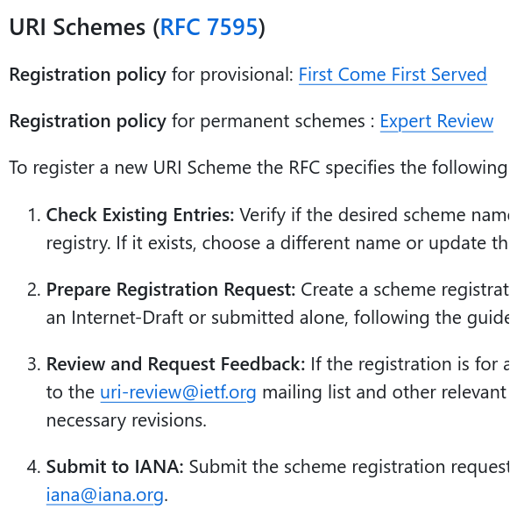
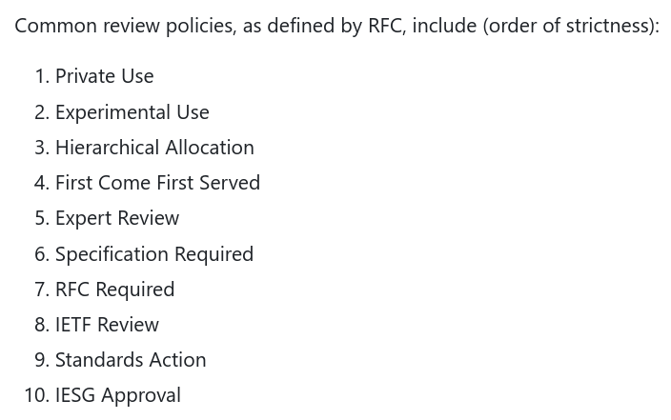
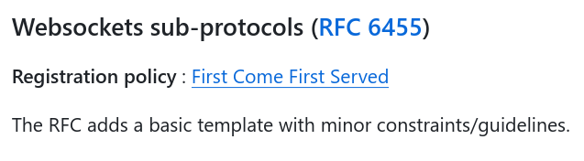
IANA Registries: Summary
Quite mature with various commonly accepted rules (as expected)
BUT it can be extended

Slide 21
W3C Reports before the Registry Mechanism
DID Specification Registries
XPointer Scheme Name Registry Policy
Media Source Extensions Byte Stream Format Registry
TTML Media Type Definition and Profile Registry
Notes:
TTML is Timed Text Markup Language

Slide 22
W3C Reports before the Registry Mechanism: Summary
Varying process complexity and formality, consensus as goal
Varying entry formats
Links to formal specifications (exception: XPointer)
Specific requirements (e.g., JSON-LD context by DID)
Deletion/deprecation processes (exception: XPointer)
Deleting only possible when requirements violated
DID only allows for deprecation
Versioning as a blank spot
→ Deprecation and Resubmission?
Notes:
Varying complexity for registration process, all require some sort of consensus
WG Lead is always involved, sometimes even W3C Directorate in the case of an appeal, ultimate goal is finding a consensus
Most require formal specification to be linked from an entry (XPointer as exception)
Some registries have additional requirements (e.g., JSON-LD context for DID)
Most registries define deletion/deprecation process
DID only allows for deprecation, otherwise deletion only in case of requirements violations
Versioning is not dealt with in these custom registries
TODO: Tabelle?

