Slide 1
Digital-to-Analog Analog-to-Digital
Microprocessor Interface

Slide 2
Data Handling Systems
Both data about the physical world and control signals sent to interact with the physical world are typically "analog" or continuously varying quantities.
In order to use the power of digital electronics, one must convert from analog to digital form on the experimental measurement end and convert from digital to analog form on the control or output end of a laboratory system.

Slide 3
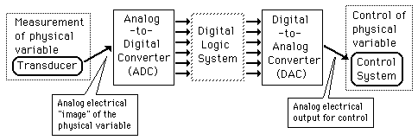
Data Collection and Control

Slide 4
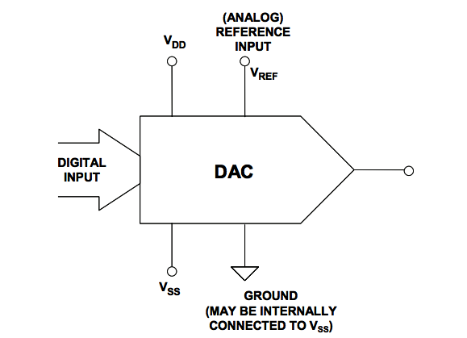
Digital-to-Analog Conversion [DAC]

Slide 5
Digital-to-Analog Conversion
When data is in binary form, the 0's and 1's may be of several forms such as the TTL form where the logic zero may be a value up to 0.8 volts and the 1 may be a voltage from 2 to 5 volts.
The data can be converted to clean digital form using gates which are designed to be on or off depending on the value of the incoming signal.

Slide 6
Digital-to-Analog Conversion
Data in clean binary digital form can be converted to an analog form by using a summing amplifier.
For example, a simple 4-bit D/A converter can be made with a four-input summing amplifier.

Slide 7
Digital-to-Analog Conversion
3 Basic Approaches:
Kelvin Divider (String DAC)
Binary Weighted DAC
R-2R Ladder

Slide 8
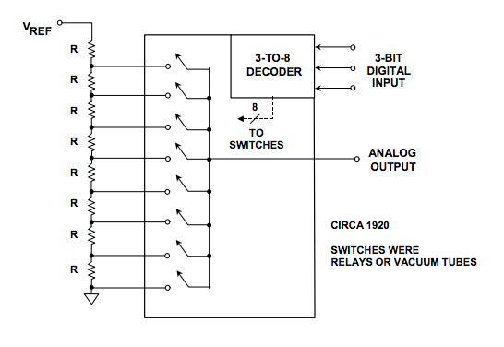
Kelvin Divider (String DAC)

Slide 9
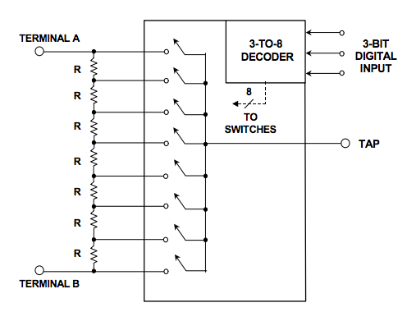
A Slight Modification to a Kelvin DAC Yields a"Digital Potentiometer"

Slide 10
Weighted Sum DAC
One way to achieve D/A conversion is to use a summing amplifier.
This approach is not satisfactory for a large number of bits because it requires too much precision in the summing resistors.
This problem is overcome in the R-2R network DAC.

Slide 11
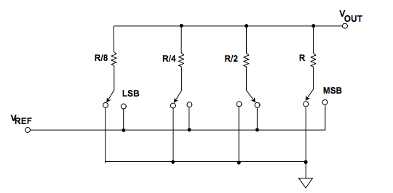
Current Soruce Weighted Sum DAC

Slide 12
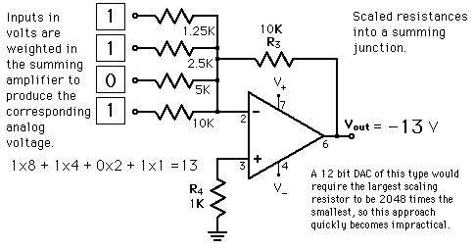
Weighted Sum DAC

Slide 13
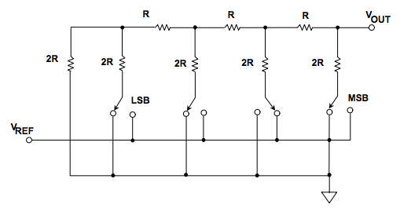
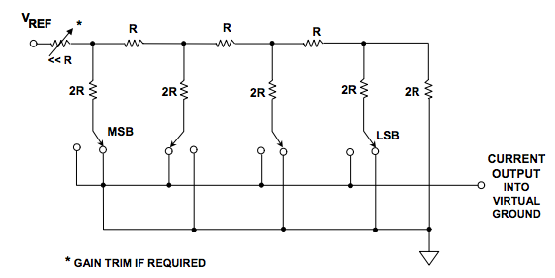
R-2R Ladder DAC
Voltage Mode Current Mode

Slide 14
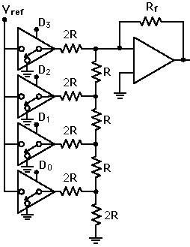

R-2R Ladder DAC

Slide 15
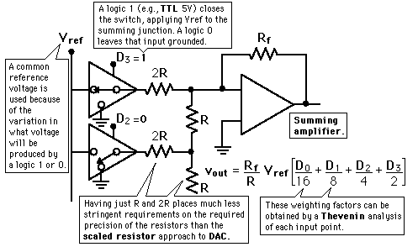
R-2R Ladder DAC

Slide 16
R-2R Ladder DAC
The summing amplifier with the R-2R ladder of resistances shown produces the output where the D's take the value 0 or 1.
The digital inputs could be TTL voltages which close the switches on a logical 1 and leave it grounded for a logical 0.
This is illustrated for 4 bits, but can be extended to any number with just the resistance values R and 2R.

Slide 17
Analog to Digital Conversion [ADC]

Slide 18
ADC Basic Principle
The basic principle of operation is to use the comparator principle to determine whether or not to turn on a particular bit of the binary number output.
It is typical for an ADC to use a digital-to-analog converter (DAC) to determine one of the inputs to the comparator.

Slide 19
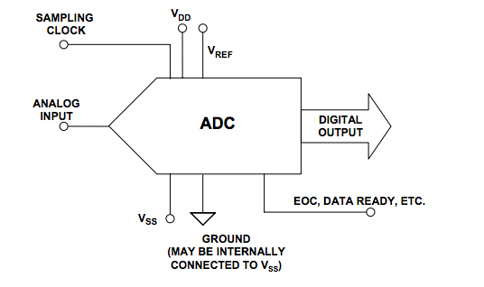
ADC Various Approaches
3 Basic Types
Digital-Ramp ADC
Successive Approximation ADC
Flash ADC

Slide 20
Digital-Ramp ADC
Conversion from analog to digital form inherently involves comparator action where the value of the analog voltage at some point in time is compared with some standard.
A common way to do that is to apply the analog voltage to one terminal of a comparator and trigger a binary counter which drives a DAC.

Slide 21
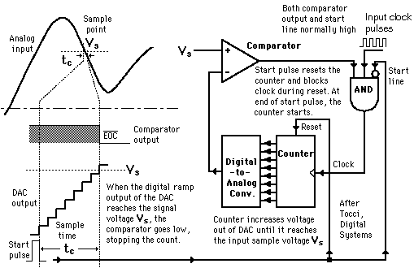
Digital-Ramp ADC

Slide 22
Digital-Ramp ADC
The output of the DAC is applied to the other terminal of the comparator.
Since the output of the DAC is increasing with the counter, it will trigger the comparator at some point when its voltage exceeds the analog input.
The transition of the comparator stops the binary counter, which at that point holds the digital value corresponding to the analog voltage.

