Slide 1
Arduino Architecture
Topics:
Microcontrollers
Programming Basics: structure and variables
Digital Output
Analog to Digital Conversion

Slide 2
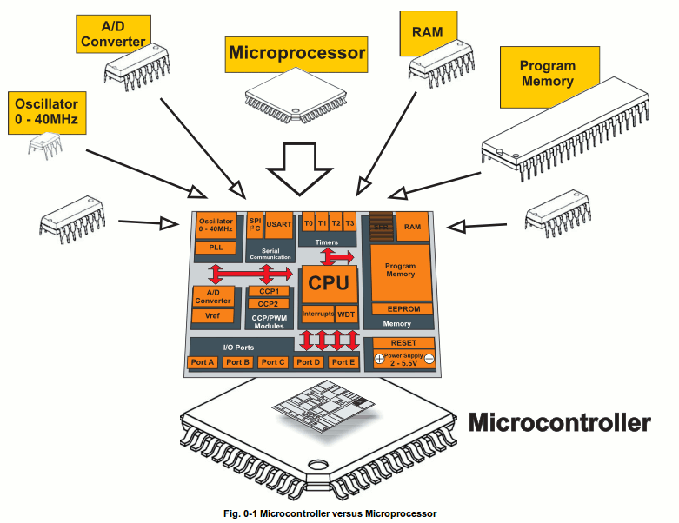
What is a Microcontroller
www.mikroe.com/chapters/view/1
A small computer on a single chip
containing a processor, memory, and input/output
Typically "embedded" inside some device that they control
A microcontroller is often small and low cost
Examples

Slide 3
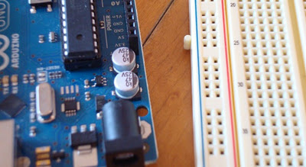
What is a Development Board
A printed circuit board designed to facilitate work with a particular microcontroller.
Typical components include:
power circuit
programming interface
basic input; usually buttons and LEDs
I/O pins

Slide 4
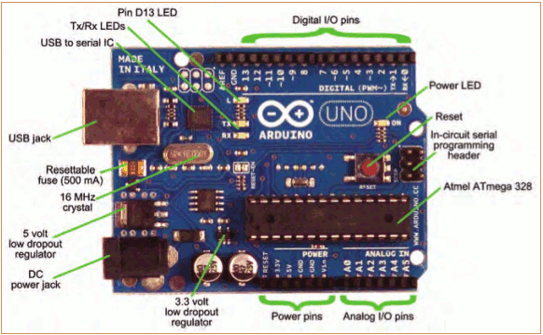
The Arduino Development Board
Making-robots-with-arduino.pdf

Slide 5
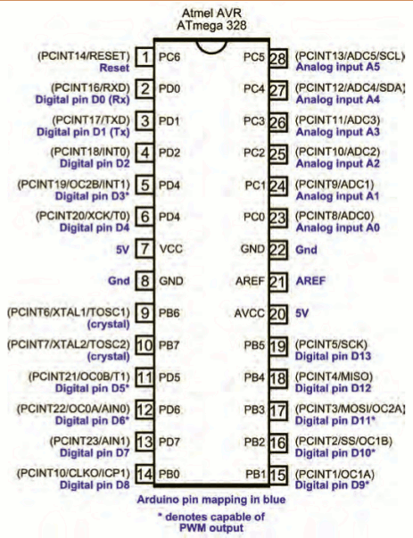
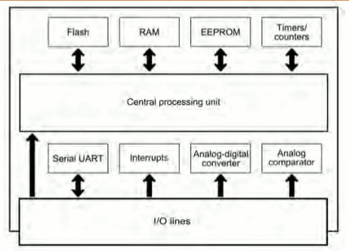
The Arduino Microcontroller: Atmel ARV Atmega 328
Specification
Making-robots-with-arduino.pdf

Slide 6
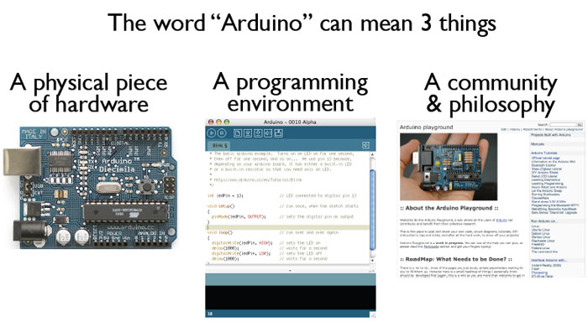
What is the Arduino
todbot.com/blog/bionicarduino

Slide 7
Getting Started
Check out: http://arduino.cc/en/Guide/HomePage
Download & install the Arduino environment (IDE)
Connect the board to your computer via the UBS cable
If needed, install the drivers (not needed in lab)
Launch the Arduino IDE
Select your board
Select your serial port
Open the blink example
Upload the program

Slide 8
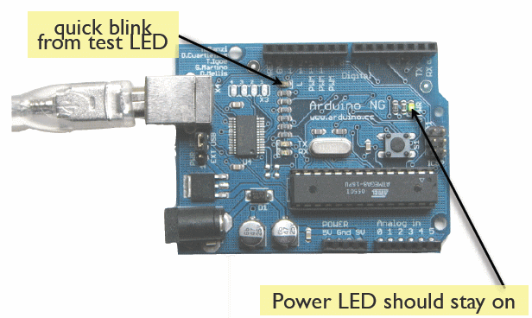
Try It: Connect the USB Cable
todbot.com/blog/bionicarduino

Slide 9
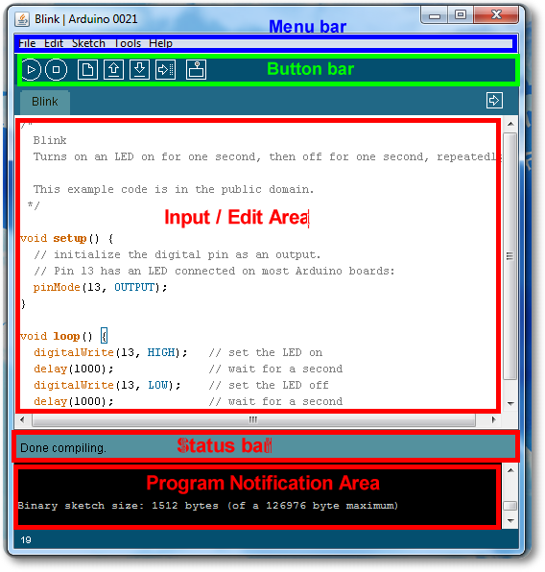
Arduino IDE
See: http://arduino.cc/en/Guide/Environment for more information

Slide 10
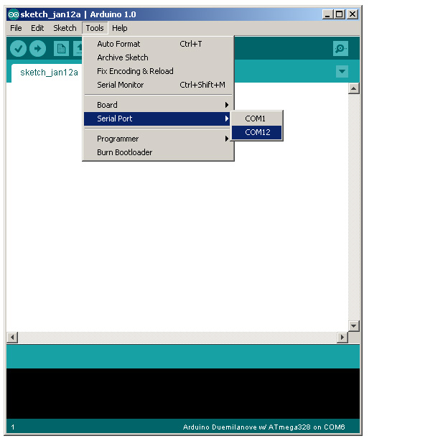
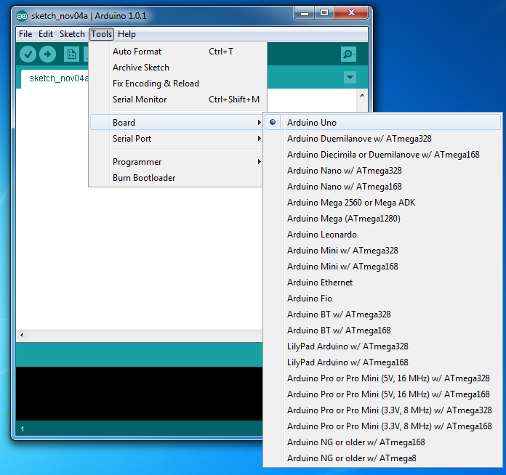
Select Serial Port and Board

Slide 11
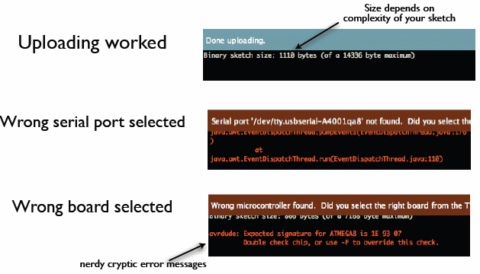
Status Messages
todbot.com/blog/bionicarduino

Slide 12
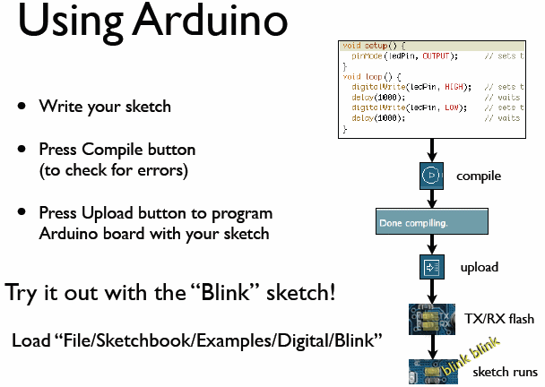
todbot.com/blog/bionicarduino

Slide 13
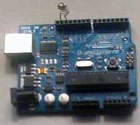
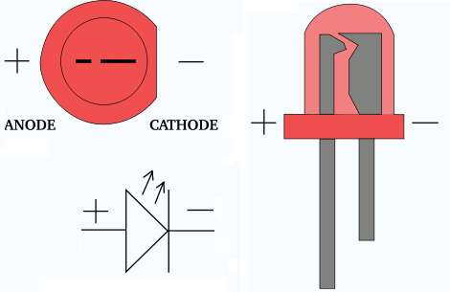
Add an External LED to pin 13
File > Examples > Digital > Blink
LED’s have polarity
Negative indicated by flat side of the housing and a short leg
www.instructables.com

Slide 14
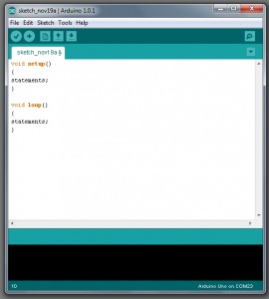
A Little Bit About Programming
Code is case sensitive
Statements are commands and must end with a semi-colon
Comments follow a // or begin with /* and end with */
loop and setup

Slide 15
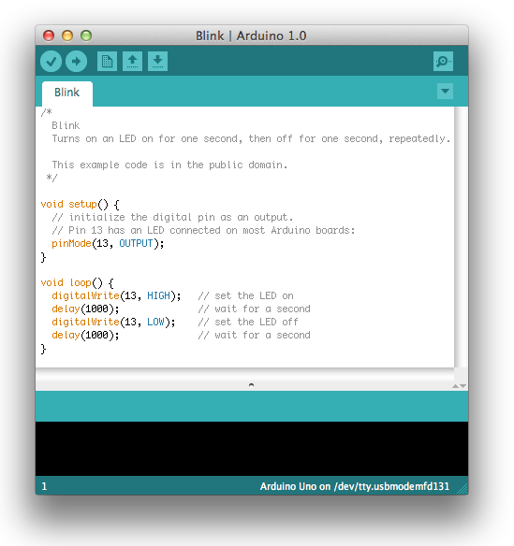
Our First Program

Slide 16
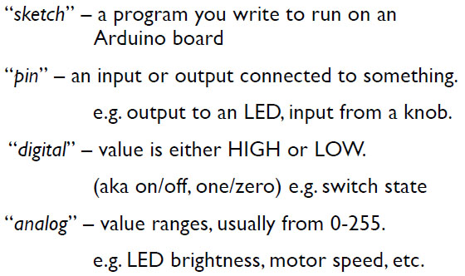
Terminology

Slide 17
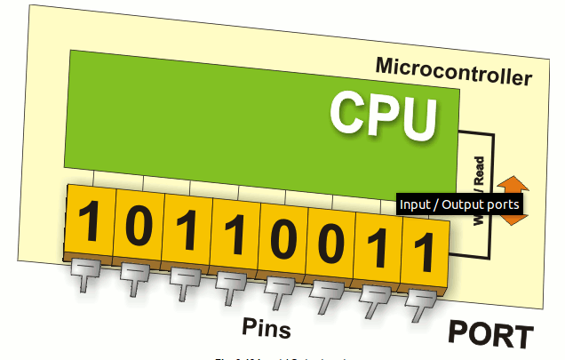
Digital I/0
www.mikroe.com/chapters/view/1
pinMode(pin, mode)
Sets pin to either INPUT or OUTPUT
digitalRead(pin)
Reads HIGH or LOW from a pin
digitalWrite(pin, value)
Writes HIGH or LOW to a pin
Electronic stuff
Output pins can provide 40 mA of current
Writing HIGH to an input pin installs a 20KΩ pullup

Slide 18
Arduino Timing
delay(ms)
Pauses for a few milliseconds
delayMicroseconds(us)
Pauses for a few microseconds
More commands: arduino.cc/en/Reference/HomePage

Slide 19
Digital? Analog?
Digital has two values: on and off
Analog has many (infinite) values
Computers don’t really do analog, they quantize
Remember the 6 analog input pins---here’s how they work
todbot.com/blog/bionicarduino

Slide 20
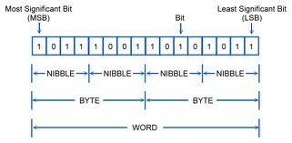
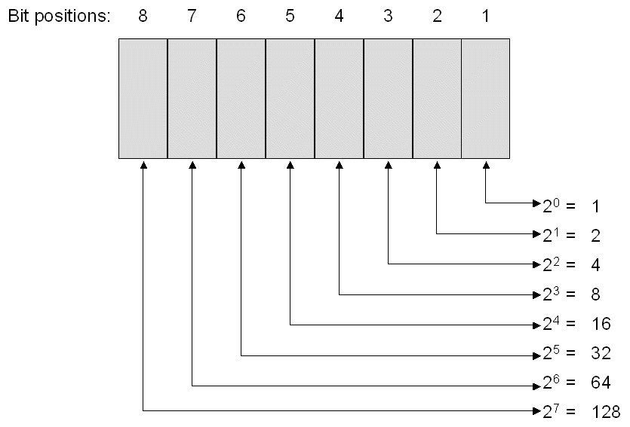
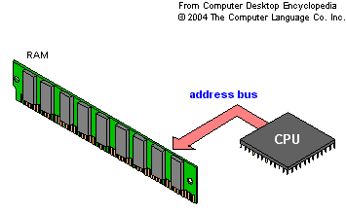
Bits and Bytes

Slide 21
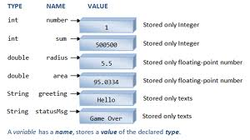
Variables
www3.ntu.edu.sg

Slide 22
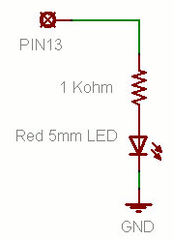
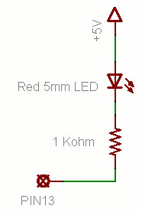
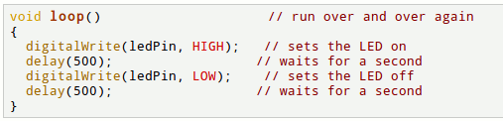
Putting It Together
Complete the sketch (program) below.
What output will be generated by this program?
What if the schematic were changed? ➔
www.ladyada.net/learn/arduino

Slide 23
Good References
www.arduino.cc
www.ladyada.net/learn/arduino
www.EarthshineElectronics.com

