Slide 1
Unemployment Trends around the world
How female unemployment is calculated?

Slide 2
Who is counted as unemployed?
“People are classified as unemployed if they do not have a job, have actively looked for work in the prior 4 weeks, and are currently available for work”
Actively looking for work may consist of any of the following activities:
Contacting: an employer directly or having a job interview a public or private employment agency
friends or relatives a school or university employment center
Submitting resumes or filling out applications
Placing or answering job advertisements
Checking union or professional registers
Passive methods of job search do not have the potential to connect job seekers with potential employers and therefore do not qualify as active job search methods.
Examples of passive methods:
Attending a job training program or course
Reading about job openings that are posted in newspapers or on the Internet
Temporary layed off workers are counted as unemployed whether or not they have engaged in a specific job seeking activity.

Slide 3
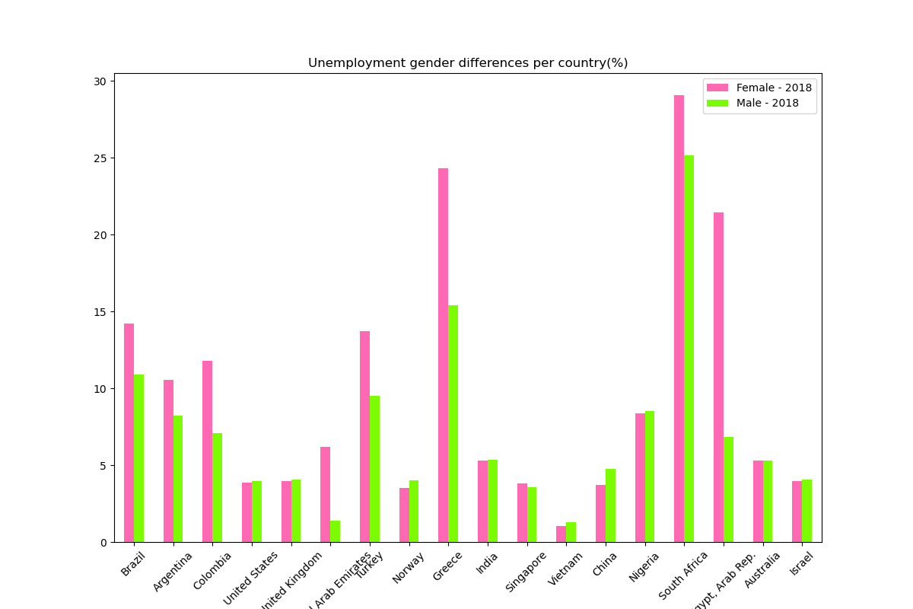
Youth Unemployment Percentage Rates, Female vs Male, 2018
 | Country Name | Female - 2018 | Male - 2018
0 | Brazil | 14.23 | 10.87
1 | Argentina | 10.54 | 8.23
2 | Colombia | 11.79 | 7.09
3 | United States | 3.84 | 3.95
4 | United Kingdom | 3.94 | 4.05
5 | United Arab Emirates | 6.19 | 1.39
6 | Turkey | 13.74 | 9.49
7 | Norway | 3.54 | 4.03
8 | Greece | 24.29 | 15.41
9 | India | 5.30 | 5.34
10 | Singapore | 3.79 | 3.55
11 | Vietnam | 1.03 | 1.28
12 | China | 3.72 | 4.75
13 | Nigeria | 8.36 | 8.51
14 | South Africa | 29.05 | 25.14
15 | Egypt, Arab Rep. | 21.44 | 6.81
16 | Australia | 5.32 | 5.28
17 | Israel | 3.95 | 4.04

Slide 4
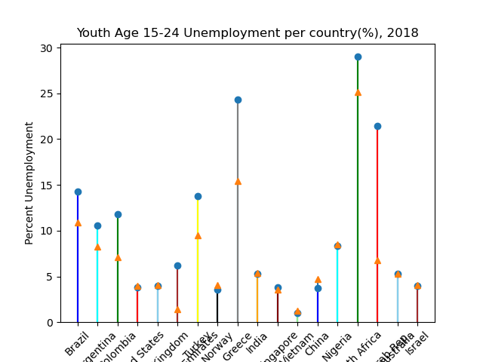

Slide 5
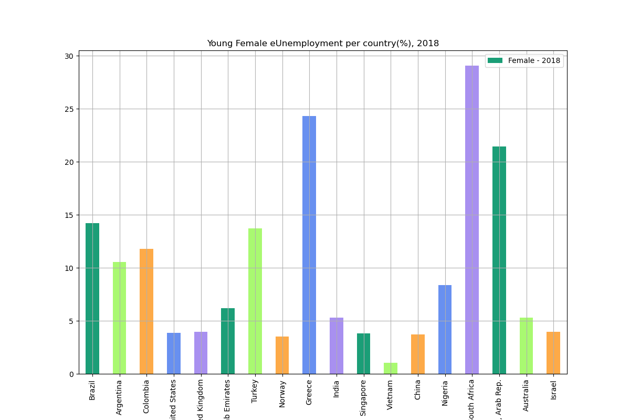
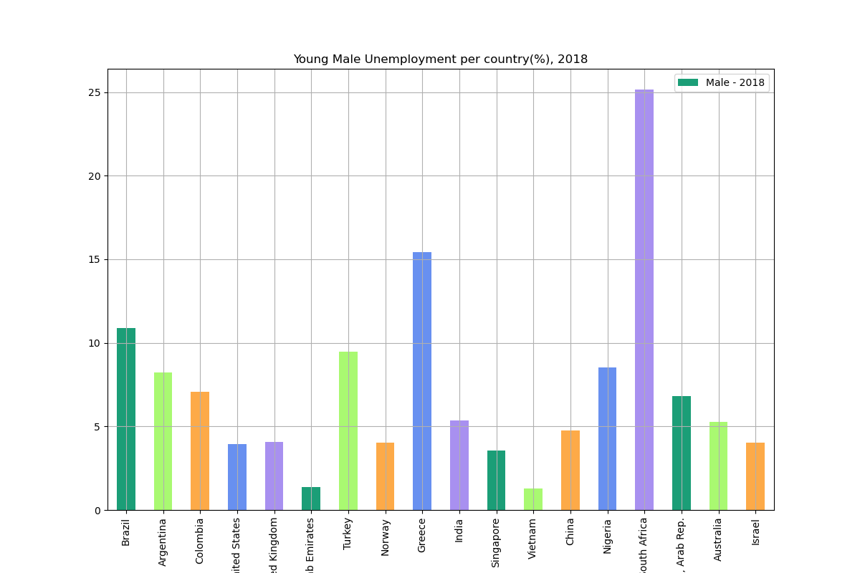
Females 15-24 Unemployment per country(%), 2018
Males 15-24 Unemployment per country(%), 2018

Slide 7
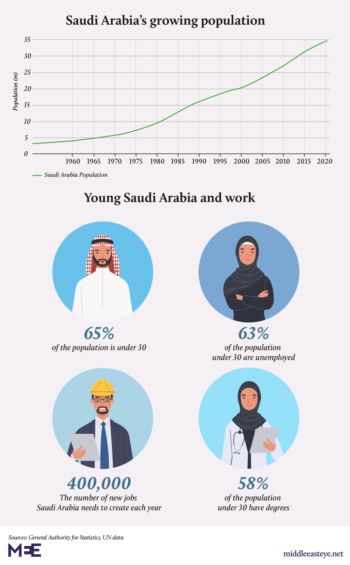
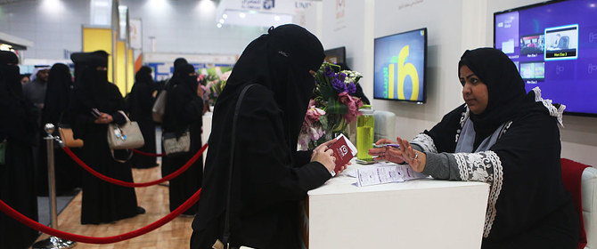
Unemployment is Saudi Arabia

Slide 8

Unemployment is on the rise globally, but gender gap is still there despite pandemics
 | Region_Country | Female-2018 | Male-2018 | Female-2020 | Male-2020
0 | Latin America | 21.9 | 15.2 | 25.9 | 18.1
1 | Northern America | 7.9 | 9.8 | 15.3 | 15.6
2 | Southern Asia | 18.6 | 18.6 | 18.9 | 20.5
3 | Europe | 14.8 | 16.5 | 15.8 | 17.2
4 | MENA | 42.4 | 21.8 | 44.5 | 23.3
5 | Greece | 44.0 | 36.4 | 39.4 | 31.4
6 | South Africa | 59.1 | 49.5 | 64.4 | 55.7
7 | Turkey | 24.7 | 17.2 | 29.3 | 22.1

Slide 9
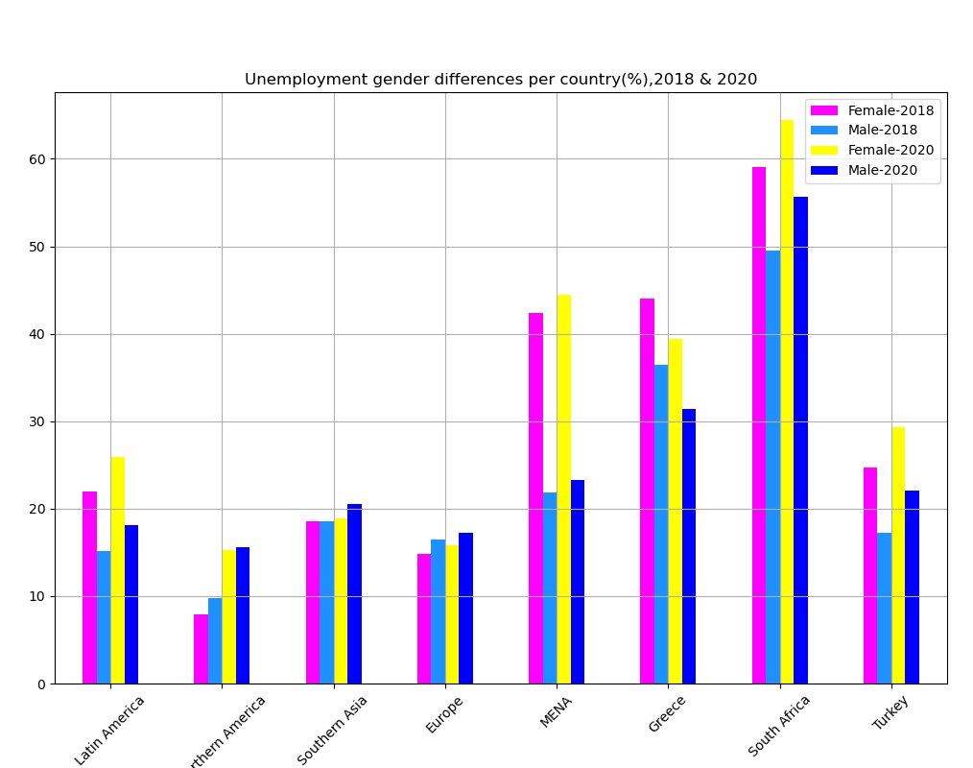
Unemployment
Percentage Gender
Difference per country,
2020 vs 2018

Slide 10
