Slide 1
BatTracker
Joseph Kaming-Thanasi

Slide 2
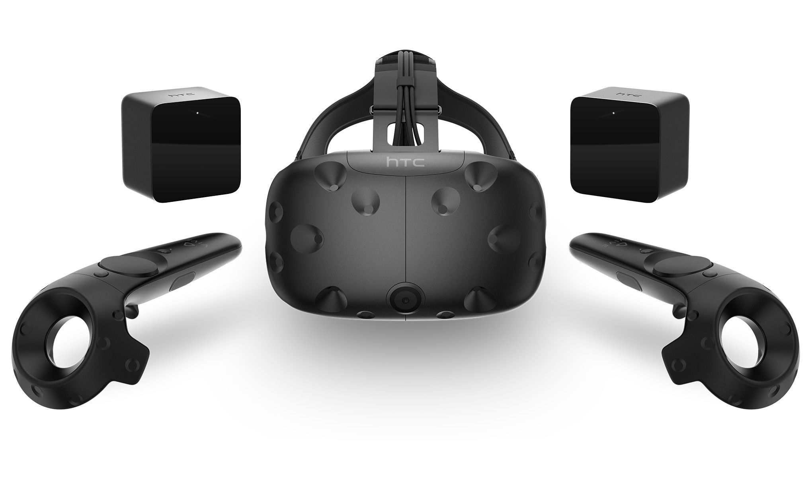
Problem Statement
Local 3D tracking is too expensive
A HTC Vive setup without the headset would be 530$

Slide 3
Journey to this project
Originally I was working on a school mapping program
I began working with an Electrical Engineering professor at Stony Brook University.
He had me working on project that would create indoor maps of buildings using only phone sensors
Eventually moved me to BatTracker, my current project

Slide 4
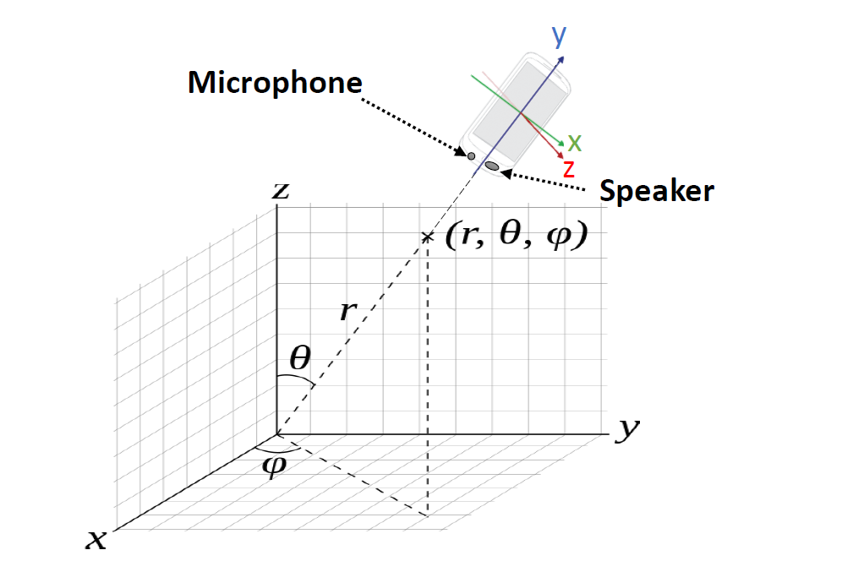
What is BatTracker?
Infrastructure free 3D location of a device
Cheaper than current solutions
Uses pre-existing hardware
Android device
Possible use cases
Virtual Reality
Medical Rehabilitation

Slide 5
Why BatTracker
This summer, I am working with Dr. Fan Ye, an electrical engineering professor at SBU, on this project.
Opportunity for me to learn mobile app development, networking, threading, and more advanced topics of computer science.

Slide 6
The Process
To learn the android API (application programming interface) I took two online classes created by google.
Layouts with XML
Focused mainly on creating a UI
Developing android apps
Focused more on backend and API topics: networking, threading, etc…

Slide 7
How does the app work?
Components
Front End - Mobile
Emitting sound
Recording sound
Recording inertial sensor data
Sending data over network to server
Back End – Desktop
Receiving data
Processing data
output

Slide 8
Current Flow
Mobile Device
Data is recorded and file is written
Server
Data file is transferred to desktop then processed
Output
Usable output given to user

Slide 9
Incremental release flow
Mobile Device
Data is recorded and streamed over the network in real time
Server
Data is received and processed in real time

Slide 10
Eventual goal flow
Mobile Device
Recording, Processing, output done in real time.

Slide 11
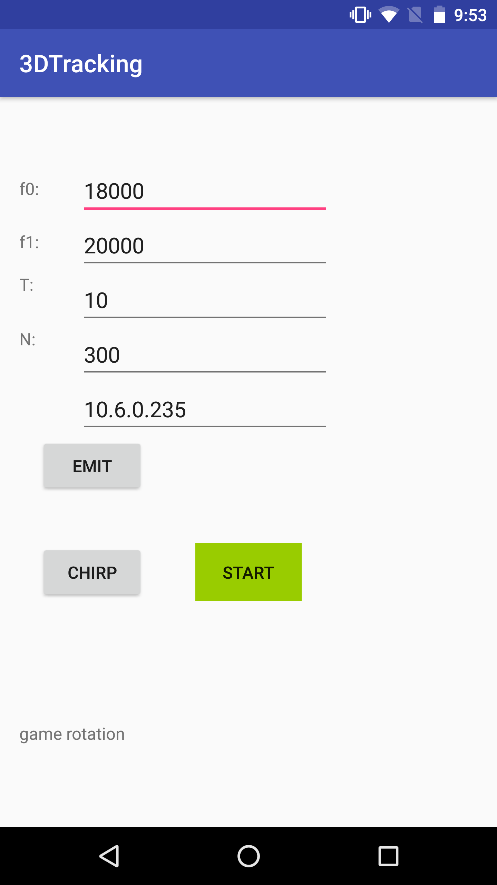
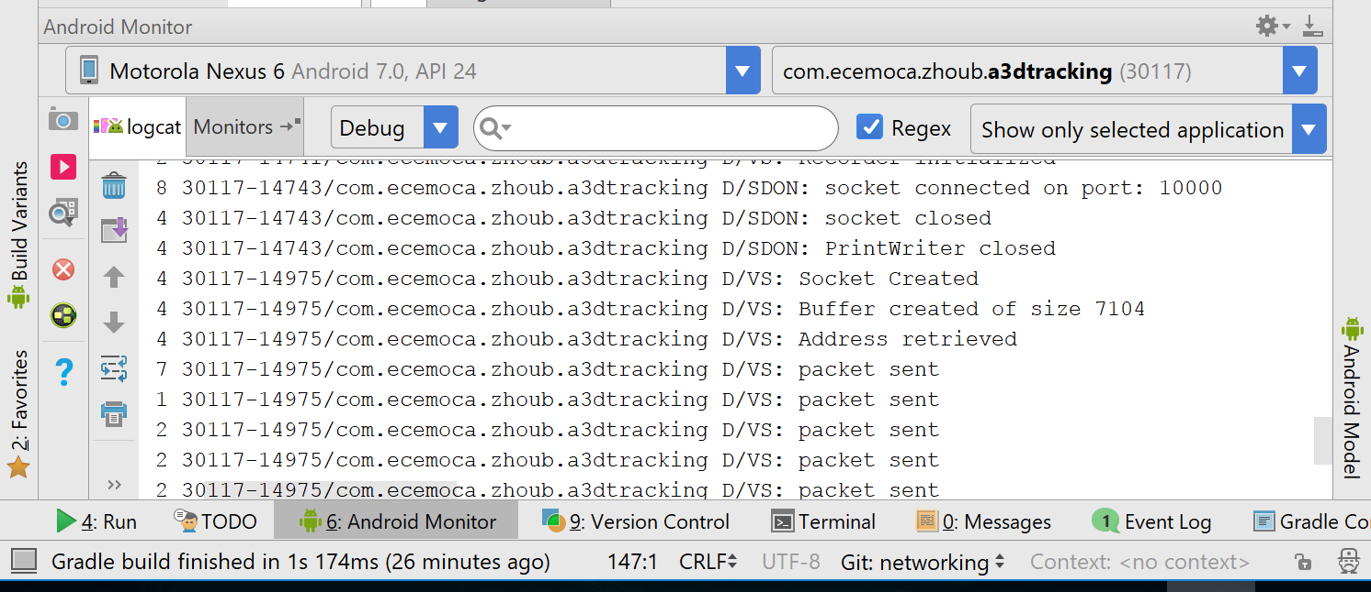
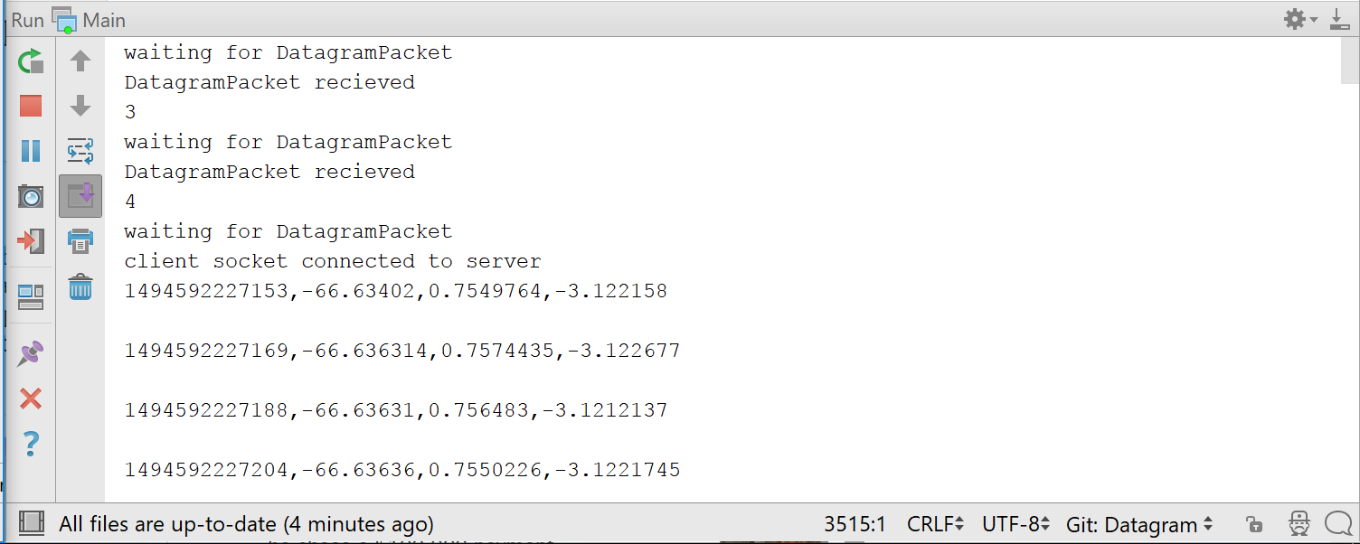
Screenshots of app
Android Log
Server Log

Slide 12
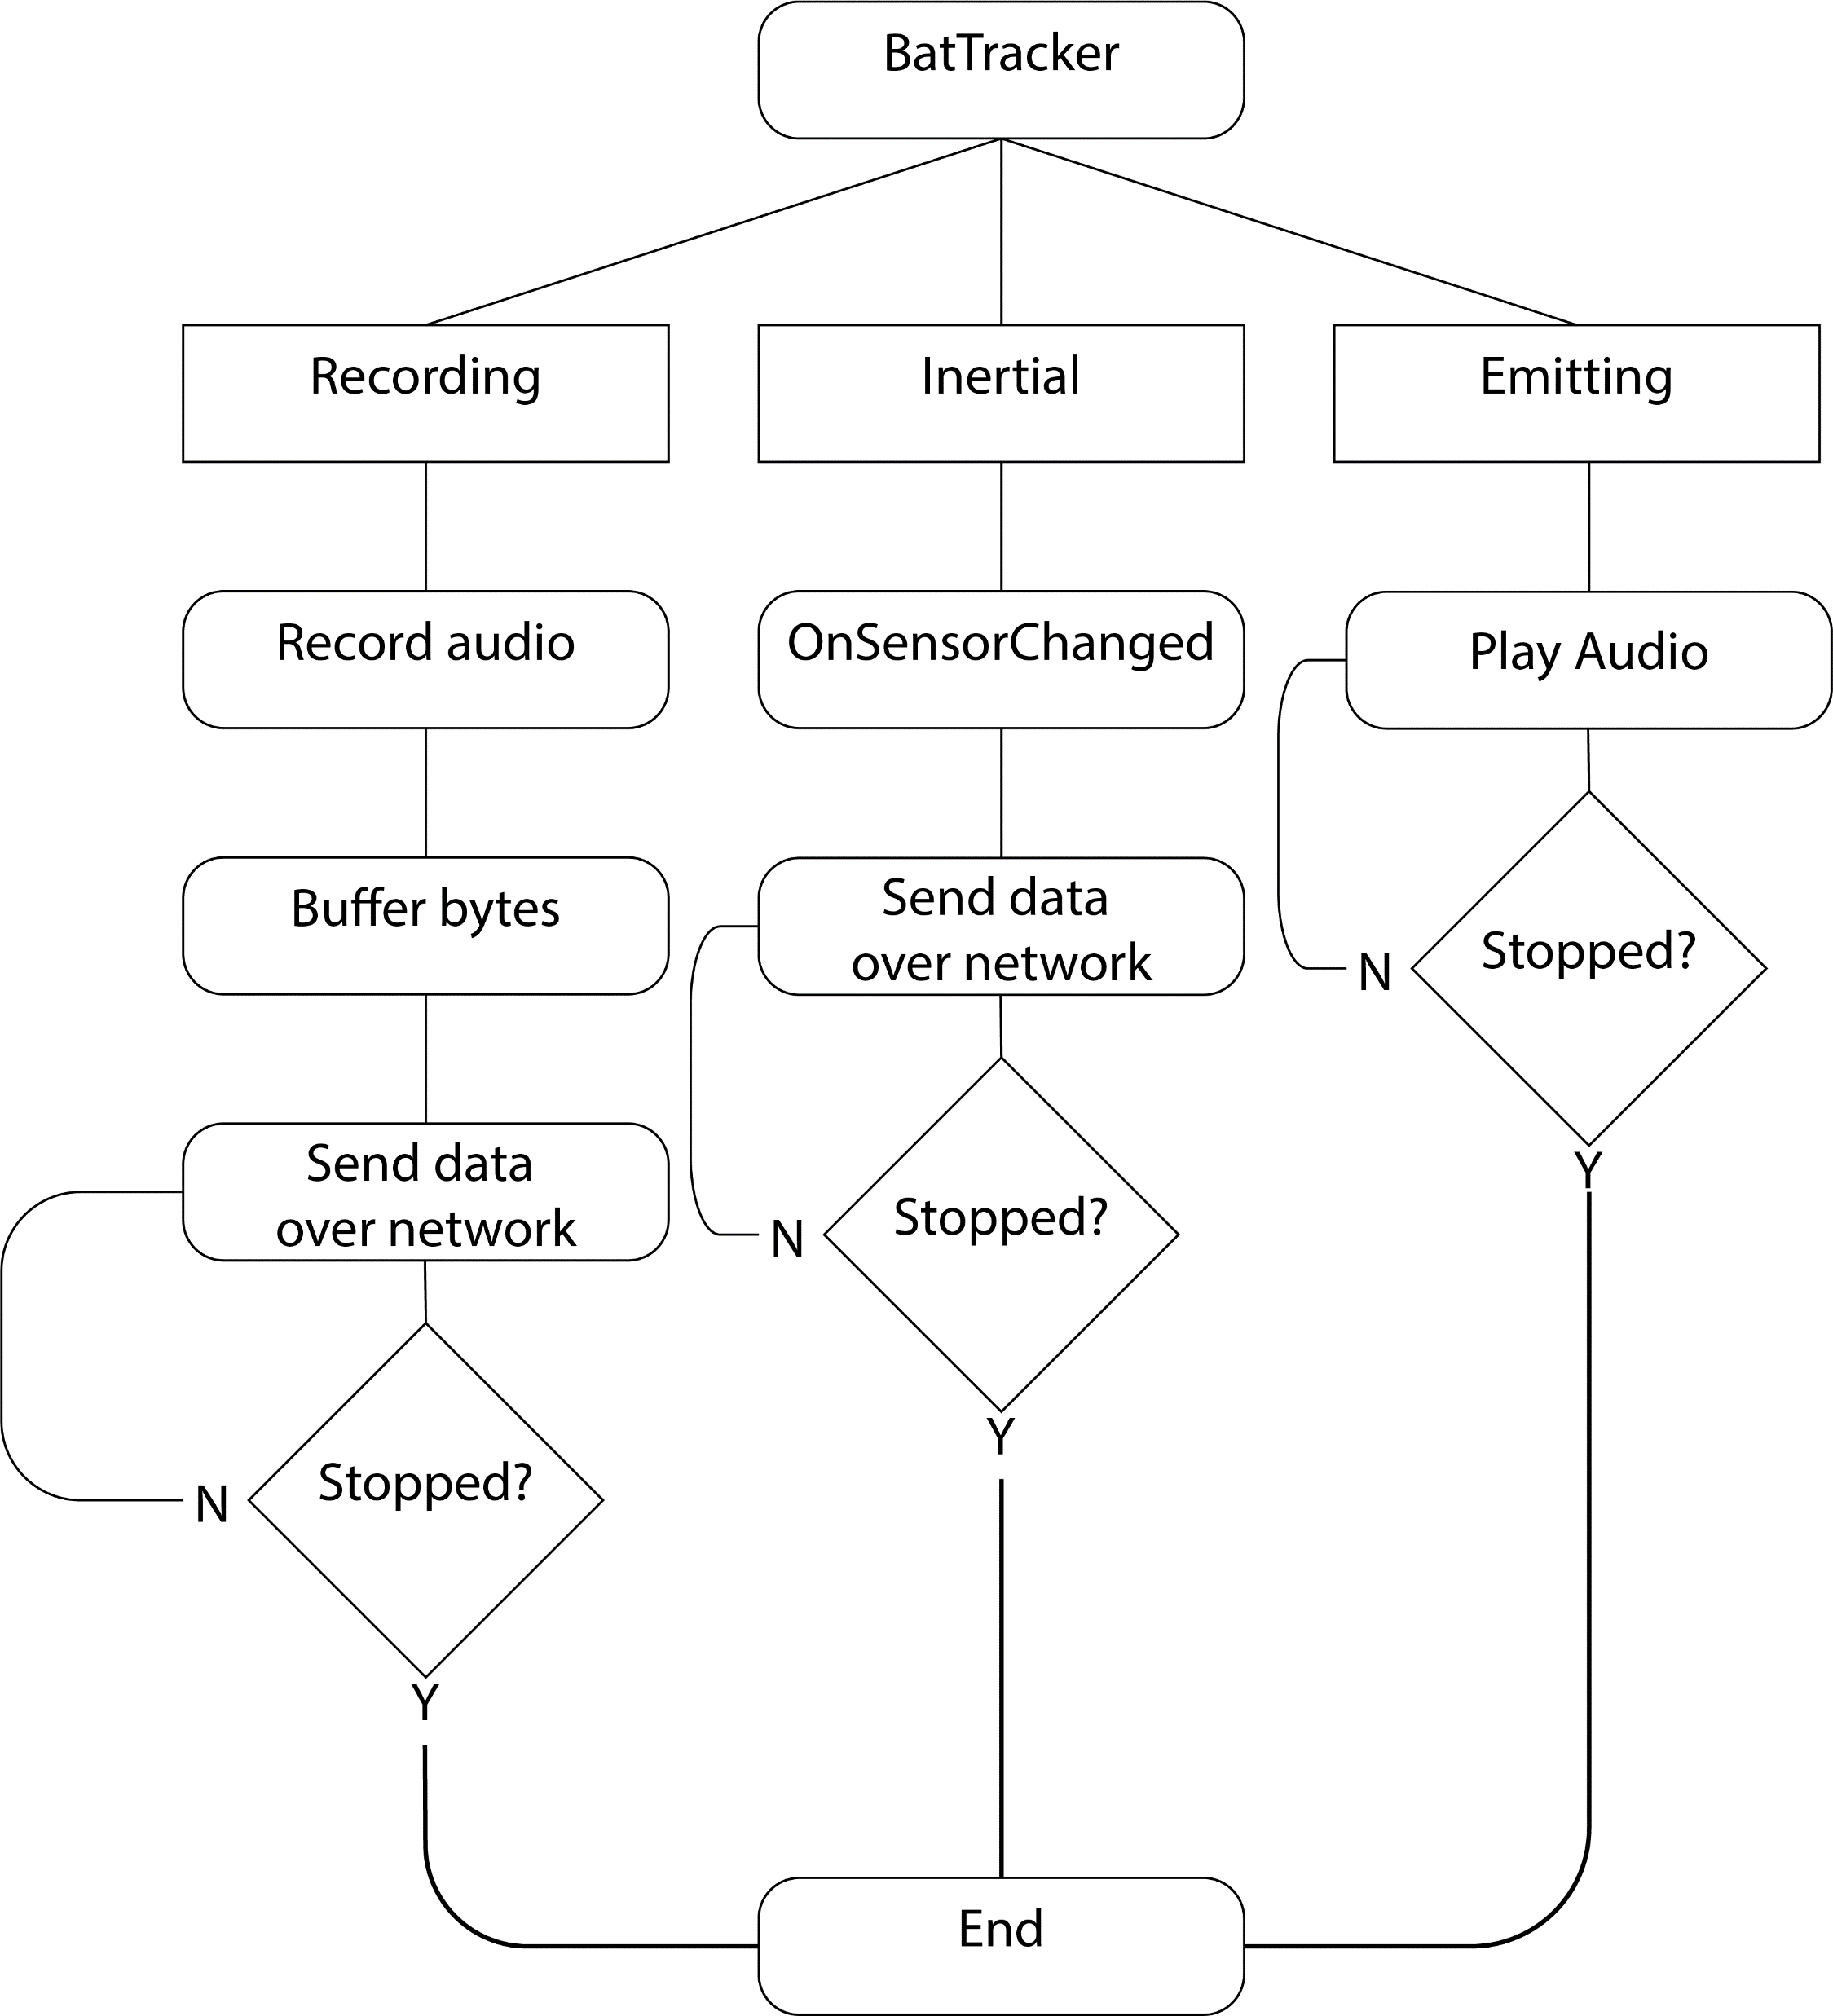
Mobile Software Diagram

Slide 13
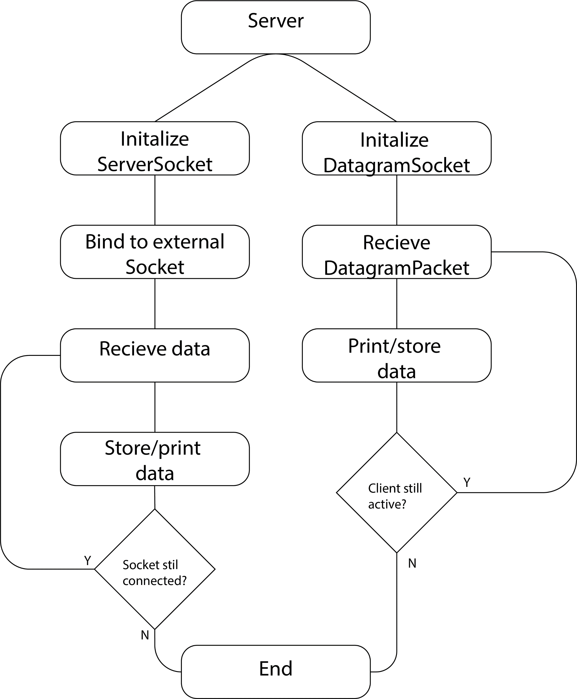
Server Software Diagram

Slide 14
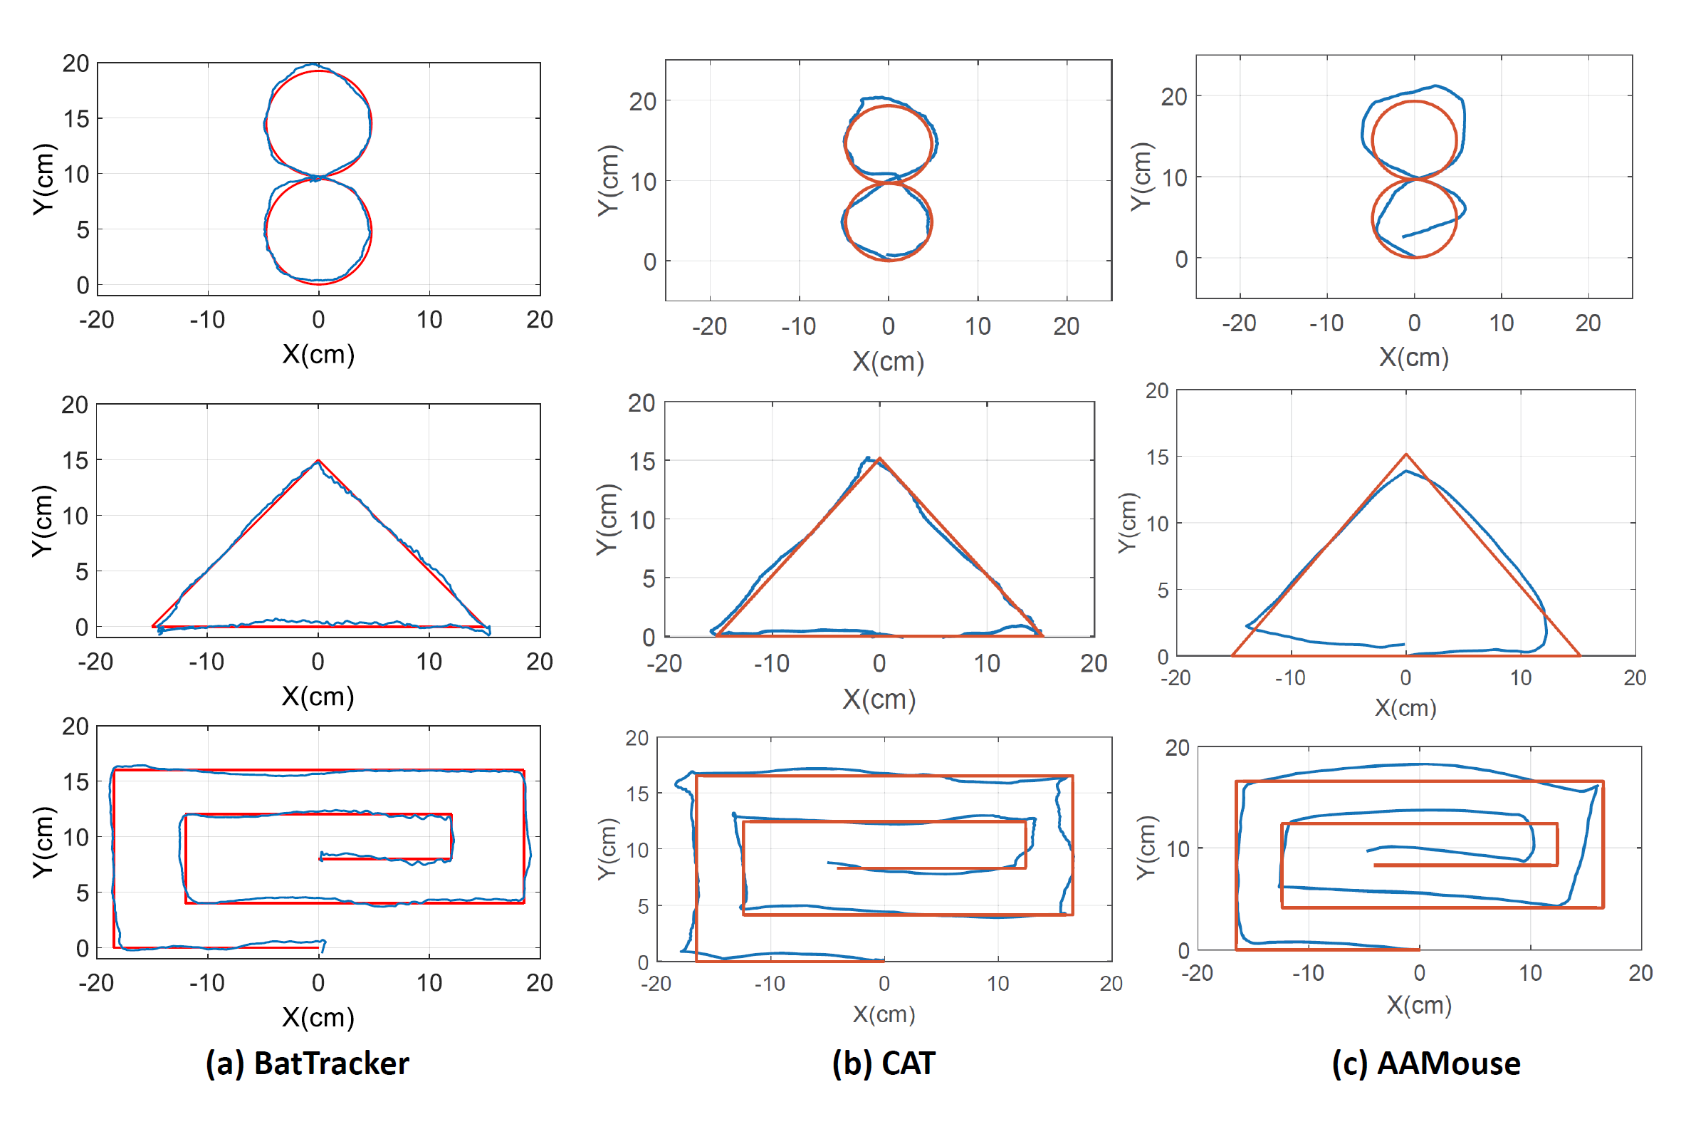
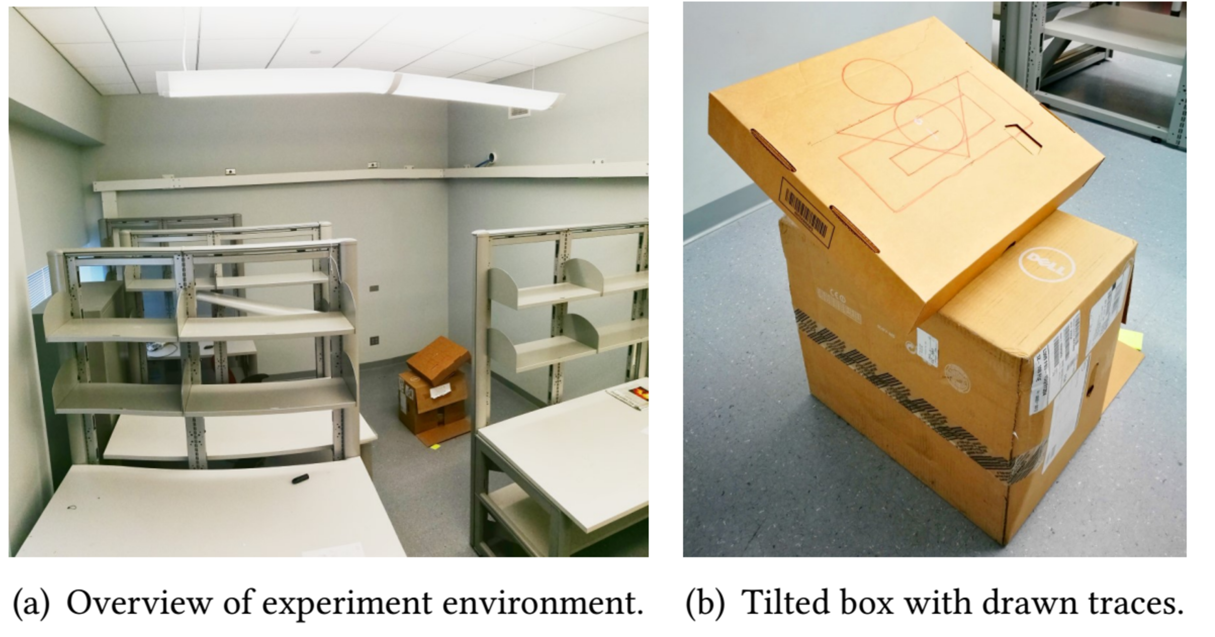
BatTracker Vs. Other audio based methods

Slide 15
Possible use cases
Virtual reality
Medical rehabilitation
General positional tracking
Leave it open ended for developers

Slide 16
How to sell
Use a API/Library licensing model
License software to be used within other apps
Make it free for developers to use but charge when app is delivered to user.
Have the software “phone home” to central licensing server so make sure that it is genuine.

Slide 17
Reflections
I had to adapt quickly to the changing projects I was involved in
I learned new topics
Basic networking
Concurrency/Parallelism
Android API
XML
Solidified my desire to study computer science in college

