Slide 1
Computer Organization 2026
Quiz 1 & Programming Assessment I
Announce date: 2026.3.19
Assessment date: 2026.3.26 & 2026.3.27

Slide 2
Quiz1 Overview
Date: 3/26
Time: 09:00 - 09:30
Rooms: A1302 (For 3/27 PA1 Students), 65203, 65304
Regardless of whether your PA1 is on 3/26 or 3/27, all must attend Quiz1 on 3/26.
3/26 PA1 Students
3/27 PA1 Students
3/26
Quiz1
PA1
3/27

Slide 3
PA1 Overview
Date: 3/26, 3/27
Time: 09:30 - 13:00
Rooms: 65203, 65304
You are asked to write inline assembly code and run it on RISC-V Spike simulator to get results.
The goal is to practice low-level programming and understand how assembly interacts with C.

Slide 4
Prerequisite: HW0 – Environment Setup
You have to follow the procedures listed in the HW0 document to set up your development environment.
We will use Docker for 3/26 & 3/27 programming assessment. Make sure you're familiar with basic Docker operations.

Slide 5
Assessment - 3 Coding Problems
Problem 1: Insertion Sort, 30%
Problem 2: Binary Search, 30%
Problem 3: Linked-List Cycle, 40%

Slide 6
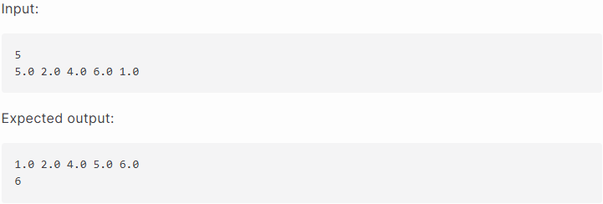
Problem 1. Insertion Sort (30%)
.
Input:
  The first line contains an integer, the size of the array.
  The second line contains floating point key values.
Output:
  The first line contains sorted array.
  The second line contains an integer, shift count, which is the times of elements shifted.

Slide 7
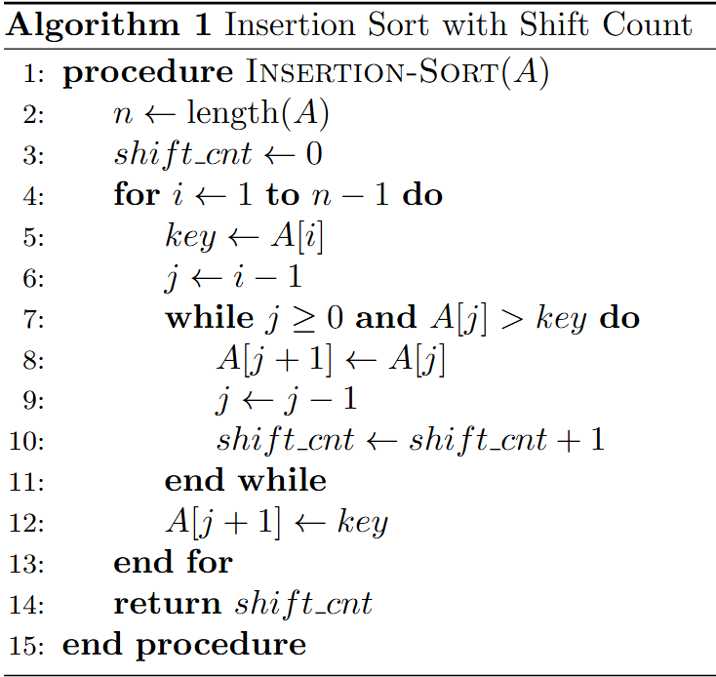
Problem 1. Insertion Sort (Cont.)
.
Main array
0
1
2
3
4
5
2
4
6
1
j=0
i=1
Inputs
array A: [5, 2, 4, 6, 1]
n: 5
shift_cnt: 0

Slide 8
Problem 1. Insertion Sort (Cont.)
1st iteration: Insert 2 (i = 1)
Main array
0
1
2
3
4
key = A[1] = 2
Compare: A[0] = 5 & key = 2 (5 > 2)
Shift: 5 shift to A[1]
shift_cnt + 1 = 0 + 1 = 1
Insert: 2 insert to A[0]
5
2
4
6
1
2
j
i
2
2
4
6
1
5
State
Current array: [2, 5, 4, 6, 1]
shift_cnt: 1

Slide 9
Problem 1. Insertion Sort (Cont.)
2nd iteration: Insert 4 (i = 2)
Main array
0
1
2
3
4
key = A[2] = 4
Compare: 5 > 4 → Shift 5 (shift_cnt + 1)
Compare: 2 > 4 → False (stop)
Insert: 4 insert to A[1]
2
5
4
6
1
4
j
i
4
4
6
2
5
1
State
Current array: [2, 4, 5, 6, 1]
shift_cnt: 2

Slide 10
Problem 1. Insertion Sort (Cont.)
3rd iteration: Insert 6 (i = 3)
Main array
0
1
2
3
4
key = A[3] = 6
Compare: 5 > 6 → False (stop)
No shift
Insert: 6 insert to A[3]
2
4
5
6
1
6
j
i
5
6
2
4
6
1
State
Current array: [2, 4, 5, 6, 1]
shift_cnt: 2

Slide 11
Problem 1. Insertion Sort (Cont.)
4th iteration: Insert 1 (i = 4)
Main array
0
1
2
3
4
key = A[4] = 1
Compare: 6 > 1 → Shift 6 (shift_cnt + 1)
Compare: 5 > 1 → Shift 5 (shift_cnt + 1)
Compare: 4 > 1 → Shift 4 (shift_cnt + 1)
Compare: 2 > 1 → Shift 2 (shift_cnt + 1)
Insert: 1 insert to A[0]
Finish
2
4
5
6
1
1
j
i
1
4
5
6
1
2
Result
Sorted array: [1, 2, 4, 5, 6]
shift_cnt: 6

Slide 12
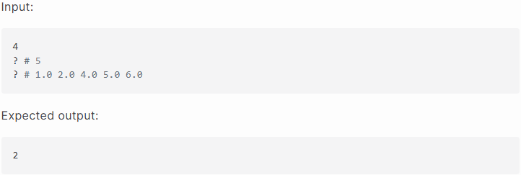
Problem 2. Binary Search (30%)
.
Input:
  The first line contains an integer, target, to search for in the array.
  The second line contains the array size filled by Problem 1.
  The third line contains the sorted array filled by Problem 1.
Output:
  A single integer representing the index of the target in the array, or -1 if the target is not found.

Slide 13
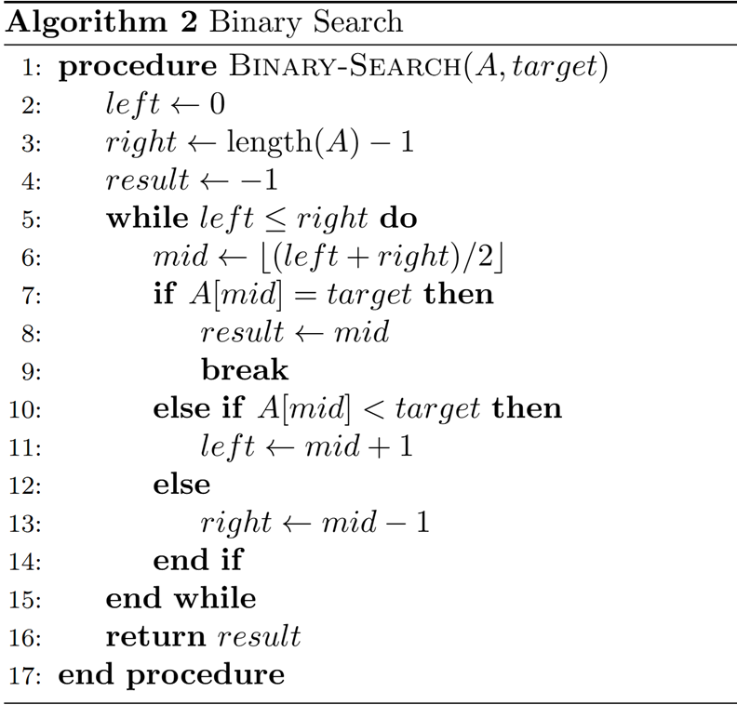
Problem 2. Binary Search (Cont.)
.
Inputs
target: 4
Array size: 5
Sorted array: [1, 2, 4, 5, 6]
# Note: The array size (line 2) and the sorted array (line 3) will be filled by Problem 1.
Result
Index: 2

Slide 14
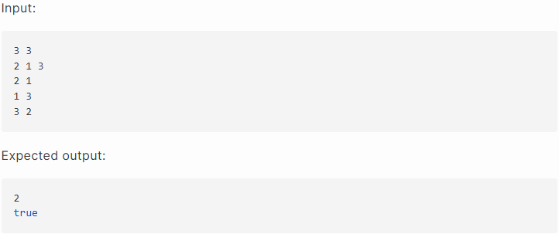
Problem 3. Linked-List Cycle (40%)
.
Input:
  The first line contains two integers, the number of nodes and the number of edges.
  The second line contains key values of the input nodes.
  Each of the lines contains two integers from and to, representing a directed edge from from to to (e.g., 1 2 means a directed edge from 1 to 2).
Output:
  The first line contains an integer key value of meet pointer.
  The second line contains the result of having cycle or not. (e.g., Has cycle: true; no cycle: false)

Slide 15
Problem 3. Linked-List Cycle (Cont.)
The Tortoise and Hare Algorithm
The tortoise moves one step at a time, and the hare moves two steps at a time.
Given a path, we want to determine whether the path contains a cycle.
If so, at which position do the hare and the tortoise meet for the first time inside the cycle?
Main list
2
1
3
Inputs
Node count: 3
Edge count: 3
Node: 2, 1, 3
Edge: (2,1), (1,3), (3,2)

Slide 16
Problem 3. Linked-List Cycle (Cont.)
The Tortoise and Hare Algorithm
Main list
T1:
  The hare moves two steps.
  The tortoise moves one step.
Not meet yet.
T2:
  The hare moves two steps.
  The tortoise moves one step.
→ Not meet yet.
T3:
  The hare moves two steps.
  The tortoise moves one step.
→ Meet!
tortoise & hare
tortoise & hare
tortoise
hare
2
1
3
Result
key: 2
Contains cycle: true

Slide 17
Test Your Assessment
Please use local-judge according to the HW0 instructions to test your program.
You have two ways to run tests:
  Use make judge to test all problems.
  Use judge -c judge.conf to test a specific problem.

Slide 18
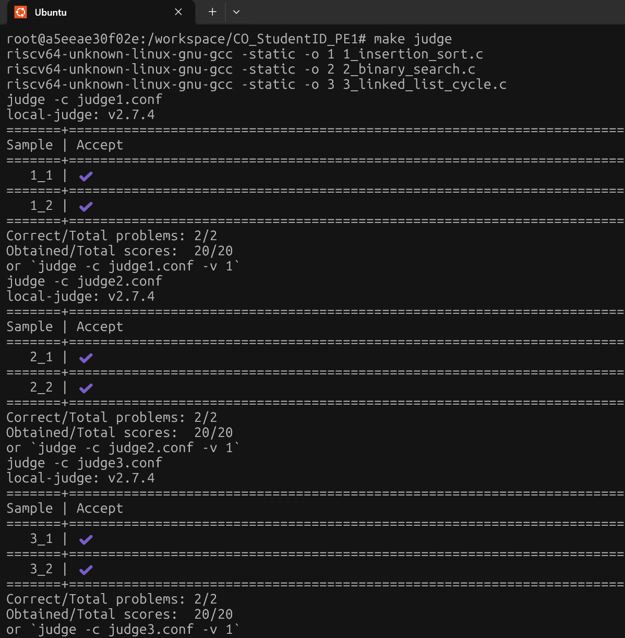
make judge
Test all exercises and all public testcases.

Slide 19
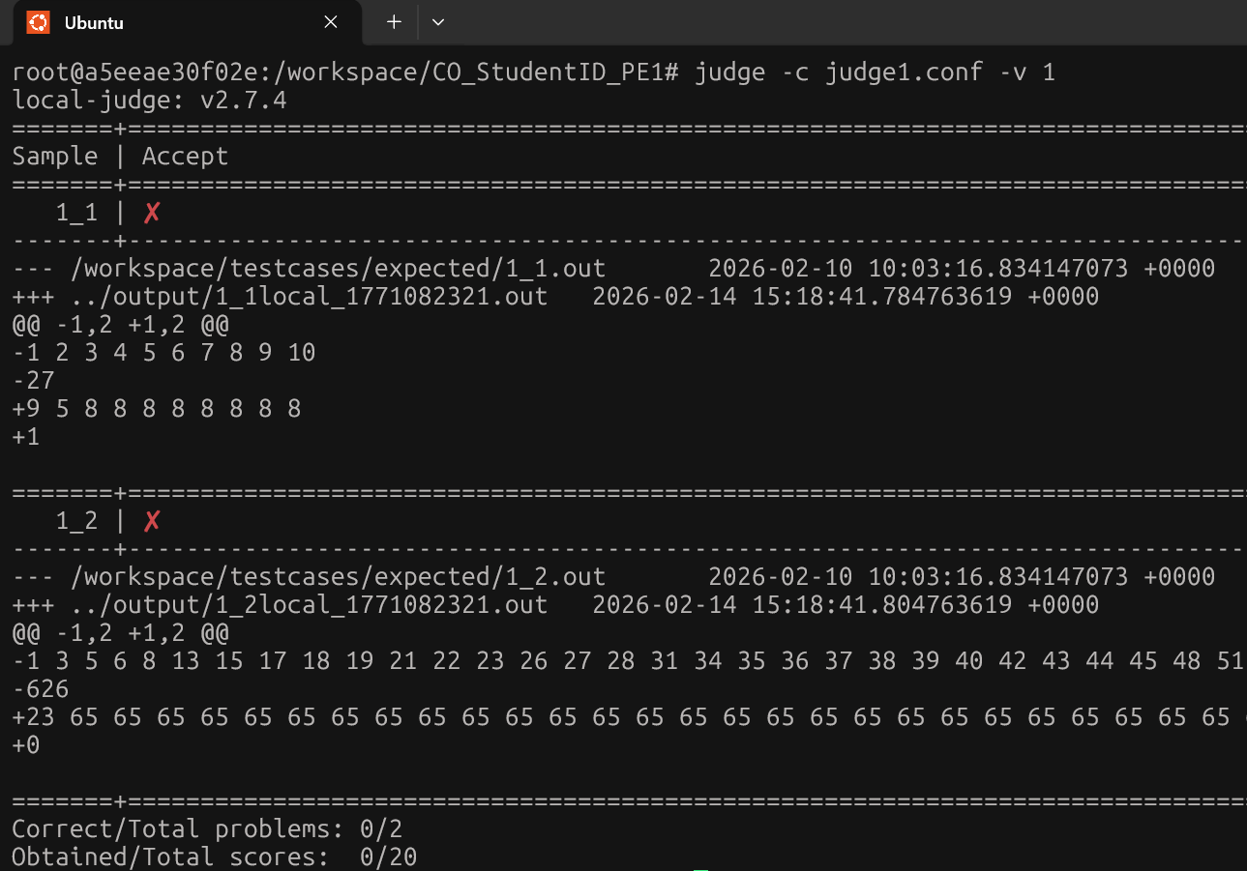
judge –c judge$i.conf –v 1
Test a specific problem.
Add -v 1 to the command if you need more information.

Slide 20
Scoring Criteria
Total score: 100 points
Problem 1: Insertion Sort, 30%
  2 public testcases (20%)
  2 hidden testcases (10%)
Problem 2: Binary Search, 30%
  2 public testcases (20%)
  2 hidden testcases (10%)
Problem 3: The Tortoise and the Hare, 40%
  2 public testcases (20%)
  4 hidden testcases (20%)

Slide 21
Important Notes
The computers in the exam environment will use Ubuntu. We will provide VSCode for students to use, the container will be pre-loaded, and no additional extensions will be installed.
During the computer-based exam:
  No entry is allowed 15 minutes after the Quiz1 and PA1 begins.
  The network need to be completely disconnected.
  You may only access the NCKU Moodle while uploading your submission.
  The use of USB/external devices, cheat sheets, paper notes, or any AI tools is strictly prohibited.
  Violations of the above rules will be regarded as cheating, and the exam score will be recorded as 0.
  There will be no hint provided during the exam.

Slide 22
Contact Information
Please email asrlab@mail.csie.ncku.edu.tw with any assessment issue or grading question before 12:00PM on March 24, 2026, email subject starts with [Comp2026].
Office Hours: Wednesdays 11:30–13:00, Room 65704, ASRLab.
3/19 09:00
3/24 12:00
3/26 & 3/27 09:00
4/23 23:59
Problem release
Email reply deadline
09:00 – 09:30 Quiz1 &
09:30 – 13:00 PA1
Post grades

