Slide 1
Computer Organization 2026
Quiz 2 & Programming Assessment II
Announce date: 2026.4.10
Assessment date: 2026.4.23 & 2026.4.24

Slide 2
Quiz2 Overview
Date: 4/23
Time: 09:00 - 09:30
Rooms: A1302, 65203, 65304
Regardless of whether your PA2 is on 4/23 or 4/24, all must attend Quiz2 on 4/23.
4/23 PA2 Students
4/24 PA2 Students
4/23
Quiz2
PA2
4/24

Slide 3
PA2 Overview
Day1: 4/23 09:30 - 13:00
Day2: 4/24 17:30 - 21:00
Rooms: 65203, 65304
In this assignment, you will implement the core computational kernels of a mel spectrogram program in C, targeting the RISC-V architecture. You are expected to use RISC-V Vector (RVV) intrinsics to optimize performance.

Slide 4
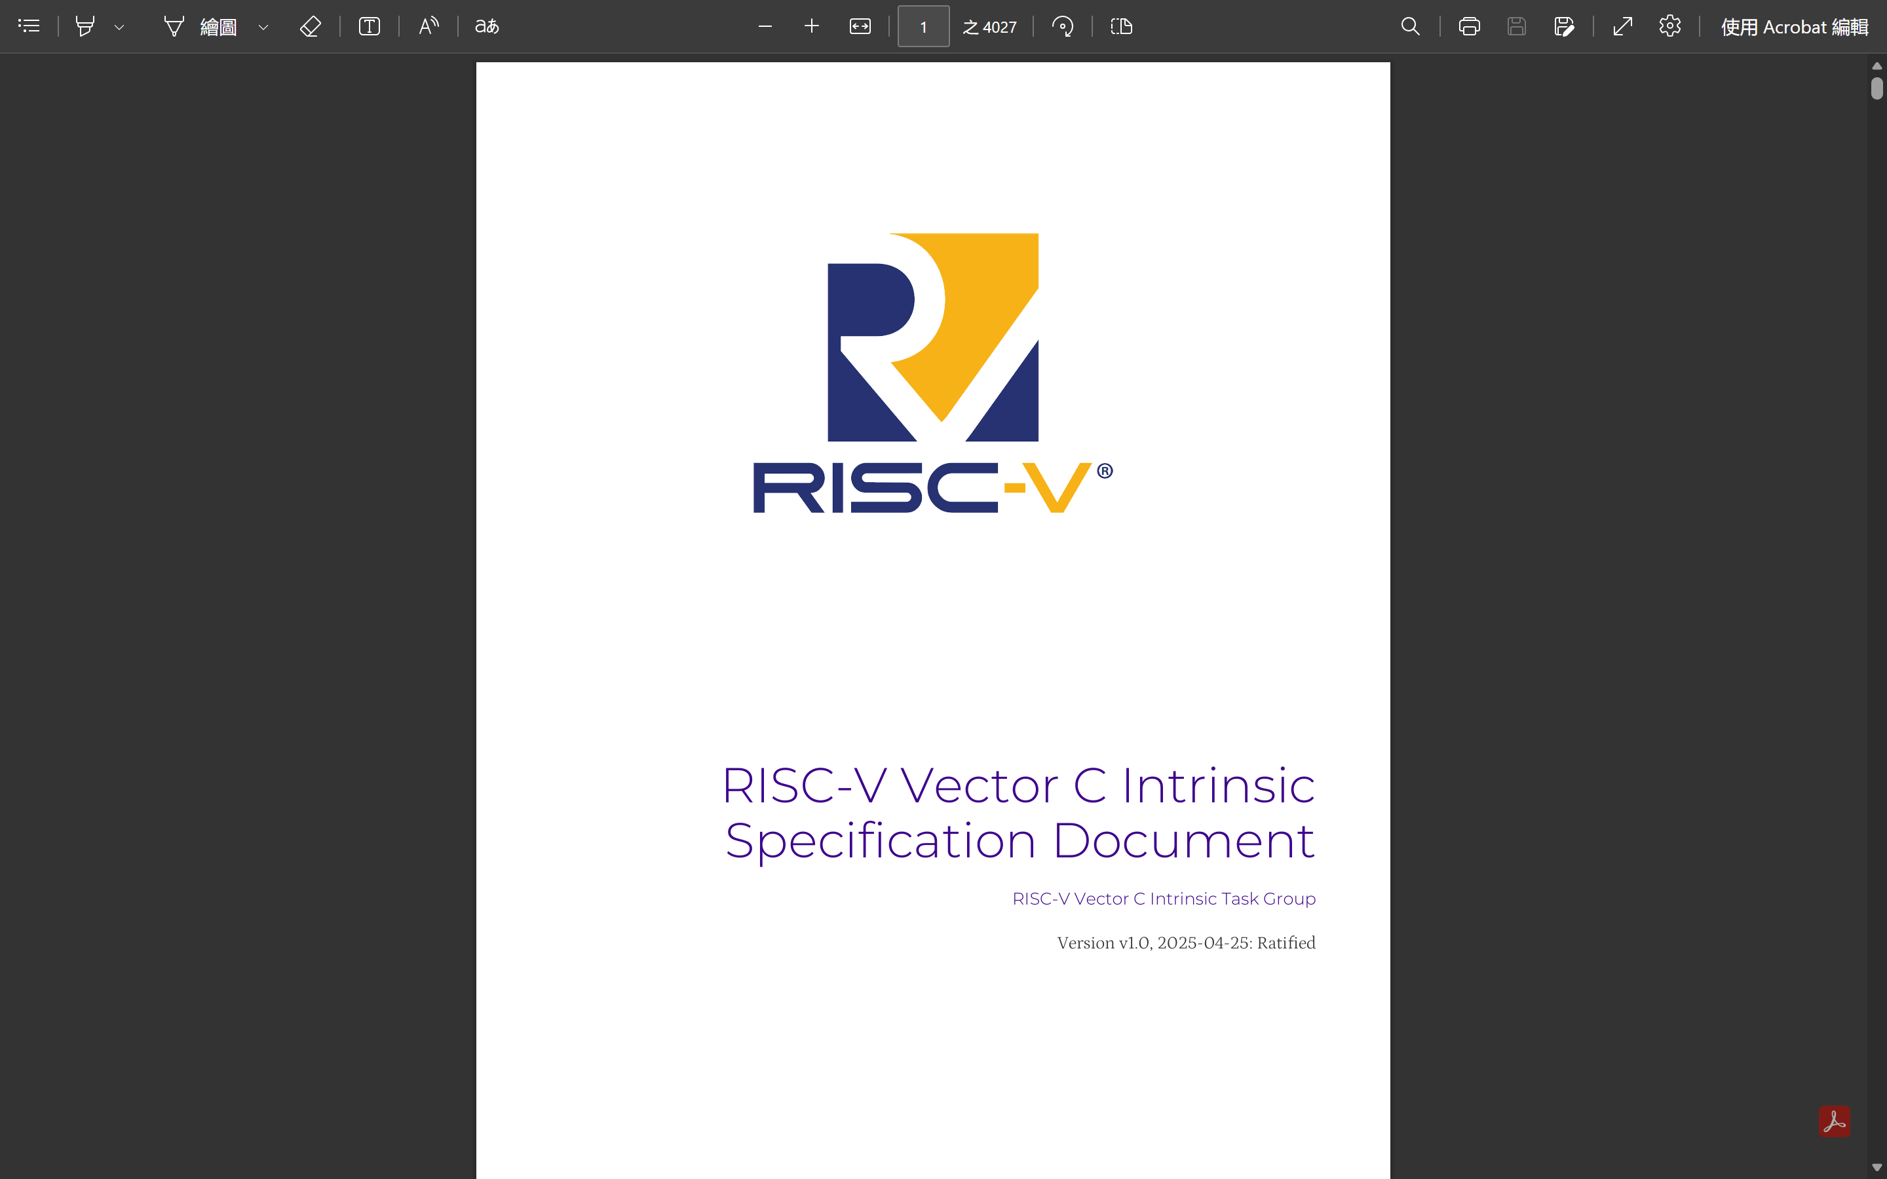

Slide 5
Prerequisite
You have to follow the procedures listed in the Environment Setup section in document to set up your environment.
We will use Docker for 4/23 & 4/24 programming assessment. Make sure you're familiar with basic Docker operations.

Slide 6
Assessment – Mel Spectrogram
You will implement exactly three functions in the src/main.c, which are briefly introduced below.
fft: Compute the discrete Fourier transform of a complex signal in-place. Any correct algorithm is accepted.
power_spectrum: Compute the power at each frequency bin from the processed stft data.
mel_filter_bank: Apply the mel filter bank to the power spectrum.

Slide 7
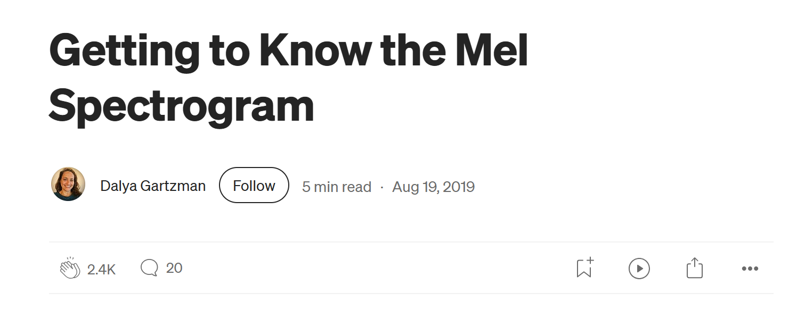
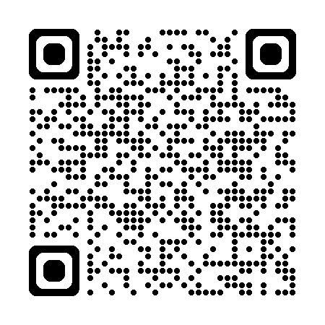
https://medium.com/data-science/getting-to-know-the-mel-spectrogram-31bca3e2d9d0

Slide 8


Slide 9
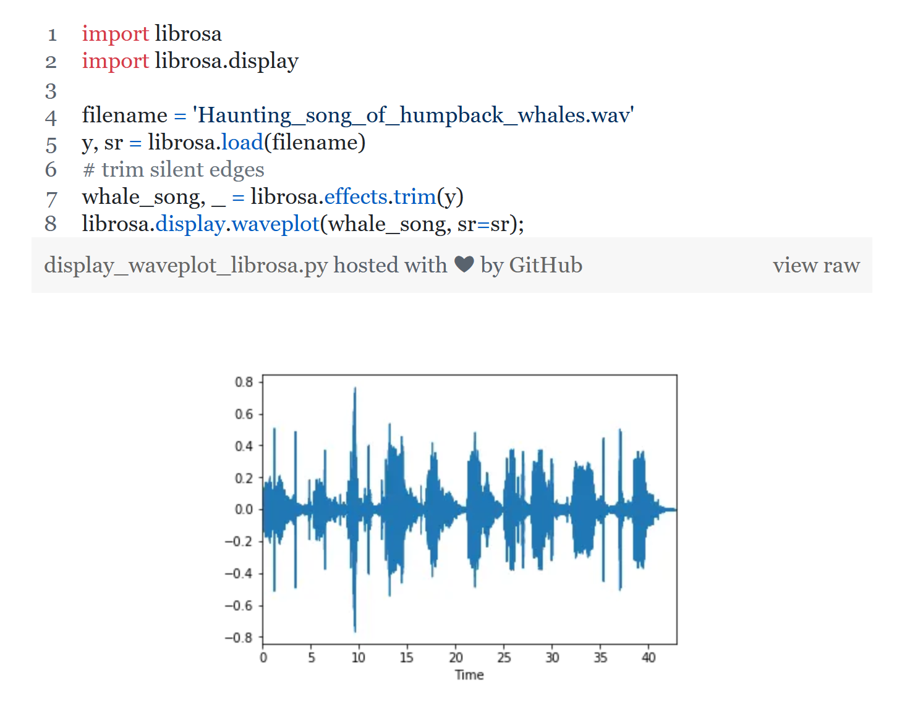

Slide 10
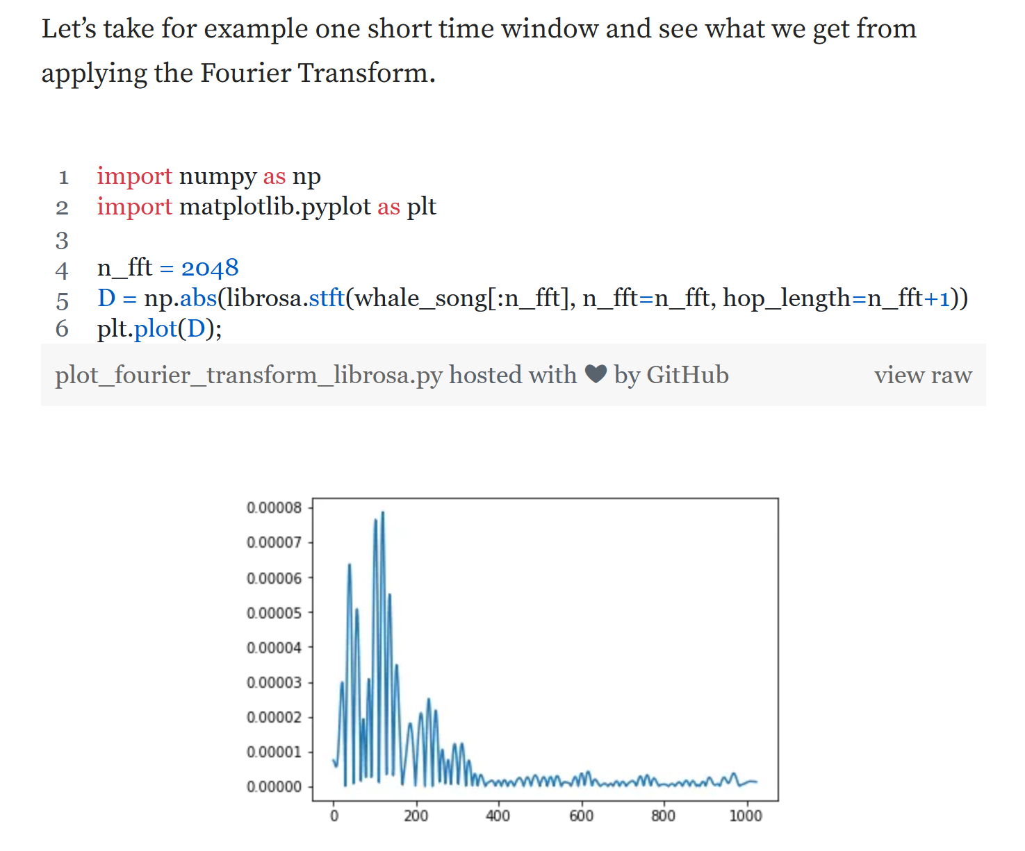

Slide 11
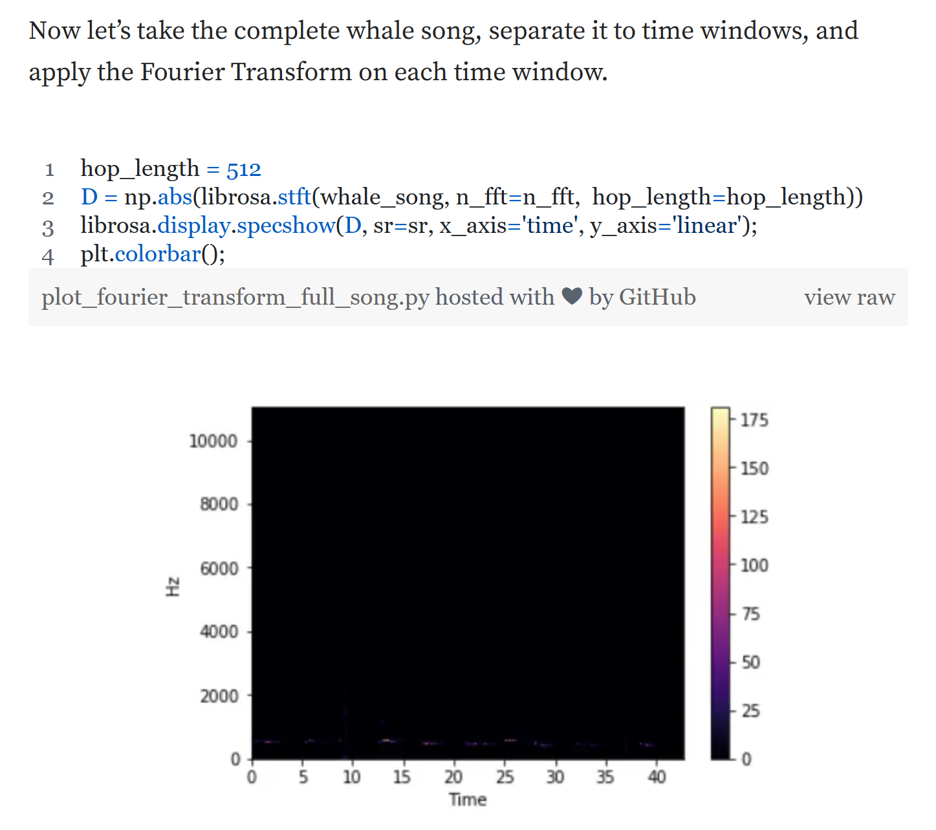

Slide 12
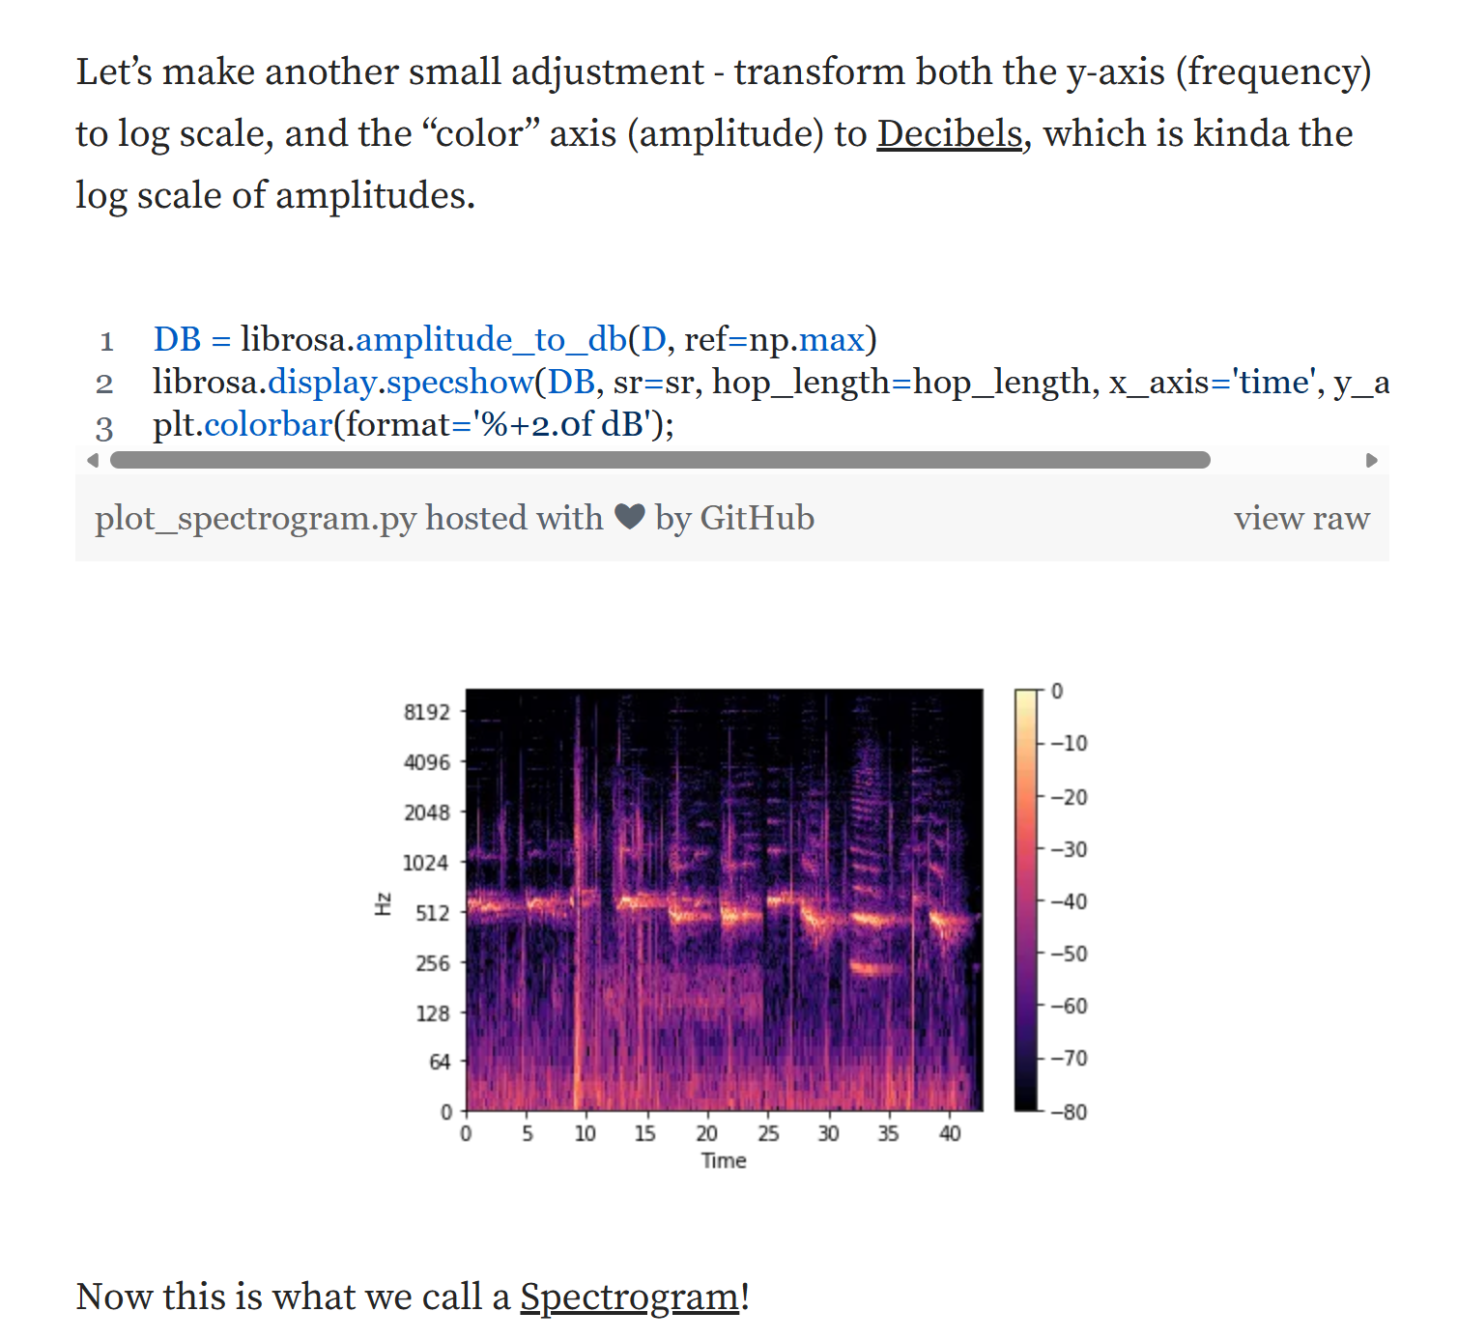

Slide 13
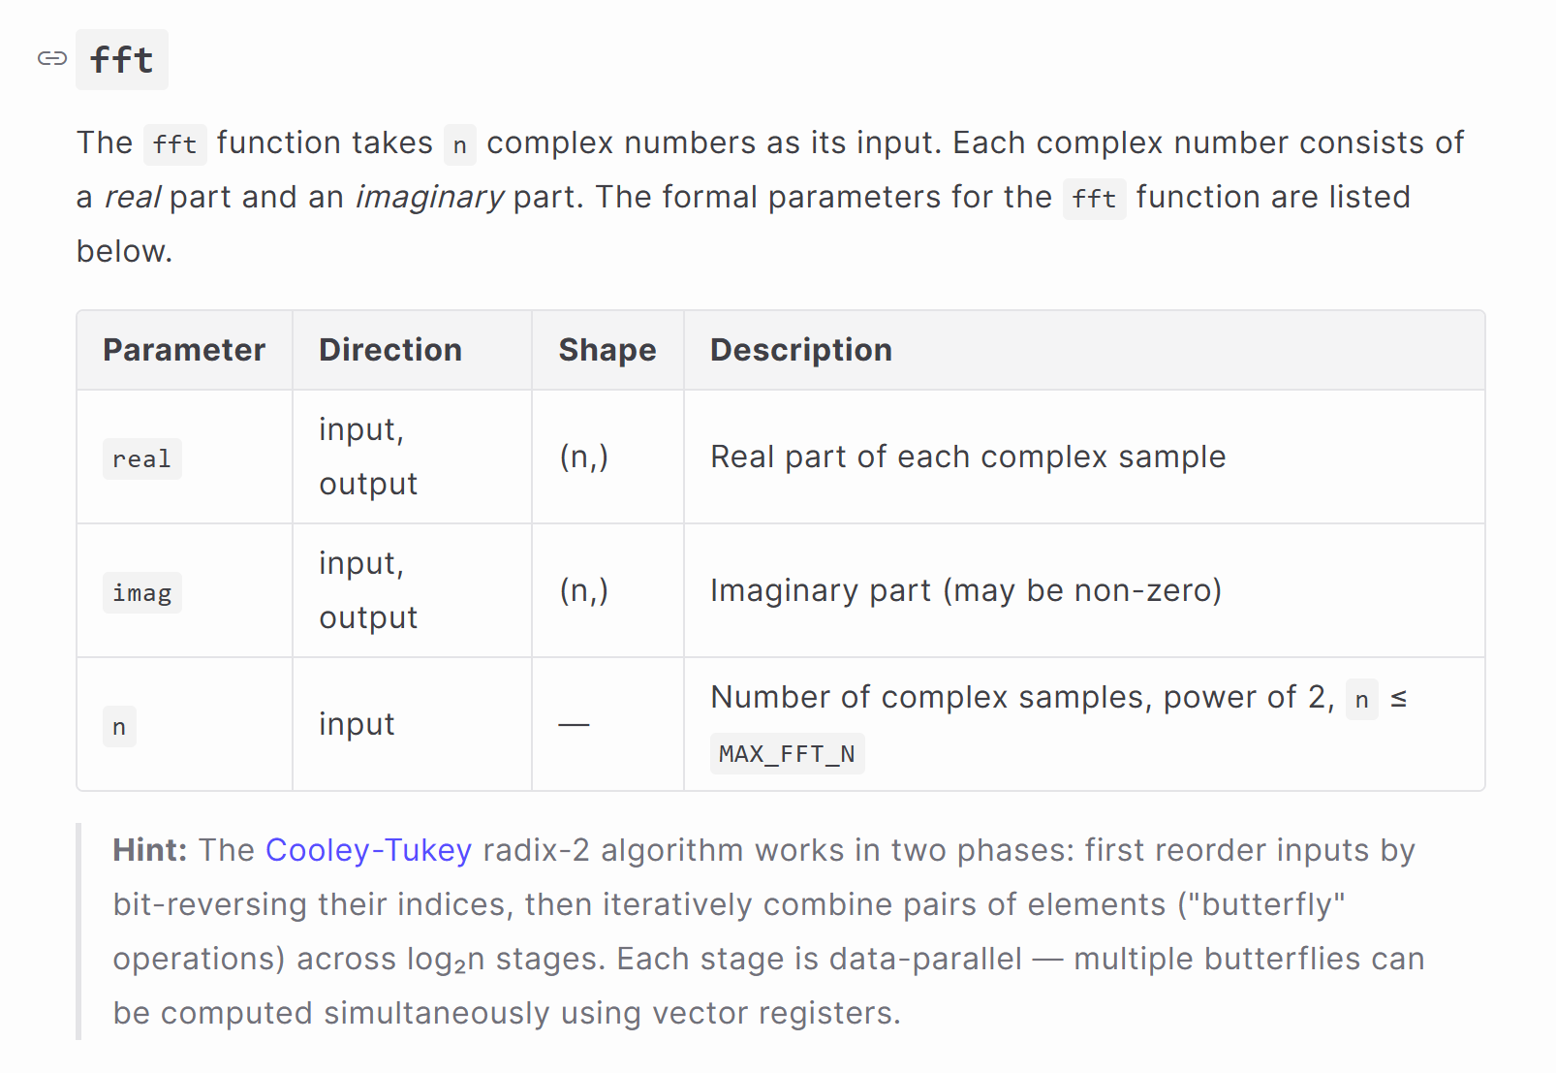

Slide 14
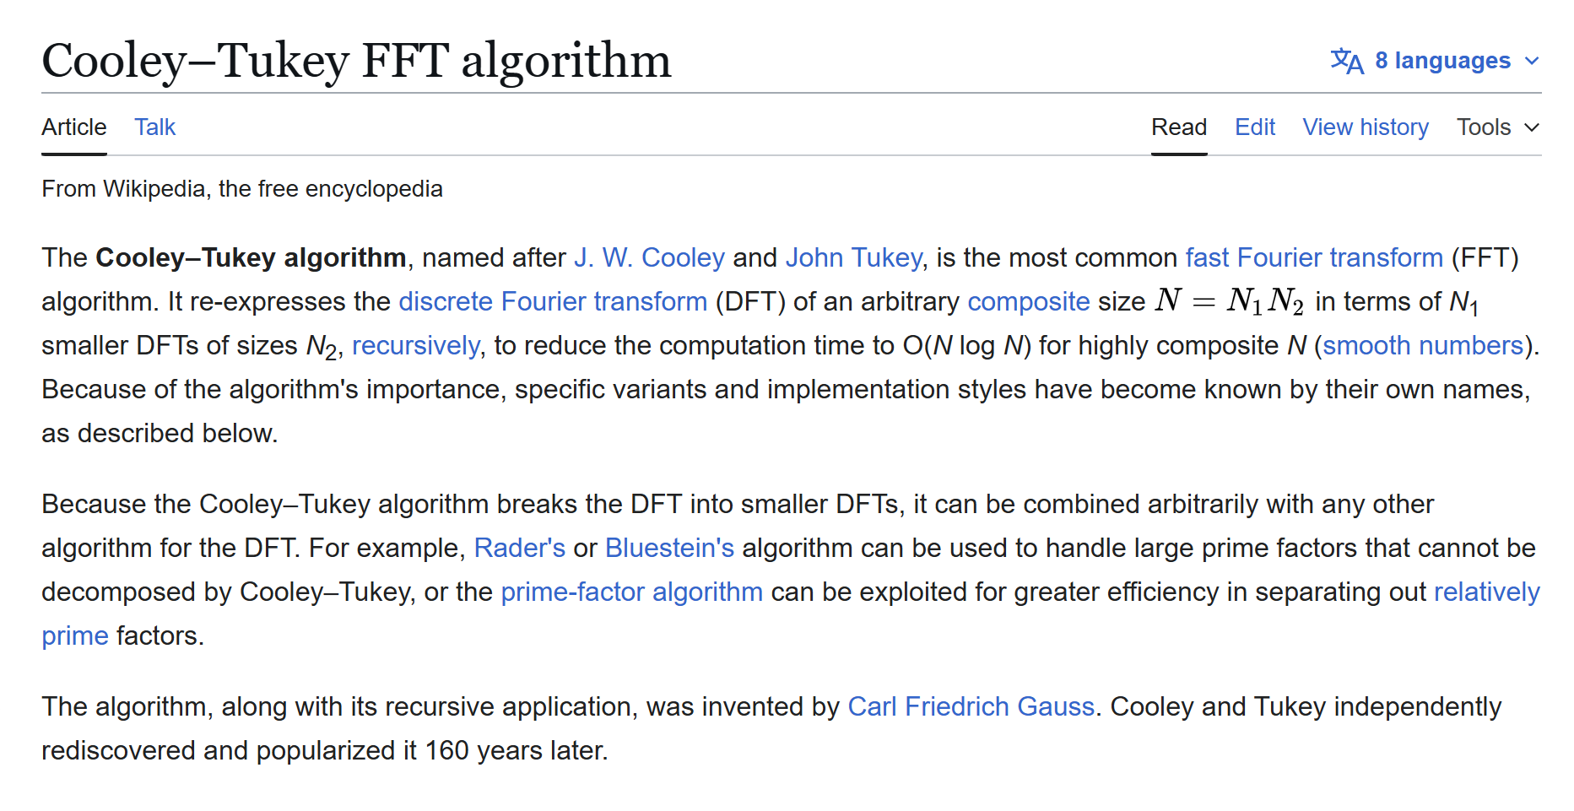

Slide 15
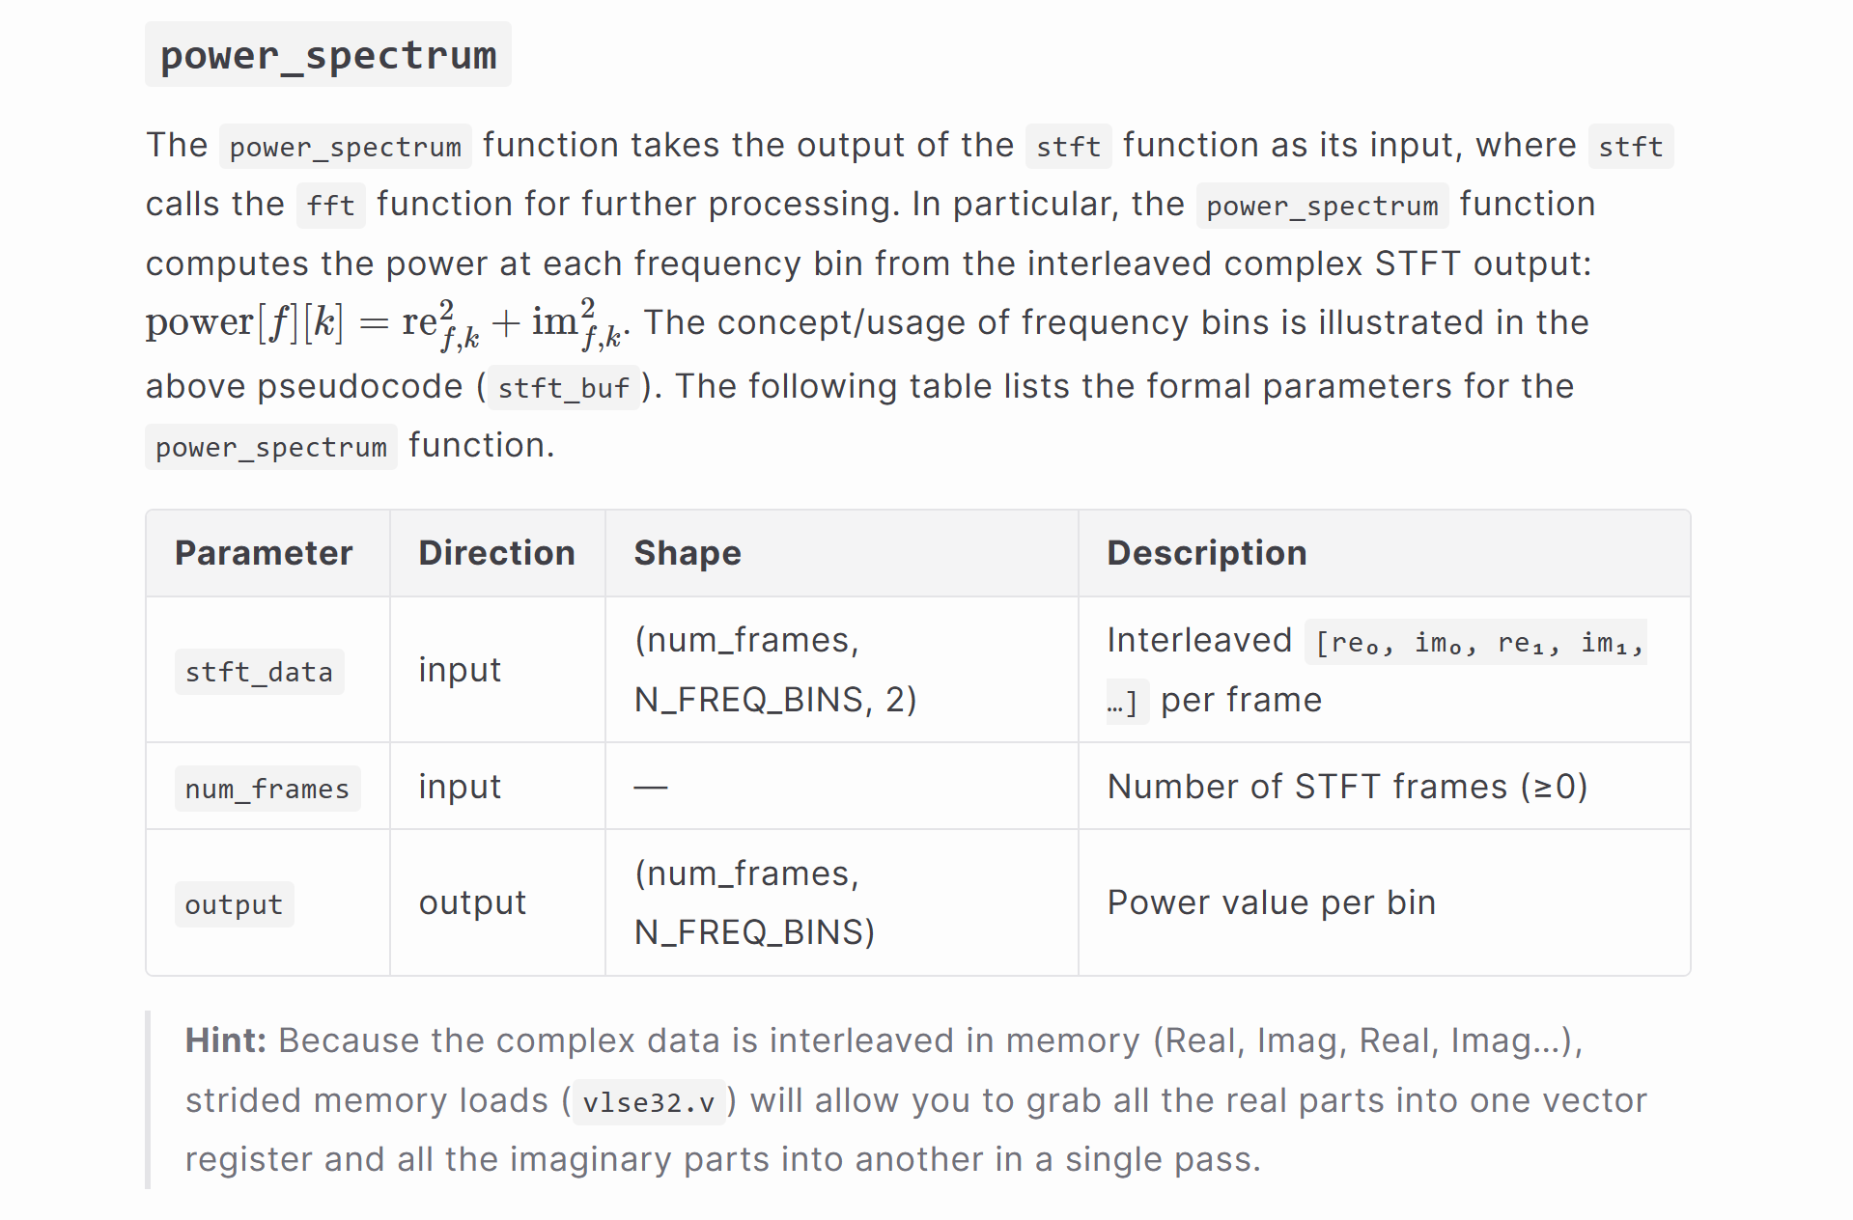

Slide 16
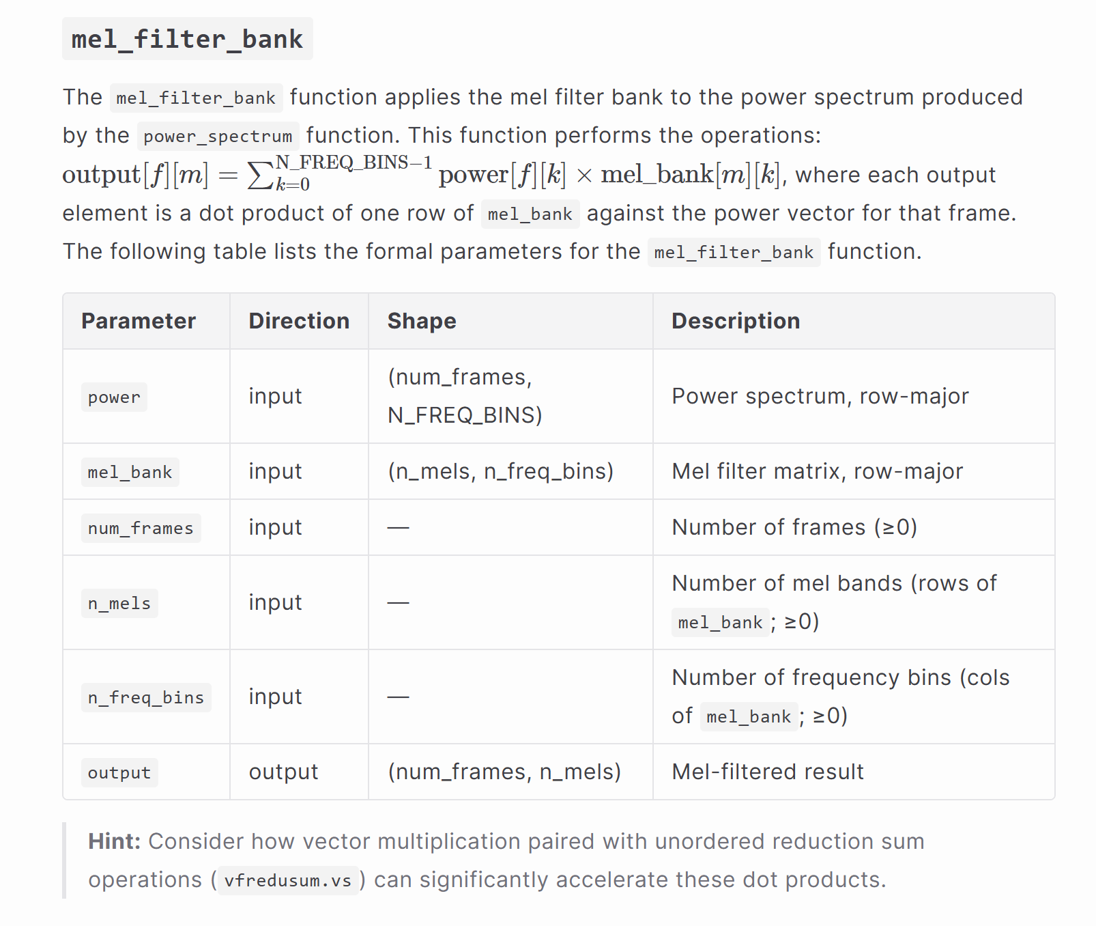

Slide 17
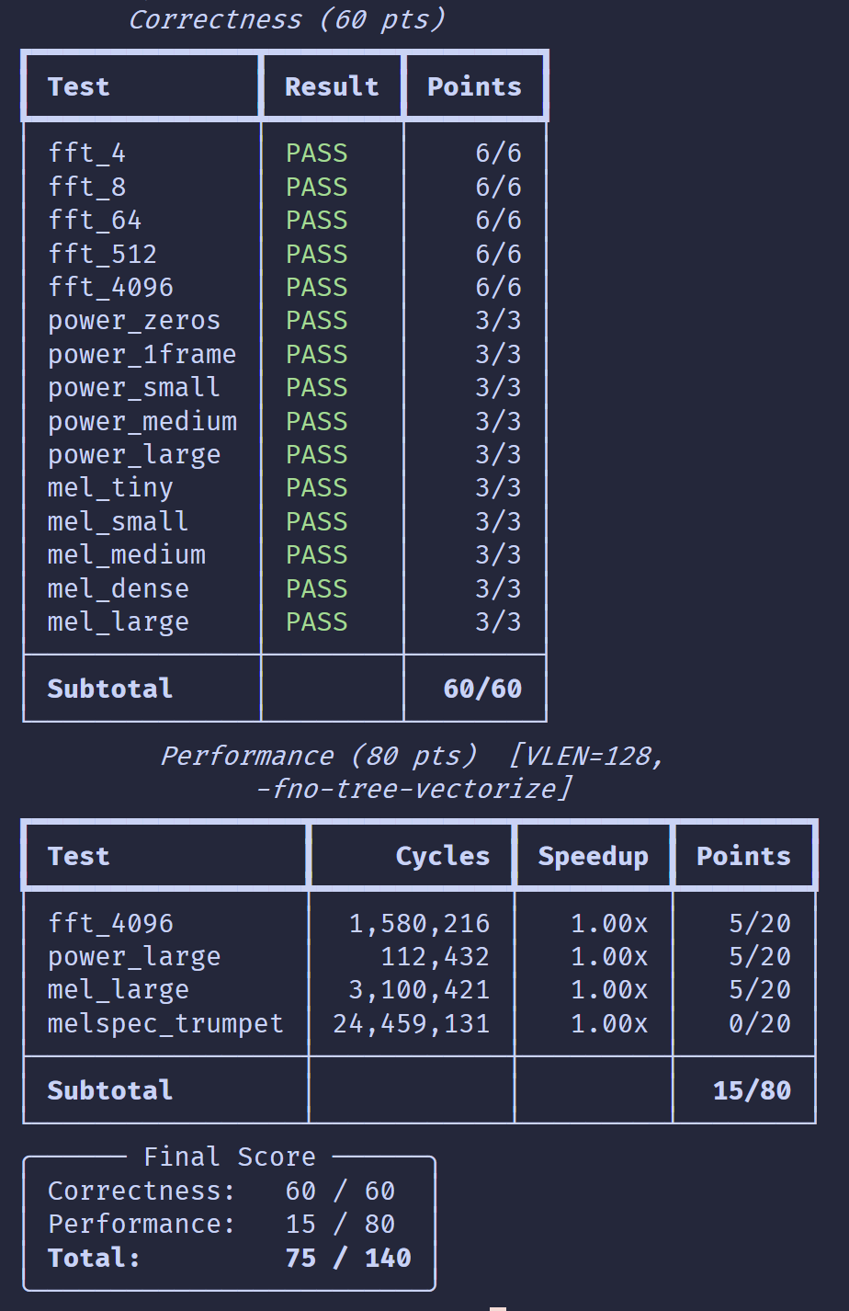
Scoring
Run make judge to test your program, and get the total score.
PA2 has a total of 140 points, 60 points for correctness and 80 points for performance.
Performance points are awarded only if the corresponding correctness test passes.

Slide 18
Important Notes
The computers in the exam environment will use Ubuntu. We will provide VSCode for students to use, the container will be pre-loaded, and no additional extensions will be installed.
During the computer-based exam:
  No entry is allowed 15 minutes after the Quiz2 and PA2 begins.
  The network need to be completely disconnected.
  You may only access the NCKU Moodle while uploading your submission.
  The use of USB/external devices, cheat sheets, paper notes, or any AI tools is strictly prohibited.
  Violations of the above rules will be regarded as cheating, and the exam score will be recorded as 0.
  There will be no hint provided during the exam.

Slide 19
Submission Rules
Uploading an unexpected filename that causes the judge to be unable to score it automatically will result in a loss of 10 points.
Unexpected file content that prevents the judge from continuing will result in 0 points.
Compiling or linking errors that prevent the judge from continuing will result in 0 points.

Slide 20
Contact Information
Please email asrlab@mail.csie.ncku.edu.tw with any assessment issue or grading question before 12:00PM on April 21, 2026, email subject starts with [Comp2026].
Office Hours: Wednesdays 11:30–13:00, Room 65704, ASRLab.
4/10 09:00
4/21 12:00
4/23 09:00 & 4/24 17:00
4/27 12:00
Problem release
Email reply deadline
09:00 – 09:30 Quiz1 &
09:30 – 13:00 PA1
Post grades

