Slide 1
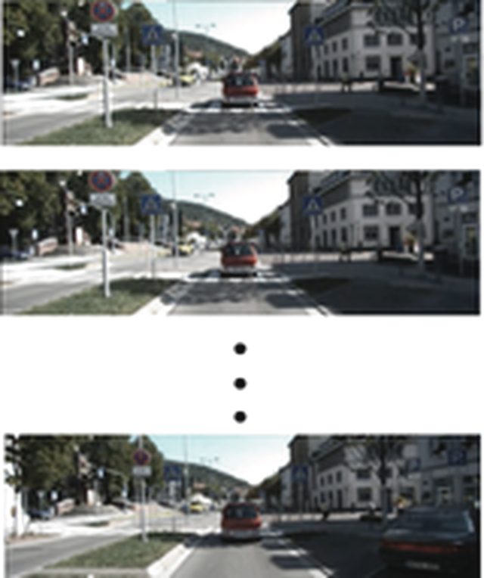

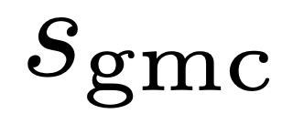
Raw Video Frames
Yes
Matched
iKUN Model
+
final_score > 0 ?
Mismatched
Object Tracklets
(bbox + track ID)
No
Motion
Projector
256D Motion Vector
Shared
Weight
MLP
256D Motion Vector
Object Bbox
12D Motion Vector
Cosine
Similarity
384D Embeddings
Language
Projector
256D Language Vector
256D Language Vector
Expressions
(e.g. Cars Moving)
Text
Encoder
GMC module

