Slide 1
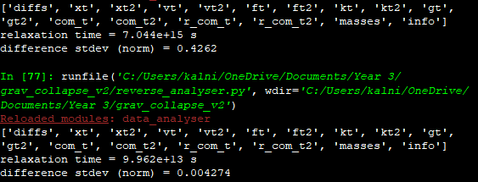
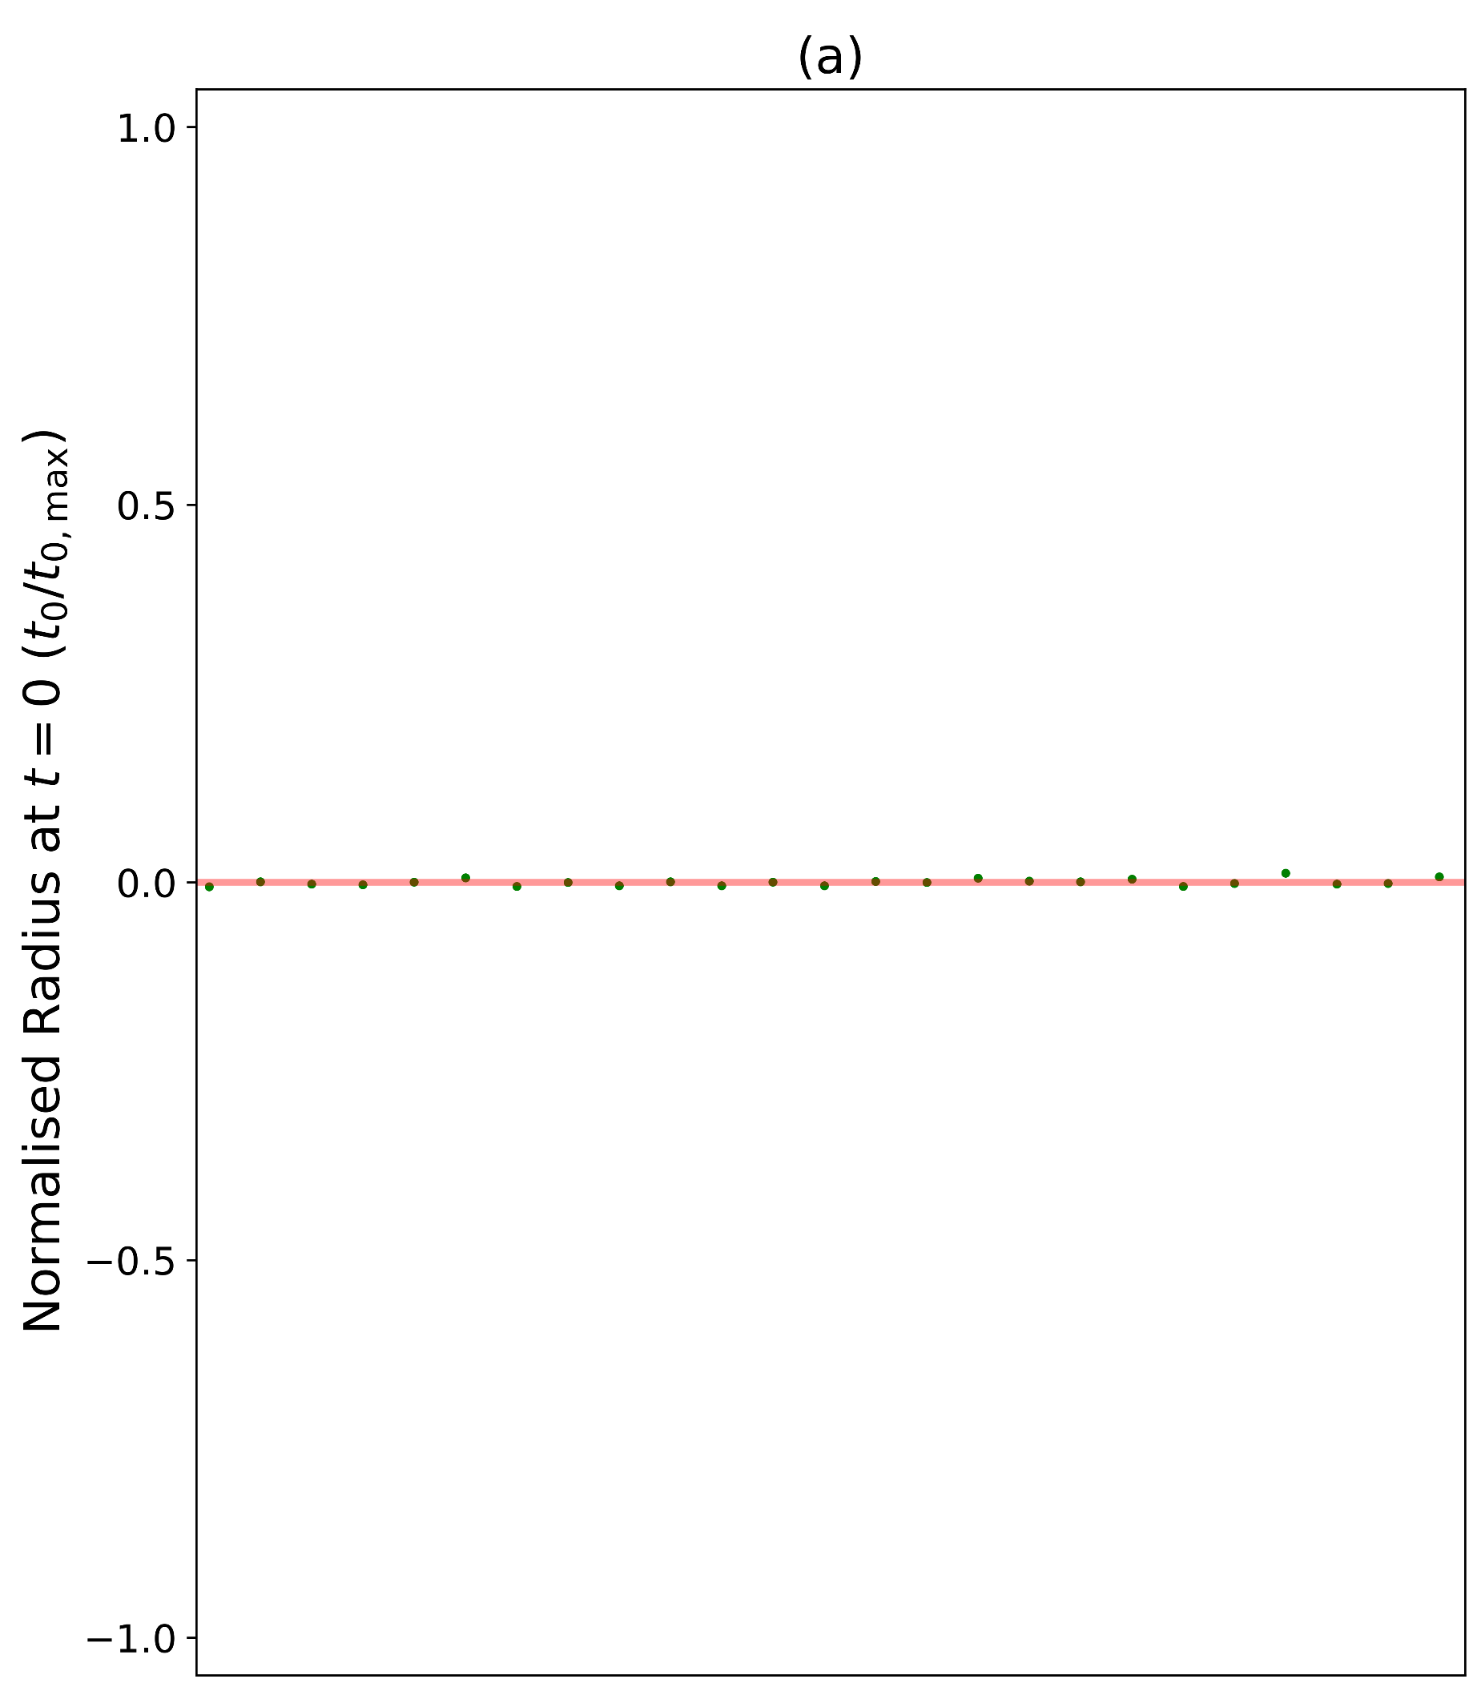
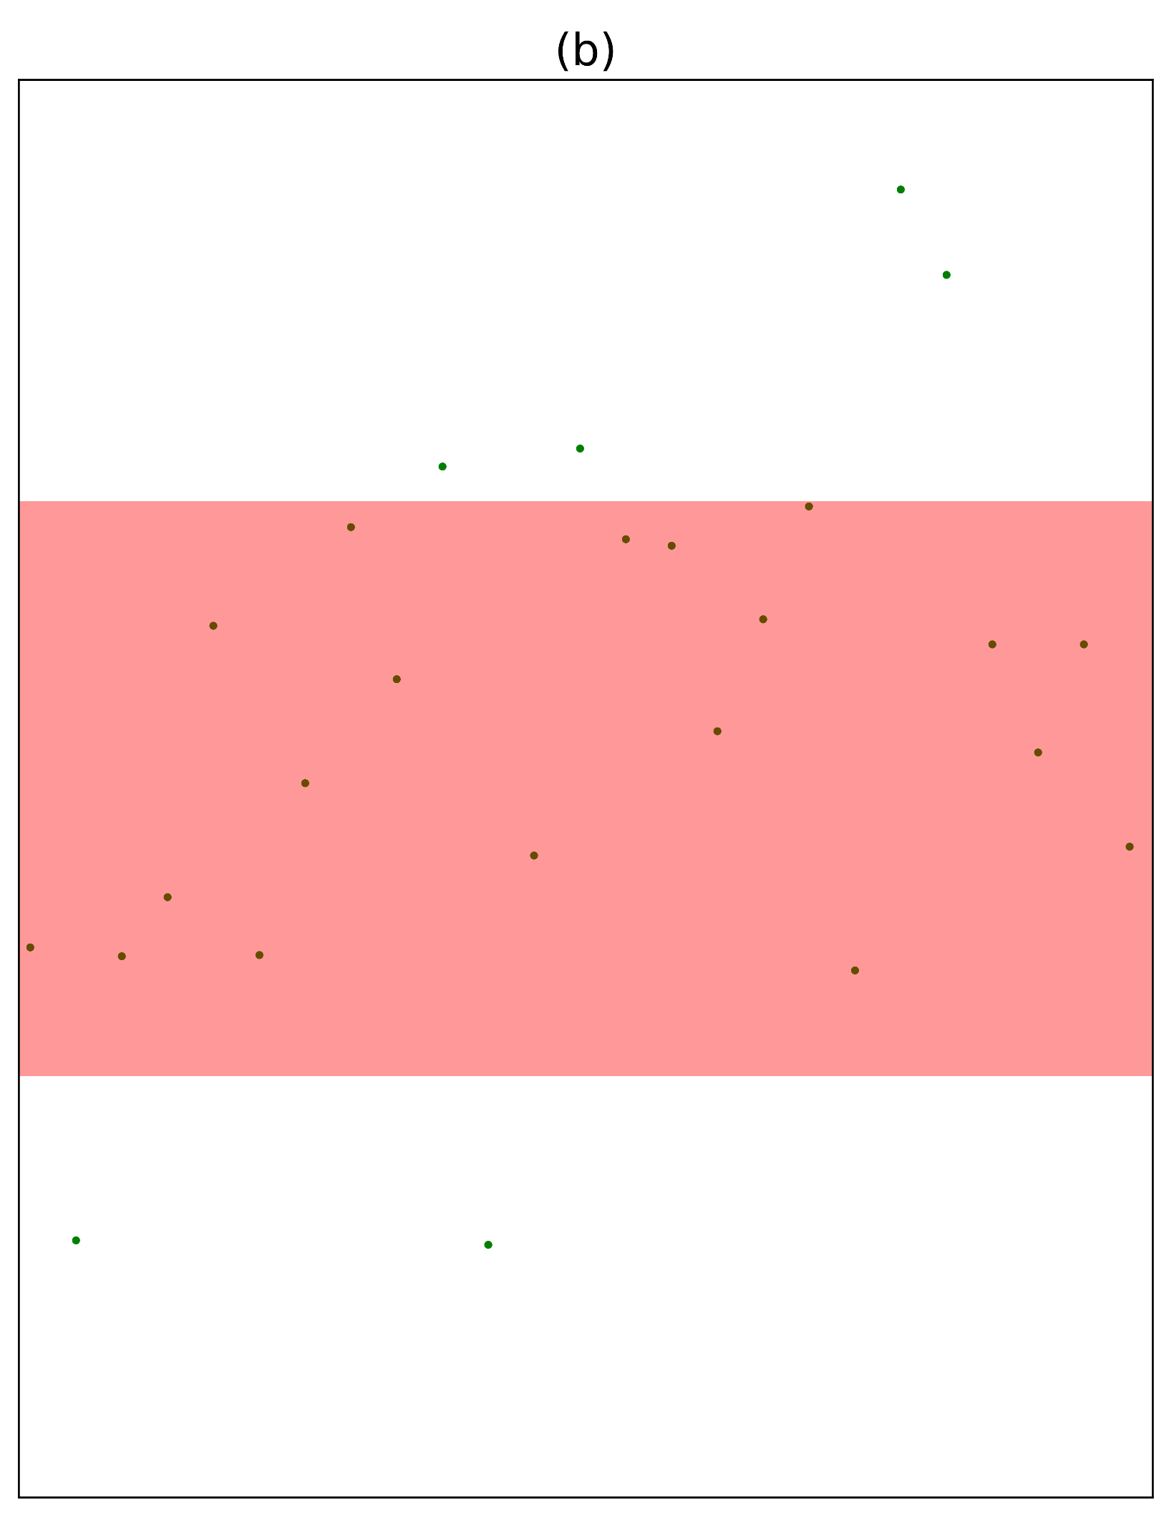
2020-03-05_16.26_rev_100p_100000s_1.0e+11dt
2020-03-08_13.46_rev_100p_10000s_5.0e+09dt

