Slide 1

GitHub for Research (Data)
Research Data Management Seminars at the University of Mannheim

Slide 2
Agenda
Introduction
Demo: Repository „ReproResearch“
Conclusions

Slide 3
Why „GitHub for research (data)“?
Managing your research (data) and automating your research
Ensuring transparency and reproducibility of your research
Empowering collaboration across countries and disciplines

Slide 4
Research data
What is Data?
Data are objects that you use and produce during your research life cycle, encompassing datasets, software, code, workflow, models, figures, tables, images and videos, interviews, articles. Data are your research asset.
Data is not only a dataset
Data is everything what makes your research (research articles) reproducible and replicable
"The Turing Way: A handbook for reproducible, ethical and collaborative research" https://the-turing-way.netlify.app/reproducible-research/rdm/rdm-data.html

Slide 5
Research and data in research
Two-step research:
1. Conducting research
2. Publishing or perishing
Data collection, creation or reuse (dataset)
Data processing and analysis (software, models, algorithms, methods, protocols, etc.)
Publishing an article in a top-tier journal
Perishing without any research outputs
Research data and code policies of a journal => Data and code availability statements
<=> Replication package
Research is not reproducible and not replicable
<=> No replication package

Slide 6
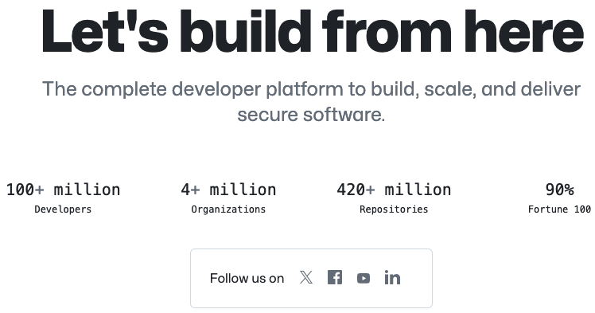
GitHub
A version control and
collaboration platform
Git-based version control
Pull requests and issue tracking
GitHub Actions for automated workflows
GitHub Pages for static website hosting
Wiki for repositories
Project management tools

Slide 7
The main concepts at GitHub
Repository (Repo): A folder where your project lives. It can be public or private.
Branch: A parallel version of a repository.
Commit: An individual change to a file or files.
Pull request: A method of submitting contributions to a project.
Merge: The process of taking the changes from one branch and integrating them into another.
Fork: A copy of a repository that you manage on your account.
Issue: A way to track of tasks, enhancements, and bugs for your projects.
Clone: A copy of a repository that lives on your computer, and the act of making that copy.

Slide 8
Agenda
Introduction
Demo: Repository „ReproResearch“
Conclusions

Slide 9
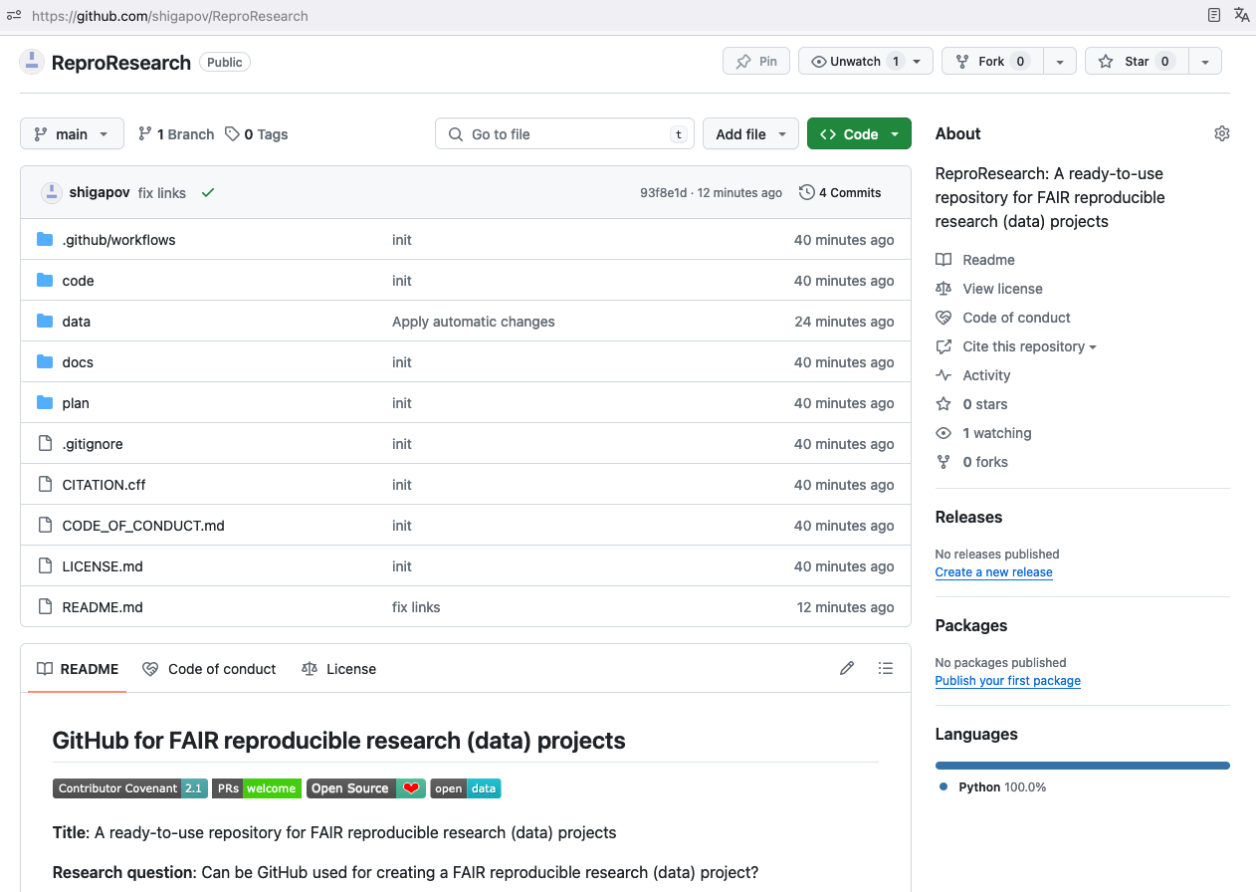
A ready-to-use repo for your research project
https://github.com/shigapov/ReproResearch
ReproResearch
A ready-to-use or -fork or -clone
A template for creating a replication package
GitHub Actions for automated reproducible analysis
GitHub Pages for static website hosting
Wiki for repositories
Project management board

Slide 10
Agenda
Introduction
Demo: Repository „ReproResearch“
Conclusions

Slide 11
What we have:
A ready-to-use GitHub repository structured according to the best practices in research data management: https://github.com/shigapov/ReproResearch
An automatic workflow using GitHub Actions for processing raw data, saving it, and making commit and push: https://github.com/shigapov/ReproResearch/tree/main/.github/workflows
A project website using the Minimal Jekyll theme with GitHub Pages deployed via GitHub Actions: https://shigapov.github.io/ReproResearch
A project wiki using GitHub Wiki (it needs seperate cloning): https://github.com/shigapov/ReproResearch/wiki
An open Kanban board for project management: https://github.com/users/shigapov/projects/1

Slide 12
Getting started with your research project at GitHub
You can use the ReproResearch repository as a template for your research project repository
Make your changes locally
Create your new repo at GitHub
Follow the instructions at the creation page.
Commit and push your local repo to your new repo at GitHub.

