Slide 1
CSC 59927 Big Data Management and Analysis: Final Project Proposal
James Kasakyan

Slide 2

Motivation
Year | Total motor vehicle accidents | Fatalities
2011 | 73,060 | 268
2012 | 68,804 | 271
2013 | 70,403 | 294
The fundamental message of Vision Zero is that death and injury on city streets is not acceptable, and that we will no longer regard serious crashes as inevitable
- Mayor Bill de Blasio

Slide 3
Project Objectives
Identify hazardous accident prone areas throughout the five boroughs
Number of accidents
Fatalities
Injuries
Number of vehicles involved
Adjusted for traffic volume
Profile
Types of traffic
Speed
Street/Traffic complaints

Slide 4
Data Sources
Name | Years | Provider
NYPD Motor Vehicle Collisions | 2012-2013 | NYC OpenData
Traffic Volume Counts | 2012-2013 | NYC OpenData
Vehicle Classification Counts | 2012-2013 | NYC OpenData
Real-time Traffic Speed | Unknown-Present | NYU CUSP
311 Service Requests | 2010-Present | NYC OpenData

Slide 5
Methodology
Data Mining Technique – Classification
Supported by Spark
Develop classification algorithm to identify hazardous areas
Descriptive analytics
Profile of hazardous areas
Common 311 complaints related to street conditions
Common types of traffic
Avg speed vs. city average

Slide 6
Big Data Challenges
Majority of challenges come from stage 2- Data Preparation
Data Conditioning
159 fields and over 10,000,000 rows spanning 5 datasets
Extensive normalization
Data cleaning

Slide 7
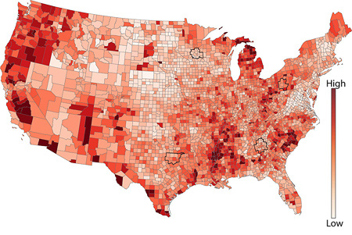
Project Deliverables
Visualization: 2D Choropleth map
Partitioned by ZIP

Slide 8
