Slide 1
CSC 59927 Big Data Management and Analysis: Final Project
James Kasakyan

Slide 2
Refresher
Classify areas around the five boroughs as “safe”, “ok”, or “hazardous”
Final datasets used
Original plan
Name | Years | Provider
NYPD Motor Vehicle Collisions | 2012-2013 | NYC OpenData
Traffic Volume Counts | 2012-2013 | NYC OpenData
311 Service Requests | 2010-Present | NYC OpenData
Name | Years | Provider
NYPD Motor Vehicle Collisions | 2012-2013 | NYC OpenData
Traffic Volume Counts | 2012-2013 | NYC OpenData
Vehicle Classification Counts | 2012-2013 | NYC OpenData
Real-time Traffic Speed | Unknown-Present | NYU CUSP
311 Service Requests | 2010-Present | NYC OpenData

Slide 3
Project Objectives
Identify hazardous accident prone areas throughout the five boroughs
Number of accidents
Fatalities
Injuries
Number of vehicles involved
Adjusted for traffic volume
Profile
Types of traffic
Speed
Street/Traffic complaints

Slide 4
Methodology
Data Mining Technique – Spark MLlib Classification Tree
Develop classification algorithm to identify hazardous areas
Descriptive analytics
Profile of hazardous areas
Common 311 complaints related to street conditions
Common types of traffic
Avg speed vs. city average

Slide 5
Changes to Methodology
Created own classification algorithm
Assume normal distribution
Classification based on standard deviations in feature categories
Accidents per 1000 vehicles
Injuries per 1000 accidents
Deaths per 1000 accidents
Vehicles involved per accident

Slide 6
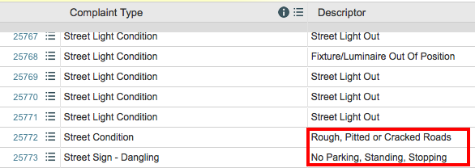
Big Data Challenges
Majority of challenges came from stage 2- Data Preparation
CSV is apparently a difficult concept to grasp

Slide 7
Big Data Challenges
311 dataset
86 complaint descriptor types for street related complaints (pothole, traffic signal light, etc)
NYPD Motor Vehicle accident dataset
47 unique accident factors (unsafe speed, fell asleep)
17 unique vehicle type classifiers (bus, bicycle)

Slide 8
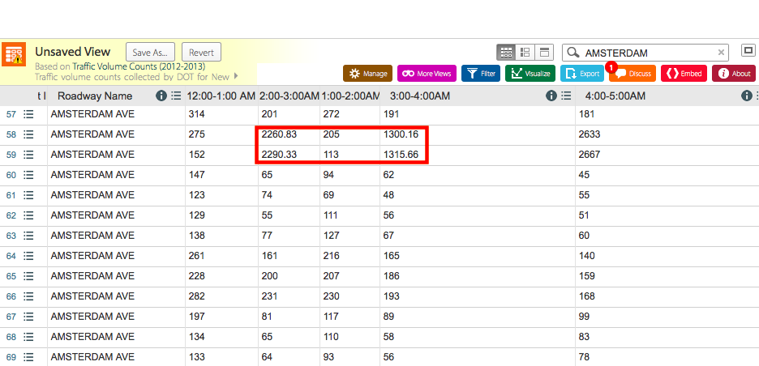
Big Data Challenges

Slide 9
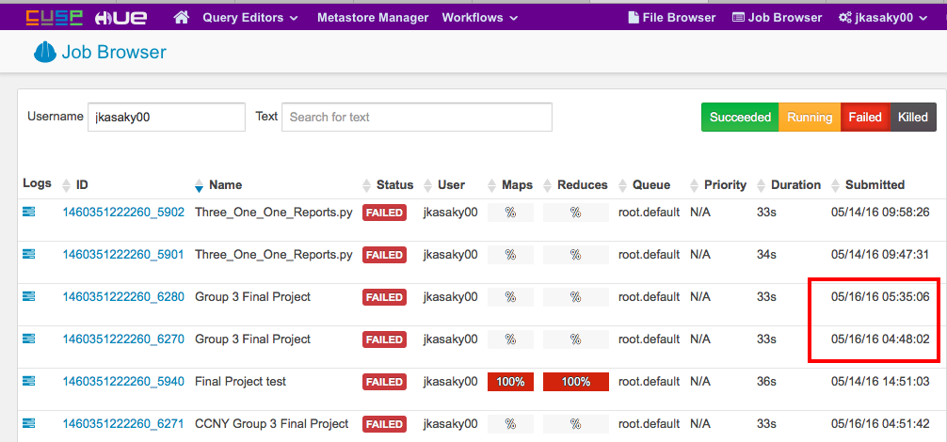
:’(

Slide 10
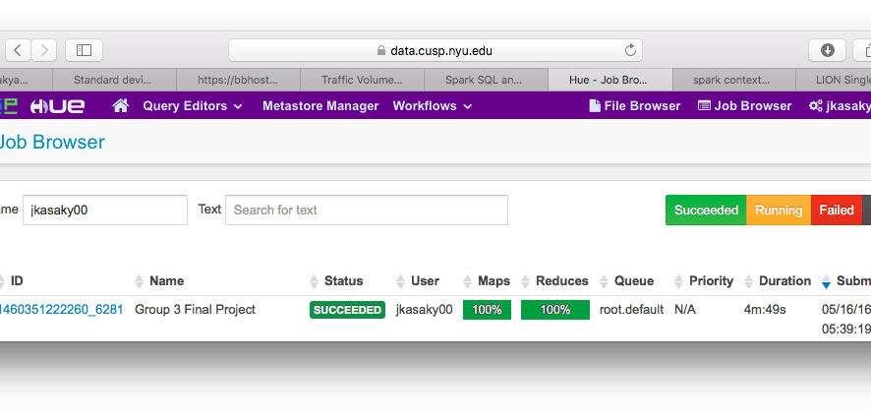
☺

Slide 11
Walkthrough
NYPD Motor Vehicle Accident dataset
Goal was zip code as key, with aggregations like total number of accidents, top accident factors, etc.
Standard map/reduce/aggregate
Top n on factors and vehicle types
47 unique accident factors (unsafe speed, fell asleep)
17 unique vehicle type classifiers (bus, bicycle

Slide 12
Walkthrough
311 Calls dataset
Messy non-standard CSV
Same as accident data, key = zip code with aggregations like total street related complaints, most common complaints
86 complaint descriptor types for street related complaints (pothole, traffic signal light, etc.)

Slide 13
Walkthrough
Traffic Volume dataset
Problem: No zip code field
Roadway name, To, From are only indicators of location
Segment ID which corresponds to shape data
Bytes of Big Apple ArcGIS geodatabase
.lyr files
Alternative: geopy geocoding package

Slide 14
Walkthrough
location = geolocator.geocode("175 5th Avenue NYC”)
location object has zip_code
Downsides: far less accurate than spatial join with shape file
Roadway name, To, and From don’t give a standard address like the example above
Roadway name: Ave U
From: W 10th ST
To: W 11th ST

Slide 15
Walkthrough
Solution
Test all three fields
All equal zip: assign volume count and samples to this zip
Two equal: assign two third volume count and samples to agreeing zips, one third to other
All three differ: assign one third count to each
Hindsight: skip these records
New Problem
Queries Nominatim database over HTTP

Slide 16
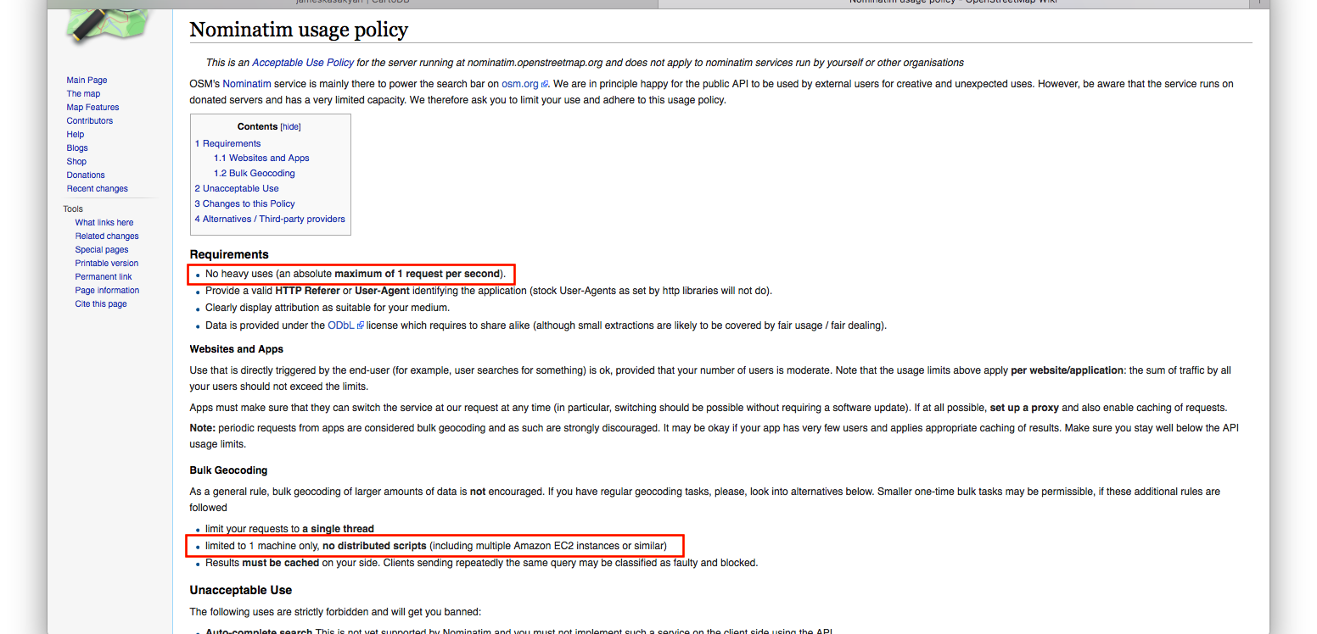
Walkthrough

Slide 17
Walkthrough
Solution:
Gather results locally and save as CSV
New Problem:
429 too many requests
Solution:
Wait one hour and try again

Slide 18
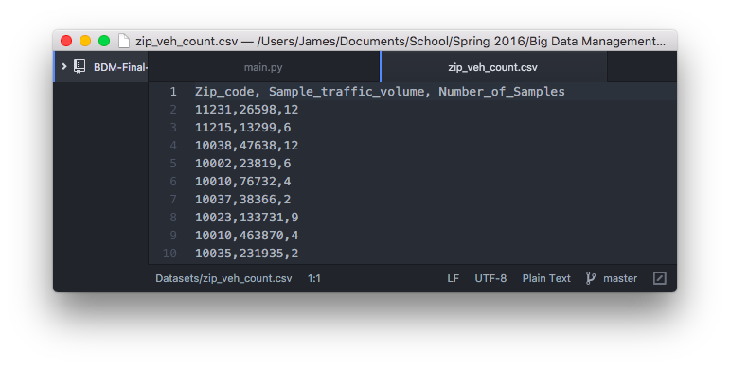
Walkthrough

Slide 19
Final Stretch
Each dataset has a script to return its result RDD
Main.py gets all RDD’s and joins them on zip as key
Normalize data
days_in_2012_2013 = 731 # 2012 was a leap year
vehicle_count_2012_2013 = vehicle_count / samples * days_in_2012_2013
Classification and aggregations

Slide 20
 | Mean | Standard deviation
Accidents /1000 vehicles | .1597 | .1457
Deaths / 1000 accidents | 1.3897 | 1.3042
Injuries / 1000 accidents | 274.1158 | 79.1831
Vehicles involved/accident | 1.9678 | .0474

Slide 21
Classification
Want to classify a zip code as either “safe”, “ok”, or hazardous
Assuming normal distribution
68% should fall within one standard deviation of mean
Natural division
Above: hazardous
Within: ok
Below: safe

Slide 22
Classification
Most important factor is accidents per 1000 vehicles
> one standard deviation above mean
Hazardous
Unless < one standard deviation below mean for all other features
Ok
< one standard deviation below mean
Safe
Unless > one standard deviation above mean for all other features

Slide 23
Classification
One std dev below < acc/1000 < one std dev above
Ok
Unless one below in all other features
Safe
Unless one above in all other features
Hazardous

Slide 24
Results
Label | # Classifications | Normal distribution expected
Hazardous | 18 = 12.5% | 16%
Ok | 117 = 81.25% | 68%
Safe | 7 = 9.25% | 16%
Total of 144 zip codes classified

Slide 25
Results: Top 3 most hazardous
City | Zip Code | Top 3 factors | Top 3 vehicle types | Top 3 street complaints
Bronx | 10468 | Driver Inattention/Distraction Failure to Yield Right of Way Fatigued/Drowsy | Passenger Vehicle Sport Utility/Station Wagon Taxi | Pothole Street light out Failed street repair
Flushing | 11354 | Driver Inattention/Distraction Failure to Yield Right of Way Fatigued/Drowsy | Passenger Vehicle Sport Utility/Station Wagon Other | Street light out Pothole Rough, pitted, or cracked roads
Brooklyn | 11231 | Driver Inattention/Distraction Oversized Vehicle Backing Unsafely | Passenger Vehicle Sport Utility/Station Wagon Other | Street light out Pothole Failed street repair

Slide 26
Project Deliverables
https://jameskasakyan.cartodb.com/dashboard

