Slide 1
Bug #54
If a home , auto and personal loan are taken out by Tom, 3 versions of Tom appear in the database.

Slide 2
Fixing Legacy Code
run it
Computer
Reproduce
Logger
Debugger
Head
Read
Printout
Refactor

Slide 3
The Peel

Slide 4
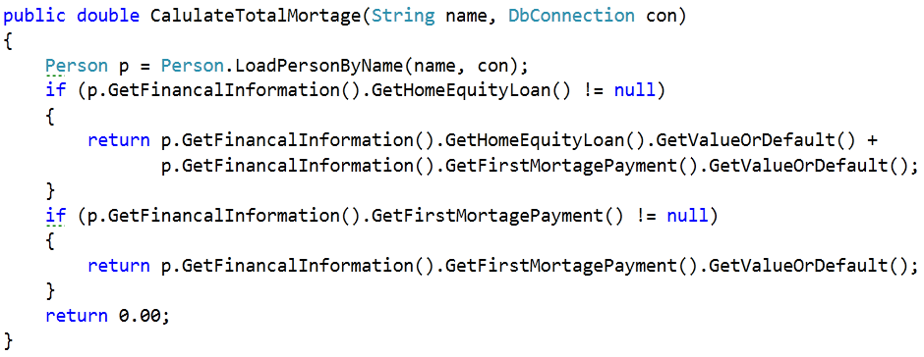

Slide 5
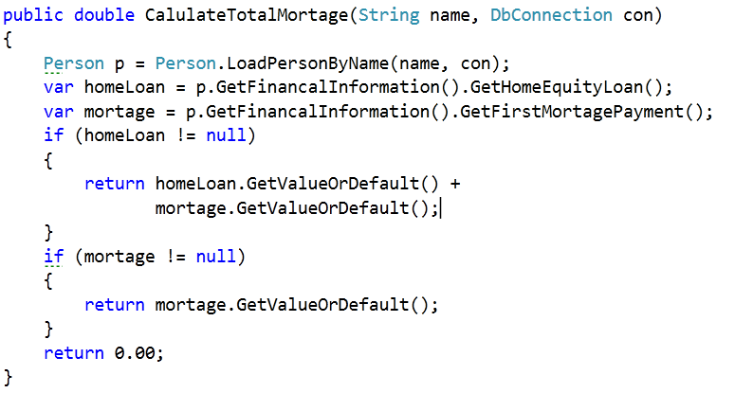

Slide 8
The Slice
return sample

Slide 9
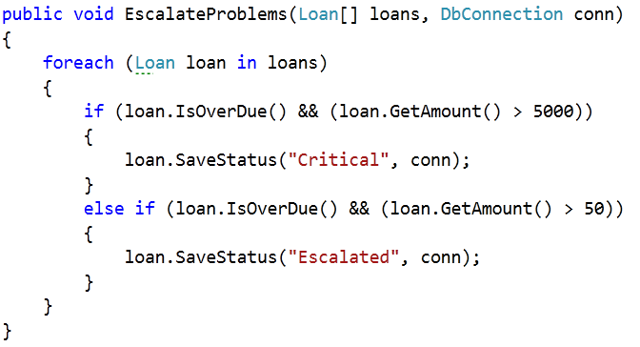

Slide 10
return sample
return sample

Slide 11
Pop Quiz C#: Question 1
When called with “ntsc” as the TvType, What does the code do?
Creates 30 Frames #30 – 0
Run it to find out

Slide 12
Pop Quiz C#: Question 2
To get this code to run, how should you handle web.Request.Params["TvFormat"]
Peel
Slice

Slide 13
Pop Quiz C#: Question 3
To get this code to run, how should you handle maker.CreateFrame("" + i);
Peel
Slice

Slide 14
Resources
VS 2010 / MsTest / Code Coverage
Mock Utility : RhinoMock http://www.ayende.com/projects/rhino-mocks.aspx

Slide 15


Contact
@Jason Kerney
Jason.kerney@gmail.com
@Llewellyn Falco
llewellynfalco.blogspot.com

