Slide 1
ICMS Data Camp
Joe Meagher

Slide 2

About Hymans Robertson
We work alongside employers, trustees, and financial services institutions.
We offer independent pensions, investments, benefits and risk consulting services.
As well as data and technology solutions.
We have around 1,200 employees across 4 offices.
Celebrated our centenary in 2021.

Slide 3
Our clients
Defined Benefit Pension Schemes
Defined Contribution Pension Schemes
Local Government Pension Schemes
Financial Advisors – via Hymans Robertson Investment Services
Employers and Individuals – via Hymans Robertson Personal Wealth

Slide 4

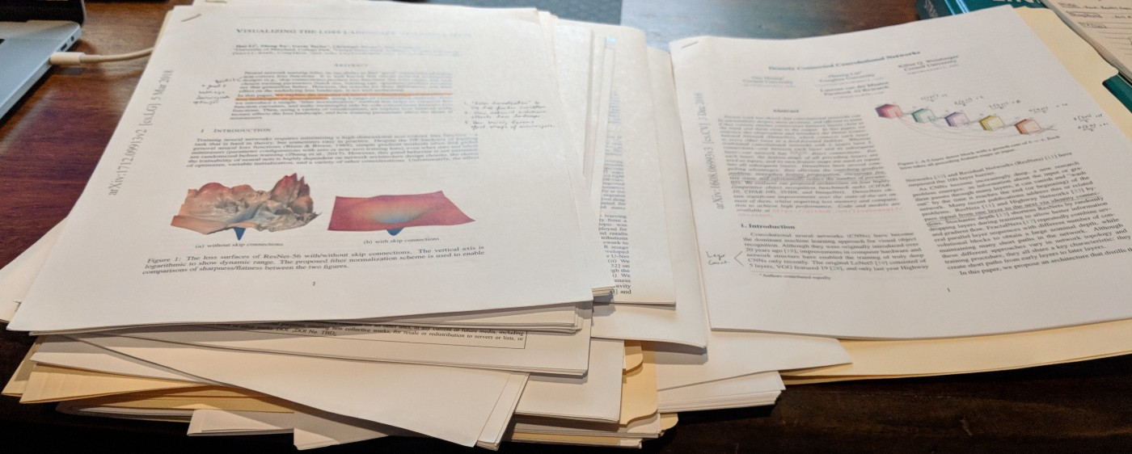
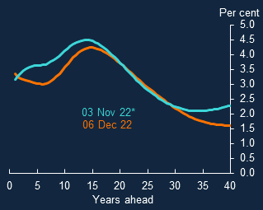
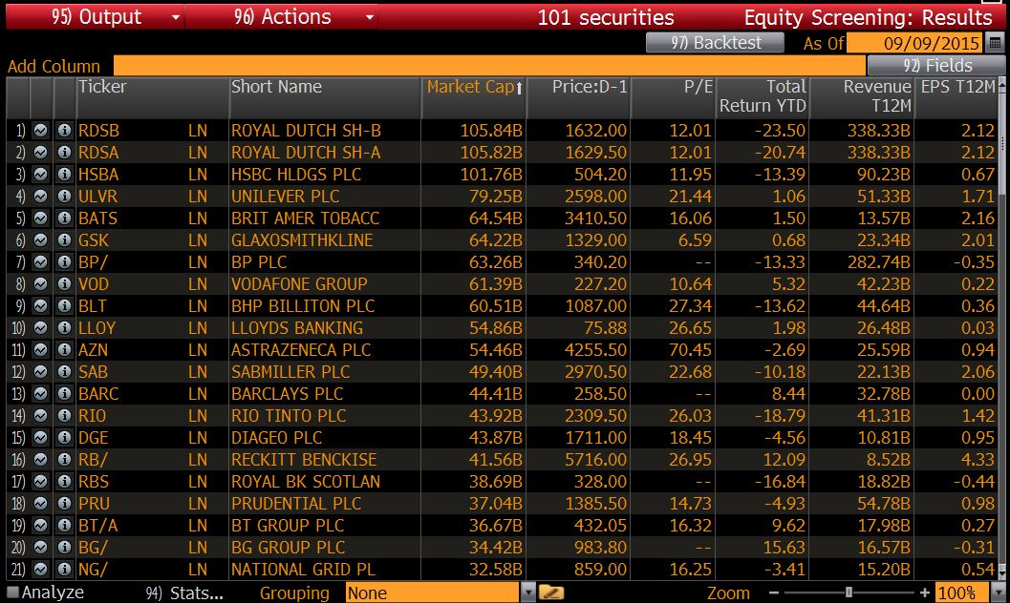
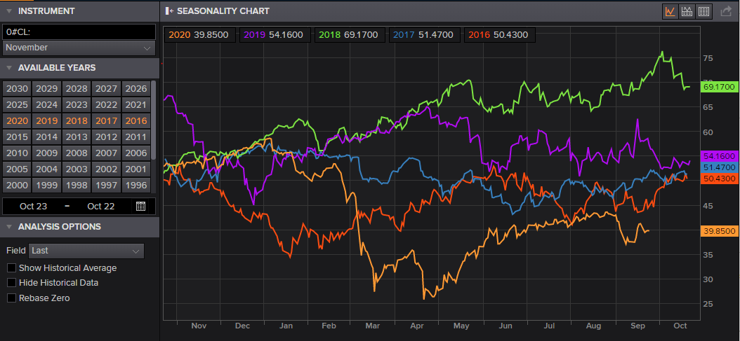
The advice we provide
Copyright 2022 Bloomberg L.P., Bank of England and LSEG

Slide 5
Digital Capabilities
Financial and Statistical Modelling
Stochastic Financial Projections, Monte Carlo simulations, Economic Scenario Generation, Statistical Methods
Emerging Technologies
Smart-Contracts, Model-as-a-Service, Digital Assistants
Machine Learning & AI
Supervised / unsupervised learning, Cluster Analysis, TensorFlow, Azure Machine Learning
Production ready systems
Robust Quality Assurance, UX Design, Application Architecture, Performance Analysis, APIs, Documentation
Data Quality
Collection, Storage, Manipulation, Visualisation
Supported by 100+ actuaries, statisticians, software developers

Slide 6






ESS Team
Research and Development (modelling & calibration)
London:
Ben Clare, PhD, FIA
Nick Blackbeard, PhD
Louise Mousten, MSc
Samuel Amoh, MSc
Adeetya Tantia, MSc, MS
Glasgow:
Joe Meagher, PhD
Ruairidh West, MA, PgD
Software (creating & maintaining software)
Edinburgh
Ross Sheppard, BSc
John Stewart, BSc (Hons)
Software development
Economics, finance and banking
Maths
Research
Actuarial: pensions and insurance
Consulting
Find more

Slide 7

ESS ecosystem
Historic data
Simulation
Investment overlay
Economy (e.g. GBP)
Bond intensity process
Nominal interest rate
Real interest rate
Credit model
Equity model
Inflation model
FX model
Property model
Outputs
Other asset classes, portfolio and fund modelling
Notes:
Start with the outputs, talk about inputs, touch on real yields
Credentials​
Supports £350bn AUA​
Empowers 600k individual GO savers​
Powers planning tools for wealth managers​
​
Proven processes​
15+ year pedigree​
Informed by research, driven by data​
Dedicated team of 8, within analytics practice of 100+ people​
​
Rigorous oversight​
Oversight committee with senior representation​
IFoA professional requirements​
Regulator scrutiny​
​
Key features​
Broad market-consistent asset class representation​
Time-dependent returns with fat tails​
Flexibly implemented, easily enhanced​

Slide 8
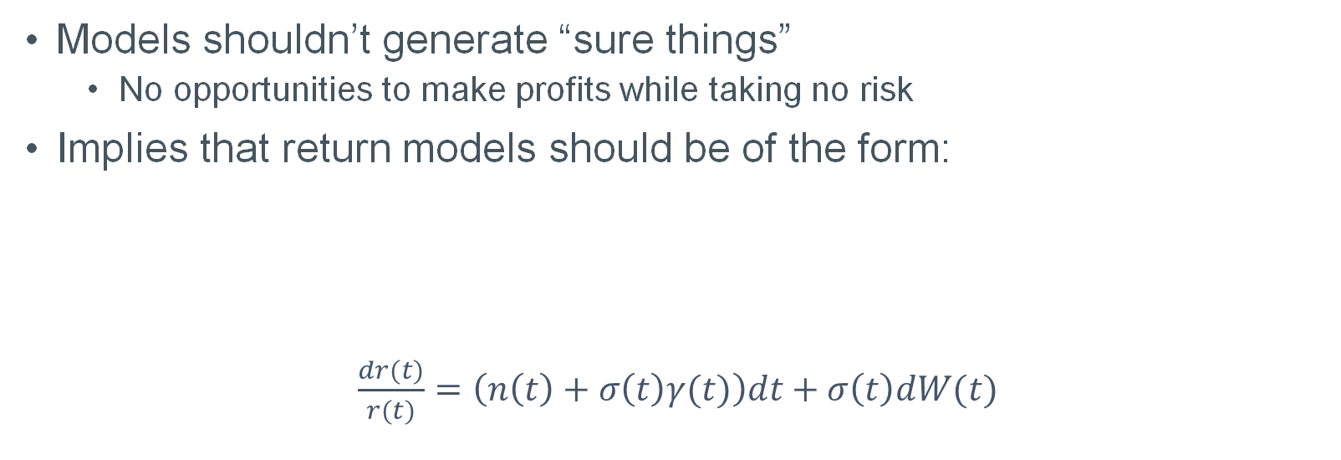
Modelling framework
Models shouldn’t generate “sure things”
No opportunities to make profits while taking no risk
Implies that return models should be of the form:
$\frac{dr(t)}{r(t)}=\left(n\left(t\right)+σ\left(t\right)γ(t)\right)dt+σ\left(t\right)dW(t)$
“risk-free return”
“risk”
“return”
“risk-premium”

Slide 9
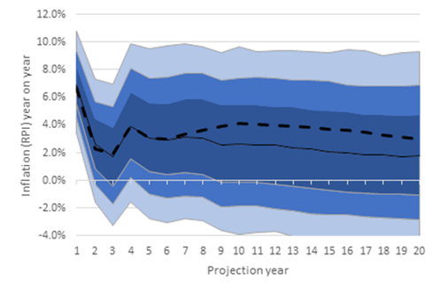
ESS output
5,000 projections of up to 100 years at monthly timesteps.
ESS models generate distributions (capital market assumptions) for a wide range of asset classes and economic variables, e.g.:​
Interest rates​
Government bonds (fixed & index-linked)​
Corporate bonds​
Listed equities (UK, overseas, emerging markets)​
Private equity​
Property​
Inflation (RPI & CPI)​
Alternative asset classes based on mixing & matching fundamental asset classes.
ESS team can add more if needed, e.g., green assets.

