Slide 1
Pacman controlled through a MYO armband
James Kinsella, Niall Devery

Slide 2
Purpose of the application
The Purpose of this application is to demonstrate our ability to incorporate new technologies and hardware into an environment, while still producing a functional and consistent app.
The classic game is iconic, the gesture mapping is straightforward as it is 2D.

Slide 4
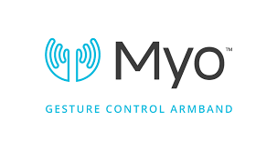
Gestures identified as appropriate for this application
Gestures for this project were decided on orientation as well as ease to perform.
The menu buttons are selected by making a fist.
The players movements are controlled by the position of the users arm. When the player raises their arm the Pacman will move upwards and work similarly downwards, left and right.
The player will be able to pause the game by performing the double tap gesture.

Slide 5
Process of development
Planning
Research the capabilities and responsiveness of the hardware being used.
Research the suitability of gestures for certain actions.
Determine what inputs the application requires in order to function.
Layout basic architecture of solution.
Determine what gestures would be suitable for each action.

Slide 6
Implementation
Set up the game environment.
Import MYO package.
Test the MYO functionality with basic commands and responses.
Using predetermined gestures to control the game.

Slide 7
Architecture for the solution

Slide 8
Conclusions & Recommendations so far

