Slide 1
Pacman in Unity, controlled with a MYO armband
James Kinsella, Niall Devery

Slide 2
Project Goals:
To faithfully recreate Pacman in Unity
To control Pacman with the Myo Armband
To Pause, navigate menus and resume gameplay
Seamless integration of gestures

Slide 3
Gameplay Mechanics:
Navigate the maze, using the Myo Armband
Collect pellets
Avoid Ghosts
Eat the big pellets, eat the ghosts
(…You’ve played Pacman before, right?)

Slide 4

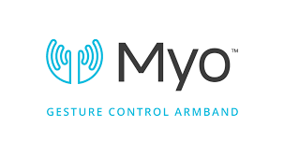
Gestures identified as appropriate for this application
The players movements are controlled by gestures:
Left/Right transitions to In/Out
Up/Down transitions to Fist/Finger spread
The player will be able to pause the game by performing the double tap gesture.
Menu navigation is also performed by the In/Out Gesture

Slide 5
Demonstration
(Hopefully…)

Slide 6
Conclusions & Recommendations so far

