Slide 1
CEFR Classification of English Language sentences
By: Bruno Cassani, Jan Korec, Colin Norstad, Max Zhang
CSCI3349: Natural Language Processing

Slide 2
Agenda
1
Motivation & Introduction
3
Method
2
Data
6
Conclusions & Future Work
4
Experiments
5
Results
CSCI3349: Natural Language Processing

Slide 3
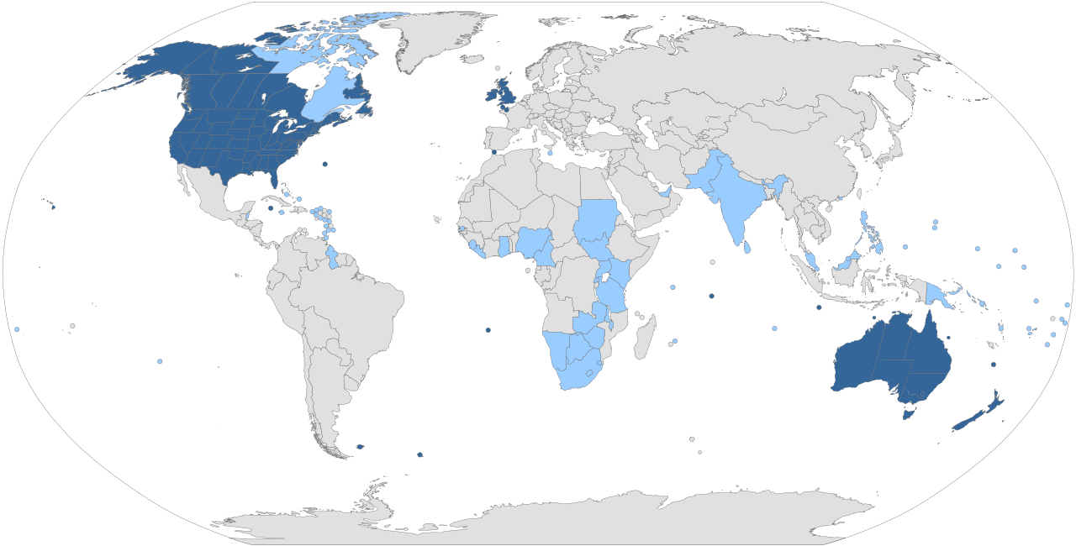




Introduction & Motivation
English is the established global language
Used in science, politics, trade, and media
English is the most commonly taught second language in the world
Current methods of evaluating English levels rely on subjective judgement
Wanted to explore ways of improving how the language is learned
CSCI3349: Natural Language Processing
Notes:
Why did you choose this topic?
Why would it be interesting to other people?
What did you hope to learn?
What are you going to show us, in general terms?

Slide 4
Introduction & Motivation
Beginner
A1
A2
CEFR
The Common European Framework of Reference for Languages
Standardized system → 6 levels
Aim to develop a model able to classify CEFR levels and give real-time feedback to learners
Real-world application of a classification task
Intermediate
B1
B2
Advanced
C1
C2
CSCI3349: Natural Language Processing

Slide 5
EXAMPLES
Sentence | Label
I finished the project with my team on time. | A1
Although the project was challenging, we managed to finish it on time by working together efficiently. | B2
Despite encountering several unforeseen complications throughout the project, we were nevertheless able to complete it on schedule through sustained collaboration and careful resource management. | C1
CSCI3349: Natural Language Processing
Notes:
• where did you get the original dataset?
• how did you turn that dataset into the dataset you used for this
class? (e.g., did you reduce the size? did you collapse labels? did you
combine two different datasets?)
• how many documents/samples? (e.g., for restaurant reviews, how
many reviews? how many restaurants? how many restaurants in each
category?)
• how many sentences/tokens per document/sample on average?
• what problems did you run into (e.g., funky special characters)
• what are some interesting things you learned about your data?
• You must use at least one table and at least one visualization
• You must provide examples from your dataset presented in a way
that is not a screenshot or ugly python output (more on that soon)

Slide 6
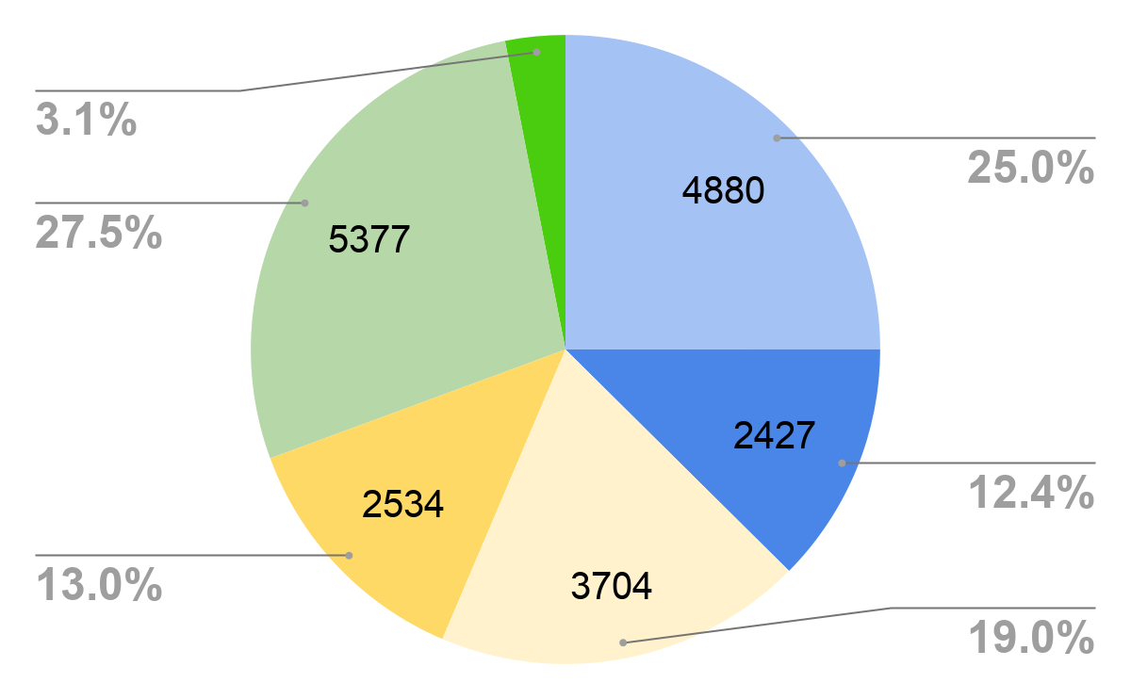
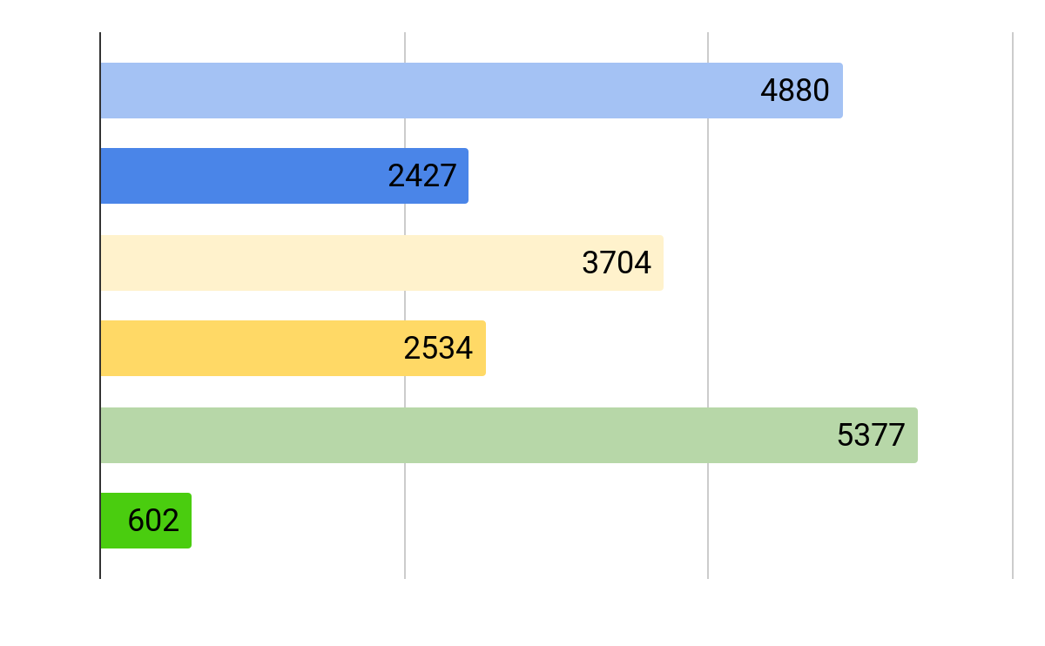
DATA OVERVIEW
Study by Yuki Arase et. al with a similar motivation
Open-source dataset on GitHub
Annotated sentences
One of the sources was missing
Stratified 80/20 split*
Augmented test data with another dataset from Kaggle
Annotated paragraphs
Preprocessing required
Class Distribution Overview (GitHub + Kaggle data combined)
CSCI3349: Natural Language Processing
Notes:
• where did you get the original dataset?
• how did you turn that dataset into the dataset you used for this
class? (e.g., did you reduce the size? did you collapse labels? did you
combine two different datasets?)
• how many documents/samples? (e.g., for restaurant reviews, how
many reviews? how many restaurants? how many restaurants in each
category?)
• how many sentences/tokens per document/sample on average?
• what problems did you run into (e.g., funky special characters)
• what are some interesting things you learned about your data?
• You must use at least one table and at least one visualization
• You must provide examples from your dataset presented in a way
that is not a screenshot or ugly python output (more on that soon)

Slide 7

PREPROCESSING
Github
Kaggle
Both translator annotations collapsed into one by rounding down
Labels of subcategories collapsed into one (A1, A2 → A, etc.)
Not all sentences in a paragraph correspond to its CEFR rating
Hardcoded rules - removing bad and redundant sentences
AI supervision rules - identifying C1/C2 sentences
Not added to testing split
CSCI3349: Natural Language Processing
Notes:
• where did you get the original dataset?
• how did you turn that dataset into the dataset you used for this
class? (e.g., did you reduce the size? did you collapse labels? did you
combine two different datasets?)
• how many documents/samples? (e.g., for restaurant reviews, how
many reviews? how many restaurants? how many restaurants in each
category?)
• how many sentences/tokens per document/sample on average?
• what problems did you run into (e.g., funky special characters)
• what are some interesting things you learned about your data?
• You must use at least one table and at least one visualization
• You must provide examples from your dataset presented in a way
that is not a screenshot or ugly python output (more on that soon)

Slide 8
PREPROCESSING (manual)
Manual observation revealed “junk sentence” patterns with no value
Hardcoded RegEx rules as initial cleaning layer
Delete sentence if …:
Length is less than 10 characters
Consists solely of non-letter characters
Contains phrases like "all rights reserved" or "e-mail to a friend."
Contains patterns like "-[A-Z]{2,}-"
CSCI3349: Natural Language Processing
Notes:
• where did you get the original dataset?
• how did you turn that dataset into the dataset you used for this
class? (e.g., did you reduce the size? did you collapse labels? did you
combine two different datasets?)
• how many documents/samples? (e.g., for restaurant reviews, how
many reviews? how many restaurants? how many restaurants in each
category?)
• how many sentences/tokens per document/sample on average?
• what problems did you run into (e.g., funky special characters)
• what are some interesting things you learned about your data?
• You must use at least one table and at least one visualization
• You must provide examples from your dataset presented in a way
that is not a screenshot or ugly python output (more on that soon)

Slide 9
PREPROCESSING (LLM)
Run sentences through GPT-4.1-mini as an extra layer of preprocessing
Add sentence if LLM assessment matches the label
AI Prompt (zero shot):
“Classify the sentence as CEFR C2 (1) or not (0).
C2 = highest level of language proficiency. highly academic, abstract, and complex language.
Answer ONLY with 1 or 0.
Sentence:
{sentence}”
CSCI3349: Natural Language Processing
Notes:
• where did you get the original dataset?
• how did you turn that dataset into the dataset you used for this
class? (e.g., did you reduce the size? did you collapse labels? did you
combine two different datasets?)
• how many documents/samples? (e.g., for restaurant reviews, how
many reviews? how many restaurants? how many restaurants in each
category?)
• how many sentences/tokens per document/sample on average?
• what problems did you run into (e.g., funky special characters)
• what are some interesting things you learned about your data?
• You must use at least one table and at least one visualization
• You must provide examples from your dataset presented in a way
that is not a screenshot or ugly python output (more on that soon)

Slide 10
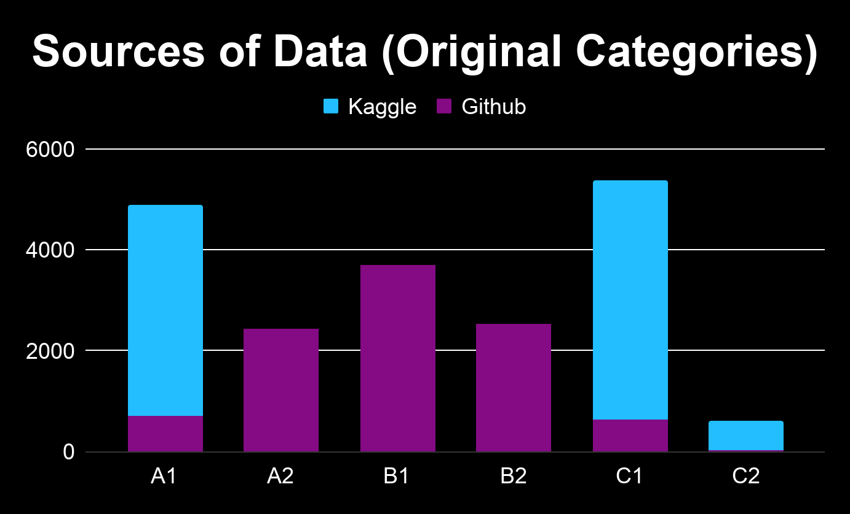
CSCI3349: Natural Language Processing
Notes:
• where did you get the original dataset?
• how did you turn that dataset into the dataset you used for this
class? (e.g., did you reduce the size? did you collapse labels? did you
combine two different datasets?)
• how many documents/samples? (e.g., for restaurant reviews, how
many reviews? how many restaurants? how many restaurants in each
category?)
• how many sentences/tokens per document/sample on average?
• what problems did you run into (e.g., funky special characters)
• what are some interesting things you learned about your data?
• You must use at least one table and at least one visualization
• You must provide examples from your dataset presented in a way
that is not a screenshot or ugly python output (more on that soon)

Slide 11
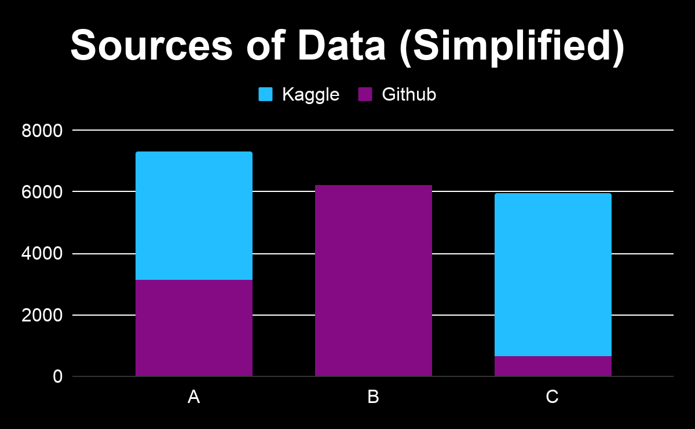
CSCI3349: Natural Language Processing
Notes:
• where did you get the original dataset?
• how did you turn that dataset into the dataset you used for this
class? (e.g., did you reduce the size? did you collapse labels? did you
combine two different datasets?)
• how many documents/samples? (e.g., for restaurant reviews, how
many reviews? how many restaurants? how many restaurants in each
category?)
• how many sentences/tokens per document/sample on average?
• what problems did you run into (e.g., funky special characters)
• what are some interesting things you learned about your data?
• You must use at least one table and at least one visualization
• You must provide examples from your dataset presented in a way
that is not a screenshot or ugly python output (more on that soon)

Slide 12
Method
Tasks
Models
Evaluation
Train separate models on two tasks:
3 class prediction
(A, B, C)
6 class prediction
(A1, A2, …, C2)
Random baselines
Simple baselines
Type-Token Ratio
Average Word Length
Constituency Parser (BENEPAR)
BERT
F1 Score across all models
Compare to previous literature
CSCI3349: Natural Language Processing
Notes:
• remind audience: what is your goal? what exactly are you trying to
predict? how many classes are there?
• what classification approaches did you use? do you have any reason
for exploring these (other than I said so)?
• what special stuff did you have to do to make your data work with
each approach? what pre-processing did you do, why, and under what
circumstances, e.g.,
• you would not remove stop words before calculating n-grams but
you would tokenize
• if using an LLM, zero-shot or few-shot? if few-shot, how did you
select your examples?
• if using an LLM what exactly was your prompt? how did you select
this prompt, and did you experiment with different prompts?
• If you did data augmentation or transfer learning, explain!

Slide 13

Initial baseline
Weighted Random Guessing F1 Score: 0.3336 for 3 class and .1668 for 6-class
CSCI3349: Natural Language Processing
Notes:
• where did you get the original dataset?
• how did you turn that dataset into the dataset you used for this
class? (e.g., did you reduce the size? did you collapse labels? did you
combine two different datasets?)
• how many documents/samples? (e.g., for restaurant reviews, how
many reviews? how many restaurants? how many restaurants in each
category?)
• how many sentences/tokens per document/sample on average?
• what problems did you run into (e.g., funky special characters)
• what are some interesting things you learned about your data?
• You must use at least one table and at least one visualization
• You must provide examples from your dataset presented in a way
that is not a screenshot or ugly python output (more on that soon)

Slide 14
TTR baseline
Logistic Regression model trained on Type-Token Ratio
Relevance
Captures varied vocabulary and lexical richness
Limitations
Unstable on short sentences
Sentence-level makes this feature weaker
F1 | A | B | C | Macro | Weighted
TTR | 0.67 | 0.26 | 0.51 | 0.48 | 0.49
CSCI3349: Natural Language Processing
Notes:
• where did you get the original dataset?
• how did you turn that dataset into the dataset you used for this
class? (e.g., did you reduce the size? did you collapse labels? did you
combine two different datasets?)
• how many documents/samples? (e.g., for restaurant reviews, how
many reviews? how many restaurants? how many restaurants in each
category?)
• how many sentences/tokens per document/sample on average?
• what problems did you run into (e.g., funky special characters)
• what are some interesting things you learned about your data?
• You must use at least one table and at least one visualization
• You must provide examples from your dataset presented in a way
that is not a screenshot or ugly python output (more on that soon)

Slide 15
WORD LENGTH baseline
Logistic Regression model trained on average number of characters per token
Relevance
Captures specialized vocabulary
Limitations
Long words ≠ difficult
Short words ≠ simple syntax
Ignores grammar
F1 | A | B | C | Macro | Weighted
Word Length | 0.73 | 0.44 | 0.42 | 0.53 | 0.55
CSCI3349: Natural Language Processing
Notes:
• where did you get the original dataset?
• how did you turn that dataset into the dataset you used for this
class? (e.g., did you reduce the size? did you collapse labels? did you
combine two different datasets?)
• how many documents/samples? (e.g., for restaurant reviews, how
many reviews? how many restaurants? how many restaurants in each
category?)
• how many sentences/tokens per document/sample on average?
• what problems did you run into (e.g., funky special characters)
• what are some interesting things you learned about your data?
• You must use at least one table and at least one visualization
• You must provide examples from your dataset presented in a way
that is not a screenshot or ugly python output (more on that soon)

Slide 16
Constituency PARSER baseline
Logistic Regression: Constituency Parse Features
Tree is created through Benepar, run through the spaCy pipeline
Each sentence → Parse Tree → features
Features: Tree height, sbar_count, avg_phrase_len, clause_count, np_count, coord_count, subordination_ratio, avg_token_depth, avg_np_len, ttr, avg_word_len
Relevance
Captures syntactic complexity
Sensitive to sentence organization
Limitations
Parsing errors become features
Limited semantic understanding
Unstable on short sentences
F1 | A | B | C | Macro | Weighted
Parsers | 0.85 | 0.65 | 0.68 | 0.73 | 0.74
CSCI3349: Natural Language Processing
Notes:
• where did you get the original dataset?
• how did you turn that dataset into the dataset you used for this
class? (e.g., did you reduce the size? did you collapse labels? did you
combine two different datasets?)
• how many documents/samples? (e.g., for restaurant reviews, how
many reviews? how many restaurants? how many restaurants in each
category?)
• how many sentences/tokens per document/sample on average?
• what problems did you run into (e.g., funky special characters)
• what are some interesting things you learned about your data?
• You must use at least one table and at least one visualization
• You must provide examples from your dataset presented in a way
that is not a screenshot or ugly python output (more on that soon)

Slide 17
BASELINES - 3 classes
F1 Scores | A | B | C | Macro | Weighted
Random | 0.33 | 0.33 | 0.33 | 0.33 | 0.33
TTR | 0.67 | 0.26 | 0.51 | 0.48 | 0.49
Word Length | 0.73 | 0.44 | 0.42 | 0.53 | 0.55
Parsers | 0.85 | 0.65 | 0.68 | 0.73 | 0.74
F1 scores across simplified baseline experiments
CSCI3349: Natural Language Processing
Notes:
• where did you get the original dataset?
• how did you turn that dataset into the dataset you used for this
class? (e.g., did you reduce the size? did you collapse labels? did you
combine two different datasets?)
• how many documents/samples? (e.g., for restaurant reviews, how
many reviews? how many restaurants? how many restaurants in each
category?)
• how many sentences/tokens per document/sample on average?
• what problems did you run into (e.g., funky special characters)
• what are some interesting things you learned about your data?
• You must use at least one table and at least one visualization
• You must provide examples from your dataset presented in a way
that is not a screenshot or ugly python output (more on that soon)

Slide 18
BASELINES - 6 classes
F1 Scores | A1 | A2 | B1 | B2 | C1 | C2 | Macro | Weighted
Random | 0.16 | 0.16 | 0.16 | 0.16 | 0.16 | 0.16 | 0.16 | 0.16
TTR | 0.57 | 0 | 0.41 | 0 | 0 | 0.53 | 0.18 | 0.28
Word Length | 0.69 | 0 | 0 | 0.33 | 0.03 | 0.49 | 0.21 | 0.30
Parsers | 0.78 | 0.18 | 0.48 | 0.21 | 0.02 | 0.66 | 0.39 | 0.51
F1 scores across baseline experiments
CSCI3349: Natural Language Processing
Notes:
• where did you get the original dataset?
• how did you turn that dataset into the dataset you used for this
class? (e.g., did you reduce the size? did you collapse labels? did you
combine two different datasets?)
• how many documents/samples? (e.g., for restaurant reviews, how
many reviews? how many restaurants? how many restaurants in each
category?)
• how many sentences/tokens per document/sample on average?
• what problems did you run into (e.g., funky special characters)
• what are some interesting things you learned about your data?
• You must use at least one table and at least one visualization
• You must provide examples from your dataset presented in a way
that is not a screenshot or ugly python output (more on that soon)

Slide 19

Experiments - WHY bert?
Contextual understanding
Captures meaning based on surrounding words (not just isolated features)
Detects subtle differences
Distinguishes small complexity changes between levels (e.g., B1 vs B2)
Pretrained knowledge
Leverages large-scale language learning → strong performance with limited data
Well-suited for sentence classification
Designed for tasks like labeling text sequences
Better generalization
Works effectively with class imbalance when combined with tuning methods
CSCI3349: Natural Language Processing
Notes:
• remind audience: what is your goal? what exactly are you trying to
predict? how many classes are there?
• what classification approaches did you use? do you have any reason
for exploring these (other than I said so)?
• what special stuff did you have to do to make your data work with
each approach? what pre-processing did you do, why, and under what
circumstances, e.g.,
• you would not remove stop words before calculating n-grams but
you would tokenize
• if using an LLM, zero-shot or few-shot? if few-shot, how did you
select your examples?
• if using an LLM what exactly was your prompt? how did you select
this prompt, and did you experiment with different prompts?
• If you did data augmentation or transfer learning, explain!
1. Contextual understanding (biggest advantage) Unlike traditional models that rely on fixed features (word counts, sentence length, etc.), BERT understands context. The same word or structure can signal different difficulty levels depending on usage, and BERT captures that through its bidirectional training.
2. Sensitivity to subtle linguistic differences CEFR levels (especially adjacent ones like B1 vs B2) differ in nuanced ways—grammar complexity, phrasing, idiomatic usage. BERT is pretrained on large corpora and learns these patterns implicitly, making it much better at distinguishing those fine differences than feature-based models.
3. Strong performance with limited labeled data You have ~17,000 labeled sentences, which is solid but not huge. Because BERT is pretrained, fine-tuning it on your dataset lets you leverage massive prior knowledge instead of learning everything from scratch.
4. Handles sentence-level classification well Your task is sentence-level CEFR classification. BERT is specifically designed for tasks like this (sequence classification), so it maps cleanly onto your problem setup.
5. Robust to class imbalance (with tuning) While not inherently solving imbalance, BERT tends to generalize better—so when you combine it with your planned techniques (loss weighting, augmentation), it’s more likely to improve performance on underrepresented classes (A1, C2).
6. Proven success in similar research Your proposal already hints at this—there’s prior work using BERT embeddings for CEFR classification. That gives you a strong empirical foundation and justification.

Slide 20
BERT - Results
Model:
We used distilbert-base-uncased model for faster/lightweight version of BERT without sacrificing much performance
Parameters:
Learning Rate: 2e-5
Per Device Train Batch Size: 16
Per Device Eval Batch Size: 16
Number of Training Epochs: 5
Weight Decay: 0.01
Task Complexity: Accuracy dropped significantly from 3-class to 6-class tasks.
Weighted Consistency: High Weighted F1 (0.88/0.77) shows stability across class distributions.
Peak Precision: Excelled at spectrum extremes: C2 (0.92) and A1 (0.91).
Class | A | B | C | Macro | Weighted
F1 | 0.91 | 0.83 | 0.88 | 0.88 | 0.88
Class | A1 | A2 | B1 | B2 | C1 | C2 | Macro | Weighted
F1 | 0.91 | 0.63 | 0.66 | 0.60 | 0.51 | 0.92 | 0.71 | 0.77
CSCI3349: Natural Language Processing
Notes:
• where did you get the original dataset?
• how did you turn that dataset into the dataset you used for this
class? (e.g., did you reduce the size? did you collapse labels? did you
combine two different datasets?)
• how many documents/samples? (e.g., for restaurant reviews, how
many reviews? how many restaurants? how many restaurants in each
category?)
• how many sentences/tokens per document/sample on average?
• what problems did you run into (e.g., funky special characters)
• what are some interesting things you learned about your data?
• You must use at least one table and at least one visualization
• You must provide examples from your dataset presented in a way
that is not a screenshot or ugly python output (more on that soon)

Slide 21
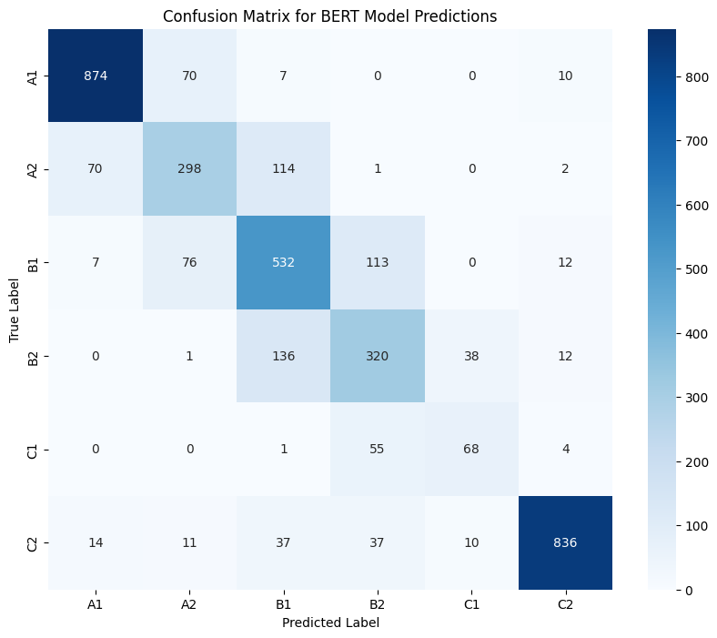
BERT - Confusion Matrix
High diagonal density proves model understands level progression.
Polar classes (A1/C2) show the clearest linguistic markers.
Significant classification drift occurs between B1 and B2 levels.
No extreme errors shows successful separation of broad skills.
Overlapping grammar hampers precision in middle-level classification.
CSCI3349: Natural Language Processing
Notes:
• where did you get the original dataset?
• how did you turn that dataset into the dataset you used for this
class? (e.g., did you reduce the size? did you collapse labels? did you
combine two different datasets?)
• how many documents/samples? (e.g., for restaurant reviews, how
many reviews? how many restaurants? how many restaurants in each
category?)
• how many sentences/tokens per document/sample on average?
• what problems did you run into (e.g., funky special characters)
• what are some interesting things you learned about your data?
• You must use at least one table and at least one visualization
• You must provide examples from your dataset presented in a way
that is not a screenshot or ugly python output (more on that soon)

Slide 22
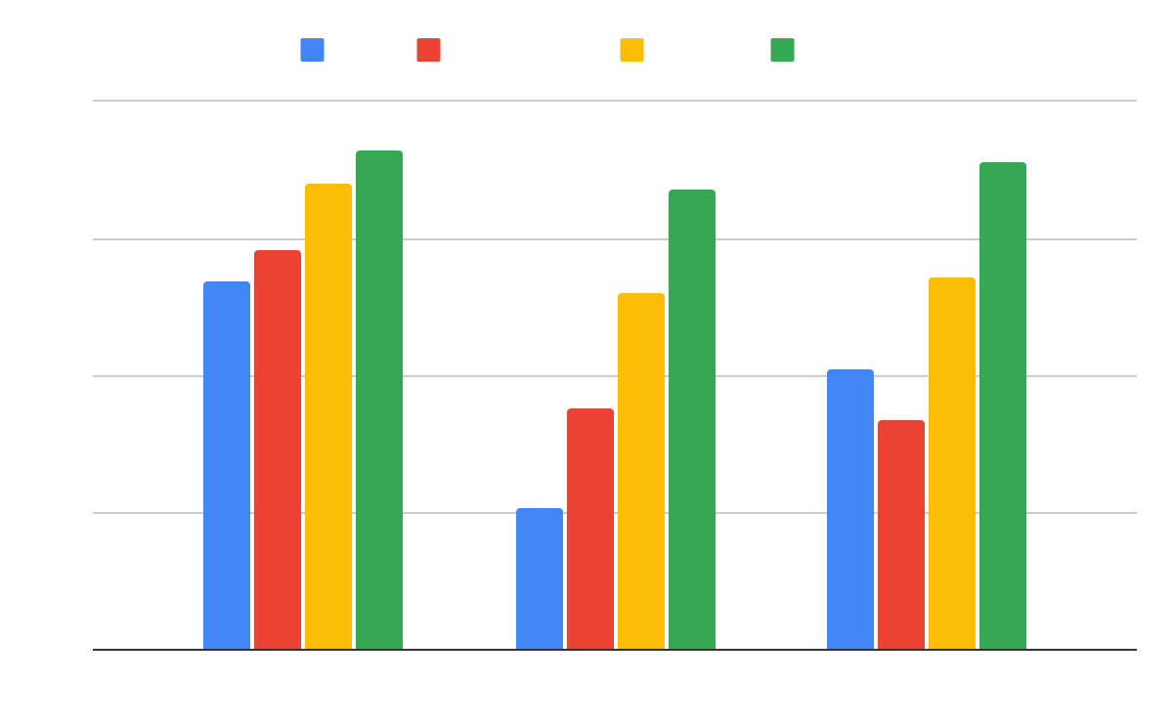
Results - 3 classES
F1 Score
Category
CSCI3349: Natural Language Processing
Notes:
• You must include
• Tables
• Visualizations
• Baselines!!!
• Do not include:
• copied-and-pasted Python output
• this will result in an automatic deduction in your grade
• lists of words that are really long and have to be printed in very
small font to fit on a slide
• numbers with more than 4 digits passed the decimal point
• low-res screenshots

Slide 23
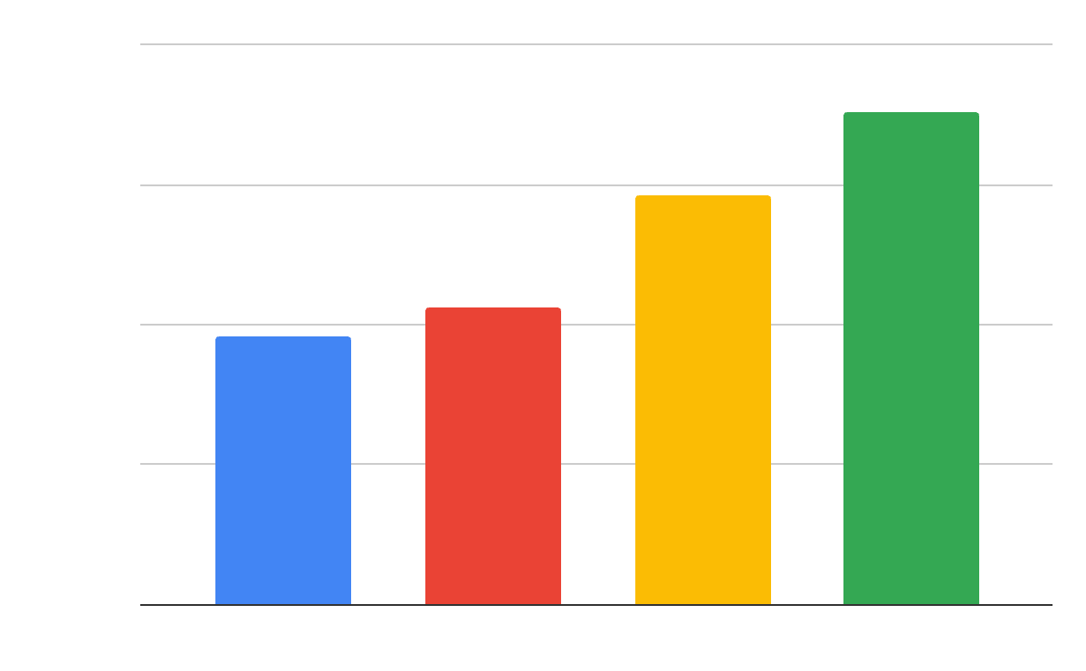
Results - 3 classES
Model
CSCI3349: Natural Language Processing
Notes:
• You must include
• Tables
• Visualizations
• Baselines!!!
• Do not include:
• copied-and-pasted Python output
• this will result in an automatic deduction in your grade
• lists of words that are really long and have to be printed in very
small font to fit on a slide
• numbers with more than 4 digits passed the decimal point
• low-res screenshots

Slide 24
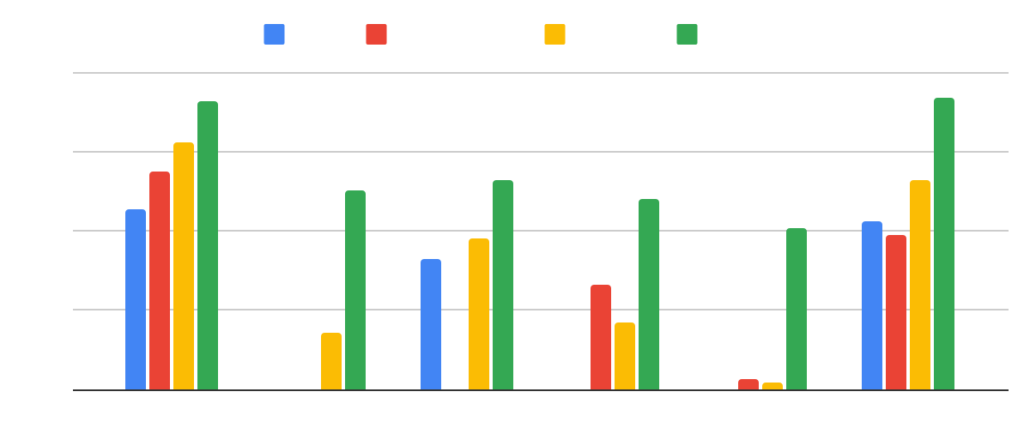
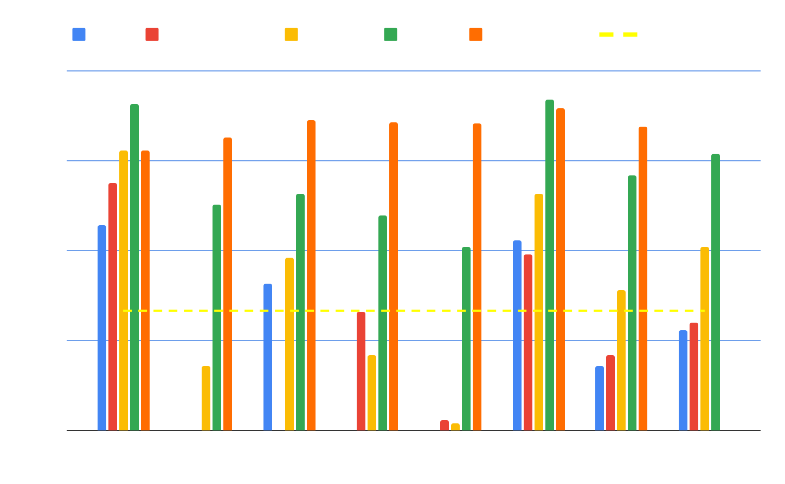
Results - 6 classES
F1 Score
Category
CSCI3349: Natural Language Processing
Notes:
• You must include
• Tables
• Visualizations
• Baselines!!!
• Do not include:
• copied-and-pasted Python output
• this will result in an automatic deduction in your grade
• lists of words that are really long and have to be printed in very
small font to fit on a slide
• numbers with more than 4 digits passed the decimal point
• low-res screenshots

Slide 25
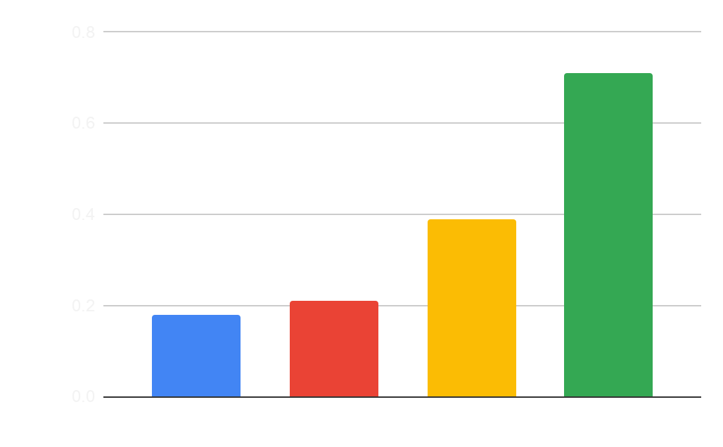
Results - 6 classES
CSCI3349: Natural Language Processing
Model
Notes:
• You must include
• Tables
• Visualizations
• Baselines!!!
• Do not include:
• copied-and-pasted Python output
• this will result in an automatic deduction in your grade
• lists of words that are really long and have to be printed in very
small font to fit on a slide
• numbers with more than 4 digits passed the decimal point
• low-res screenshots

Slide 26

Conclusions
BERT achieved the best metrics
Contextual and positional embeddings outperform linguistic features
Language is subjective, so 100% accuracy and F1 is nearly impossible
B1/B2 proved to be the hardest to classify, suggesting similarities
CSCI3349: Natural Language Processing
Notes:
• what else would you do if you had more time?
• what interesting things did you discover that surprised you?
• how would you address any problems you encountered?

Slide 27

Future work
If we had more time and tokens, we would run the OpenAI API through all of our data
Interested to see results for a more outdated dataset, or one from different dialects
Build a real-time learner feedback tool
CSCI3349: Natural Language Processing
Notes:
• what else would you do if you had more time?
• what interesting things did you discover that surprised you?
• how would you address any problems you encountered?

Slide 28
Thank you!
0.3336

Slide 29
Questions?

