Slide 1

Case Study 2
Predicting Attrition and Monthly Income
By: Jack Kortokrax

Slide 2
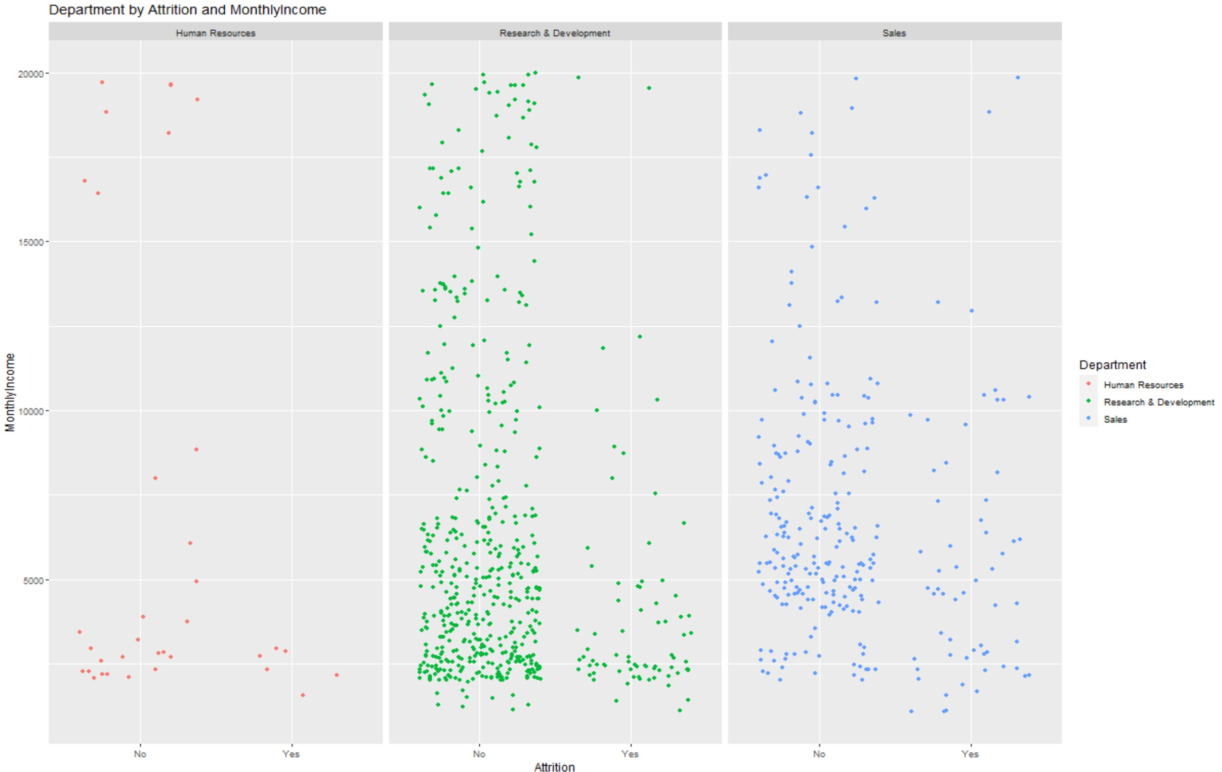
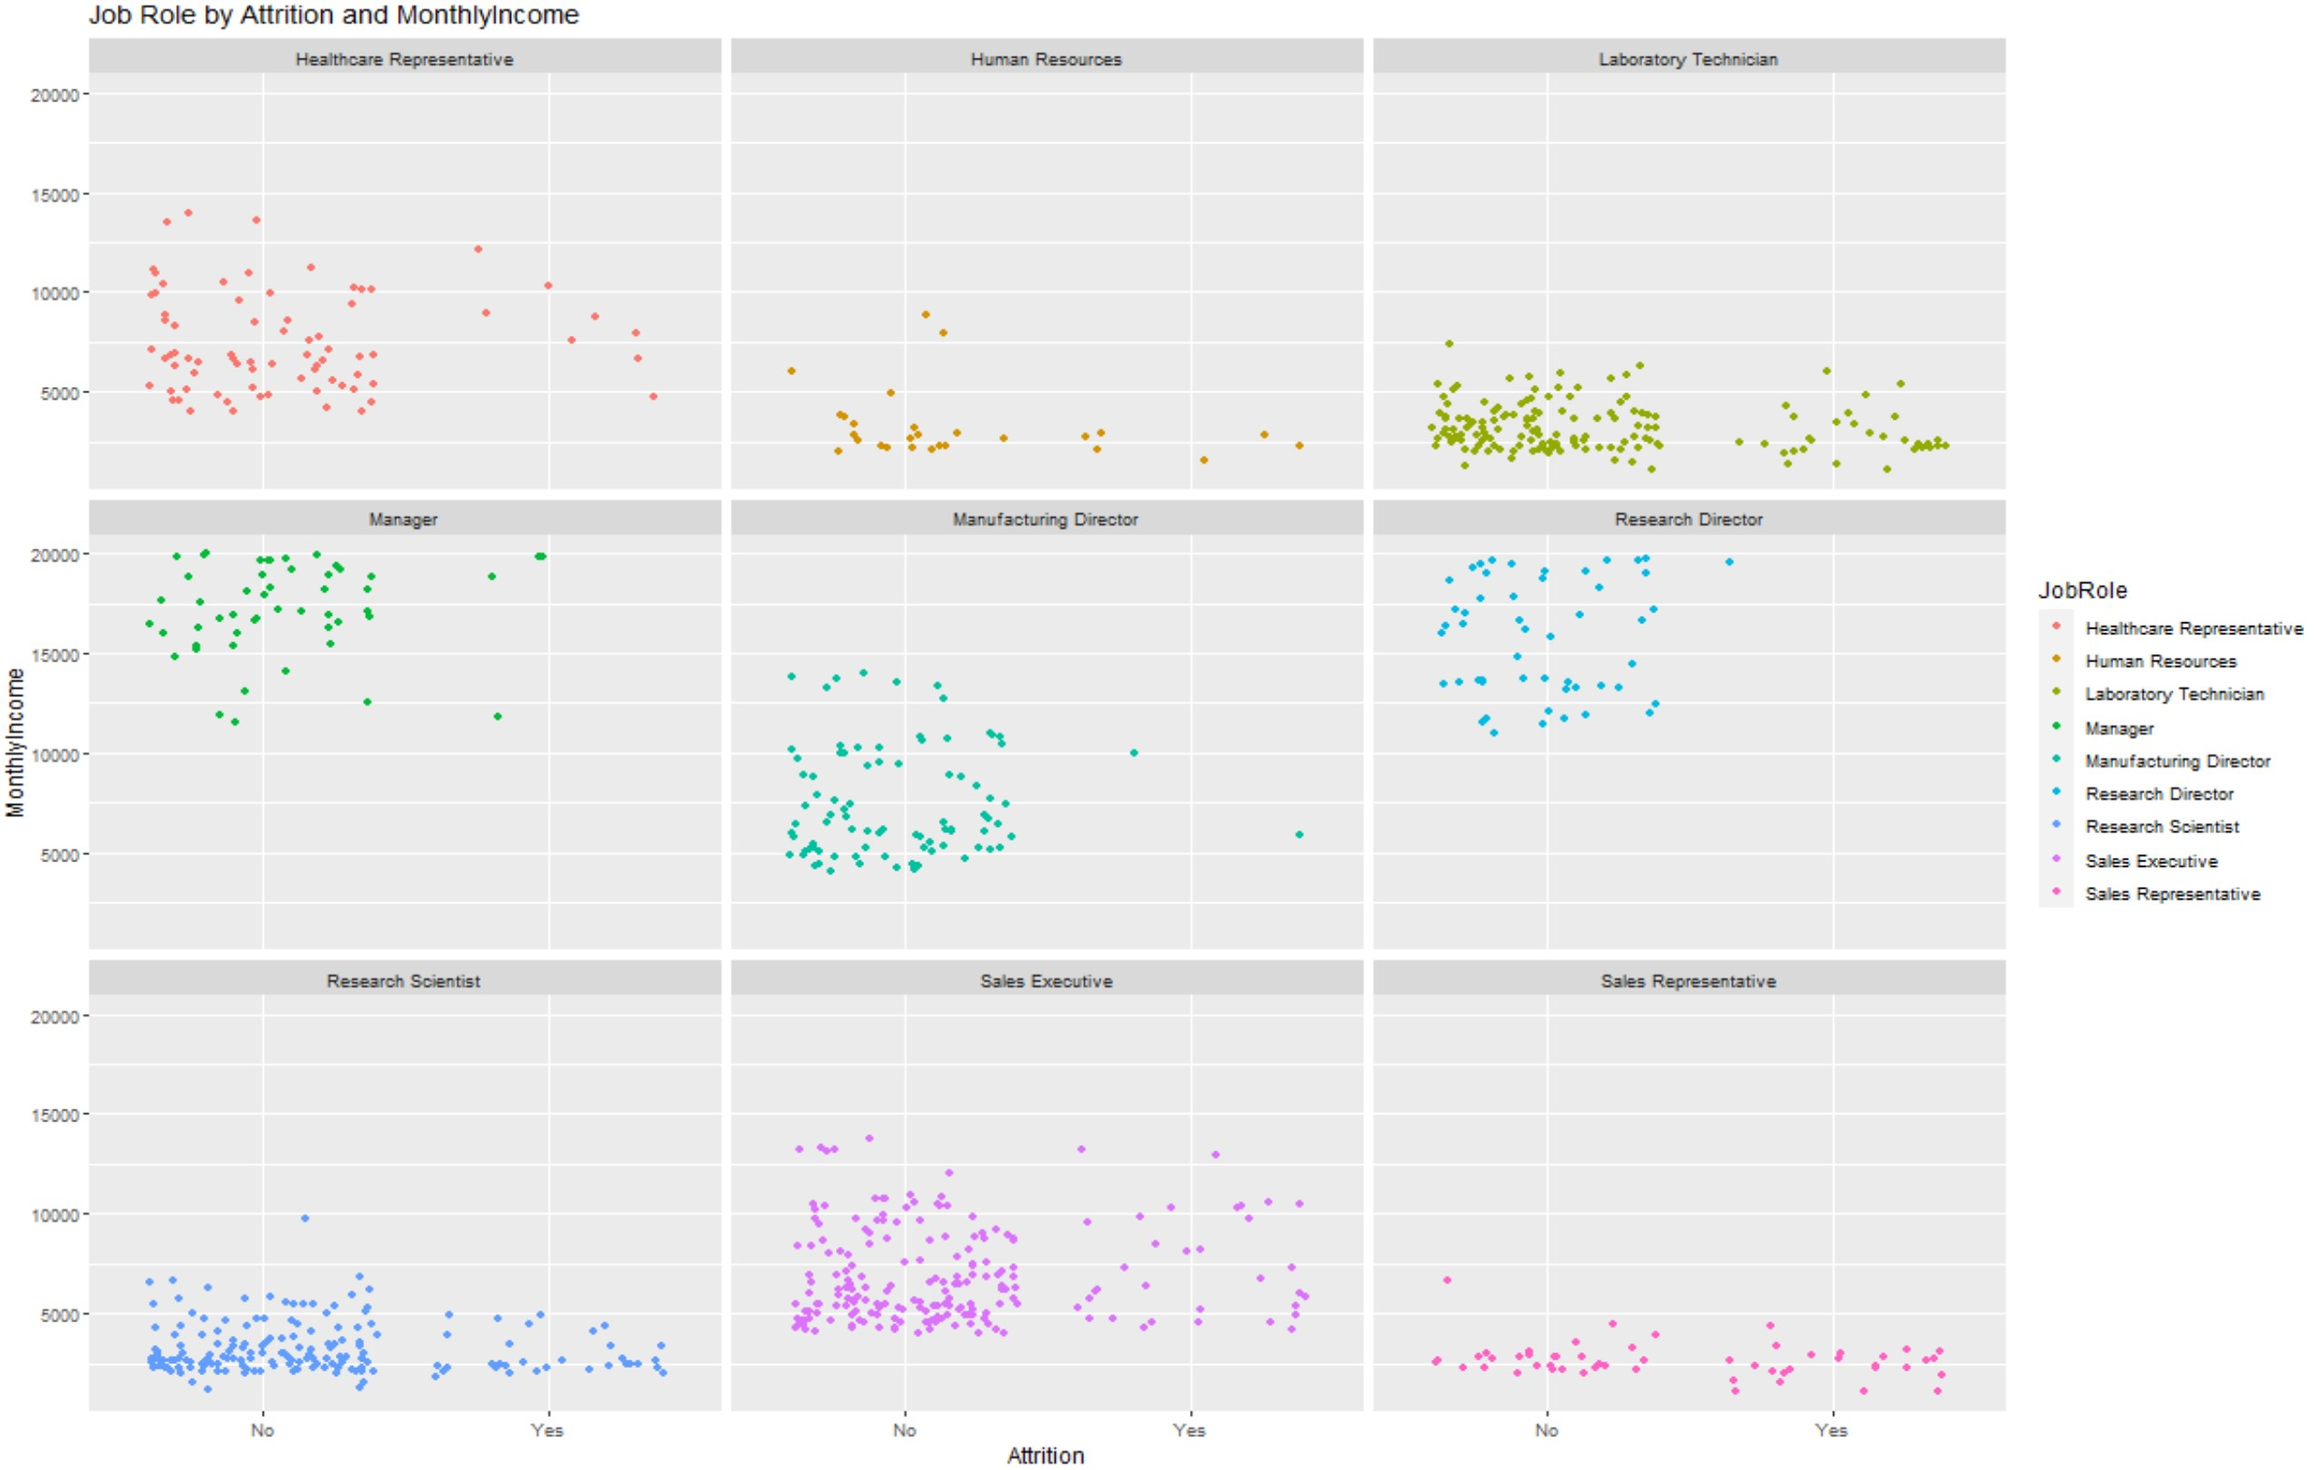
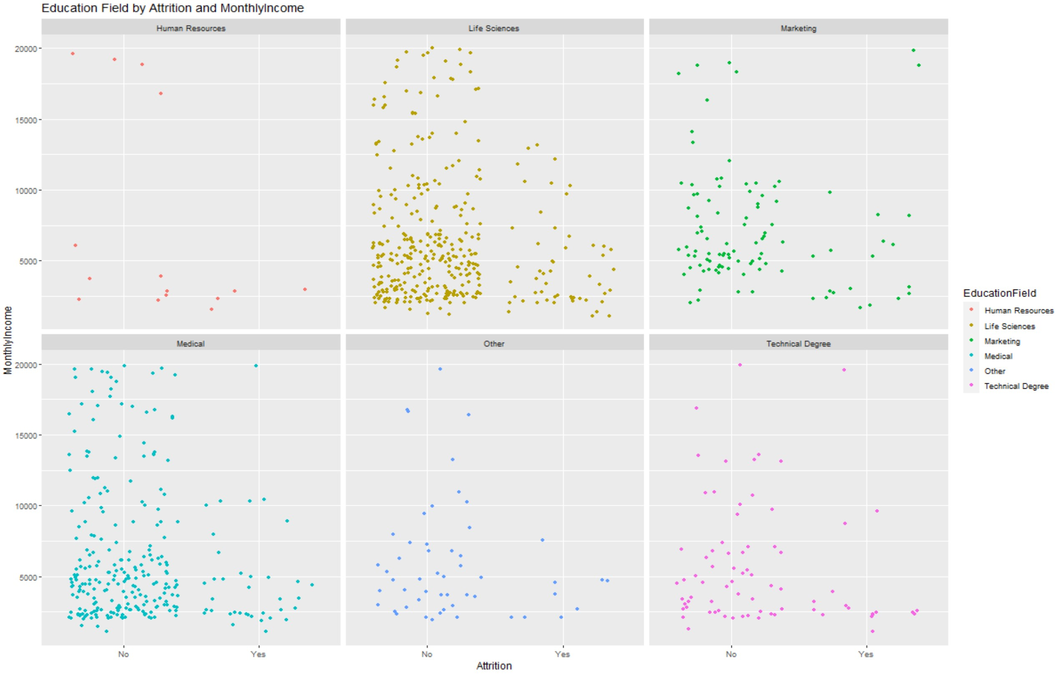
Exploring And Cleaning the Data
Primary focus of the analysis was of the relationships associated with the ‘MonthlyIncome’ and Attrition Variable.
I primarily observed that a those with a higher MonthlyIncome were less associated with Attrition.
Both Attrition and MonthlyIncome have a visual correlation with with many of the other variables in that Attrition is positively associated with low Job Satisfaction, younger individuals, individuals with less work experience and other poor Satisfaction levels. MonthlyIncome displayed the opposite relationship to Attrition, but Attrition was not absent among high earning observations.

Slide 3
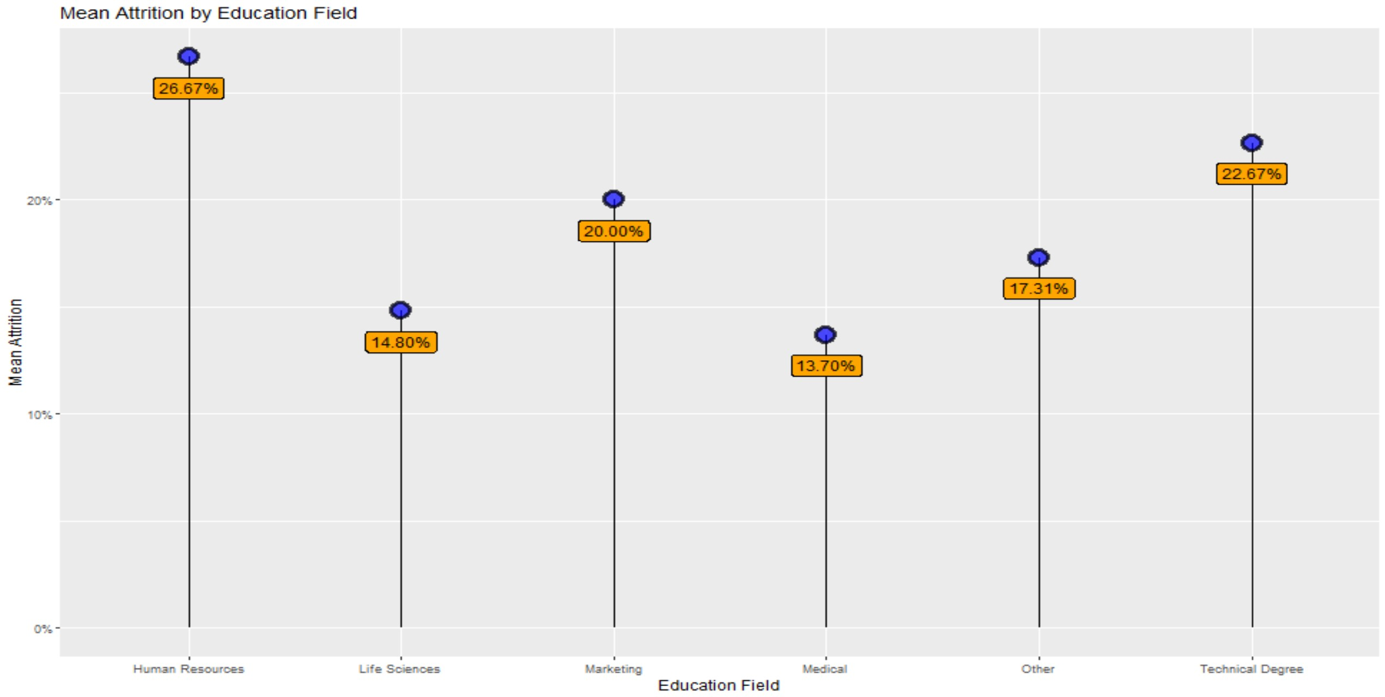
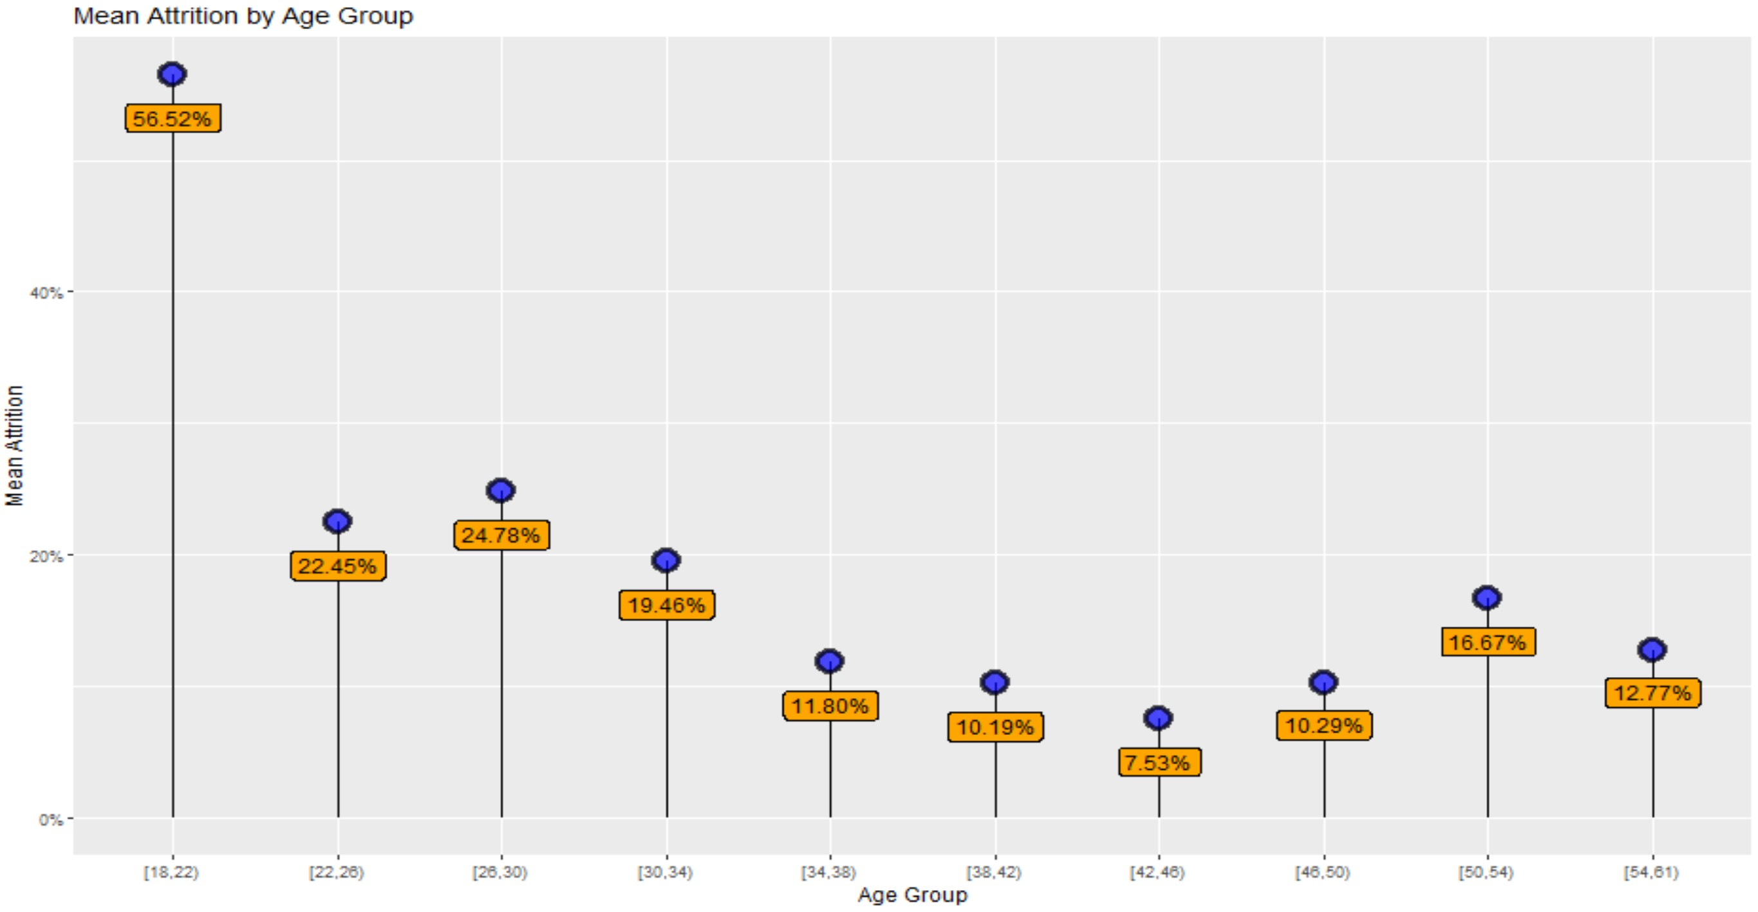
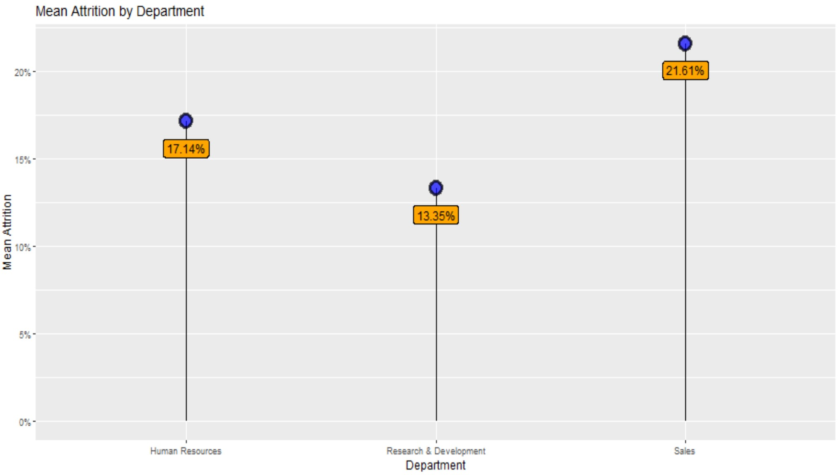
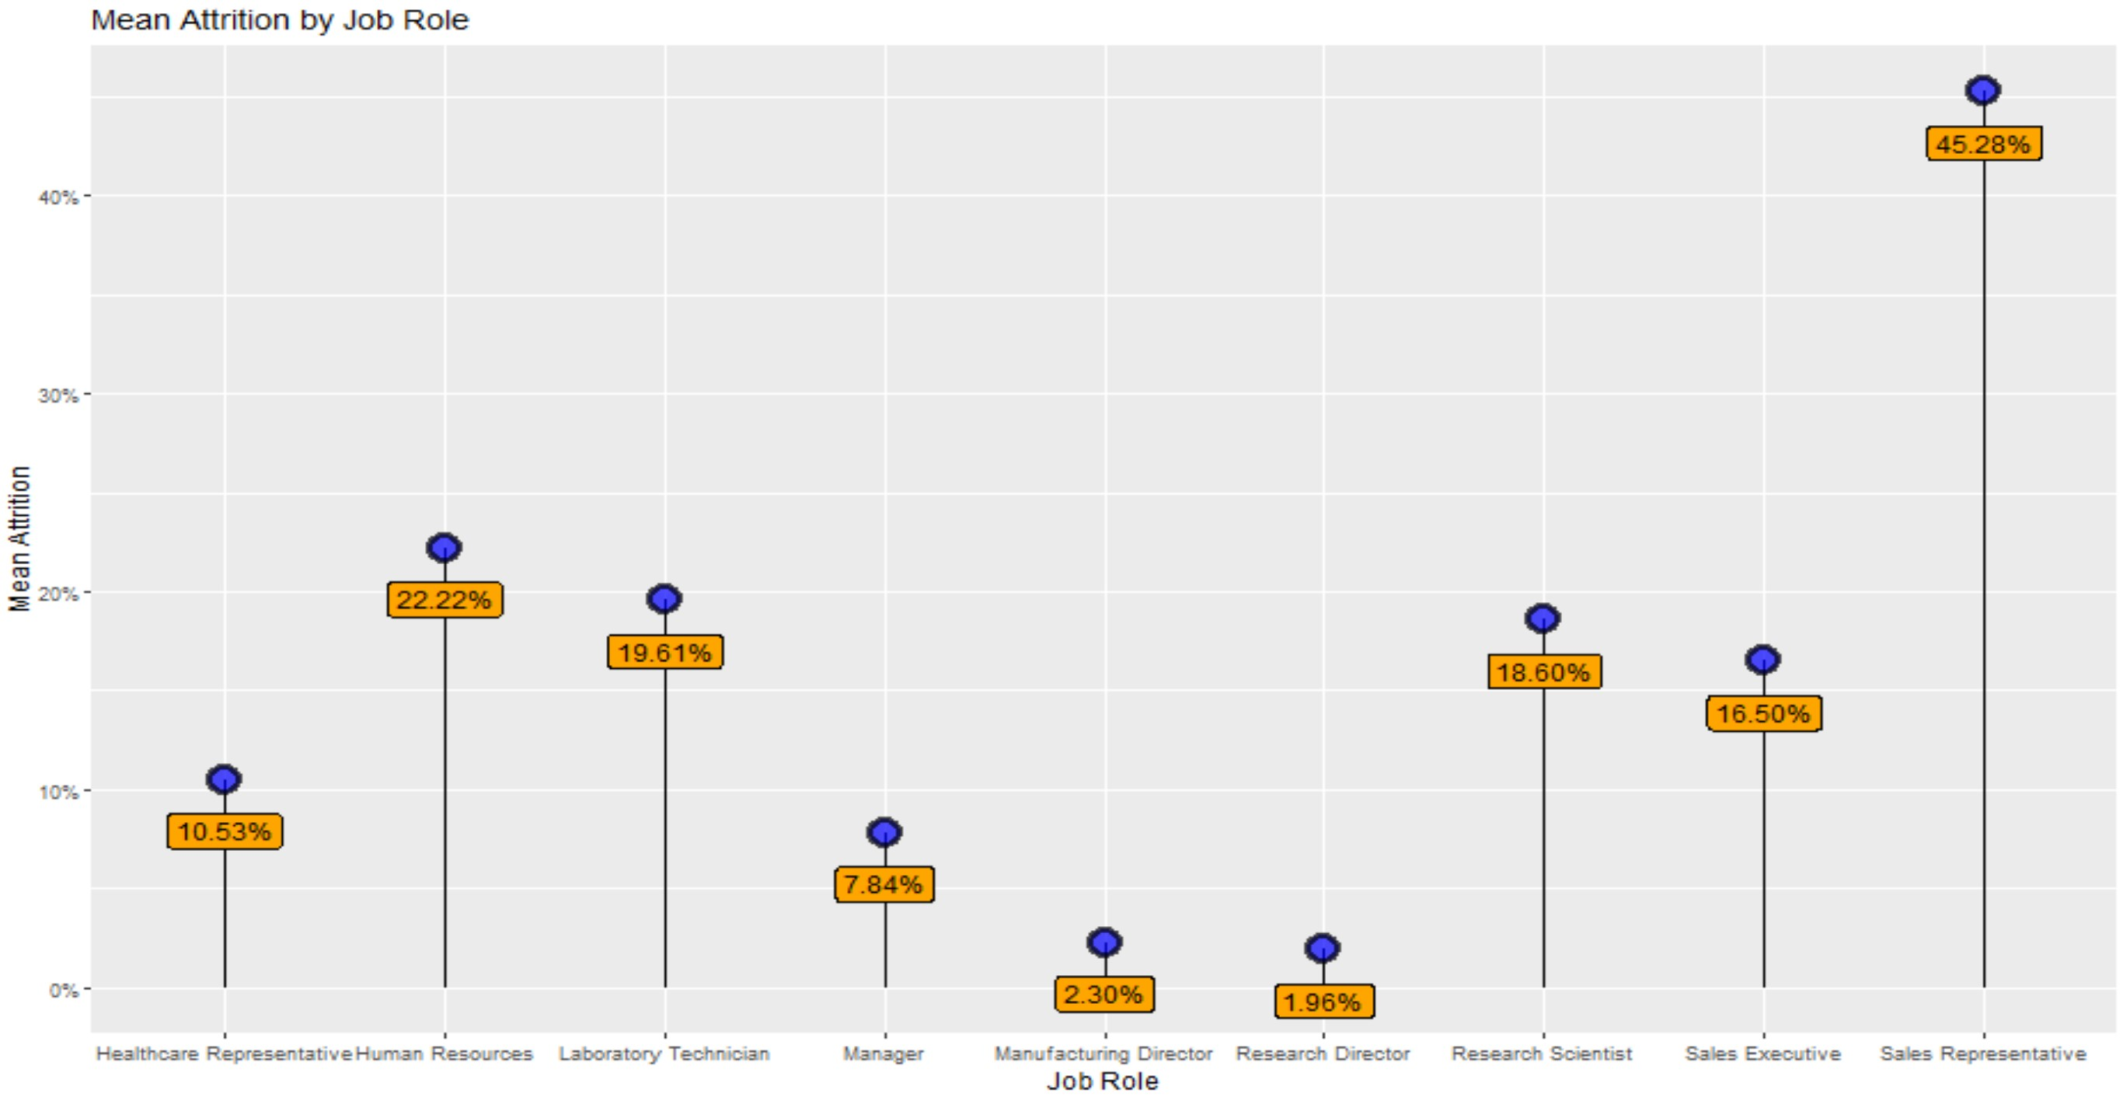
Exploring And Cleaning the Data
Highest Mean Attrition:
Education Field: Human Resources (26.67%)
Department: Sales (21.61%)
Job Role: Sales Representative (45.28%)
Age_Bin: 18-22 (56.52%)
Lowest Mean Attrition:
Education Field: Medical (13.70%)
Department: Research & Development (13.35%)
Job Role: Research Developer (1.98%)
Age_Bin: 42-46 (7.53%)

Slide 4
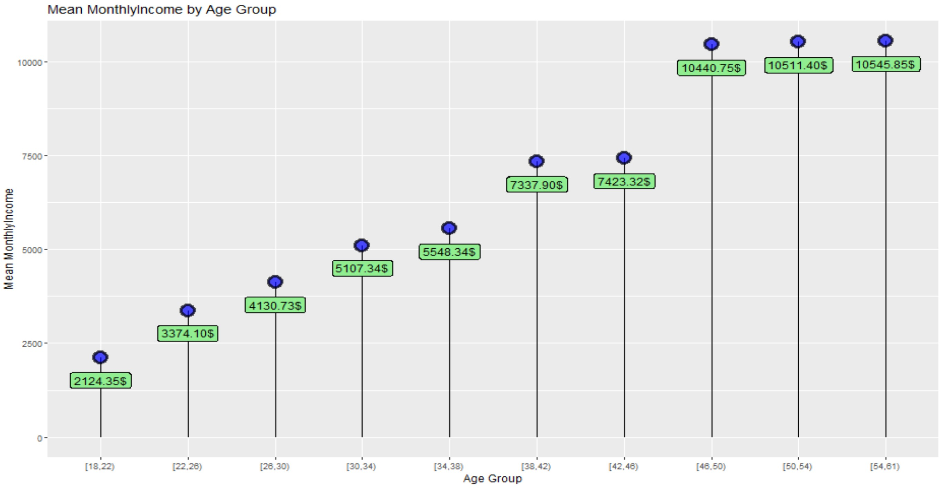
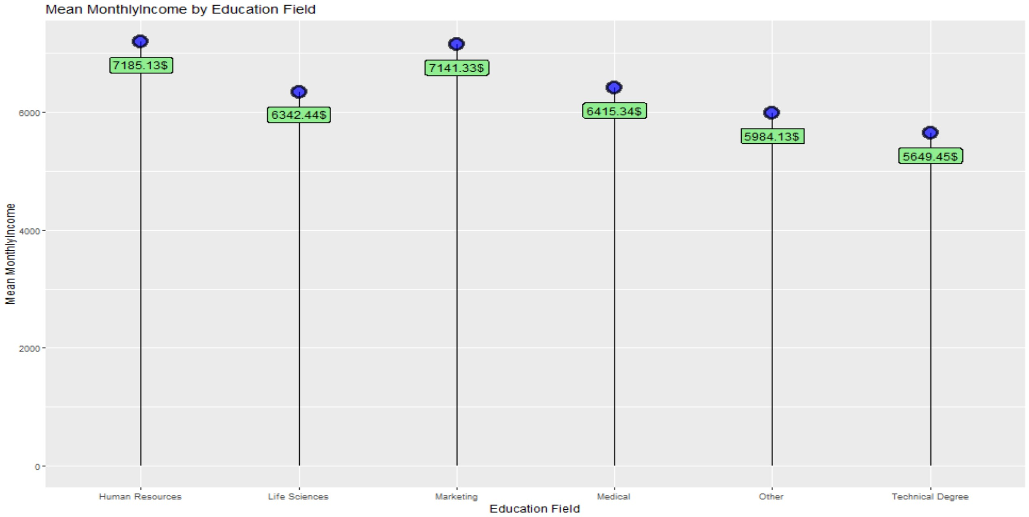
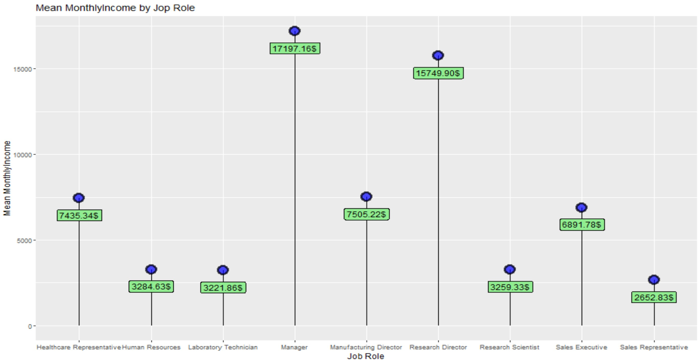
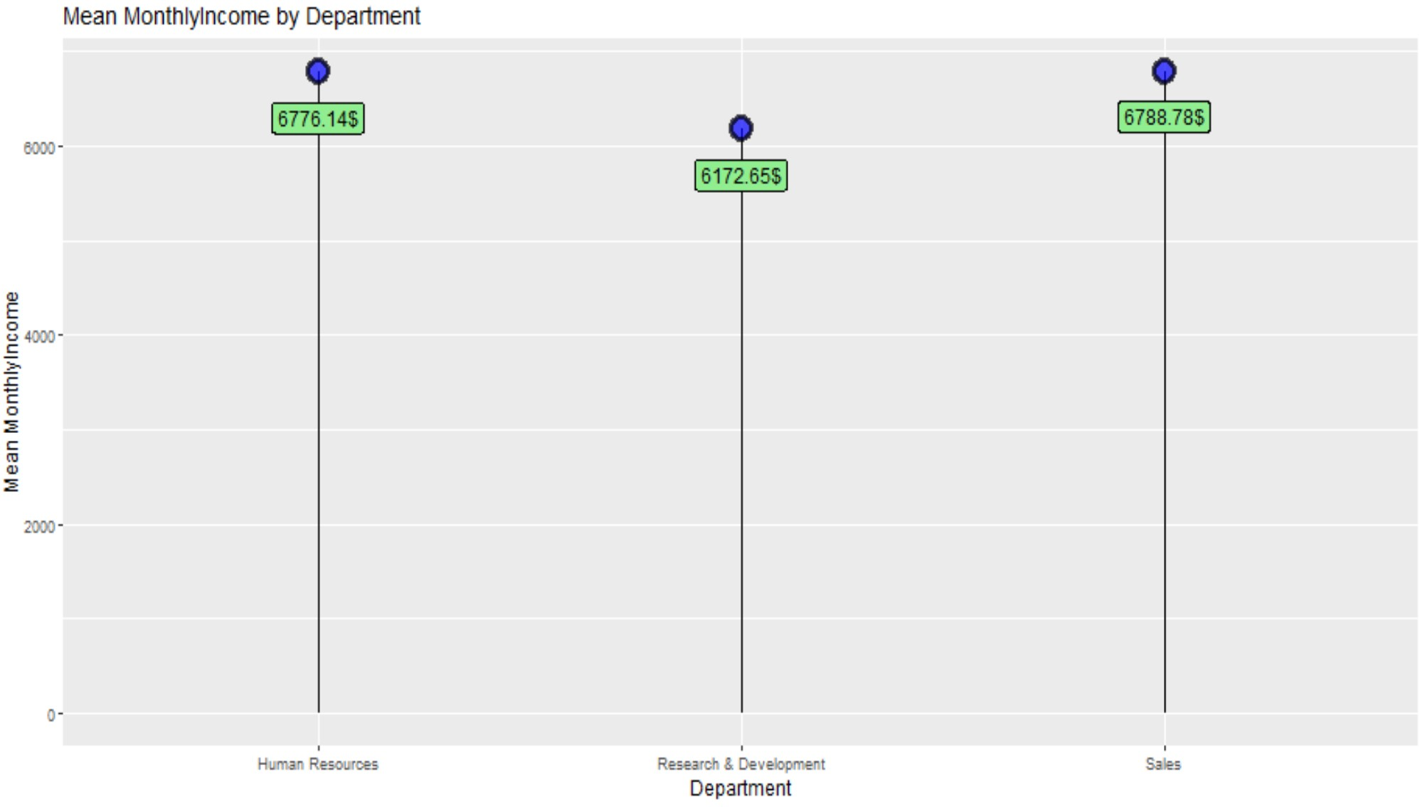
Exploring And Cleaning the Data
Highest Mean MonthlyIncome:
Education Field: Human Resources ($7,185.13)
Department: Sales ($6,788.78)
Job Role: Manager ($17,197.16)
Age_Bin: 54-61 ($10,545.85)
Lowest Mean MonthlyIncome:
Education Field: Technical ($5,649.45)
Department: Research & Development ($6,172.65)
Job Role: Sales Representatives ($2,652.83)
Age_Bin: 18-22 ($2,124.35)

Slide 5
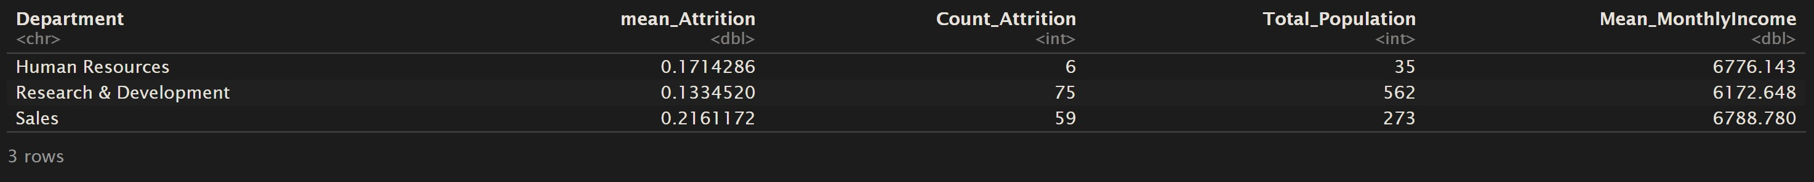
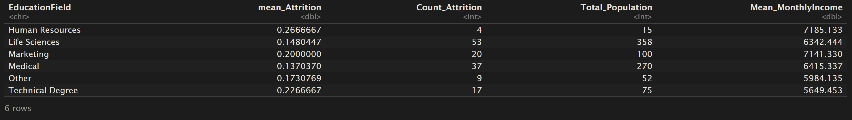
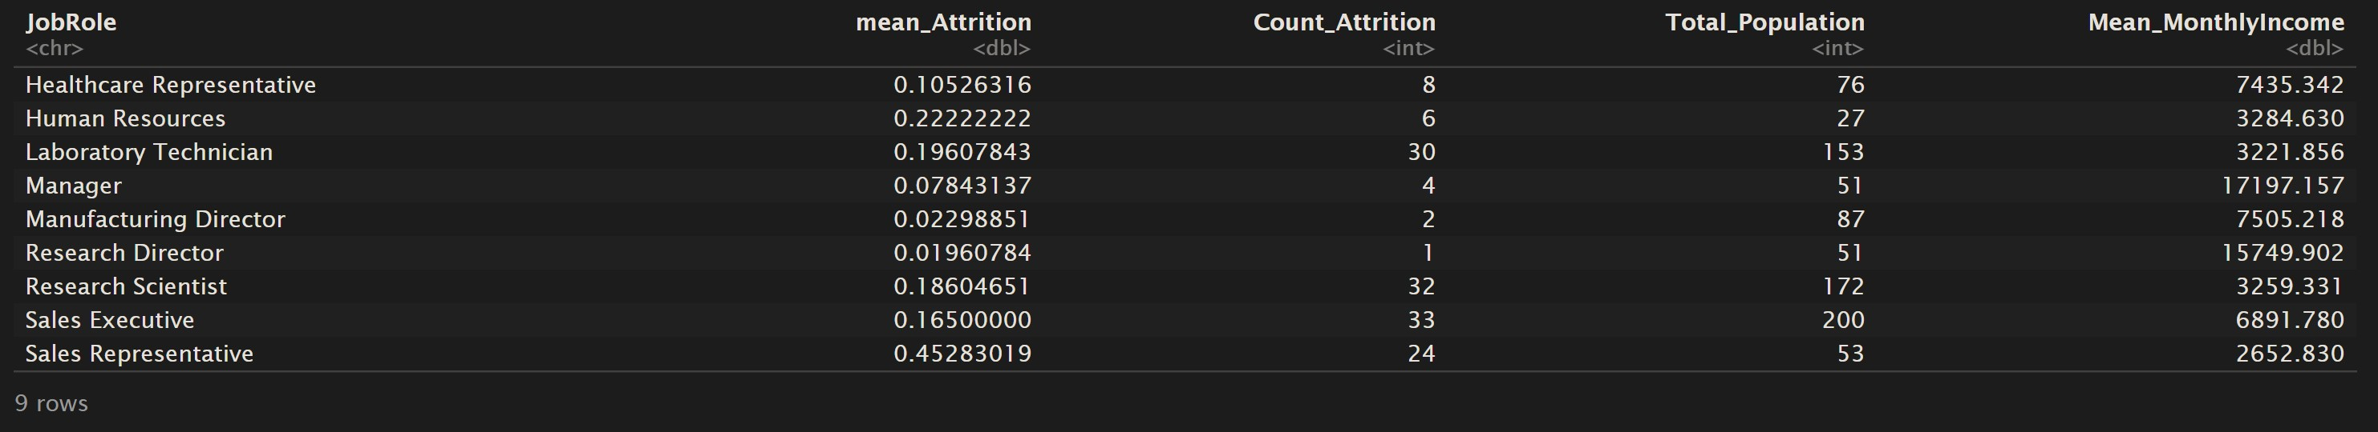
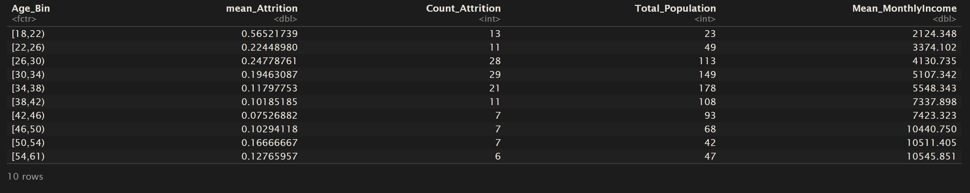
Exploring And Cleaning the Data
Table For Mean Attrition and Monthly Income by Department.
Table For Mean Attrition and Monthly Income by Education Field.
Table For Mean Attrition and Monthly Income by Job Role.
Table For Mean Attrition and Monthly Income by Age_Bin.

Slide 6
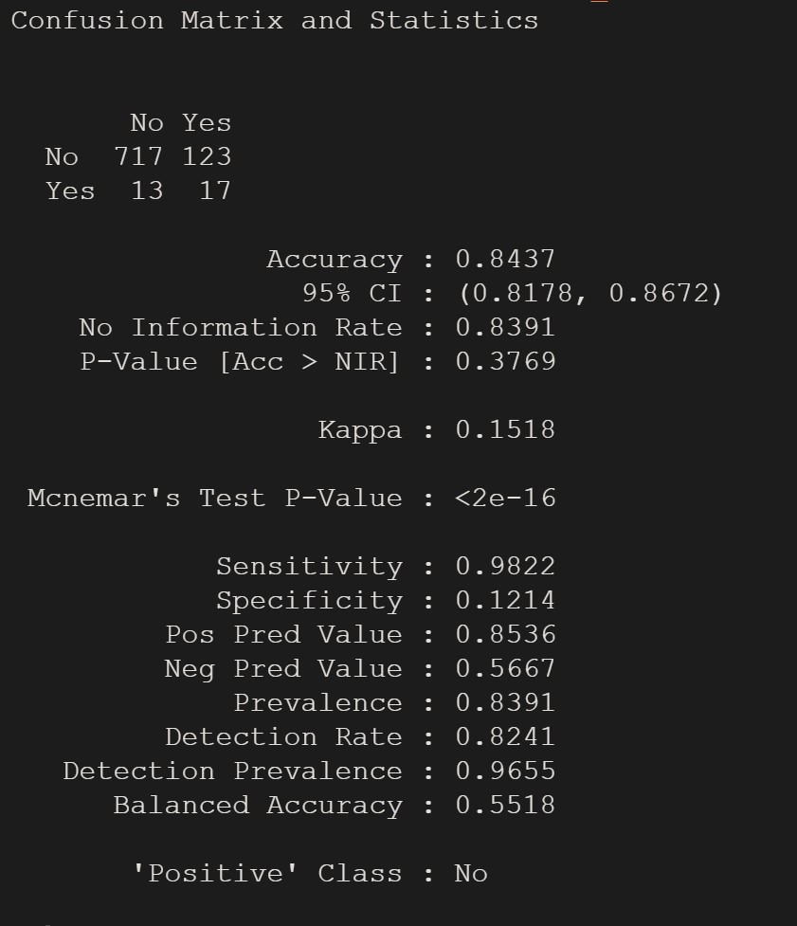
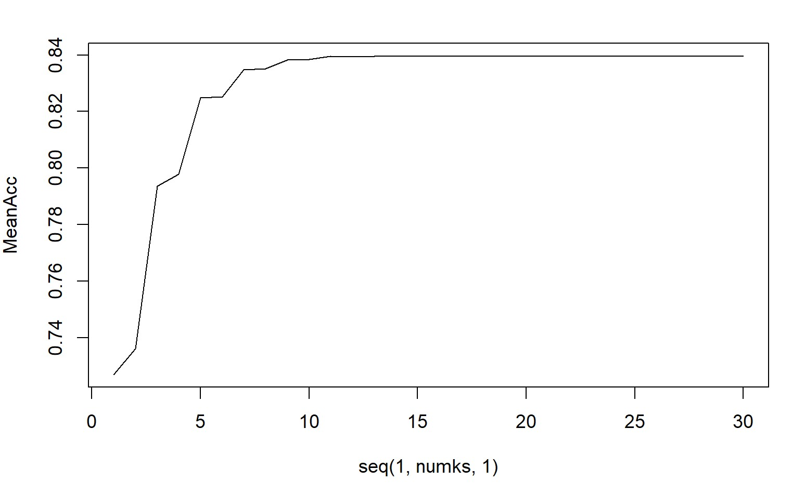
KNN and Naïve Bayer’s
A look into Sales Department…
KNN testing often revealed that it was relatively easy to obtain a high accuracy and high sensitivity but struggled to achieved a reasonable specificity to the model without breaking it down further. I utilized Naïve Bayer’s testing to investigate the Sale’s Department group to predict the likely status of Attrition. I discovered that following statistics:
Sales Representative Attrition Likelihood:
No= 45.67%, Yes= 54.33%
Sales Executive Attrition Likelihood:
No= 77.88%, Yes= 22.12%
Manager Attrition Likelihood:
No= 89.10%, Yes= 10.90%
These findings are consistent with our initial visual observations

Slide 7
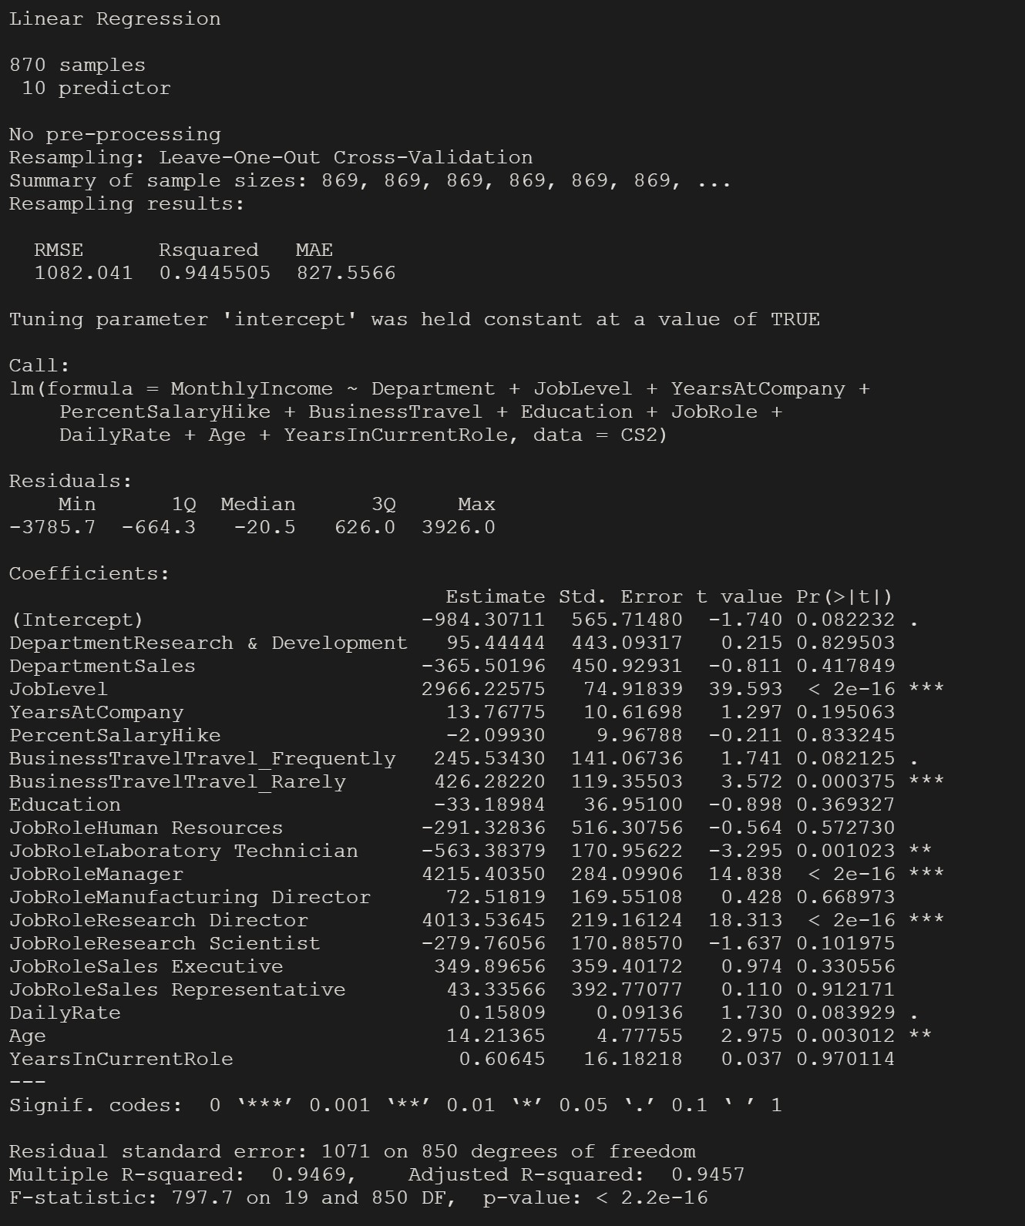
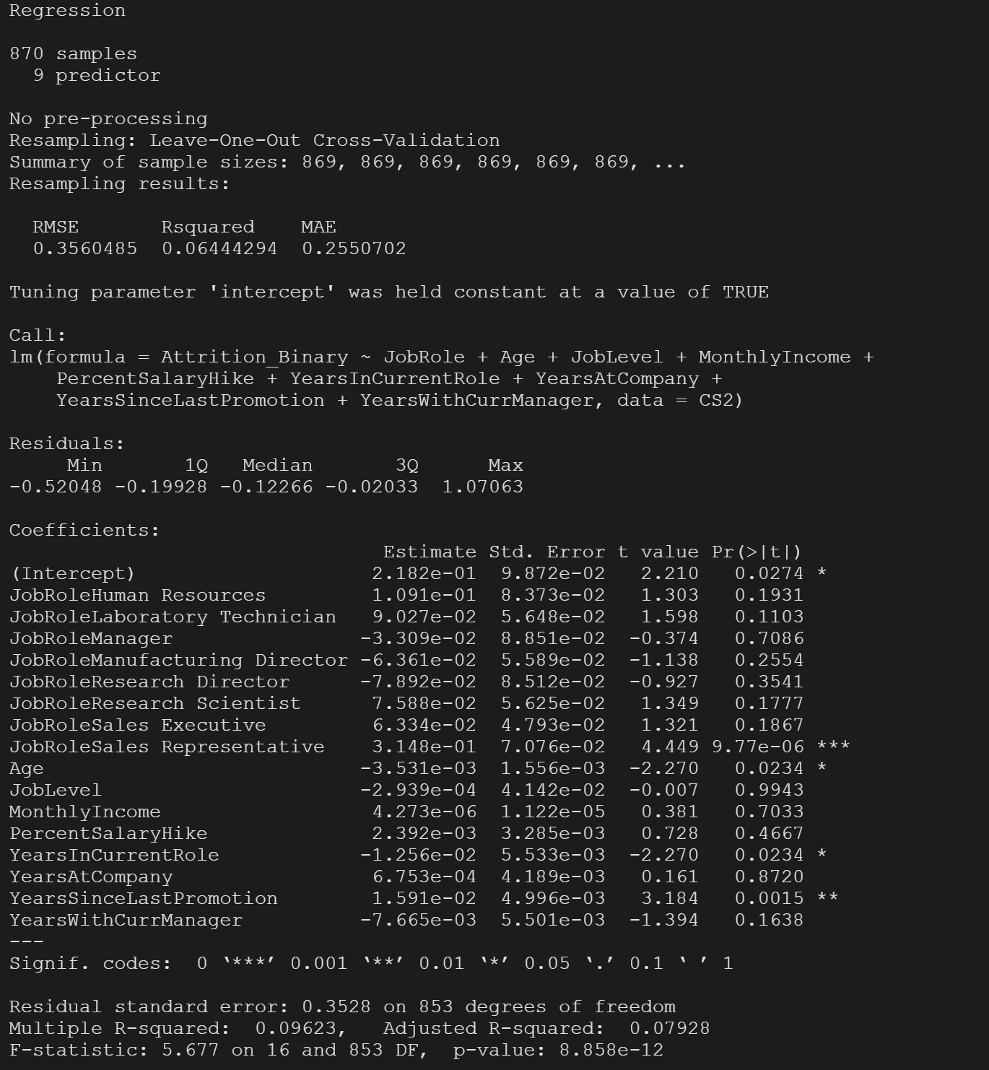
Linear Regression
Linear Regression of Monthly Income
Linear Regression of Attrition
A linear regression model to predict the likely Monthly Income captured and RMSE of $1082.04. This indicates that a prediction would likely be within a $1,000 of the actual value.
A linear regression model to predict the likely Attrition of an observation based on the several factors returned an RMSE of .35. This indicates that a prediction would likely predict Attrition as “Yes” approximately 35 percent of the time.

