Slide 1
Business Analytical Systems
Authors: Jackson lowder & Nicholas samelson
Company: abai consulting inc.

Slide 2
The Mission
FloralThymes is a flower shop where customers buy custom-made bouquets and flower bundles. They sell flowers for all occasion such as birthdays, Christmas, Thanksgiving, as a gift, and many more. The primary goal is to spread happiness through the satisfaction of customer's purchase and explore the variety of lovely flowers.

Slide 3
Objectives
Be creative with a wide range of flowers
Create bouquets and bundles for any situation, events, and thymes faster and cheaper
Increase customer awareness through social media
Expand shops to other locations
Efficiency and Productivity

Slide 4
Competition Strategies
Use social media such as Facebook, Instagram, Twitter, and even blog to increase awareness
Compare prices of other shops and price fairly for the market
Collaborate with big companies like Walmart, Hyvee, H-Mart and get bundles and bouquets in the stores
Continuously improve website for easier customer interaction
Explore cheaper flower wraps, pots, and dirt while maintaining eco-friendly mindset
Hire more helpers to reduce congestion and improve productivity

Slide 5
Main Business Functions
Order Processing
Inventory management
CRM
Delivery Service
Reporting and Analytics
Employee Management
Market and Promotion
Financial Management
E – Commerce Work
Supplier Management

Slide 6
Top 10 Business Analytical Systems
Google Analytics
Tableau
SAP Business One
Netsuite
Microsoft Dynamic 365
Lightspeed
Square
Zoho Inventory
Quickbooks
Hubspots
Notes:
Some features of these systems that will help the company are analyzing and tracking data such as website traffic and markets. Some are automated systems for core business processes while others help make the systems run smoother in terms of payment transaction, shipment orders, and so much more.

Slide 7
Swot Analysis
Strengths
User-Friendly Interfaces
Comprehensive Functionality
Integration Capabilities
Efficiency and Productivity
Workflow Automation
Weakness
Cost of Implementation
Security Concerns
Learning Curves
Resource Allocation
Time Needed To Set Up

Slide 8
Swot Analysis (Cont.)
Opportunity
E-Commerce Growth
Mobile App Development
Marketing Automation
Customer Experience Enhancement
Partnership Opportunities
Threat
Cybersecurity Risks
Vendor Reliability
Data Breaches
Regulatory Changes
Market Fluctuations

Slide 9
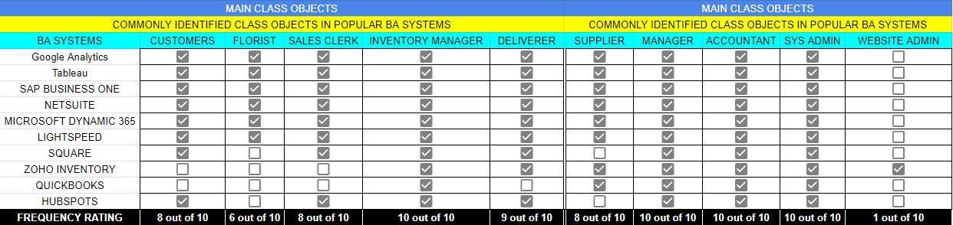
Class Objects (10 Existing)

Slide 10
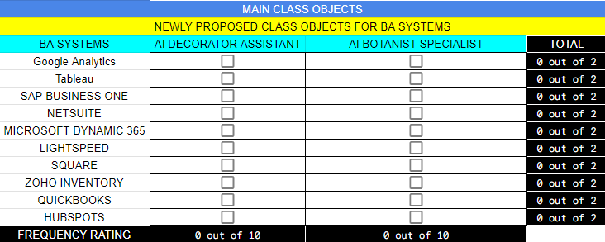
Class Objects (2 New)

Slide 11
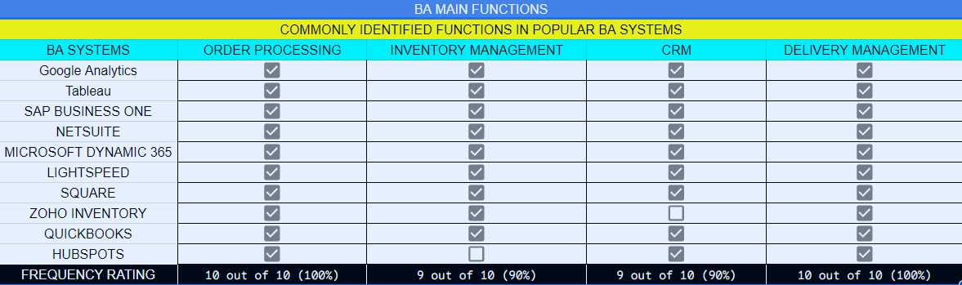
10 Common Functions

Slide 12
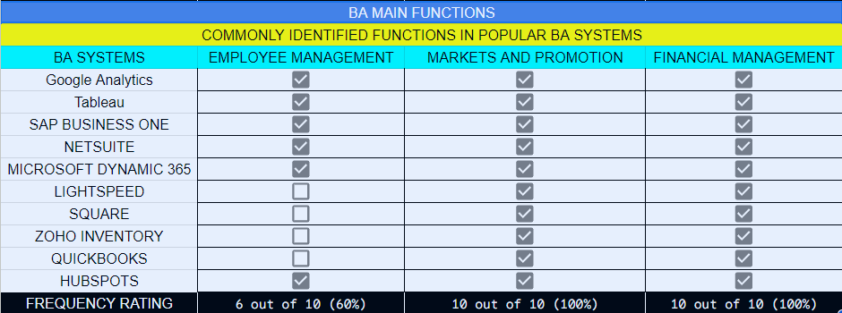
10 Common Functions (Cont.)

Slide 13
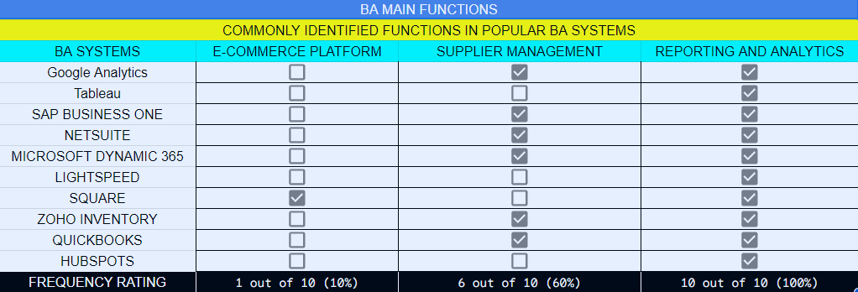
10 Common Functions (Cont.)

Slide 14
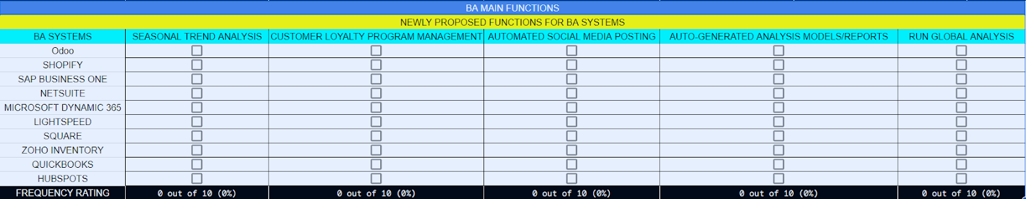
5 New Function

Slide 15
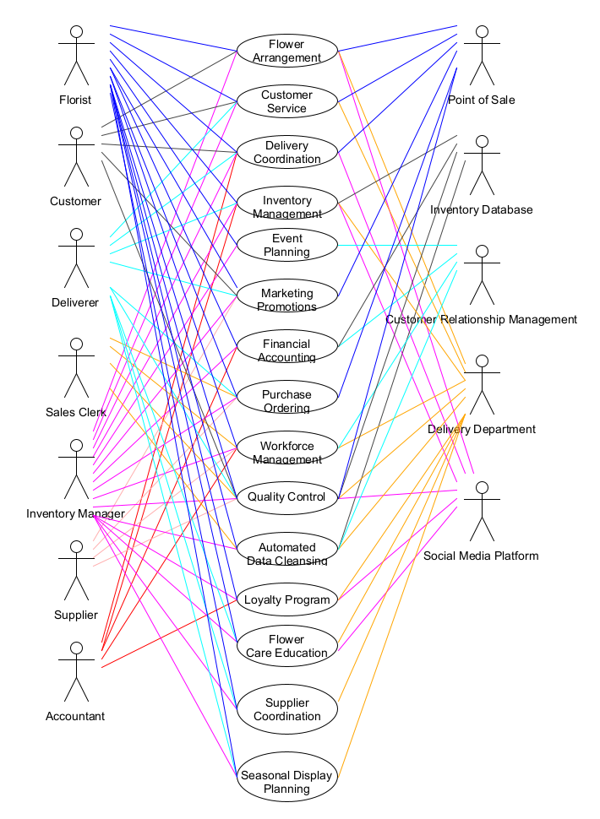
Use Case Diagram

Slide 16
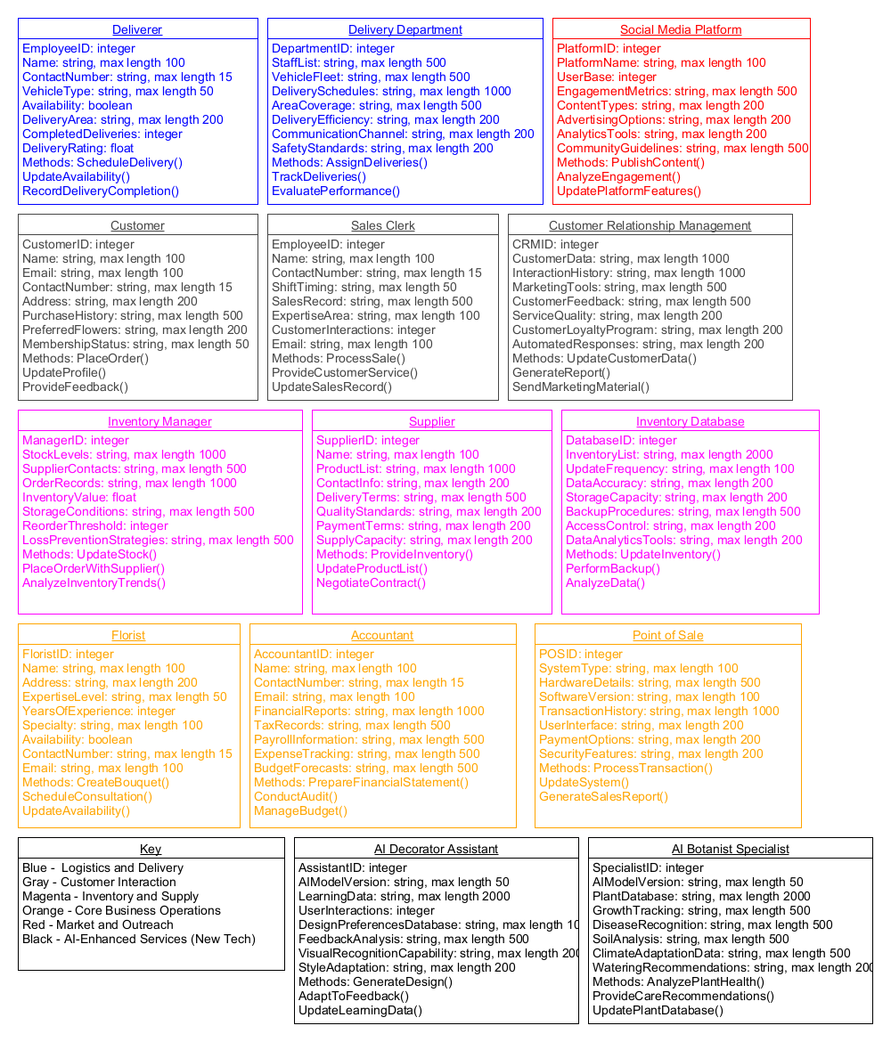
Class Objects Diagram

Slide 17
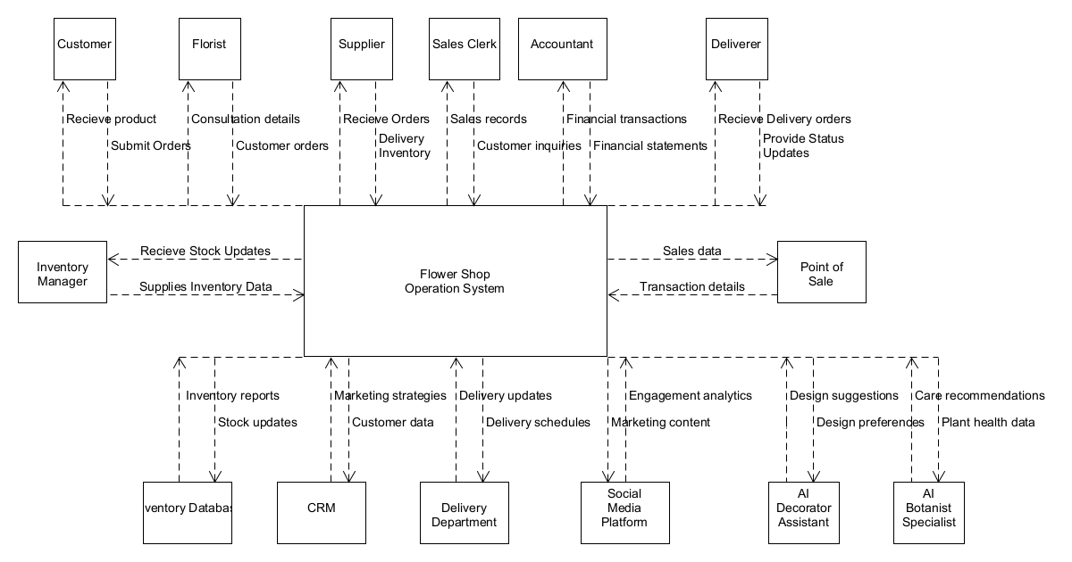
Context DFD

Slide 18
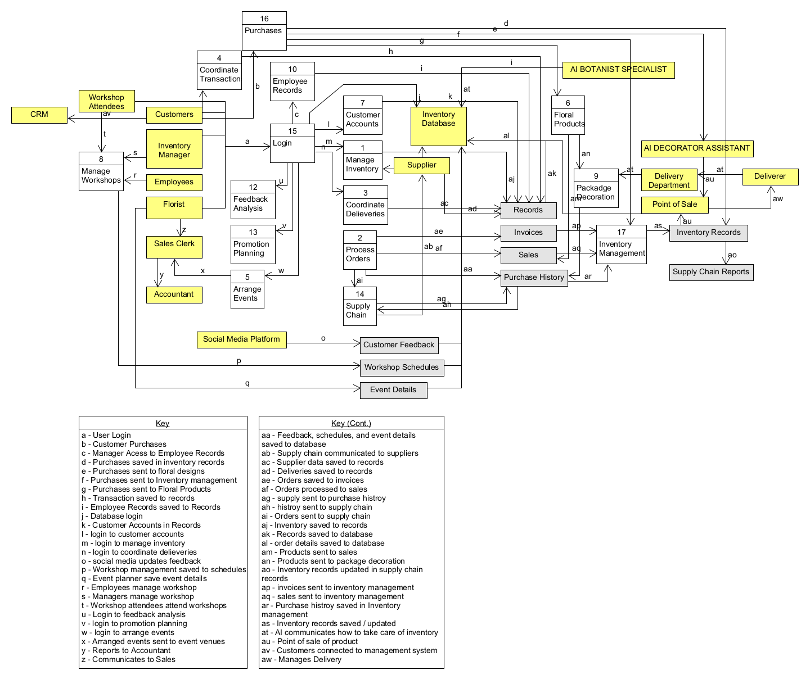
Level 0 DFD

Slide 19
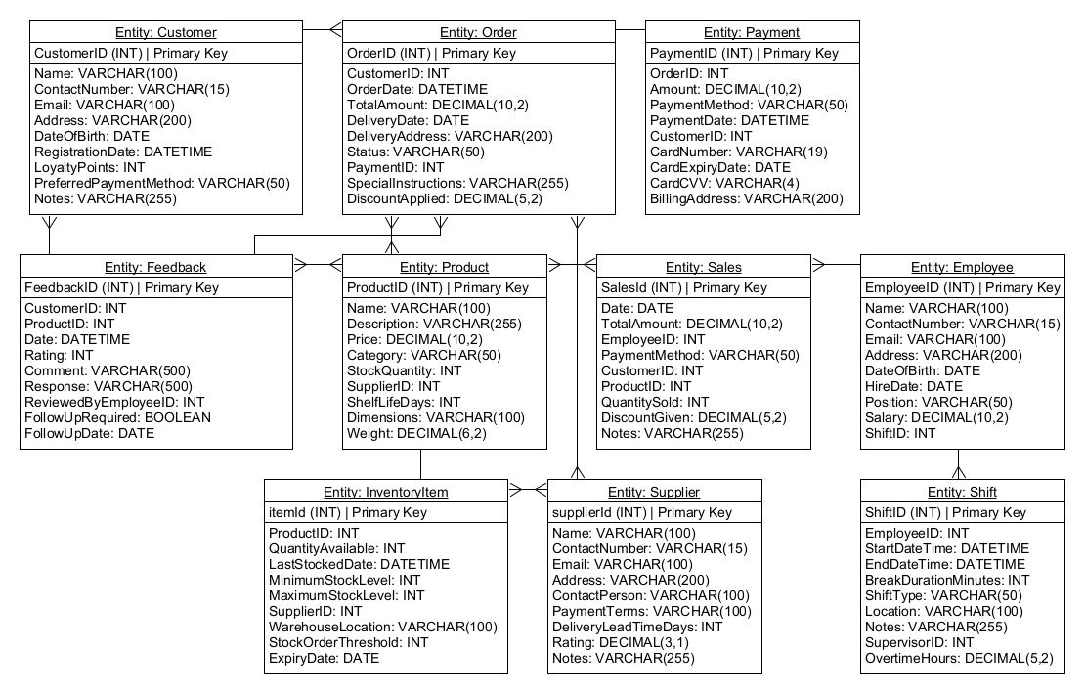
Entity Relationship Diagram

Slide 20
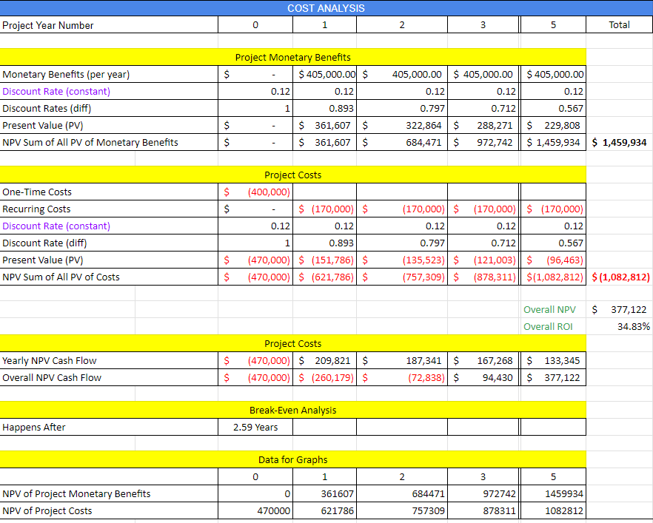
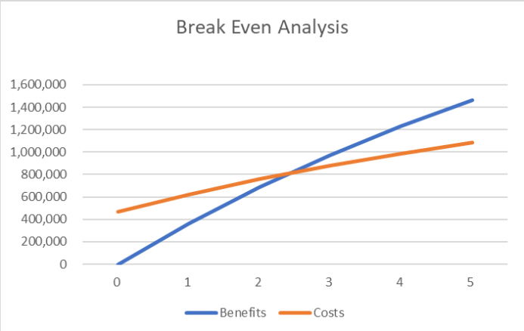
Cost Benefit Analysis

