Slide 1
Dev containers and implementation within GitHub Codespace
John Chodkowski
10/1/2026
Midwest Bioinformatics Office Hour

Slide 2
Development containers
Run a development environment insider of a container instead of directly on your computer
  Most commonly through a Docker container
Advantages
  Everything is pre-installed and shareable
    Reproducibility across a workgroup
  Isolated environments avoid package conflicts
    Use 1 dev container per project or task
  Agnostic to compute platform
    Local, remote, cloud, cluster
  Works seamlessly with Visual Studio Code (VS Code)
    Run VS Code inside a Docker container when you launch your dev container
  Integrates with GitHub Codespace
    Git repos can contain dev container components to launch a codespace
https://containers.dev/

Slide 3
Dev container components
devcontainer.json
  Config file providing instructions on how to build (customize) the dev container
  Required
Dockerfile
  A txt file with step-by-step instructions for building your source code, aka Docker container
  Optional
docker-compose.yml
  Multi-container configurations
    E.g. an R container (analysis) + a PostGres SQL container (database)
  Optional
  Will not cover this today

Slide 4
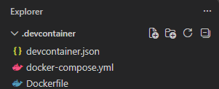
Directory structure

Slide 5
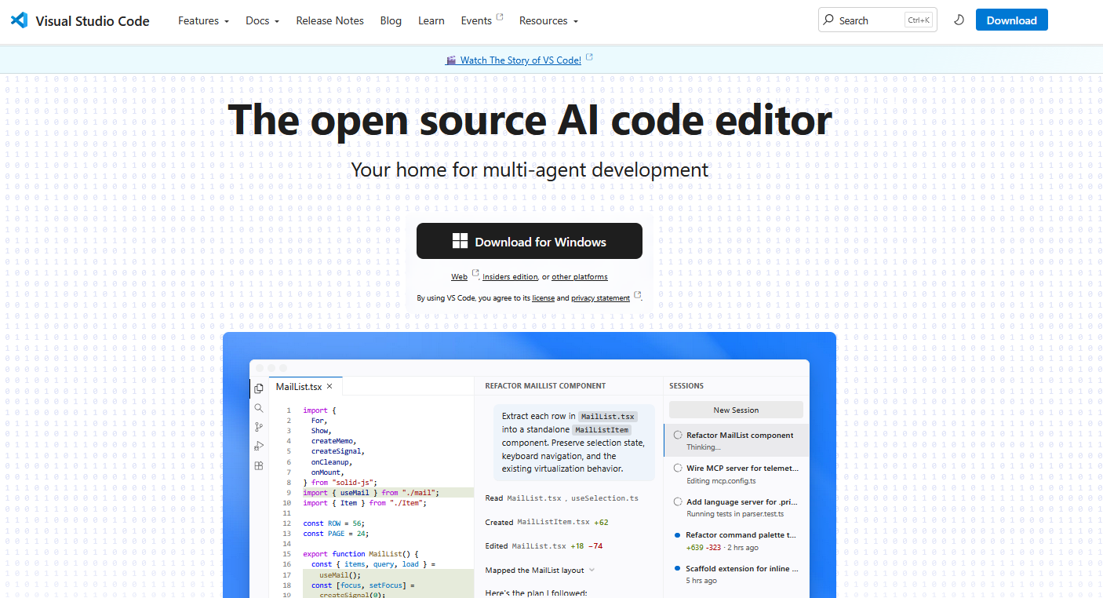
Integrates with Visual Studo (VS) Code
https://code.visualstudio.com/
Let’s walkthrough the creation of a simple dev container

Slide 6
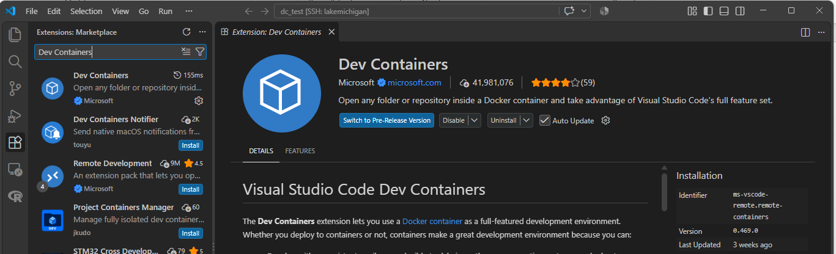
Step 1: install the Dev Container extension

Slide 7
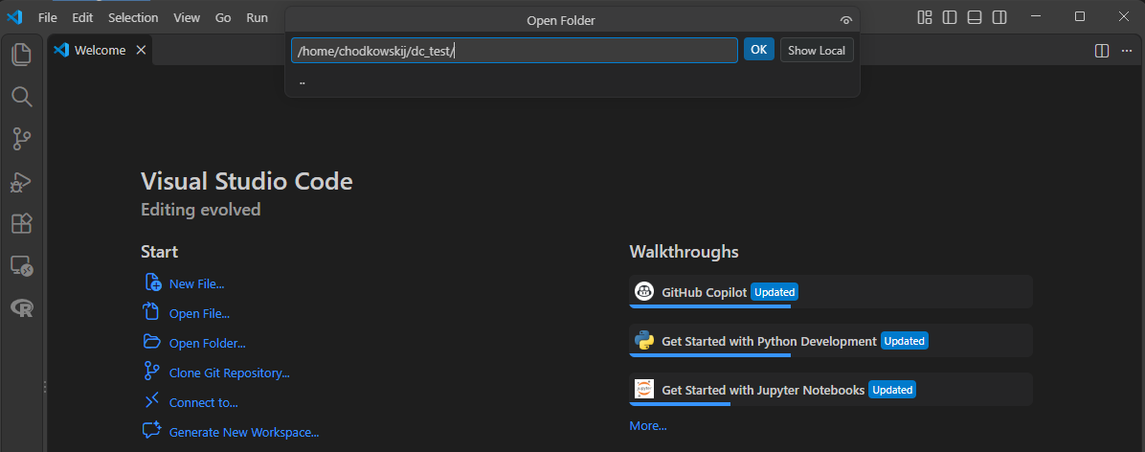
Step 2: Navigate to a directory of interest

Slide 8
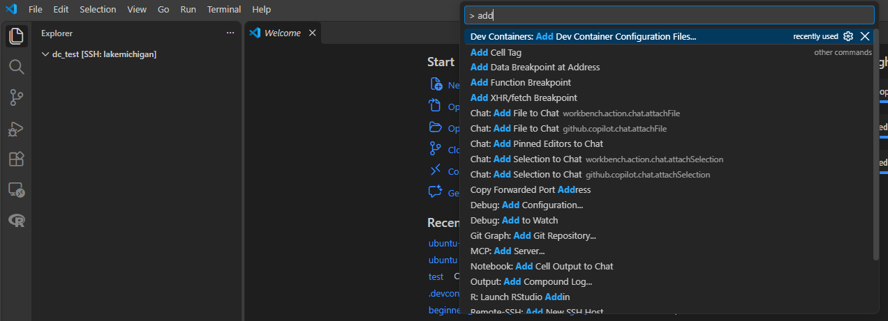
Step 3. Add config files to the directory
Note: the “>” is needed to open the command palette vs searching for files

Slide 9
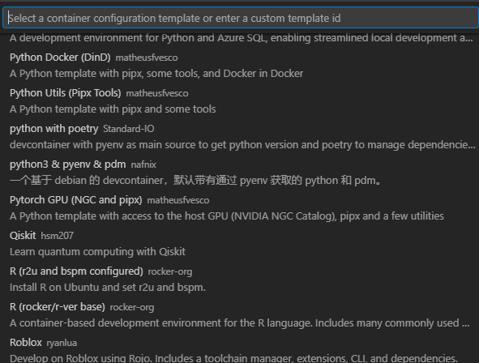
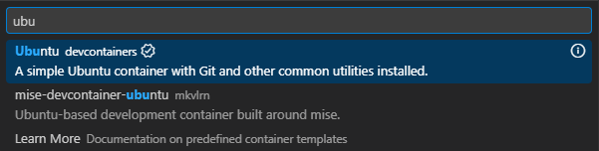
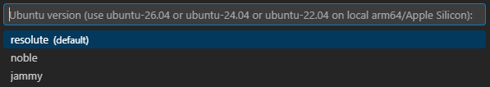
Step 4. Select a container config
The list of available templates can be viewed, here: https://containers.dev/templates
For this demo, I chose a simple ubuntu container
https://hub.docker.com/_/ubuntu

Slide 10
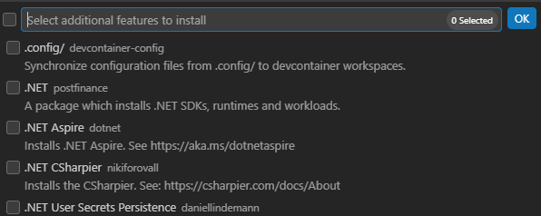
Step 5. Add (optional) features
Self-contained shareable units of installation code. Features are built on top of the container base layer.
I personally prefer to just add a custom Dockerfile specifying my “features” or installations

Slide 11

Step 6. Add an (optional) file
https://docs.github.com/en/code-security/concepts/supply-chain-security/about-the-dependabot-yml-file
https://containers.dev/guide/dependabot
A GitHub feature to automatically scan and manage dependencies. Automatically generates a request to update dev container features (previous slide)

Slide 12
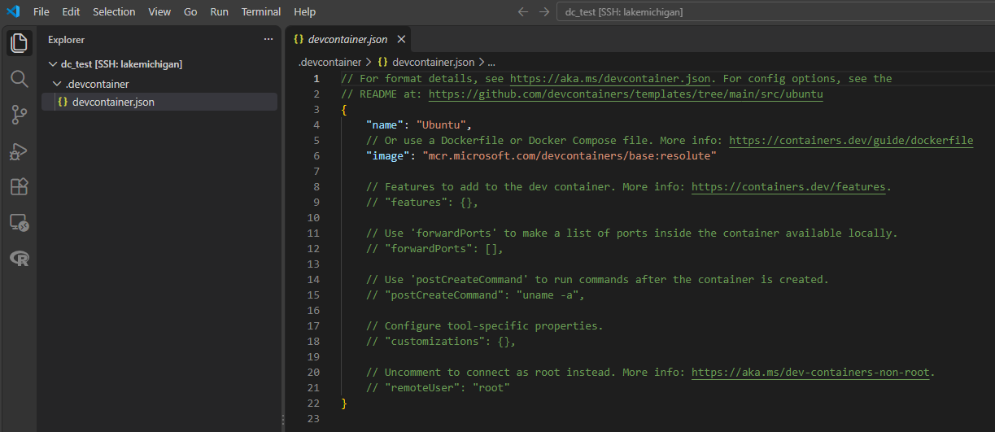
dev container creation is then complete!

Slide 13
A .devcontainer directory with a template devcontain.json is then created and saved in your current working directory
Name displayed for dev container when in use
Name of image from container registry
Self-contained shareable units of installation code
Locally access applications within the container
Run a command post-dev container creation
VS code settings and addition of extensions
User specification
These were added by default with the Ubuntu container config template, but a whole list of specifications can be viewed, here.

Slide 14
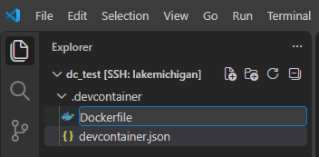
Step 7. Add Dockerfile
“Add new file”

Slide 15
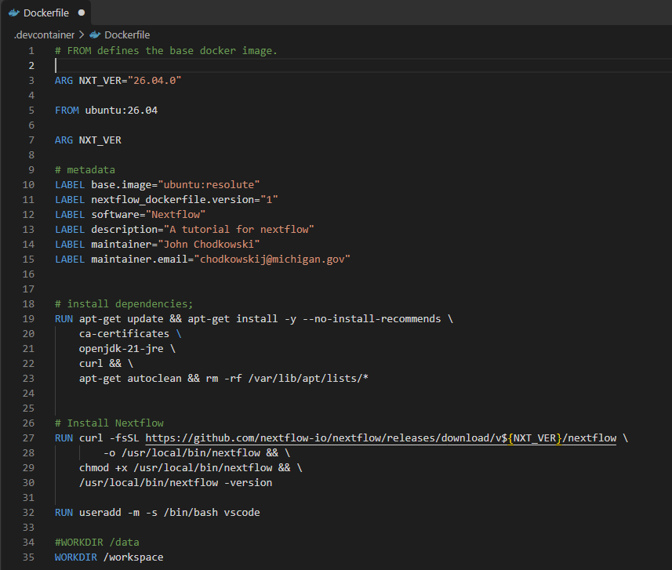
Step 8. Edit Dockerfile
ARG: Creates variables within a Dockerfile that is used during image build
FROM: indicates which image to start from

Slide 16
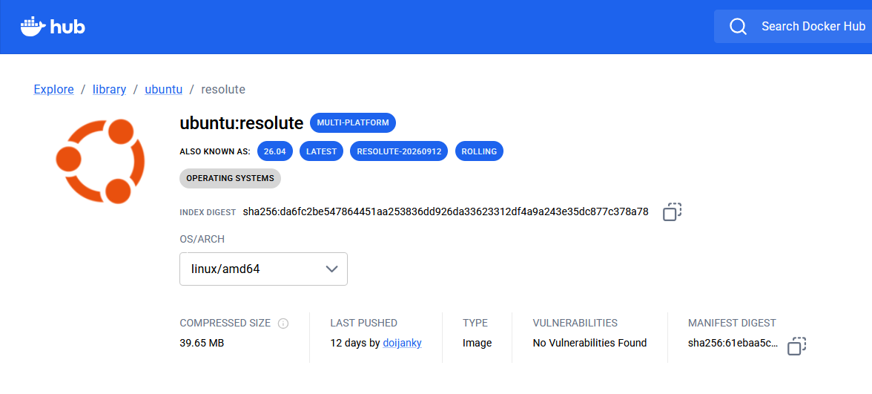
Base image: https://hub.docker.com/_/ubuntu
For even better reproducibility, folks are starting to use the manifest digest to specify the base image:
FROM ubuntu@sha256:61ebaa5cc23ca45450db85eac015435199ec569e28ec222ea13f2aed2110b8a6
Pros: complete reproducibility, Cons: security vulnerabilities

Slide 17
Step 8. Edit Dockerfile
ARG: Creates variables within a Dockerfile that is used during image build
FROM: indicates which image to start from
LABEL: image metadata
RUN: runs any valid shell command while building the image
WORKDIR: sets the work directory when you launch the dev container

Slide 18
Learn more about Docker
Dockerfile reference | Docker Docs
APHL training directory

Slide 19
How do I find resources for creating Dockerfiles?
The source (https://docs.seqera.io/nextflow/install)
https://github.com/StaPH-B/docker-builds
LLMs

Slide 20
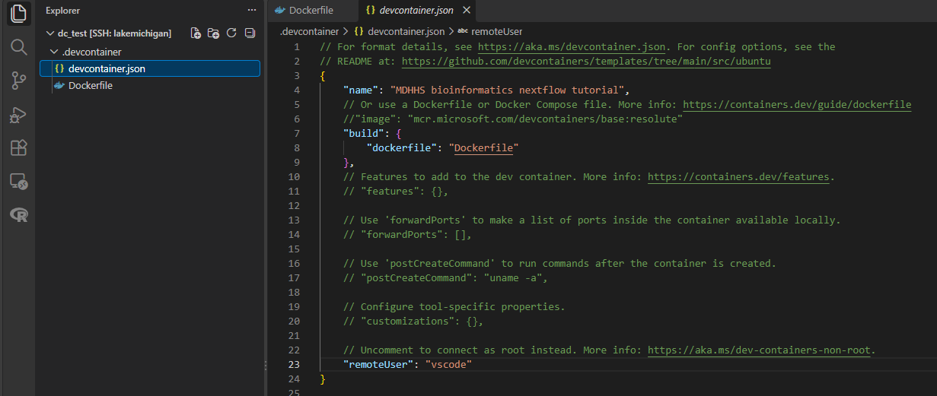
Step 9: Edit devcontainer.json specifications
Instead of using base ubuntu image during dev container creation, build from the Dockerfile, instead

Slide 21
Original devcontainer.json

Slide 22
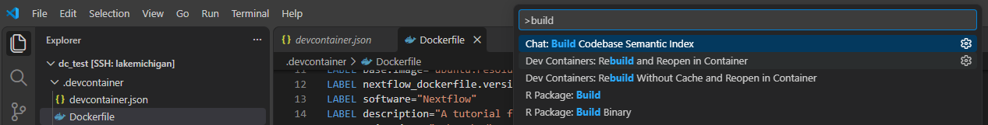
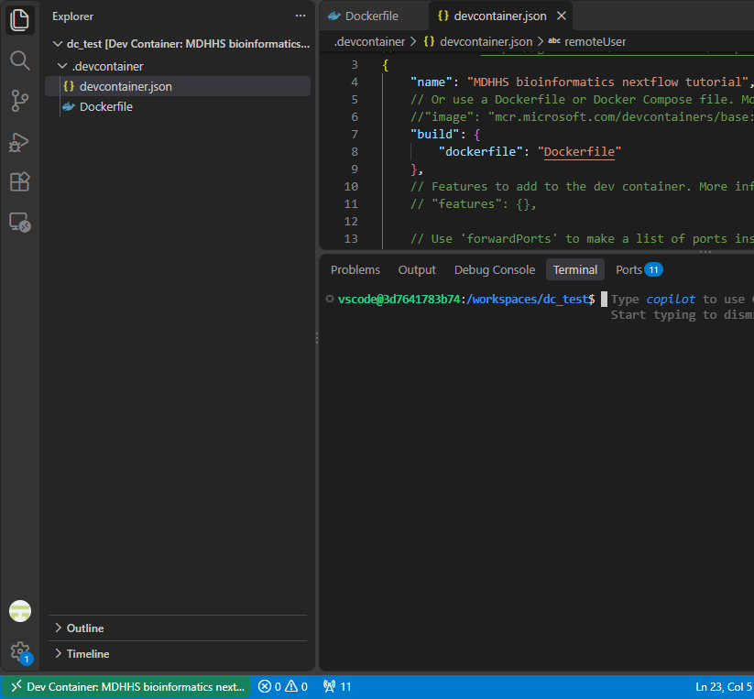
Demo dev container launch
Successfully launched dev container
Currently on our remote cluster
Dev Containers:
Rebuild and Reopen in Container
Recall, “~” is /home/UserName
Assigned
username
WORKDIR
* But this was launched on our cluster at MDHHS. There’s another utility for using dev containers, and that’s via GitHub codespaces

Slide 23
GitHub Codespaces
A linux environment hosted within a docker container hosted by GitHub
Users can fork a repo and start their own codespace
  Provides Virtual Machine (VM) compute environment
  Provides VS code editor
At minimum, the GitHub repo needs a .devcontainer folder and within:
  devcontainer.json
    Customize VS code workspace
  Dockerfile (optional)
    Specify container environment and tool installations

Slide 24
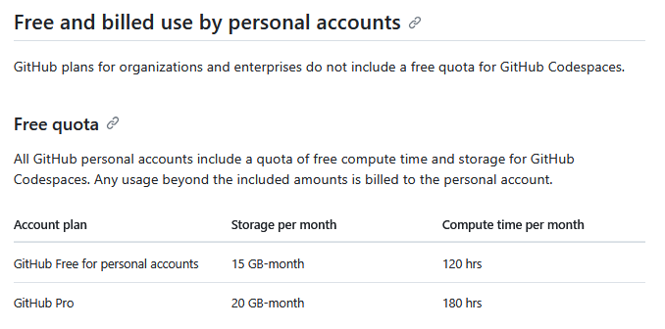
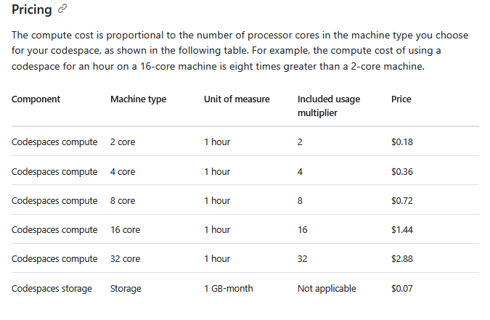
Codespaces free quota permits a viable platform for cross-jurisdiction trainings
The minimum virtual machine (VM) you can launch is 2 cores, so you really only have 60 h of free compute time per month
Make a second GitHub account with an alternative email if you happen to run out of free usage
Active sessions automatically end after 15-30 minutes of inactivity, but storage usage remains
Codespaces are deleted after 30 days of inactivity

Slide 25
dev container training example
https://github.com/JLC2141/mdhhs_nextflow_training

Slide 26
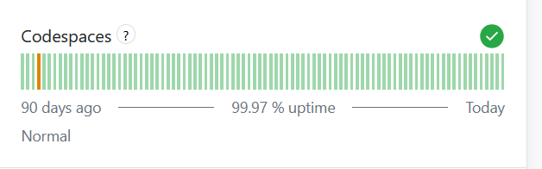
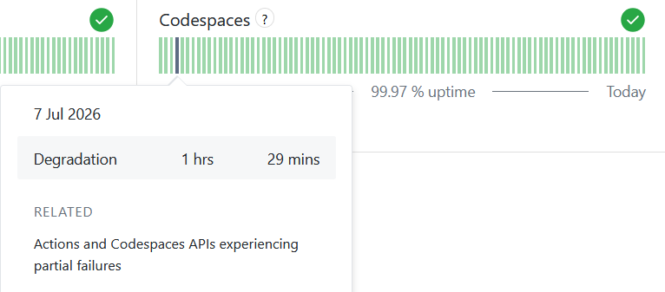
Cons of Codespaces (but still very reliable)
https://www.githubstatus.com/

Slide 27
Summary
Dev containers for training require
  Container runtime
    Docker
  VS code
    With Dev Containers extension
  .devcontainer
    devcontainer.json
    Dockerfile
  GitHub account

Slide 28
Questions?

