Slide 1
Reproducible
Scalable, parallelism,
Nextflow is the way
John Chodkowski
Nextflow breakout session
10/20/2026

Slide 2
What is Nextflow?
A workflow management software for building bioinformatics pipelines.
“Nextflow is a domain specific language (DSL) implemented on top of the Groovy programming language, which in turn is a super-set of the Java programming language.”
  Easy-to-write data-intensive computational workflows
“Nextflow enables scalable and reproducible scientific workflows using software containers. It allows the adaptation of pipelines written in the most common scripting languages.”
https://www.nextflow.io/index.html

Slide 3
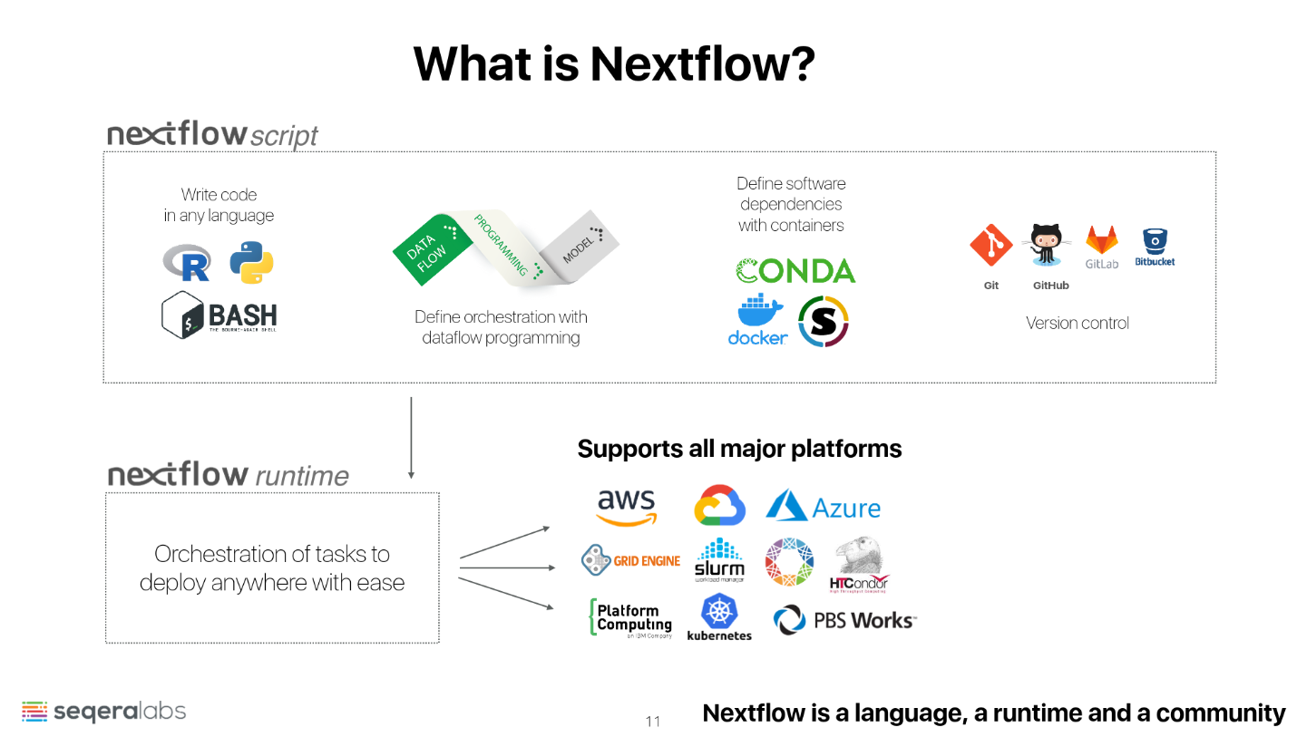
A workflow management software for building bioinformatics pipelines.
https://www.nextflow.io/index.html
Source: https://sateeshperi.github.io/nextflow_varcal/nextflow/

Slide 4
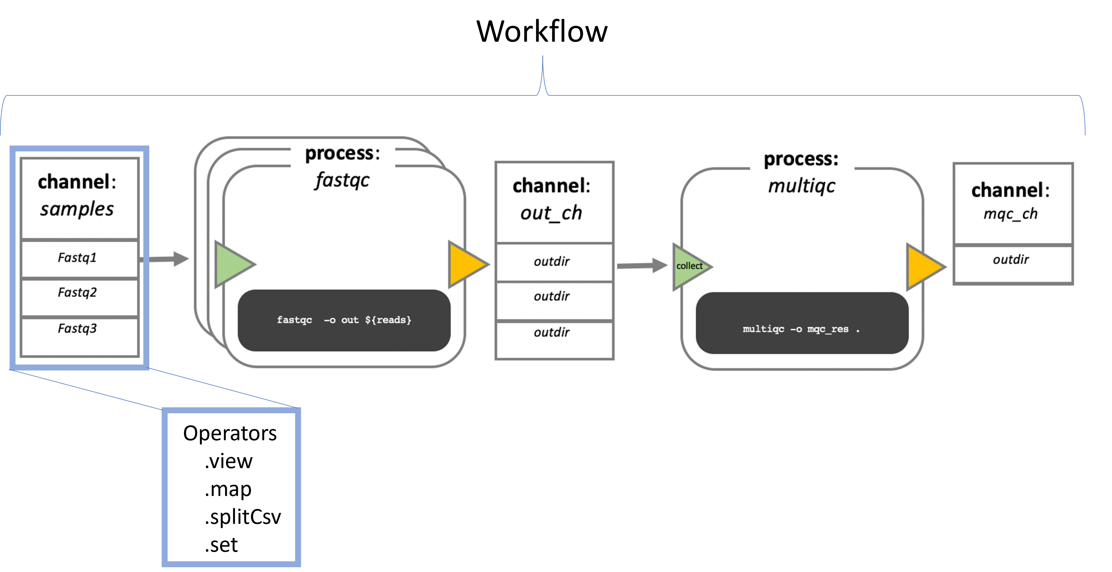
Nextflow pipelines are built with processes, channels, and operators
Processes: individually packaged bioinformatic tools
Channels: data conduits
Operators: transform channels

Slide 5
Nextflowify and let your pipeline thrive
Input A
(FASTQ)
Process A
Coding: R
Container: Tool 1
Process B
Coding: BASH
Container: Tool 2
Process C
Coding: Python
Container: Tool 3
Input B
Input C
Output A
Output B
Adapted from: source

Slide 6
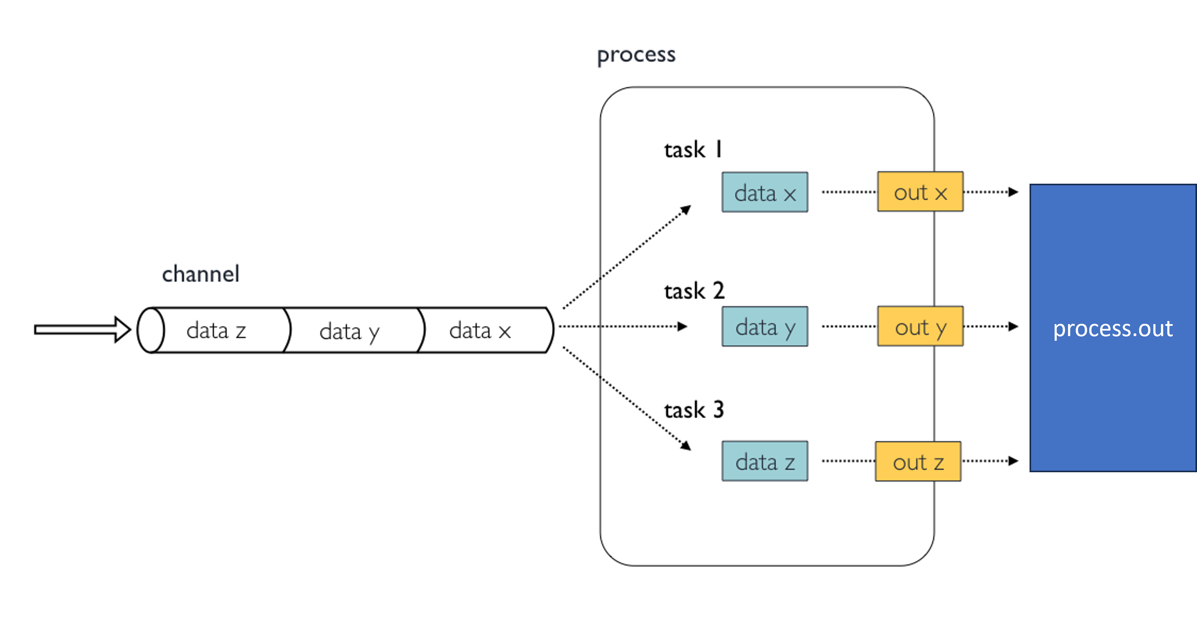
Parallel task execution
Handled automatically
Note: Imagine that data x, y and z are fastq files from separate samples. The channel feeds the data into one process. All 3 samples can be simultaneously analyzed at the same time (assuming enough computational resources)

Slide 7
Nextflow benefits
Portable
  Works on HPC or Cloud
Scalable
  Resource allocation is defined
Reproducible
  Containers
Data provenance
  Complete history of runs
    Files, configs, task executions, etc.
Pipeline checkpoints
  Work directory and resume feature
Automatic parallelization of task handling

Slide 8
Common nextflow pipeline organizational structure
main.nf
  Invoke the workflow of your choice
  required in order for the nextflow run command to function
workflows directory
  Storage of workflows
  A full analysis pipeline is written within each workflows/name_of_workflow.nf
subworkflows directory
  A “mini-workflow” containing a chain of multiple modules
modules directory
  Split into local and nf-core directories
  Bioinformatics tools are stored here
  Scripts here define the process
nextflow.config
  Global configuration parameters to be used in all workflows
  E.g. paths of reference files that will be used in multiple workflows
conf directory
  base.config: Computing resources specifications
  modules.config: Parameters for modules of interest
assets
  Storage of reference files and databases
bin directory
  Storage of custom scripts

Slide 9
GitHub Codespace will provide all of us the same environment to build our nextflow pipeline
A virtual linux environment hosted within a docker container hosted by GitHub
Users can start their own codespace from any available GitHub repo
  Provides a compute environment
  Provides VS code editor
At minimum, the GitHub repo needs a .devcontainer folder and within:
  devcontainer.json
    Customize VS code workspace
  Dockerfile
    Install tools of interest

Slide 10
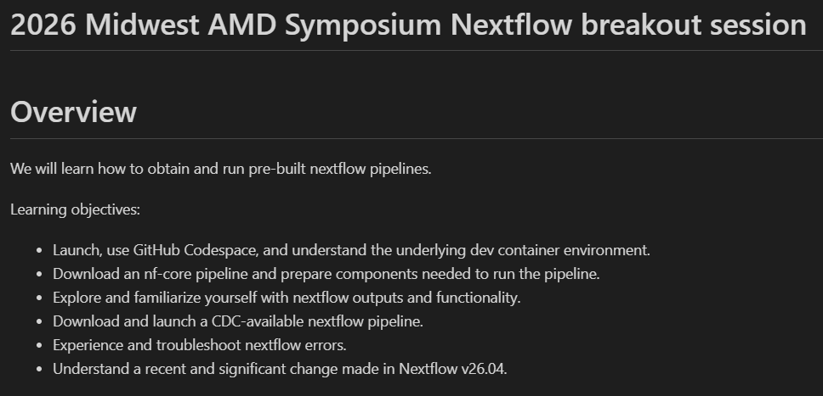

Slide 11
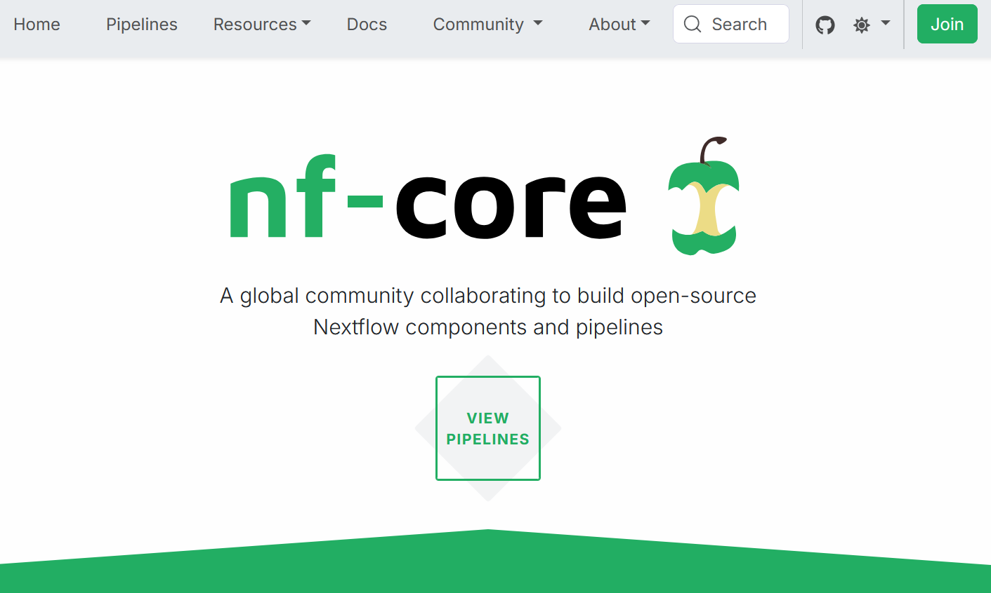
Nextflow is the software. nf-core is the global community collaborating to build standardized pipelines available to all
nf-core tools
  A CLI to build and obtain nextflow pipelines
https://nf-co.re/
https://nf-co.re/docs/nf-core-tools

Slide 12
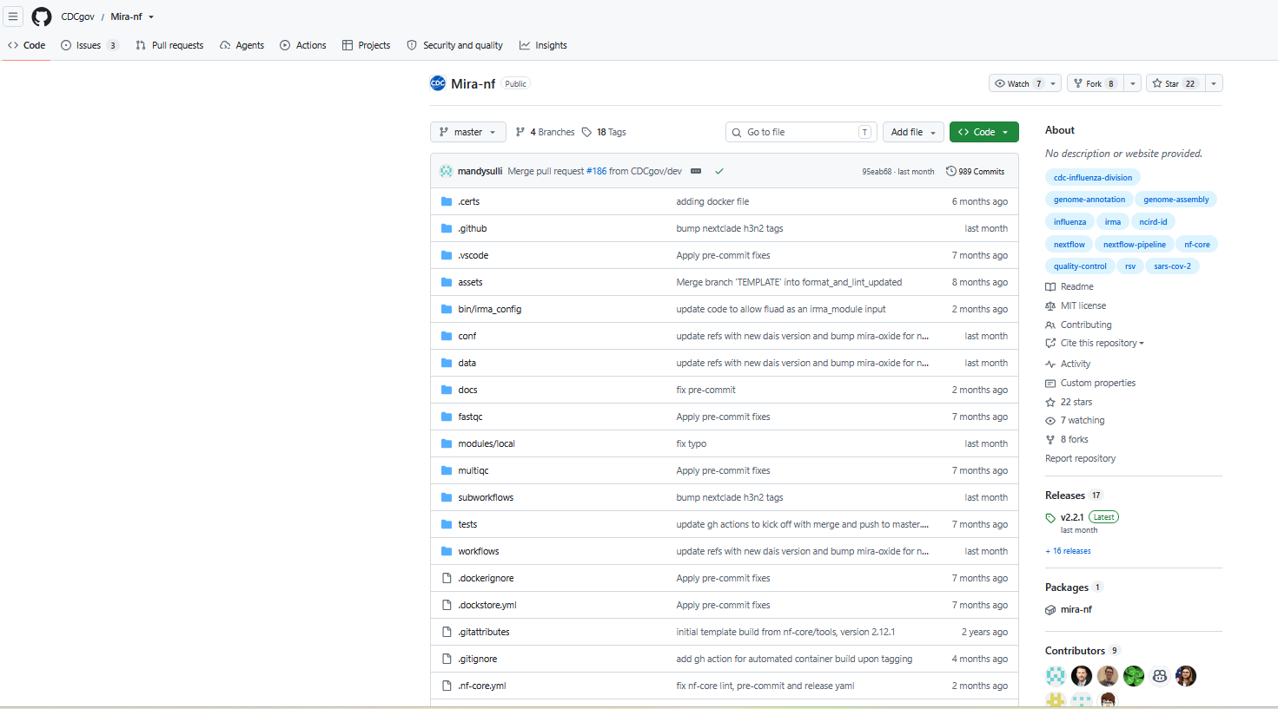
Various nextflow pipelines are already available and built by the CDC and SPHL community (and nf-core)
I always recommend checking if a pipeline for your analysis needs is already available

Slide 13
Let’s get started!
Form groups
Walkthrough the tutorial in groups
There are two challenges
  We’ll come back together to go over these challenges

