Slide 1
Plugin Webhook
JL Lormeau

Slide 2

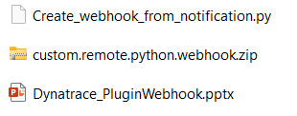
Plugin Automic
Livrable
Plugin
Copie des notifications webhook en plugin webhook
plugin
This ppt

Slide 3

Overview
Par AlertingProfile
API Problem
Filter on alerting profile
schedule AG
1
internal_webhook.py
Internal webhook
Detail
New Problem OPEN or
New Problem CLOSE
2
3
2
4
payload
Status success or failed
Cluster Dynatrace
Active Gate

Slide 4
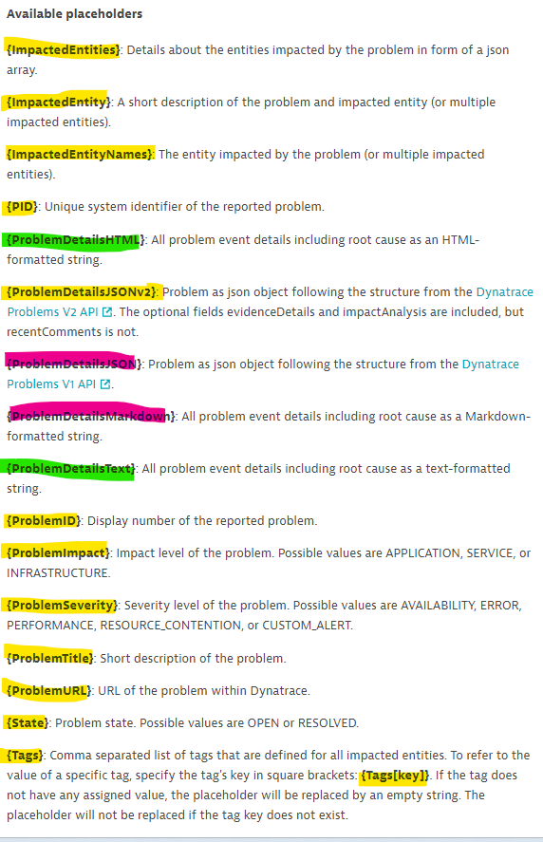
Payload
Identical
Small difference
Not included
Exemple
{
"tenant": "OPE-INTRA",
"state": "{State}",
"problempid": "{PID}",
"problemid": "{ProblemID}",
"environment": "OPERATIONNEL",
"problemimpact": "{ProblemImpact}",
"origin": "dynmo.intra.renault.fr",
"impactedentity": "{ImpactedEntity}",
"impactedentities": "{ImpactedEntities}",
"tags": "{Tags}",
"problemtitle" : "{ProblemTitle}",
"problemdetailstext" : "{ProblemDetailsText}",
"problemseverity": "{ProblemSeverity}",
"alertingprofile": "ciim-esx-hsf_vll_vcenter-vll“
}

Slide 5
Default configuration
pageSize='50'
delay='from=now-5m’
If new OPEN problem
Ajout du comment
the open ticket has been sent to the webhook
If new CLOSED problem
Ajout du comment
the closed ticket has been sent to the webhook
Custom Device Group = Webhook
ContextComment = webhook integration
Payload pour le test de connection URL
{
"State": "OPEN",
"ProblemID": "888",
"ProblemTitle": "Dynatrace problem notification test run for webhook"
}

Slide 6
Installation

Slide 7

Deploiement
Installation du plugin sur l’UI sur AG
Installation du plugin sur l’activegate
* Restart service remotepluginmodule
Copie des configs Notification Webhook sur le plugin webhook
Set variable
export MyTenan= jzq02463.live.dynatrace.com (sans https)
export MyToken=xxx
export ActiveGateId= 2255808504741848081
run Create_webhook_from_notification.py
Token scope
problems read
problems write
configuratons read(*)
configuratons write(*)
(*) Pour Create_webhook_from_notification.py

Slide 8
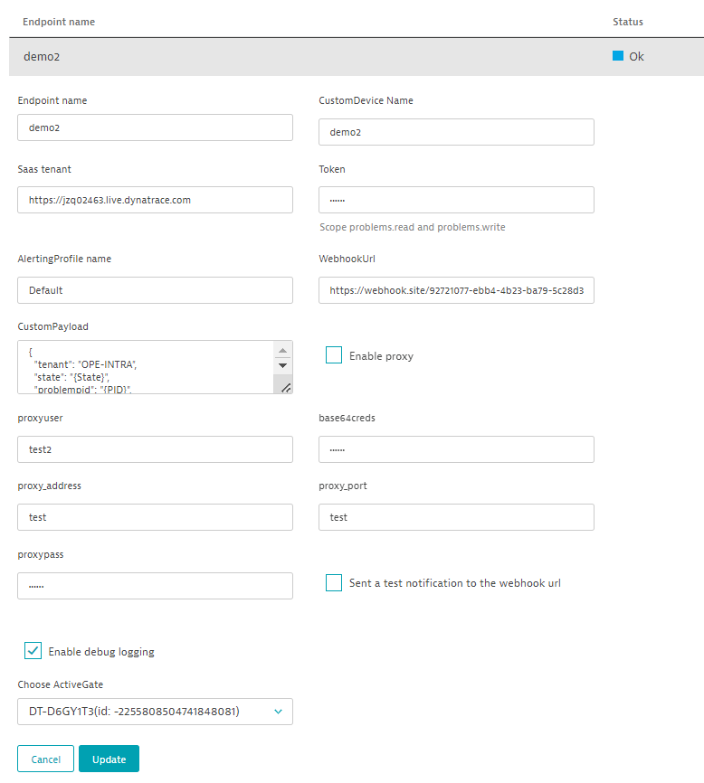
Deployment
Dynatrace UI
ActiveGate
Dynatrace tenant
Settings > Monitoring > Monitored technologies
ActiveGate (sudo)
ActiveGate path: /softwares/dynatrace/
Data path: /softwares/dynatrace/remotepluginmodule/internalwebhook
Unzip custom.remote.python.webhook.zip
Restart the service
sudo service remotepluginmodule restart
Logs :
/var/lib/dynatrace/remotepluginmodule/log/remoteplugin/custom.remote.python.webhook
Custom device name
tenant
Payload
Webhook url
Proxy
Test webhook connection
Activegate

Slide 9
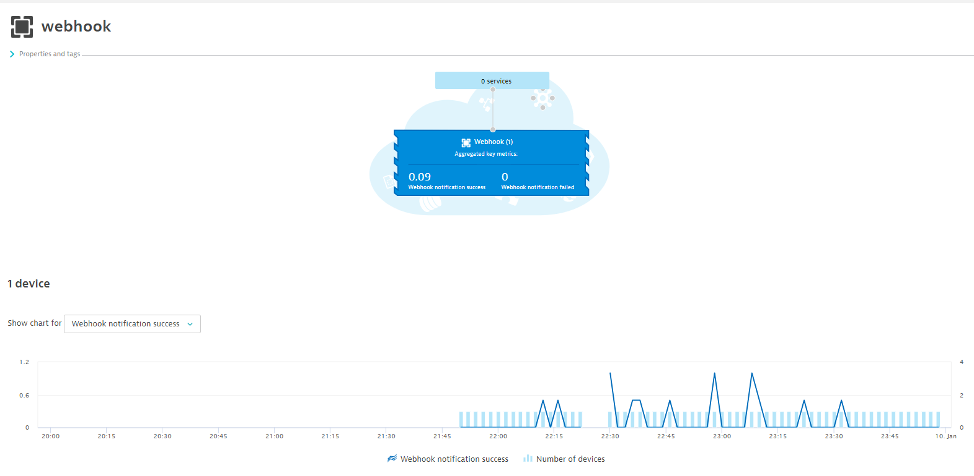
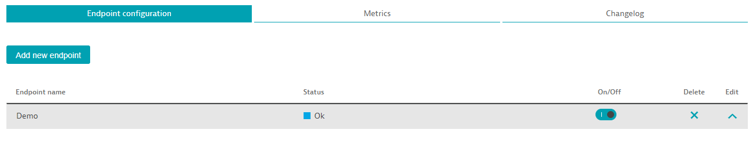
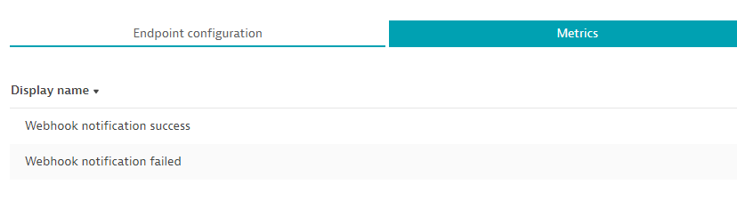
Validation
Technologies > Webhook
Settings > Monitoring > Monitored technologies

Slide 10
Exemple de Paylaod

Slide 11
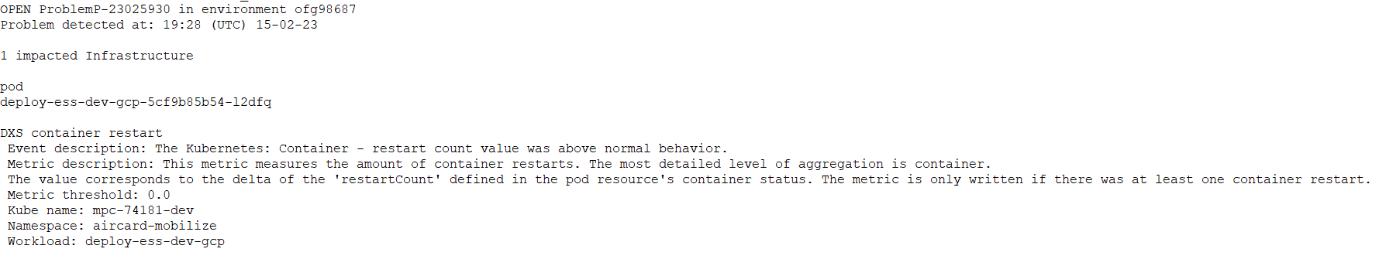
Infra - Pod

Slide 12
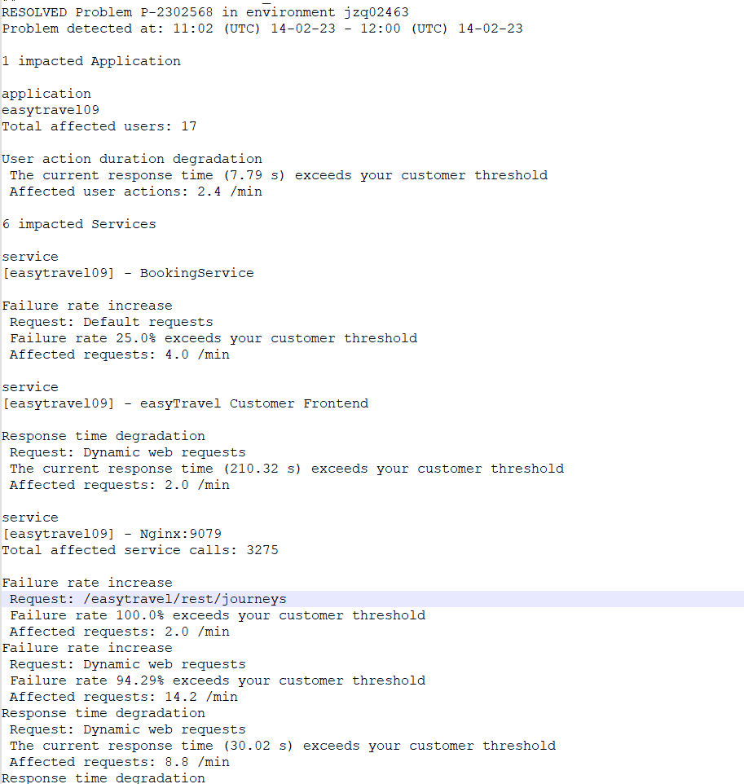
Appli et service

Slide 13
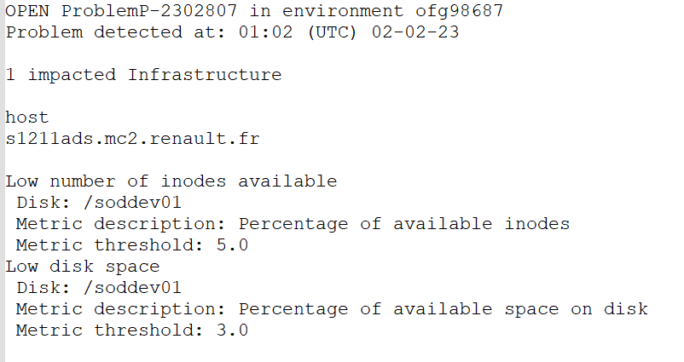
Infra disk

