Slide 1
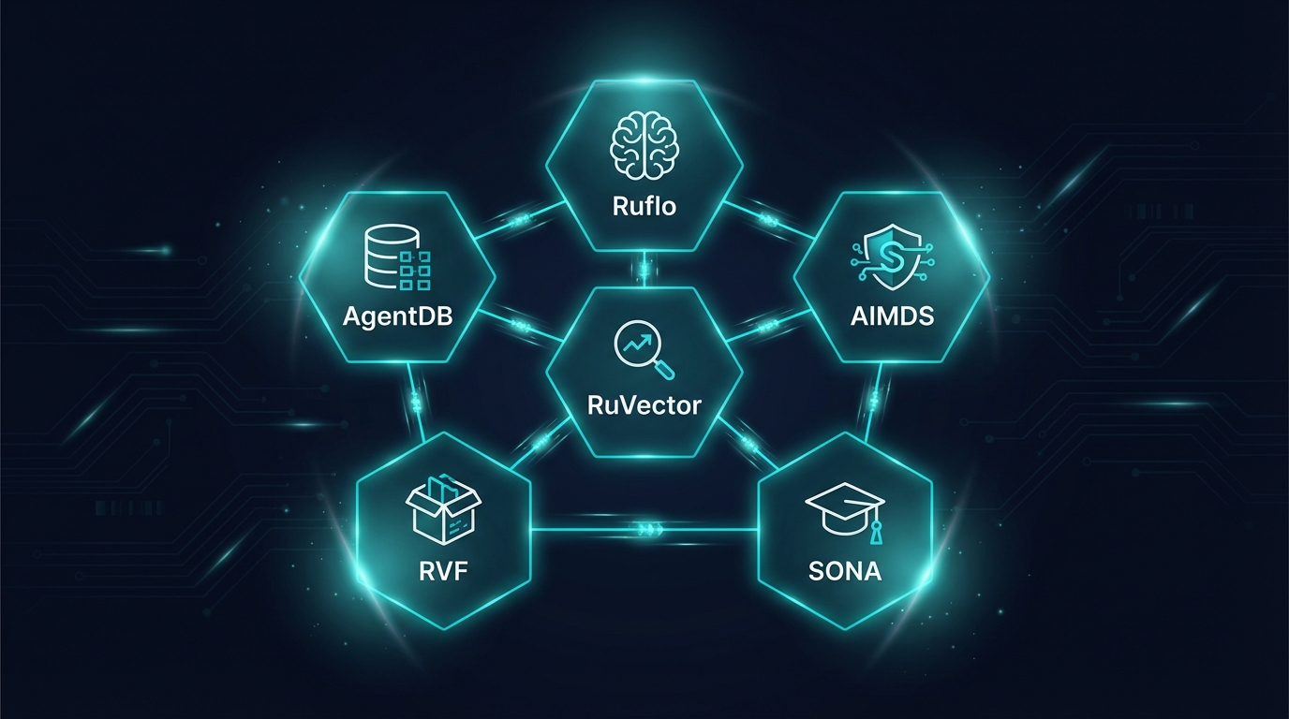
RUVNET
Technical Architecture
Deep Dive
148 capabilities across 14 modules. Production-grade agentic infrastructure.
80+
290+
39
265K
Rust Crates
SQL Functions
Attention Mechanisms
Lines of Code
MIT License | ruvnet.com

Slide 2
What Providers Actually Ship
They ship the inference endpoint. You build the other 11 layers.
Capability | OpenAI | Anthropic | Google | AWS | RuvNet
LLM API | ✓ | ✓ | ✓ | ✓ | ✓
Multi-Agent (150+ types) | ✗ | ✗ | ✗ | ✗ | ✓
Persistent Memory (4 types) | ✗ | ✗ | ✗ | ✗ | ✓
Vector Search (<100µs) | ✗ | ✗ | ✗ | ✗ | ✓
Security Middleware | ✗ | ✗ | ✗ | ✗ | ✓
Offline / Air-Gapped | ✗ | ✗ | ✗ | ✗ | ✓
Self-Learning (<1ms) | ✗ | ✗ | ✗ | ✗ | ✓
WASM Runtime (7.2KB) | ✗ | ✗ | ✗ | ✗ | ✓
Anti-Hallucination (formal) | ✗ | ✗ | ✗ | ✗ | ✓
Graph Analytics (GNN) | ✗ | ✗ | ✗ | ✗ | ✓
MCP Protocol (96 tools) | ✗ | ○ | ✗ | ✗ | ✓
Data Sovereignty | ✗ | ✗ | ✗ | ○ | ✓

Slide 3
System Architecture
14 modules. Unified data plane. Security envelope.
Input
▶
AIMDS
▶
Ruflo
▶
RuVector
▶
AgentDB
▶
SONA
▶
Output
0.06ms scan
150+ agents
5 topologies
61µs search
4 memory types
9 RL algorithms
RVF: 3-Tier Compute
Nervous System: 5 Bio-Inspired Layers
WASM (5.5KB) | eBPF (kernel bypass) | Unikernel (125ms Linux boot)
Sensing (<100ns) | Reflex (<1µs) | Memory (10³⁰ cap) | Learning | Coherence
PostgreSQL Unified Data Plane — 290+ SQL Functions | HNSW Indexing | RuVector Extension | Drop-in pgvector replacement
Security Envelope — Witness Chains (ML-DSA-65 Post-Quantum) | TEE Attestations | PII Redaction | DNA Lineage Tracking
96 MCP Tools
80+ Rust Crates
49+ npm Packages
25+ ADRs
14 Modules
This entire stack is open source. MIT license. Free forever.

Slide 4
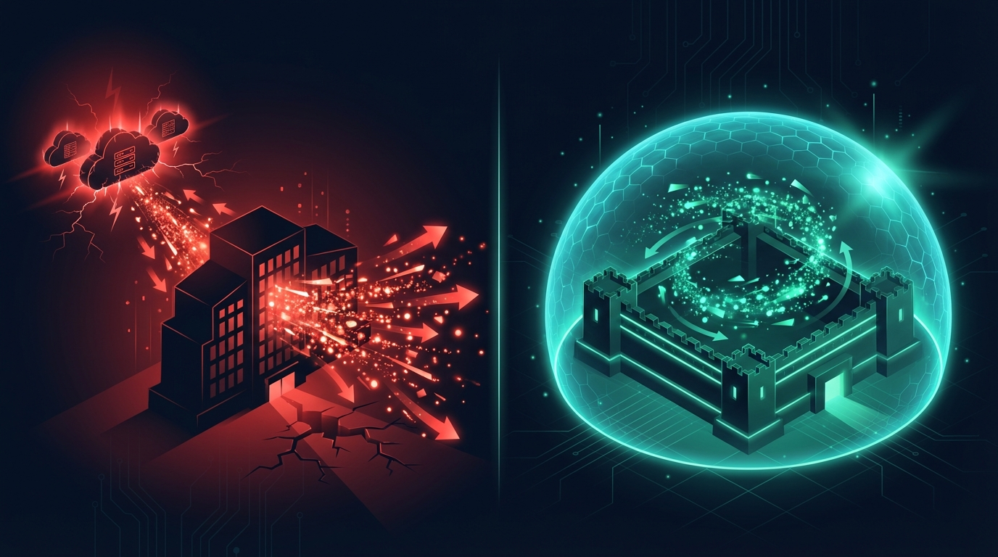
ONLY POSSIBLE WITH RUVNET
Enterprise AI Without Data Leakage
Every AI API sends your data to someone else's servers. RuVector runs inside your PostgreSQL.
Standard AI Architecture
RuvNet Architecture
Your Data → Internet → OpenAI/Google Servers → Response
Your Data → Your PostgreSQL → RuVector (in-process) → Response
Data transmitted to third-party infrastructure
No audit trail of what happens to your data
Compliance teams block adoption
Network dependency = single point of failure
290+ SQL functions run in your DB process
AIMDS scans inbound AND outbound for leaks
Witness chains: cryptographic audit of every op
Air-gap with RVF containers — zero network code
EXAMPLE: Bank Loan Portfolio Analysis
10 years of loan performance data. Millions of records. With standard AI: compliance blocks the project because data would leave the network. With RuVector: deploy as a PostgreSQL extension on your existing DB. AIMDS enforces PII redaction. AI analyzes everything in-place. HNSW finds similar historical patterns in 61µs. Compliance signs off day one because zero data leaves the building.

Slide 5
ONLY POSSIBLE WITH RUVNET
Ship AI in 5.5 Kilobytes
RVF containers pack model + logic + vector search + memory + security into one file.
The WASM runtime is 5.5KB. That's smaller than this sentence in most fonts.
rvDNA: Genomics on a Phone
3B base pairs | <100ms | 7.2KB WASM
3 BILLION DNA base pairs processed in <100ms. Variant calling at 155 ns/SNP. Horvath Clock biological age analysis. Pharmacogenomics drug dosing. All in a browser tab. A $50 phone becomes a genomics lab.
Offline Field Intelligence
Zero backend | Zero latency | Full AI
Entire equipment manual + troubleshooting history + diagnostic AI in one .rvf file. The file IS the server. Works underground, underwater, in a mine shaft. Agent carries full organizational knowledge without connectivity.
Browser-Native Enterprise Search
7.2KB engine | Client-side | Zero infra
Micro-HNSW runs the complete vector search engine client-side. User opens a web page — no installation, no server, no API keys. Search 100K+ documents semantically in the browser. IT deploys nothing.
Three compute tiers: WASM (5.5KB, browser) → eBPF (kernel bypass, 10Gbps+) → Unikernel (125ms Linux boot, bare metal)

Slide 6
ONLY POSSIBLE WITH RUVNET
Integrate at the Knowledge Level, Not SQL
SQL-Level Integration (Traditional)
Knowledge-Level Integration (RuvNet)
Months of ETL pipeline development
Breaks when source schemas change
Can't join unstructured data (PDFs, Slack, email)
$500K-$2M projects, 6-12 months delivery
RuVector embeds everything into semantic space
Self-healing: adapts automatically to changes
Joins by meaning: PDFs + SQL + Slack + email
Weeks, not months. Knowledge graphs, not ETL.
What This Enables
Microbiome Discovery
250M agents analyzed 40GB across 8,000 biological samples. GNN + HNSW discovered Huntington's disease ↔ gut microbiome correlations that human researchers hadn't identified. 187M interactions/sec. The AI was the researcher.
Enterprise-Wide Search
"Show me everything about the Acme deal" searches Salesforce, Jira, Confluence, Slack, email, and PDFs — by meaning, not keywords. One HNSW query, 61µs, every system. No connectors, no schema mapping.
Legacy COBOL Bridge
COBOL systems from the 1990s connected to modern REST APIs via knowledge embeddings in one afternoon. No rewrite. No translation layer. The vector embeddings understand both COBOL copybooks and JSON schemas.

Slide 7
Ruflo: Multi-Agent Orchestration
The brain that coordinates 150+ agent types across 5 network topologies.
Swarm Topologies
Scale & Coordination
Hierarchical
Queen-led with anti-drift detection
Hive Mind
1,000+ agents with sub-ms shared memory via PostgreSQL advisory locks
Mesh
Peer-to-peer, Byzantine fault tolerant
Emily OS
Ring
Token-passing coordination
2 to 100,000 agents, LLM-agnostic, horizontal scaling
Star
Central hub routing
Raft Consensus
Leader election, multi-master replication with CRDT support
Adaptive
Topology shifts under load
Gossip Protocol
Drift detection, behavioral monitoring across agents
150+
5
100K
<1ms
Agent Types
Topologies
Agent Scale
Shared Memory

Slide 8
RuVector: PostgreSQL-Native Vector Search
Not a separate vector database. A PostgreSQL extension. ACID transactions on vector operations.
Core Capabilities
RVCOW: Multi-Tenant Economics
290+ SQL functions in-process
HNSW indexing (61µs search latency)
Drop-in pgvector replacement
ACID transactions on vector ops
Joins vectors with relational data
80+ Rust crates for extensions
Progressive indexing (L0/L1/L2)
Temperature-tiered quantization
512MB parent + 1,000 tenants = ~2.5MB/tenant
Approach | Storage | Cost
Full Copy | 512GB | $51,200/mo
RVCOW | ~2.5GB | $250/mo
Savings | 200x | 99.5%
COW branch creation: 2.6ms
CowMap cluster lookup: 28ns
Row-level security per tenant
61µs
8,000x
290+
200x
HNSW Search
vs Pinecone
SQL Functions
COW Savings
RuVector isn't just faster search. It's a fundamentally new data architecture that unlocks capabilities impossible with traditional vector databases — in-process execution, WASM portability, and native PostgreSQL integration that eliminates the 'AI sidecar' pattern entirely.

Slide 9
RVF: The Executable Knowledge Unit
24-segment binary format. Not a database file — an executable that contains intelligence.
Core Data (3)
AI / Model (3)
COW Branching (4)
Vectors, Metadata, Indexes
LoRA deltas, GGUF weights, Inference config
Git-like versioning (200x savings)
Security (2)
Compute (3+)
AGI Container (9)
Witness chains (ML-DSA-65), TEE attestations
WASM (5.5KB) | eBPF | Unikernel (125ms)
Identity + tools + authority + evaluation
Docker image: 50-500 MB
Minimal container: 5-50 MB
RVF WASM runtime: 5.5 KB
Docker images are megabytes. An RVF WASM runtime is 5.5 kilobytes.

Slide 10
AIMDS: Security via Chaos Theory
3-layer pipeline. Lyapunov chaos detection. Mathematical certainty, not heuristics.
STAGE 1: DETECTION
STAGE 2: ANALYSIS
STAGE 3: RESPONSE
0.06ms
80ms
<50ms
50+ detection patterns
Aho-Corasick matching
Real-time stream processing
Lyapunov chaos detection
LTL policy verification
Behavioral divergence
7 adaptive strategies
25-level strange-loop
Real-time mitigation
Lyapunov Chaos Detection
Positive Lyapunov exponent = system diverging from expected behavior = adversarial. Same mathematics that predicts weather chaos. Detects novel attacks without pattern libraries.
782KB
>12K/s
<5%
0.06ms
Binary Size
Requests/Sec
False Positive
Detection Time

Slide 11
SONA + ReasoningBank: Real-Time Learning
Every decision makes the system smarter. Automatically. <1ms. $0.
SONA: Two-Tier LoRA
Traditional Fine-Tuning
MicroLoRA (rank-2, ~45µs): instant reactions
BaseLoRA (rank-16, ~500µs): deep learning
$0 cost, <1ms latency, zero downtime
EWC++ prevents catastrophic forgetting (45% less)
Days to weeks of training time
$1K-$100K per fine-tune cycle
Requires scheduled downtime
Catastrophic forgetting on new domains
ReasoningBank 4-Step Pipeline
1. RETRIEVE
▶
2. JUDGE
▶
3. DISTILL
▶
4. CONSOLIDATE
HNSW search for similar past decisions
Assign verdicts based on outcomes
Micro-LoRA pattern extraction
EWC++ prevents forgetting
300x
2,211/s
+55%
$0
Faster Retrieval
SIMD Ops/Sec
Quality Improvement
Learning Cost

Slide 12
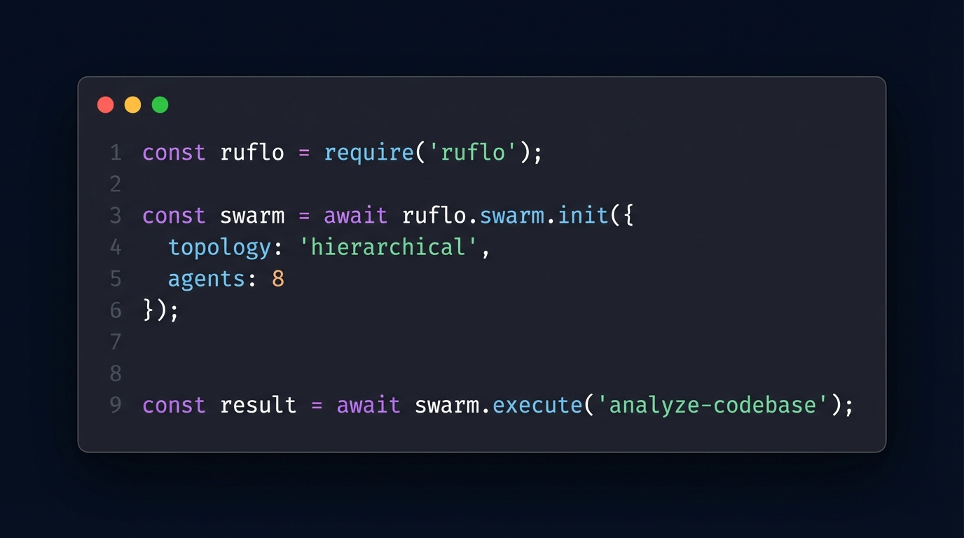
Ship It In 5 Lines
Production multi-agent swarms. Self-learning. Self-healing. One require statement.
const ruflo = require('ruflo');
// Initialize a self-healing agent swarm
const swarm = await ruflo.swarm.init({
topology: 'hierarchical', agents: 8, strategy: 'specialized'
});
// Deploy 51 autonomous agents in one command
const fleet = await swarm.deploy({
domains: ['billing', 'compliance', 'support'],
memory: 'persistent', // AgentDB - agents remember everything
security: 'aimds', // Chaos theory threat detection
runtime: 'rvf-wasm' // 5.5KB - runs anywhere
});
fleet.on('resolution', (data) => {
// SONA generates LoRA adapters automatically
// Your AI gets smarter. Zero cost. Zero effort.
});
Claude Code shipped sub-agents in March 2026. Ruflo shipped this in August 2025. 8 months earlier.

Slide 13
Bio-Inspired Nervous System
Not a metaphor — implemented computational neuroscience. 22.9K lines, 359 tests.
Layer 1: SENSING
<100ns
Lock-free ring buffers, 10K+ events/ms
Layer 2: REFLEX
<1µs
K-Winner-Take-All, dendritic coincidence detection
Layer 3: MEMORY
10³⁰ cap
Hyperdimensional Computing, XOR binding <50ns
Layer 4: LEARNING
O(1)/synapse
BTSP one-shot, E-prop online, EWC++ anti-forgetting
Layer 5: COHERENCE
40Hz gamma
Kuramoto oscillators, global workspace, predictive coding
Circadian Controller: 5-50x compute savings during quiet periods — the system sleeps when you do

Slide 14
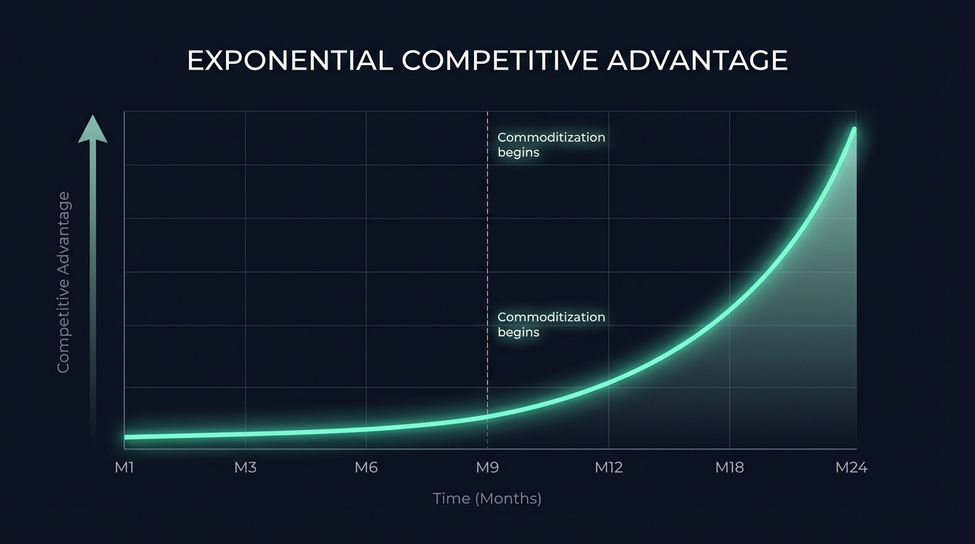
We Built the Future 8 Months Early
RuvNet doesn't follow the industry roadmap. The industry follows ours.
Aug 2025
Ruflo ships multi-agent orchestration
SHIPPED
150+ agent types, 5 topologies, hierarchical swarms with anti-drift detection
Oct 2025
RVF cognitive containers ship (5.5KB)
SHIPPED
24-segment binary format. WASM runtime. Self-booting intelligence units.
Dec 2025
MinCut dynamic partitioning ships
SHIPPED
Stoer-Wagner algorithm. Self-healing graph analytics. 448+ tests.
Mar 2026
Claude Code ships "sub-agents"
Anthropic announces sub-agent capability. 8 months after Ruflo.
???
Industry catches up on vector search, WASM, chaos security
Still waiting for anyone to match RuVector, RVF, or AIMDS.
Two standard deviations beyond state of the art. Open source. MIT license. Free.

Slide 15
Graph Analytics: MinCut + GNN + HNSW
Stoer-Wagner algorithm. 448+ tests. Production graph intelligence.
MinCut Applications
GNN on HNSW Topology
Finding architectural bottlenecks
Identifying weak points in distributed systems
Detecting natural module boundaries
Measuring attack surface
Swarm topology optimization
Anti-pattern detection via absence analysis
GCN, GAT, GraphSAGE implementations
GraphRoPE: hop-distance-aware embeddings
Louvain community detection
Spectral clustering (K-way)
Bridge/articulation point detection
Dynamic MinCut for real-time health
Industry Proof Points
Pinterest
Google Maps
Uber Eats
150% hit-rate improvement
50% better ETA
20%+ engagement
Graph-based recommendation
Graph routing optimization
Graph-ranked discovery

Slide 16
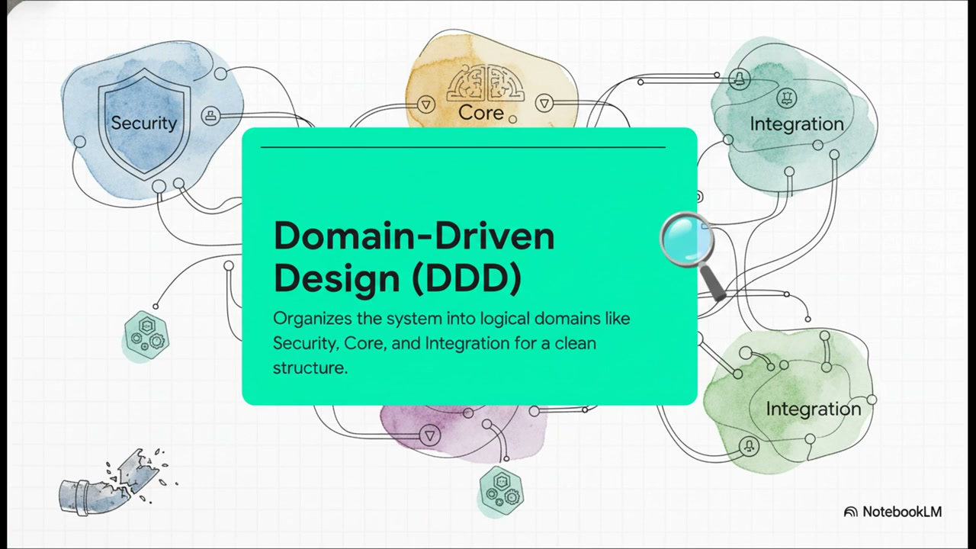
Performance Benchmarks
Measured results against best-in-class competitors.
Metric | RuVector | Best Competitor | Advantage
HNSW Search | 61µs | 500ms+ (Pinecone) | 8,000x
Fox Flow QPS | 12.8M | 3K (Redis) | 4,000x
Detection Time | 0.06ms | ~10ms (rule-based) | 167x
WASM Runtime | 5.5KB | 100MB+ (containers) | 18,000x
Learning Latency | <1ms | Days-weeks | >86Mx
Reflex Response | <1µs | N/A | Unique
Agent Scale | 100K | ~10-50 | 2,000x+
SWE-Bench | 84.8% | 33.2% (GPT-4o) | 2.5x
Attention Mechanisms | 39 types | 1-3 types | 13-39x
8,000x
4,000x
167x
18,000x
Vector Search
Stream Processing
Threat Detection
Smaller Runtime

Slide 17
Integration Architecture
MCP protocol. PostgreSQL-native. Drop-in pgvector replacement.
MCP Protocol: 96 Tools
PostgreSQL-Native
Deferred loading for performance
Agent orchestration + memory + search
Task management + workflow engine
Security scanning + graph analytics
No separate vector database deployment
290+ SQL functions in-process
ACID transactions on vector ops
Drop-in pgvector migration
APIs, SDKs & Integration Points
REST API
Standard HTTP
gRPC
High-perf binary
TypeScript SDK
Full type safety
Python SDK
ML pipelines
WASM SDK
Client-side search
Webhooks
Event-driven

Slide 18
Implementation Roadmap
From zero to production in 3 months. Incremental value at every phase.
1: Foundation
2: Intelligence
3: Customize
4: Scale
Week 1-2
Week 3-4
Month 2
Month 3+
Core RuVector PostgreSQL extension
AIMDS security middleware
Basic agent deployment
HNSW index configuration
AgentDB memory (4 types)
ReasoningBank + SONA
Ruflo orchestration
MCP tool integration
Custom agent development
Domain-specific LoRA training
Graph analytics deployment
Performance tuning
Production scaling + monitoring
WASM edge deployment
Multi-tenant RVCOW
Advanced swarm topologies
Each phase delivers standalone value. No big-bang migration required.

Slide 19
RUVNET
Schedule a 30-Minute
Architecture Review
148+
14
80+
290+
Capabilities
Modules
Rust Crates
SQL Functions
39
9
5
24
Attention Mechanisms
RL Algorithms
Bio-Inspired Layers
RVF Segment Types
Two standard deviations beyond state of the art. Open source. Free. The architecture everyone will use.
ruvnet.com | hello@ruvnet.com

