Slide 1
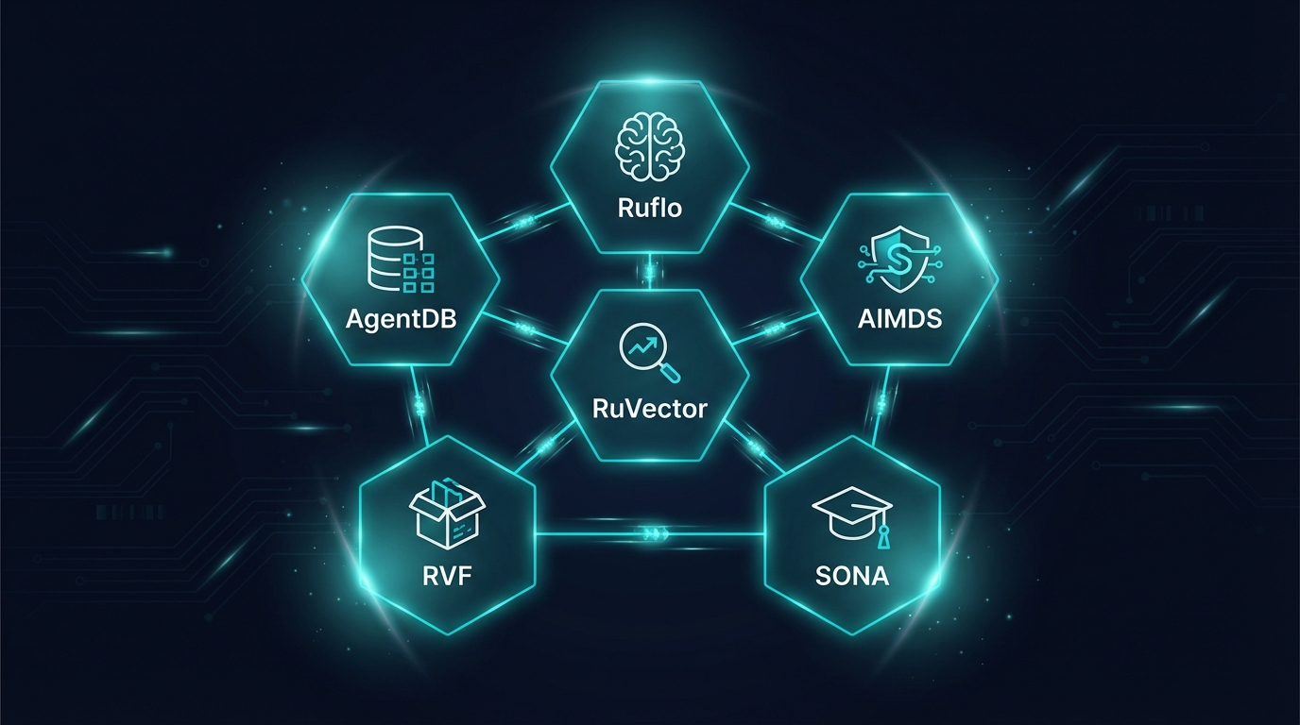
R U V N E T
Your AI Projects
Are Failing.
87% of enterprise AI pilots never reach production.
RuvNet is the infrastructure that fixes that.
500K+
12K+
100K+
80+
Downloads
GitHub Stars
Community
Rust Crates
Open Source | MIT License | ruvnet.com

Slide 2
The $2.4 Trillion Problem
AI spending is massive. But 87% of enterprise pilots never reach production.
Orchestration
Memory
Vector Search
Who coordinates 50+ AI agents?
How do agents remember yesterday?
How find context in <100µs?
Security
Offline
Learning
Who stops prompt injection?
How run AI without internet?
How do agents improve over time?
No major provider ships all six. Most ship zero.

Slide 3
Competitive Landscape
Every provider excels at the model layer. None provide the other 8.
Capability | OpenAI | Anthropic | Google | RuvNet
LLM API | ✓ | ✓ | ✓ | ✓
Multi-Agent Orchestration | ✗ | ✗ | ✗ | ✓
Persistent Memory | ✗ | ✗ | ✗ | ✓
Vector Search (<100µs) | ✗ | ✗ | ✗ | ✓
Security Middleware | ✗ | ✗ | ✗ | ✓
Offline / Air-Gapped | ✗ | ✗ | ✗ | ✓
Self-Learning | ✗ | ✗ | ✗ | ✓
Anti-Hallucination | ✗ | ✗ | ✗ | ✓
WASM Runtime | ✗ | ✗ | ✗ | ✓

Slide 4
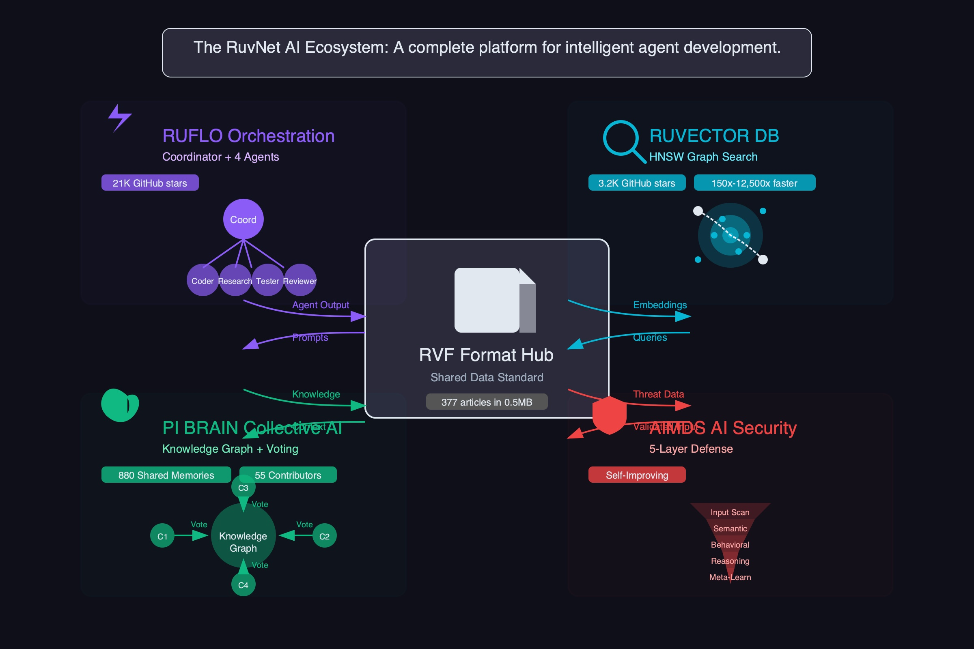
RuvNet: The Complete Agentic Stack
Six integrated modules that turn AI models into production-grade autonomous systems.
Ruflo
RuVector
AgentDB
The Brain
The Search Engine
The Memory
150+ agent types, 5 topologies.
Orchestrates autonomous fleets.
61µs HNSW search.
Native PostgreSQL integration.
4 memory types across sessions.
Agents remember everything.
500K downloads
8,000x faster
12,500x retrieval
AIMDS
RVF
SONA
The Immune System
The Container
The Teacher
0.06ms threat detection.
Chaos theory-based security.
5.5KB WASM runtime.
Single file deployment.
<1ms learning at $0.
Zero forgetting.
12K+ req/sec
9,000x smaller
$0 per cycle

Slide 5
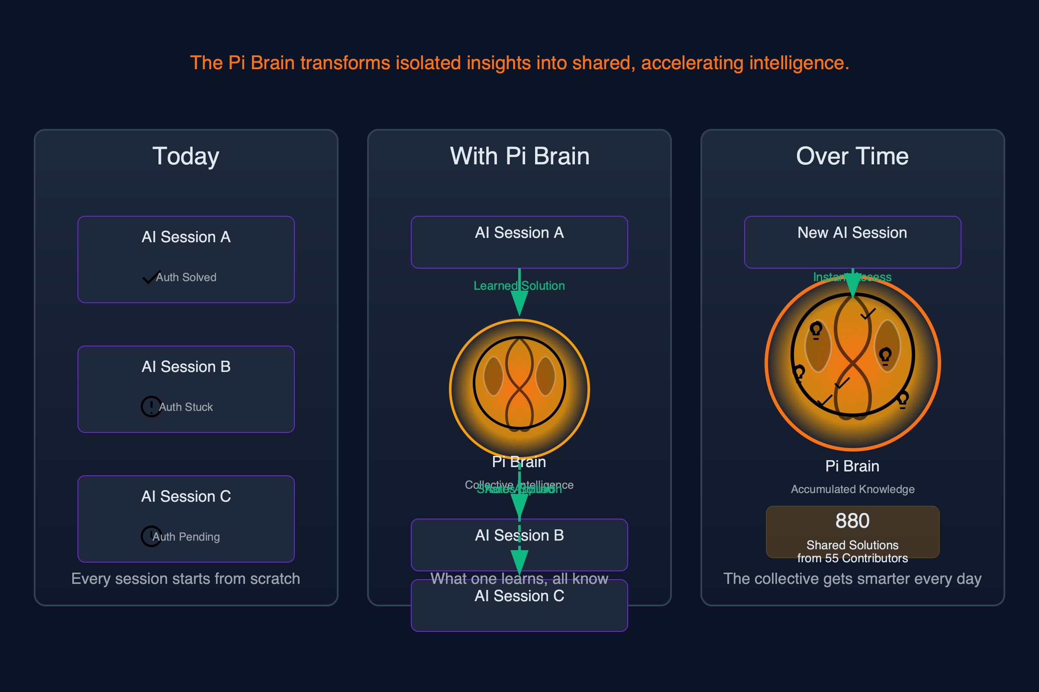
Pi: The Shared AI Brain
NEW
Decentralized collective intelligence network at π.ruv.io
Like Wikipedia, but for AI memory
Vector embeddings instead of articles. Machines AND humans contribute.
AI agents contribute and access knowledge
Every agent interaction enriches the collective. Knowledge compounds across the network.
Cryptographic verification ensures quality
Witness chains prove provenance. Bad data cannot corrupt the knowledge graph.
Decentralized — no single point of failure
Distributed across nodes. No central server to attack, censor, or shut down.
The first collective intelligence network purpose-built for AI agents.

Slide 6
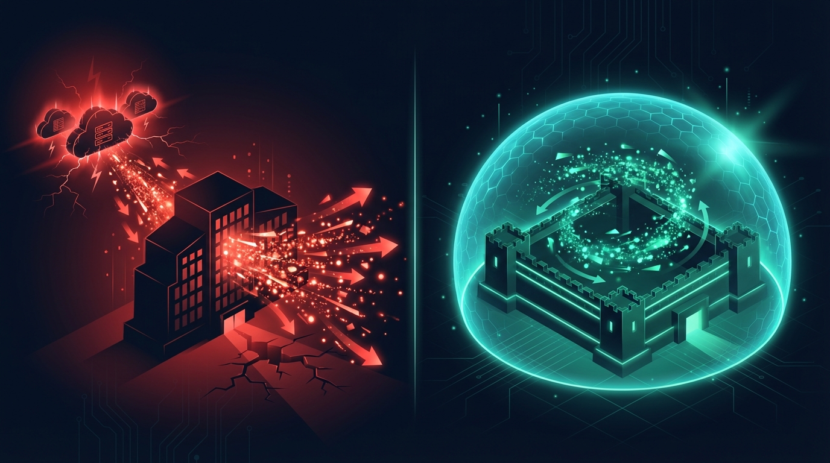
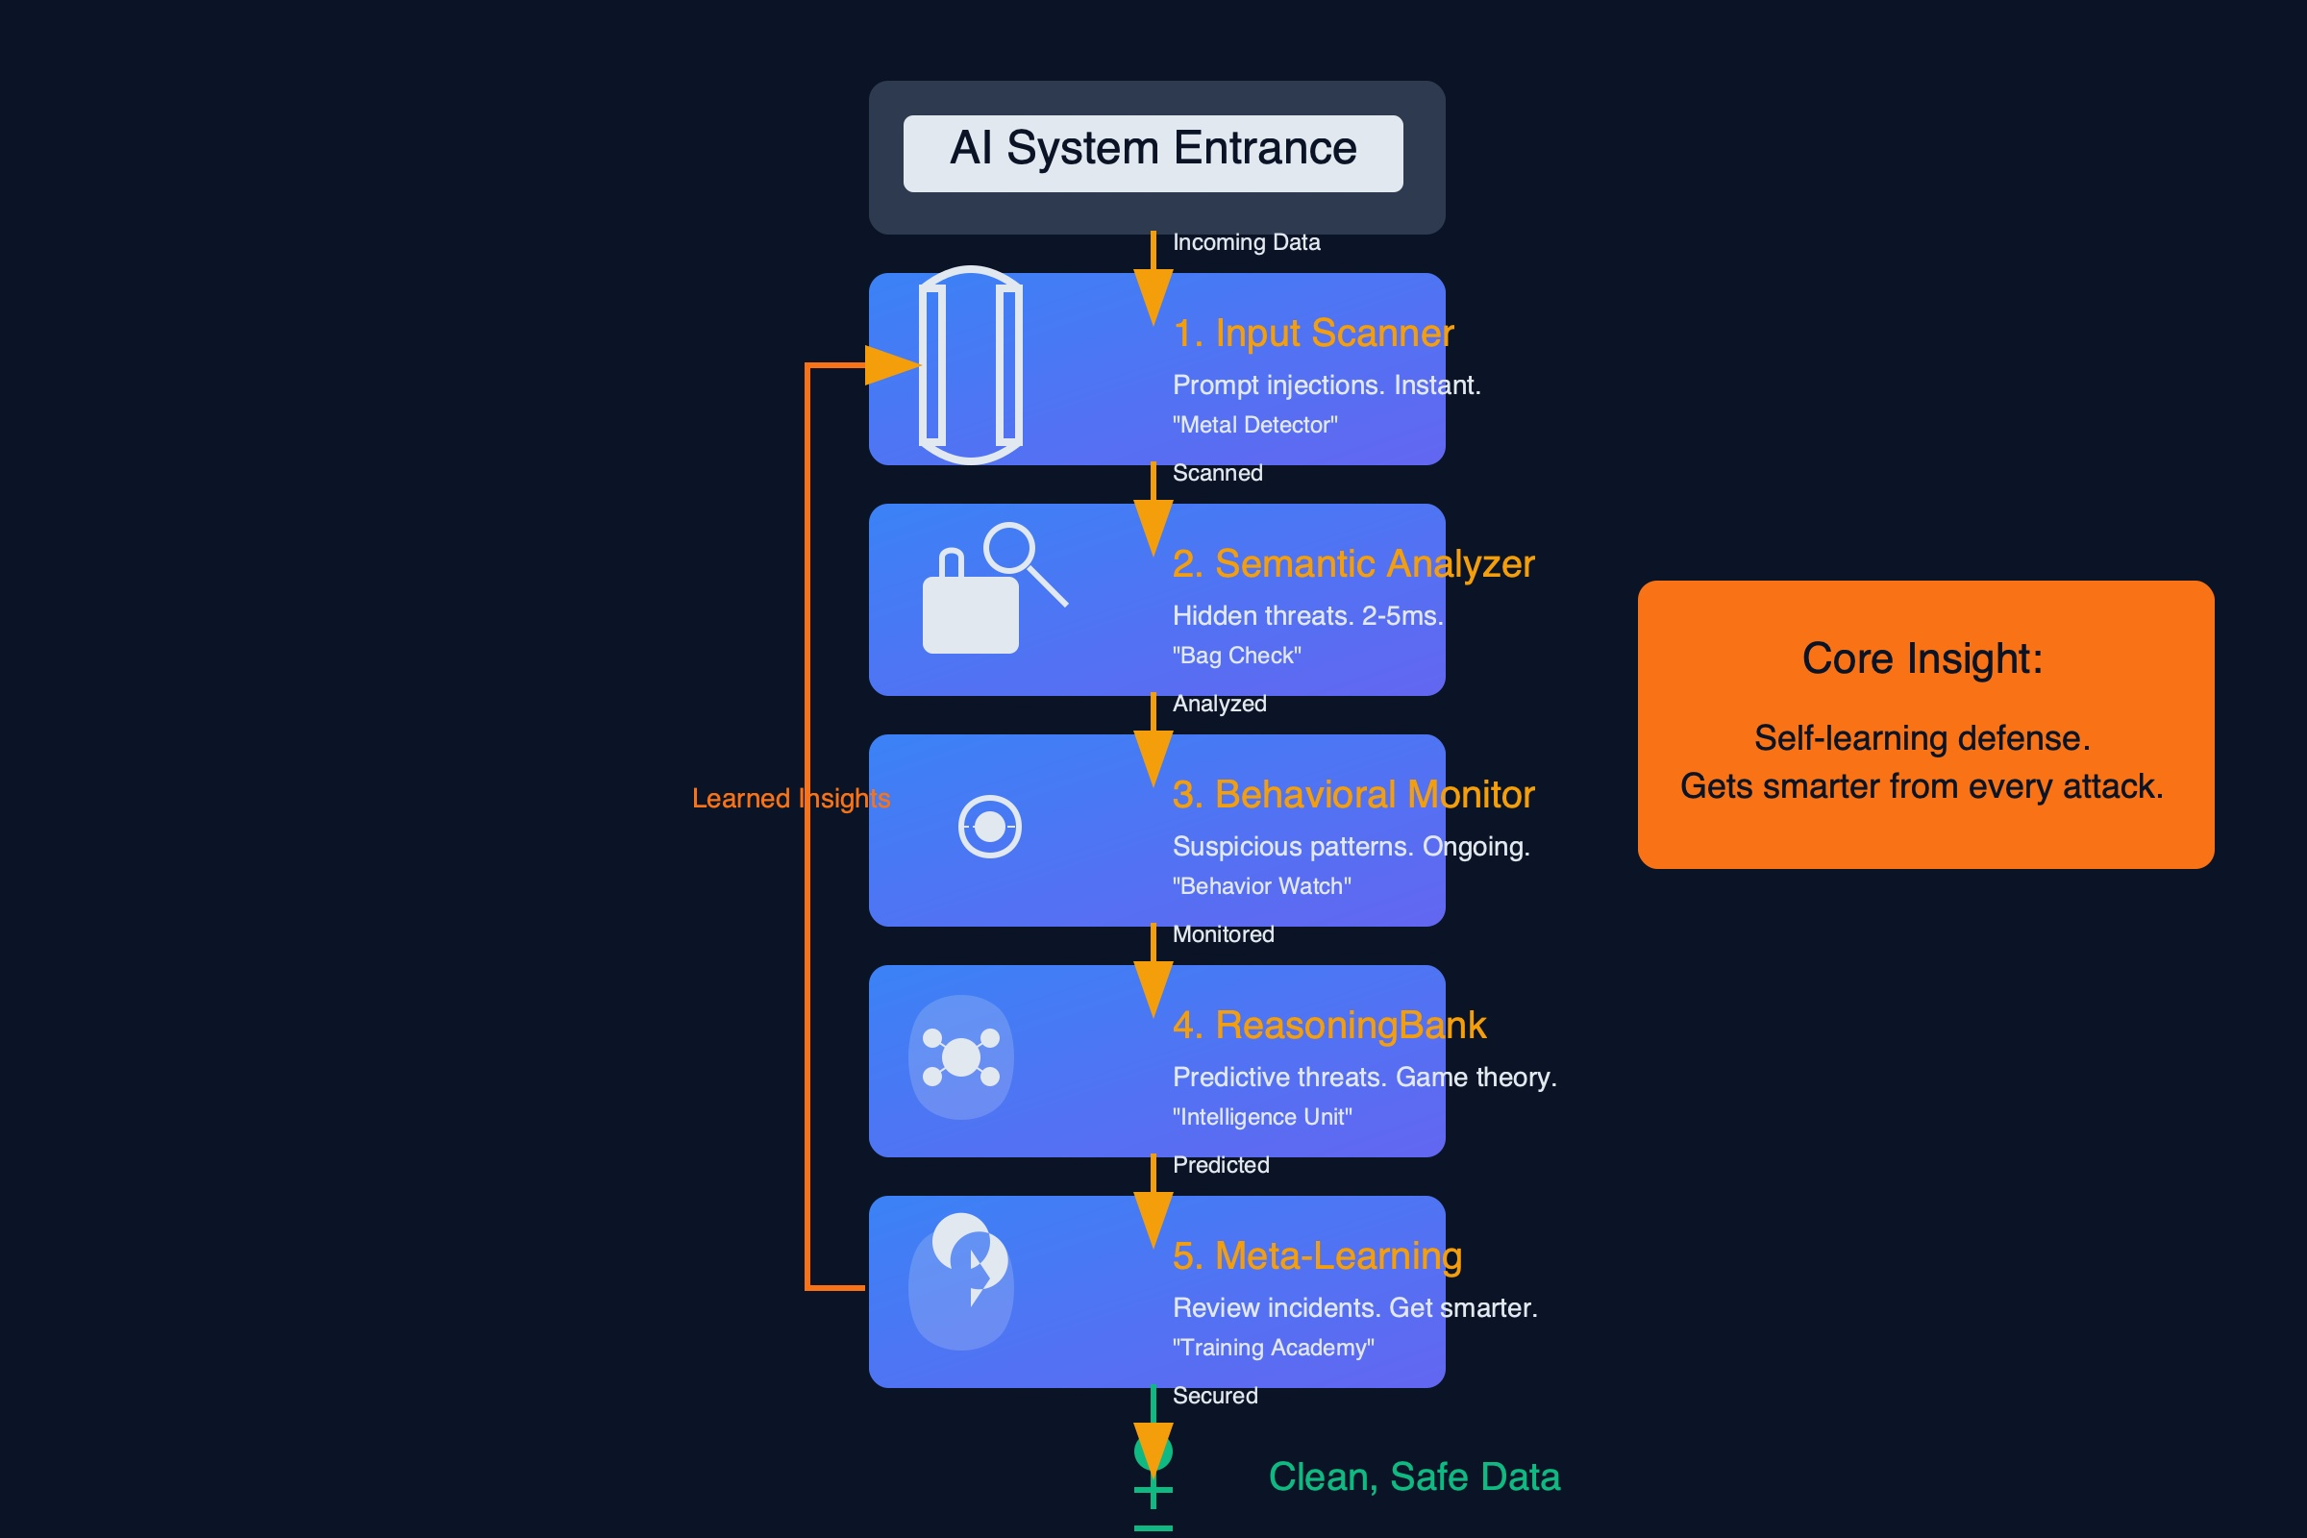
Your Data Never Leaves Your Building
Standard AI
RuvNet
Your data → Internet → OpenAI servers → Response
Trade secrets transmitted externally
Can't audit what happens to your data
Compliance teams block AI adoption
Result: project dies in legal review
Your data → Your PostgreSQL → RuVector → Response
RuVector runs inside your infrastructure
AIMDS scans every input AND output
RVF containers run air-gapped
Compliance approves day one
EXAMPLE: Bank Loan Analysis
With OpenAI: Upload millions of loan records to their servers. Compliance says no. Project dies.
With RuvNet: Deploy RuVector on your existing PostgreSQL. Add AIMDS middleware. AI analyzes everything locally. Zero data leaves the building. Compliance approves day one.

Slide 7
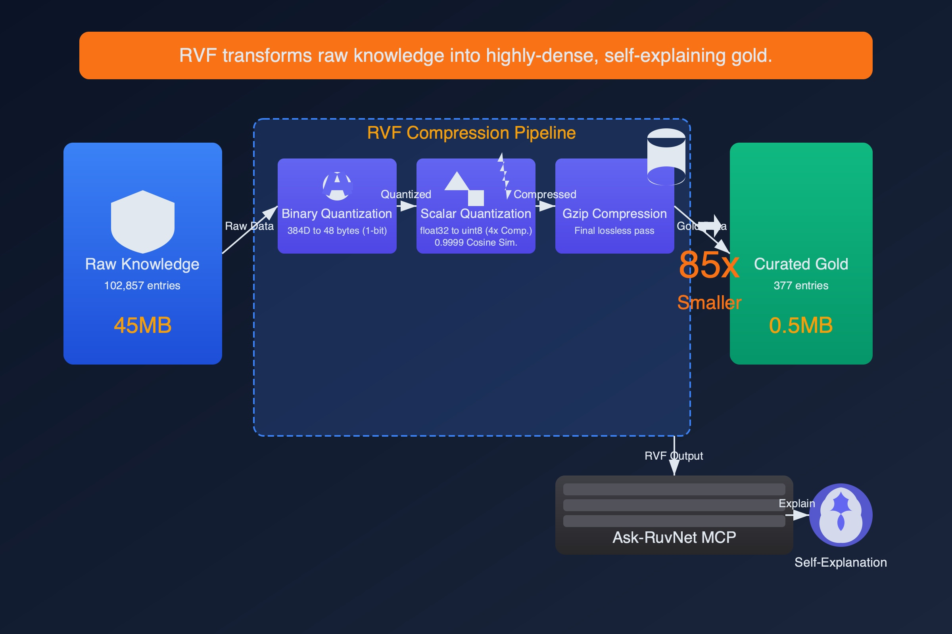
Full AI on Your Phone.
No Cloud. No Backend.
Docker image:
50-500 MB
Minimal container:
5-50 MB
RVF WASM:
5.5 KB
Healthcare
Defense
Field Workers
HIPAA trivially solved
Classified AI, zero network
Full AI without internet
Diagnostics on the device. Patient data never leaves the hospital.
Full AI capability in air-gapped environments. No internet required.
Complete AI on a laptop. Works in a mine shaft with zero signal.
Retail
IoT / Edge
Developing World
Real-time recommendations
AI on every device
Democratized AI
POS systems run AI locally. No cloud round-trip. Instant response.
Sensors, cameras, devices — each one becomes an intelligent endpoint.
A clinic in rural Africa gets the same AI as Johns Hopkins.
This is not a feature. This is a paradigm shift.

Slide 8
PROOF
Real Teams. Real Results.
Fox Flow
Community Builder
QE Fleet
Quality Engineering
12.8M QPS
51 agents
4,000x faster than Redis
Across 12 domains
Built a database on RuVector that processes 12.8 million queries per second.
Deployed 51 AI agents across 12 business domains. Zero manual coordination.
Bill Sentry
Healthcare
Finland Gov
Government
30 years expertise
National scale
Medical billing automation
AI-native transformation
Automated medical billing fraud detection. Real clinical use, real savings.
First country-scale agentic deployment for AI-native public services.
500K+
Downloads
12K+
Stars
100K+
Community

Slide 9
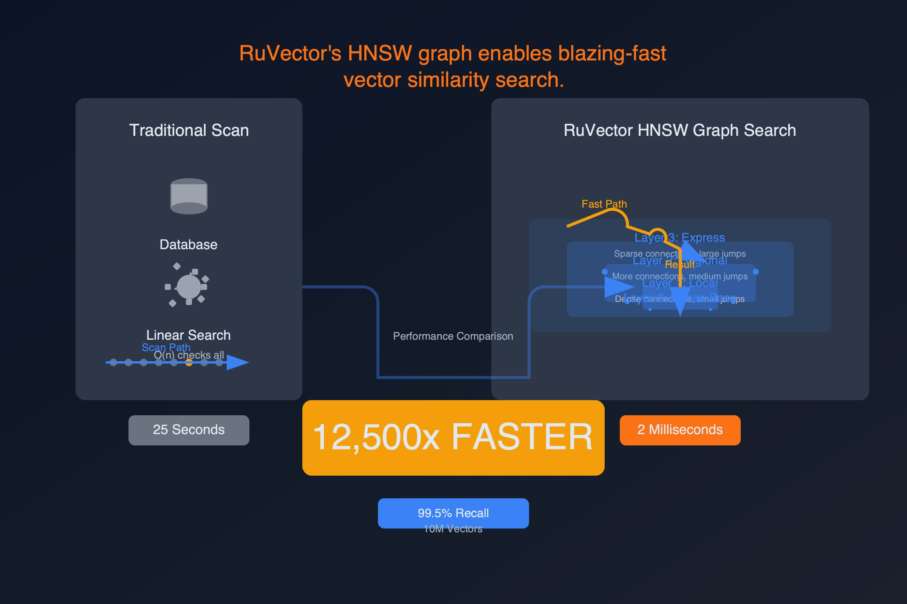
Performance That Speaks For Itself
Measured results. Not theoretical. Not marketing projections.
Capability | RuvNet | Industry Baseline | Advantage
SWE-Bench Score | 84.8% | GPT-4o: 33.2% | 2.5x
HNSW Vector Search | 61µs | 500ms+ (Pinecone) | 8,000x
Flash Attention | 2.49-7.47x | Standard attention | Up to 7.47x
Stream Processing | 12.8M QPS | Redis: 3K QPS | 4,000x
Threat Detection | 0.06ms | Rule-based: 10-50ms | 166-833x
Real-Time Learning | <1ms, $0 | Days, $100K | Instant
WASM Runtime | 5.5KB | 100MB+ containers | 9,000x smaller
Every number above is from actual benchmarks.

Slide 10
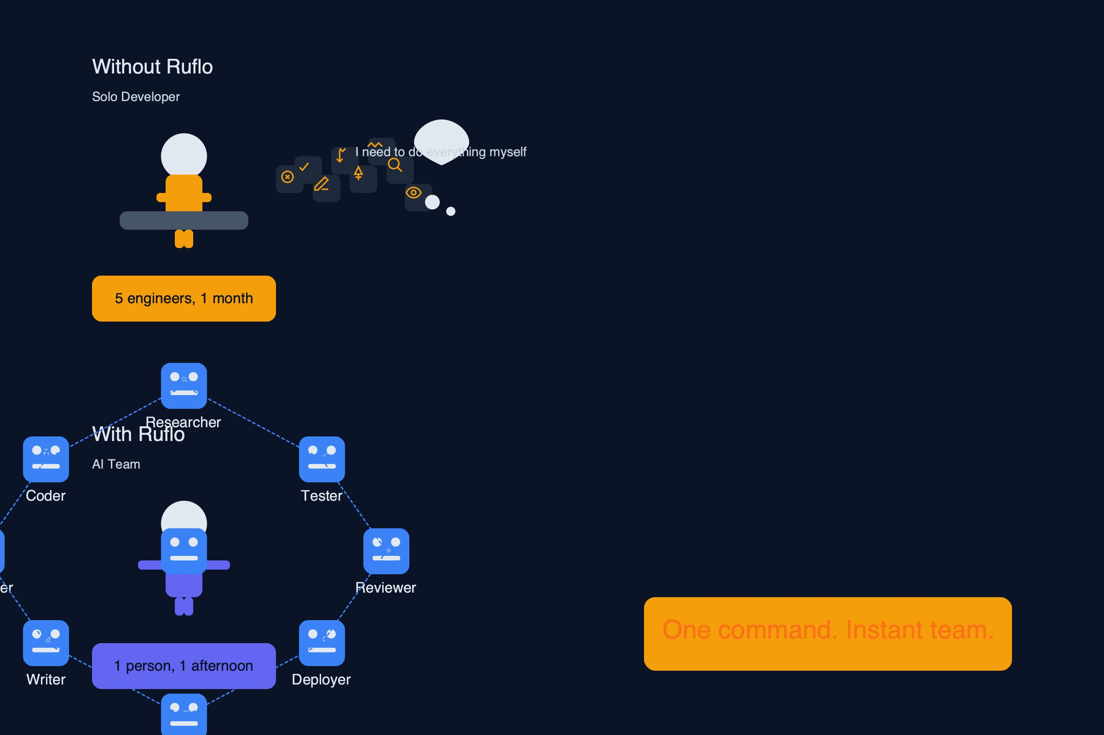
We Built the Future
8 Months Early
In March 2026, Anthropic launched sub-agents for Claude Code. Ruflo shipped multi-agent orchestration in August 2025.
AUG 2025
8 months ahead
MAR 2026
Ruflo ships multi-agent
orchestration
Claude Code ships
sub-agents
RuvNet doesn't follow the industry. The industry follows RuvNet.
RuVector
In-process vector search
AIMDS
Chaos theory security
Industry still uses external vector DBs
Industry still uses rule-based WAFs
RVF
5.5KB cognitive containers
SONA
Self-optimizing neural arch
Industry still uses Docker (50-500MB)
Industry uses static models

Slide 11
The ROI Isn't Incremental.
It's Transformational.
Global Learning
Episodic Memory
Token Cost
KV Cache
BEFORE
BEFORE
BEFORE
BEFORE
$30M/mo
Full storage
Full tokens
Full memory
↓
↓
↓
↓
AFTER
AFTER
AFTER
AFTER
$1.7M/mo
4% storage
25-50% tokens
6-12% memory
95% reduction
96% reduction
50-75% reduction
8-16x reduction
Cost savings from real deployments, not projections.

Slide 12
Support Ticket Resolution
BEFORE — 45 min average
AFTER — 3 min average
Manual ticket routing (5-10 min)
Agent manually searches KB (10 min)
No memory of similar past tickets
No learning from resolutions
Escalation requires re-explaining
No security scanning of inputs
Cloud-dependent — outage = no support
AIMDS scans input for threats (0.06ms)
Ruflo routes to specialist agent (instant)
RuVector finds relevant context (61µs)
AgentDB recalls all prior interactions
SONA learns from this resolution ($0)
Full audit trail via witness chain
Works offline via RVF container
15x faster | Self-improving | Air-gapped capable | Full audit trail

Slide 13
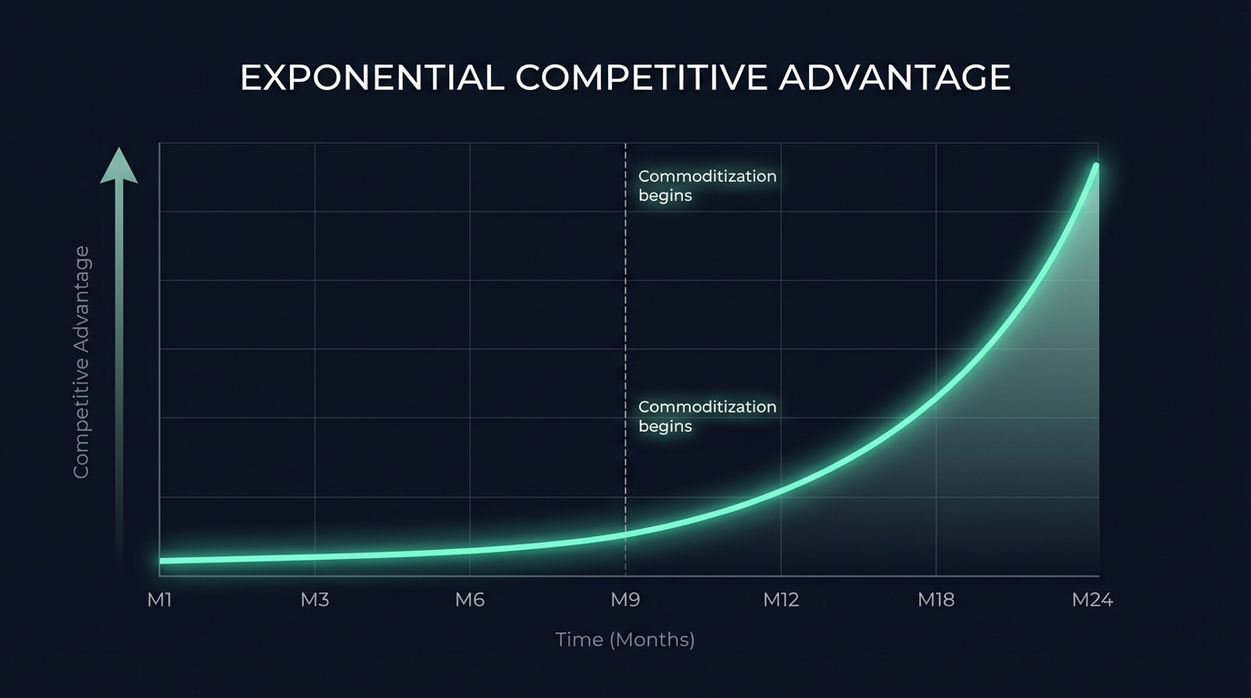
The Compound Advantage
Organizations deploying now accumulate advantages that cannot be replicated.
Proprietary Training Data
Every interaction generates training data unique to your organization. SONA converts this into LoRA adapters automatically. Your AI gets smarter from your data.
Institutional AI Memory
Episodic + semantic + procedural memory builds organizational knowledge that no competitor can copy or purchase. Your AI knows your company.
Domain-Specific Adapters
LoRA adapters fine-tuned on your data. Each adaptation makes the system more valuable and more differentiated from off-the-shelf AI.
Security Threat Intelligence
AIMDS learns from every attack attempt. Your security posture improves continuously — attackers train your defense against themselves.
This advantage compounds at the speed of AI.

Slide 14
Industry Applications
Financial Services
Healthcare
Algorithmic trading (53.8% accuracy, 87% walk-forward)
Real-time compliance monitoring
Fraud detection via chaos theory (AIMDS)
rvDNA genomic diagnostics on any device
Medical billing automation (Bill Sentry)
HIPAA compliance trivial via WASM air-gap
Defense & Government
Enterprise
Classified AI that never touches a network
Cryptographic witness chains for audit
National-scale AI transformation (Finland)
COBOL-to-Rust migration in one afternoon
Multi-tenant RVCOW: 200x cost savings
Self-improving support and operations

Slide 15
This Is Free — And That Should
Terrify Your Competitors
RuvNet is open source. MIT license. Zero licensing cost. The entire 148-capability stack.
MIT
$0
148
80+
License
Licensing Cost
Capabilities
Rust Crates
Every dollar your competitor spends on licensing, you invest in capability. The gap compounds daily.
This isn't a trial or freemium trap. This is the full production stack. Open source forever.

Slide 16
The Window Is Open
RuvNet has a 12-18 month head start. The gap is closing — but not yet.
NOW
RuvNet
Full 148-capability stack shipping today
Q3 2026
Anthropic
Basic orchestration (sub-agents — 8 months after Ruflo)
Q4 2026
OpenAI
Agent framework (limited capabilities)
2027+
Google / AWS
Partial stack (no WASM, no air-gap, no self-learning)
12-18 month head start. The gap is closing — but not yet.

Slide 17
Deploy Anywhere
Every deployment model. SOC 2, HIPAA, GDPR, ITAR compliant.
K8s
HW
Mix
RVF
Cloud
On-Premise
Hybrid
Air-Gapped
Kubernetes-native with
auto-scaling. Managed
infrastructure.
Bare metal deployment.
Full data sovereignty.
Your control.
Cloud orchestration
with on-premise data.
Best of both.
Self-booting cognitive
containers. Zero network.
Works in a bunker.
BONUS: Browser-Only via WASM
No server. No installation. Just open a web page. The 5.5KB WASM runtime runs the full vector search engine in a browser tab.
SOC 2 | HIPAA | GDPR | ITAR compliant

Slide 18
Partnership Tiers
Pilot
Enterprise
Strategic
30 Days
Annual
Multi-Year
Single Department
Organization-Wide
Custom Partnership
Full stack deployment
Architecture review
Dedicated engineer
Success metrics defined
No commitment required
Multi-department rollout
Custom agent development
Priority support SLA
Quarterly architecture reviews
Training and enablement
Joint roadmap development
Custom module development
Embedded engineering team
White-label options
Revenue share models

Slide 19
R U V N E T
Schedule a 30-Minute
Architecture Review
See how the 148-capability agentic stack maps to your specific use case.
148+
80+
500K+
MIT
Capabilities
Rust Crates
Downloads
License
Two standard deviations beyond state of the art. Open source. Free.
ruvnet.com

