Slide 1
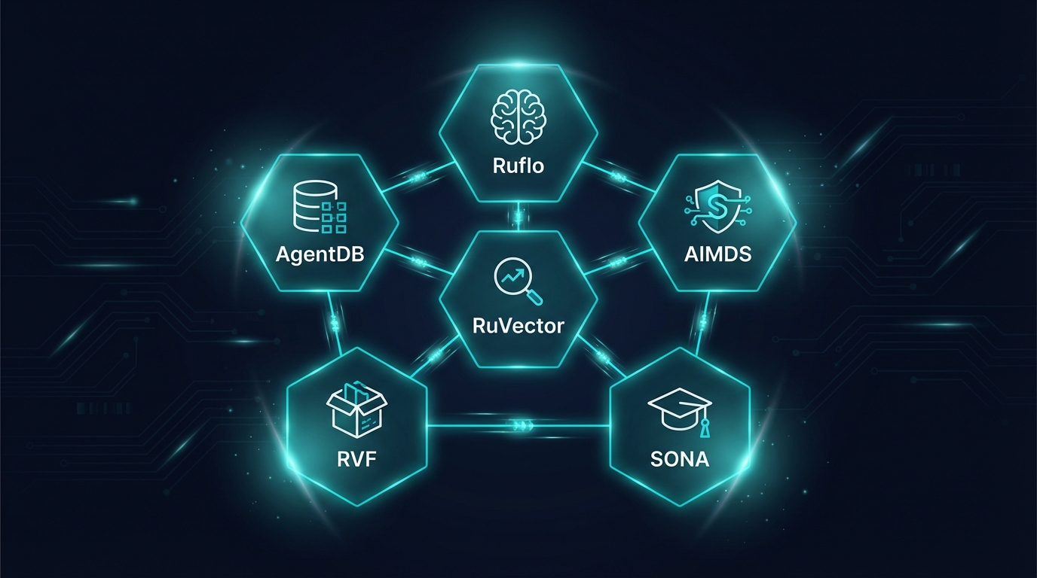
RUVNET
Technical Architecture
Deep Dive
148 capabilities across 14 modules. Production-grade agentic infrastructure.
80+
290+
39
265K
Rust Crates
SQL Functions
Attention Mechanisms
Lines of Code
MIT License | ruvnet.com

Slide 2
What Providers Actually Ship
They ship the inference endpoint. You build the other 11 layers.
Capability | OpenAI | Anthropic | Google | AWS | RuvNet
LLM API | ✓ | ✓ | ✓ | ✓ | ✓
Multi-Agent (150+ types) | ✗ | ✗ | ✗ | ✗ | ✓
Persistent Memory (4 types) | ✗ | ✗ | ✗ | ✗ | ✓
Vector Search (<100µs) | ✗ | ✗ | ✗ | ✗ | ✓
Security Middleware | ✗ | ✗ | ✗ | ✗ | ✓
Offline / Air-Gapped | ✗ | ✗ | ✗ | ✗ | ✓
Self-Learning (<1ms) | ✗ | ✗ | ✗ | ✗ | ✓
WASM Runtime (7.2KB) | ✗ | ✗ | ✗ | ✗ | ✓
Anti-Hallucination (formal) | ✗ | ✗ | ✗ | ✗ | ✓
Graph Analytics (GNN) | ✗ | ✗ | ✗ | ✗ | ✓
MCP Protocol (96 tools) | ✗ | ○ | ✗ | ✗ | ✓
Data Sovereignty | ✗ | ✗ | ✗ | ○ | ✓

Slide 3
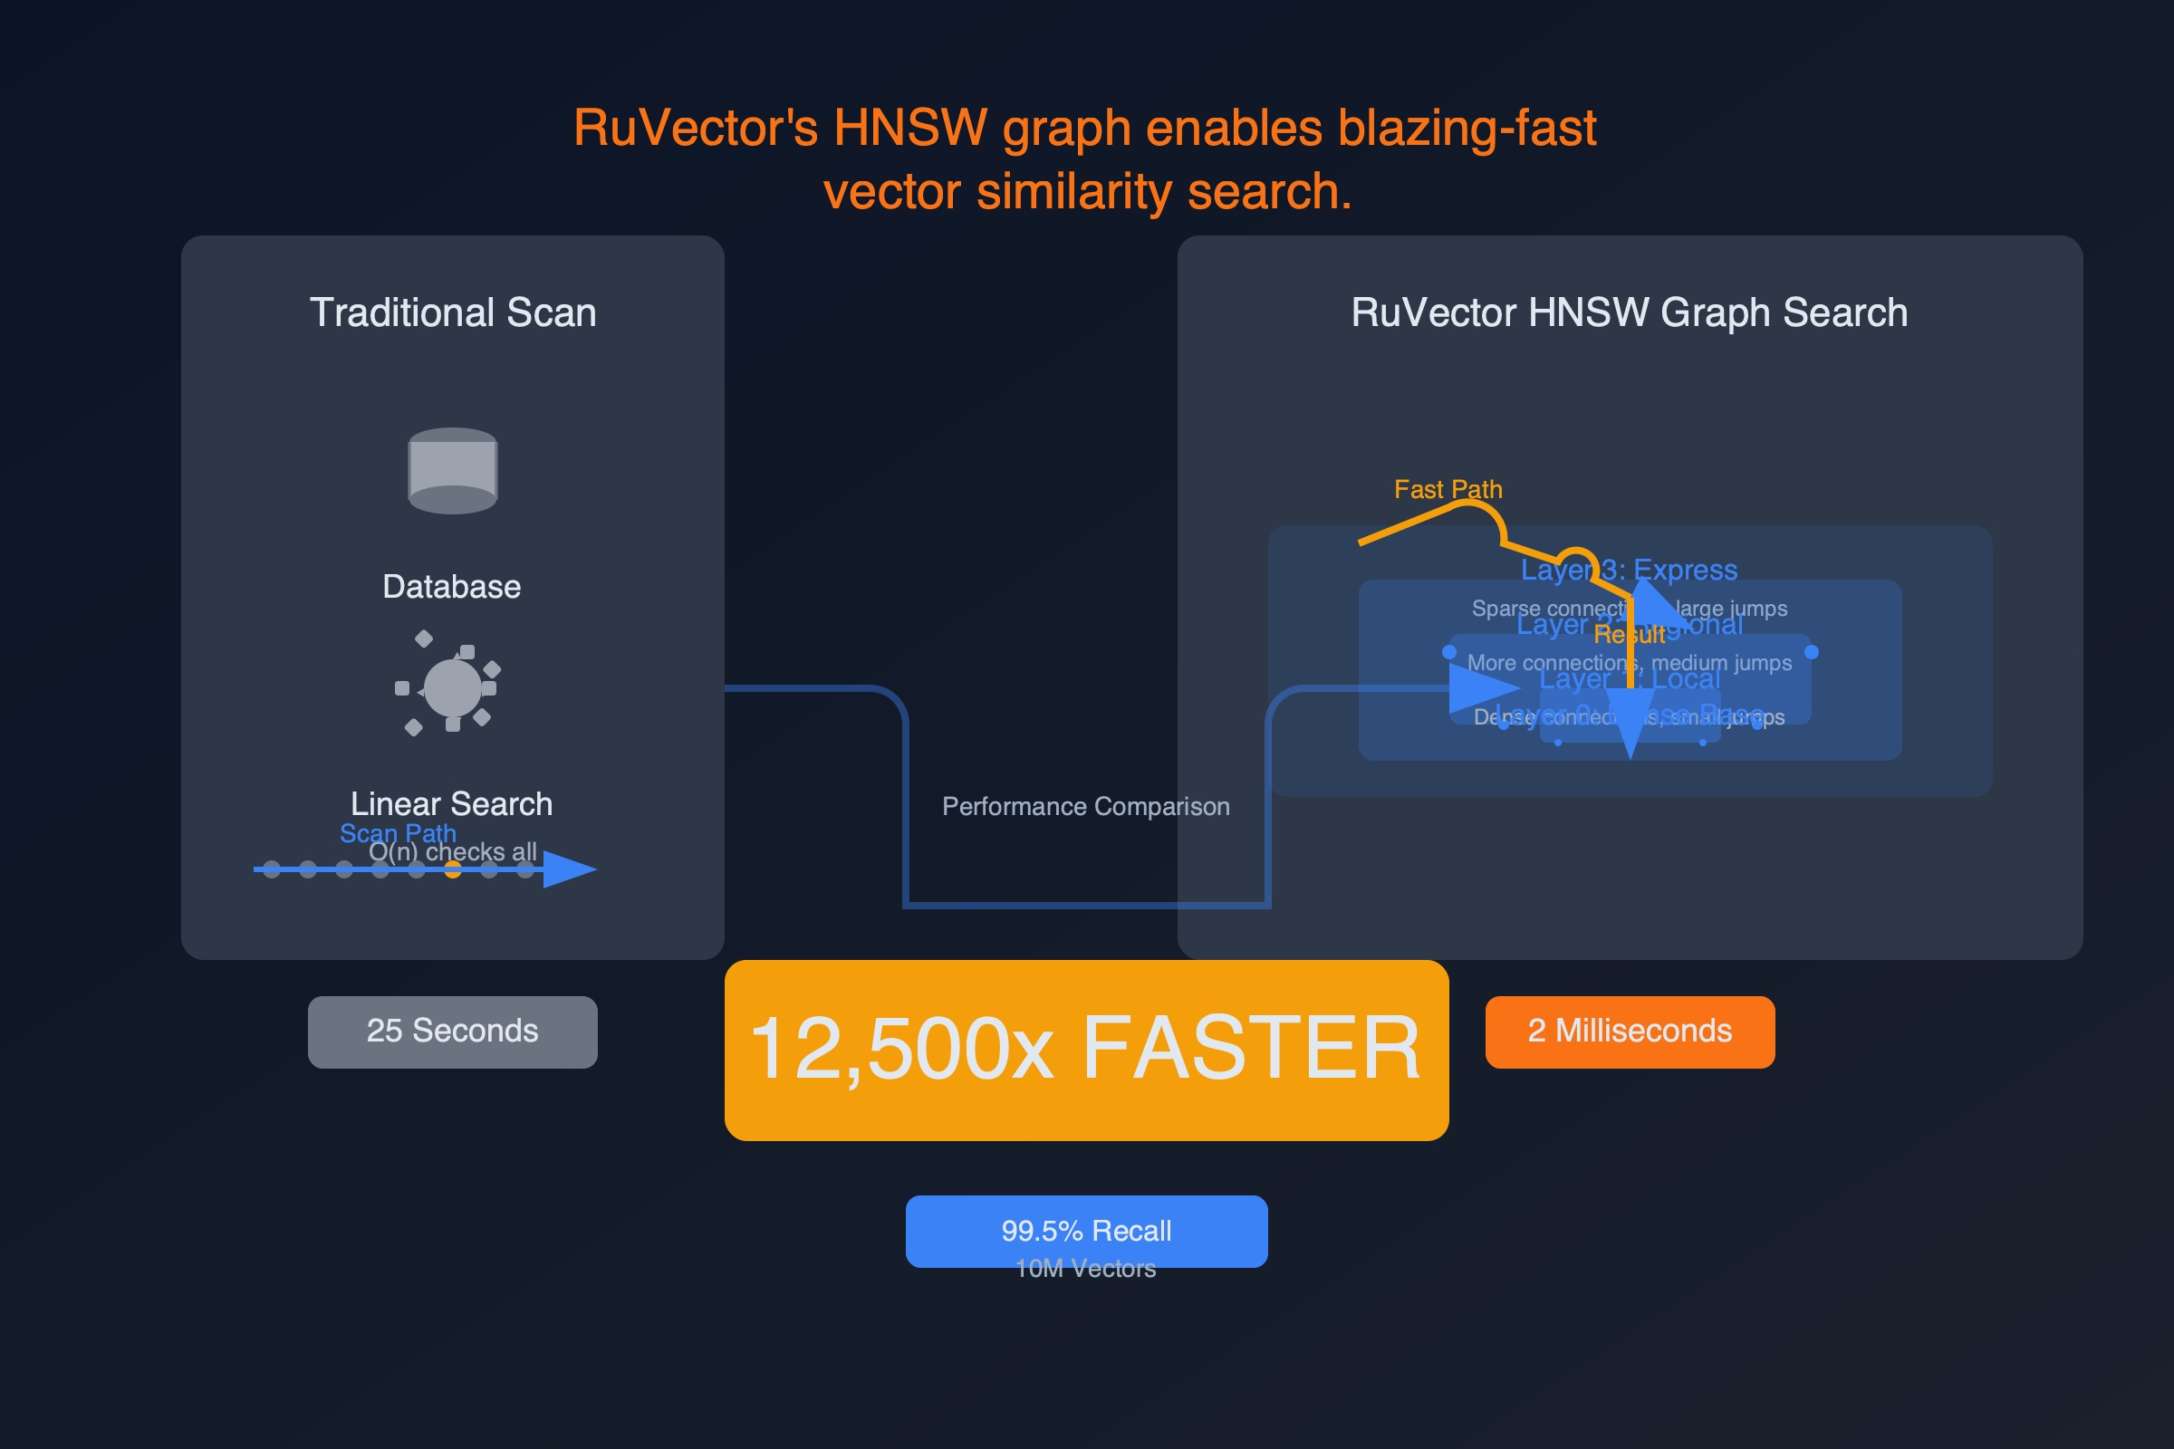
System Architecture
14 modules. Unified data plane. Security envelope.
Input
▶
AIMDS
▶
Ruflo
▶
RuVector
▶
AgentDB
▶
SONA
▶
Output
0.06ms scan
150+ agents
5 topologies
61µs search
4 memory types
9 RL algorithms
RVF: 3-Tier Compute
Nervous System: 5 Bio-Inspired Layers
WASM (5.5KB) | eBPF (kernel bypass) | Unikernel (125ms Linux boot)
Sensing (<100ns) | Reflex (<1µs) | Memory (10³⁰ cap) | Learning | Coherence
PostgreSQL Unified Data Plane — 290+ SQL Functions | HNSW Indexing | RuVector Extension | Drop-in pgvector replacement
Security Envelope — Witness Chains (ML-DSA-65 Post-Quantum) | TEE Attestations | PII Redaction | DNA Lineage Tracking
96 MCP Tools
80+ Rust Crates
49+ npm Packages
25+ ADRs
14 Modules

Slide 4
The Philosophy: Algorithms Beat GPUs
The industry throws hardware at problems. We throw mathematics.
Brute Force Approach
Algorithmic Efficiency
$100M+/year
$1.7M/month
Massive GPU clusters required
$30M/month operational costs
Linear scaling with data volume
Vendor lock-in to cloud providers
Environmental impact: enormous
MinCut-Gated: 50-90% compute skip
Coherence Transformer optimization
Runs on commodity hardware
Sub-linear scaling with HNSW
5.5KB WASM runtime, zero GPUs
$30M/month
→
$1.7M/month
|
94% cost reduction
Same capabilities. Better results. A fraction of the cost.

Slide 5
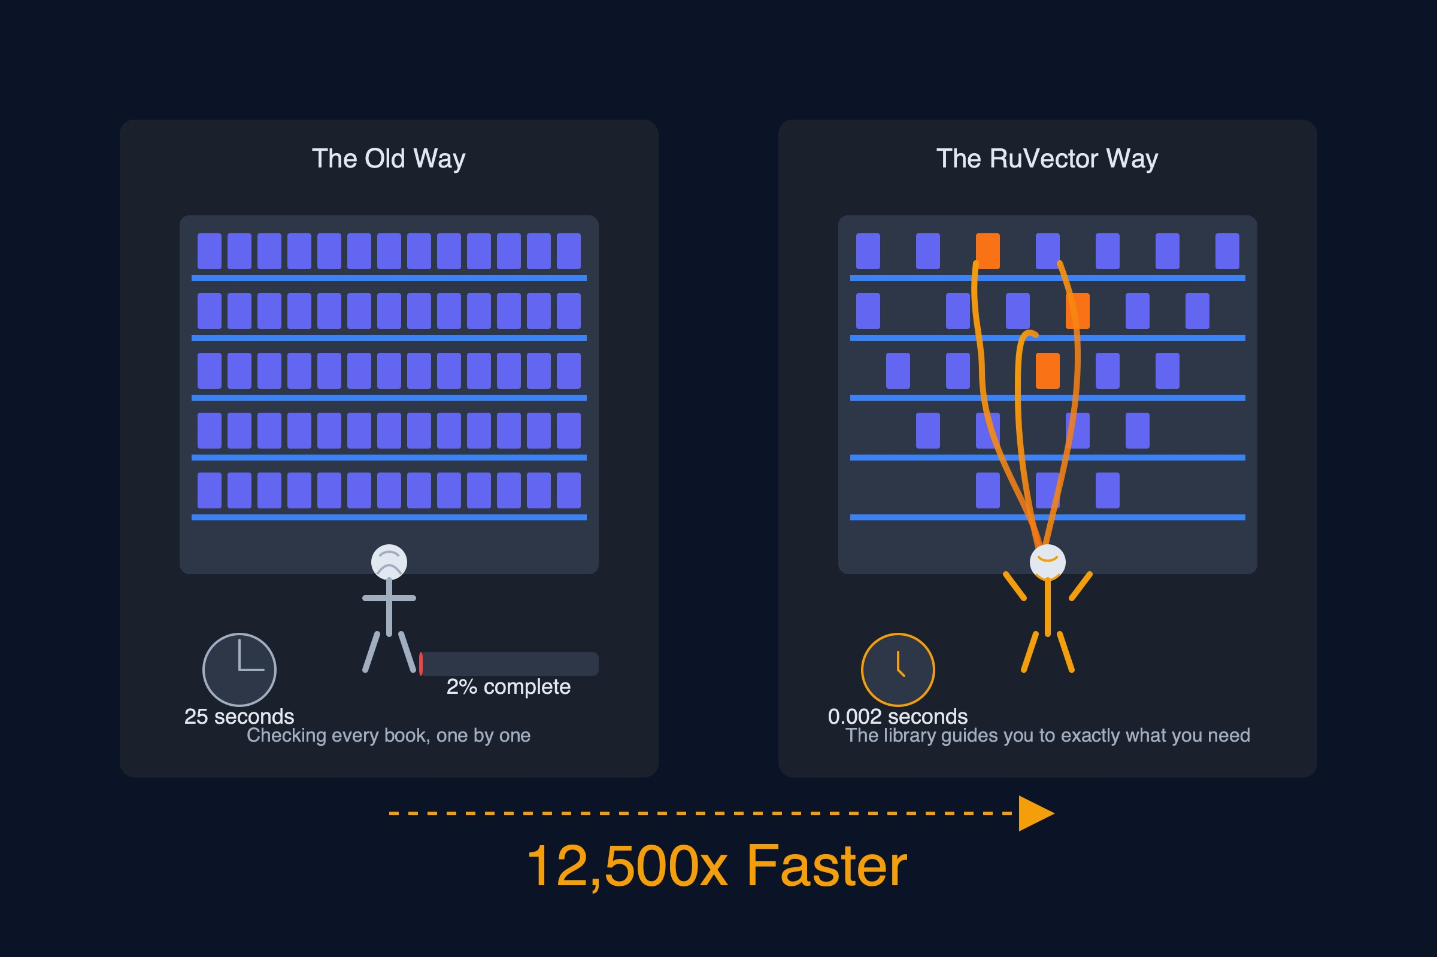
Pi: Decentralized Collective Intelligence
The first collective intelligence network where AI agents contribute knowledge alongside humans.
Decentralized
Nodes
▶
Vector
Embeddings
▶
Cryptographic
Verification
▶
Consensus
Protocol
π.ruv.io — LIVE
Technical Specifications
What Makes It Different
384-dimension vectors (all-MiniLM-L6-v2)
Cryptographic verification of all contributions
Decentralized contribution from AI + humans
MCP server integration (pi-brain tools)
Knowledge persistence across sessions
Not RAG — true collective intelligence
Knowledge compounds across all participants
Vector embeddings for semantic storage
No central authority — fully decentralized
Built on RuVector + RVF infrastructure
Intelligence that grows with every participant. AI agents and humans contributing to the same knowledge graph.

Slide 6
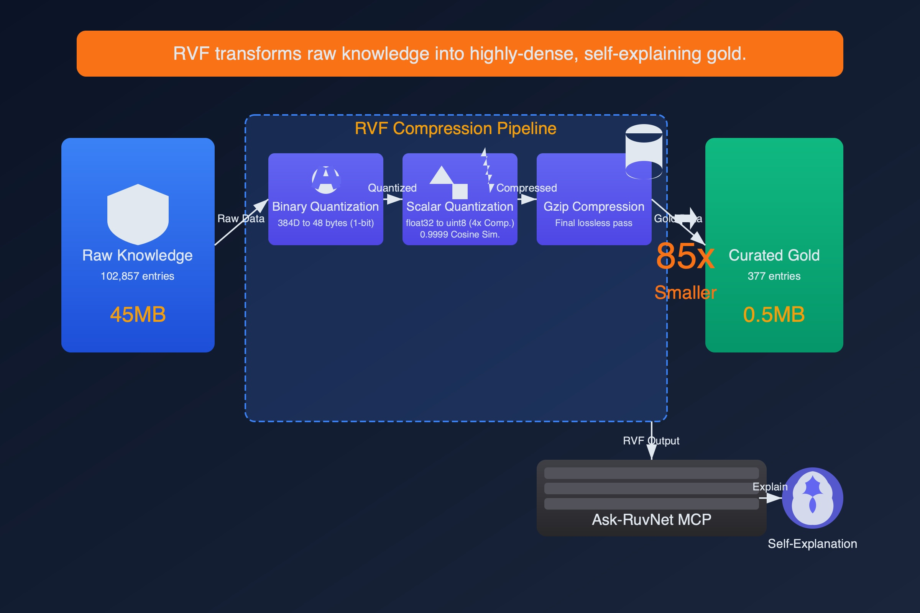
RVF: The Executable Knowledge Unit
24-segment binary format. Not a database file — an executable that contains intelligence.
Core Data (3)
AI / Model (3)
COW Branching (4)
Vectors, Metadata, Indexes
LoRA deltas, GGUF weights, Inference config
Git-like versioning (200x savings)
Security (2)
Compute (3+)
AGI Container (9)
Witness chains (ML-DSA-65), TEE attestations
WASM (5.5KB) | eBPF | Unikernel (125ms)
Identity + tools + authority + evaluation
Docker image: 50-500 MB
Minimal container: 5-50 MB
RVF WASM runtime: 5.5 KB
Docker images are megabytes. An RVF WASM runtime is 5.5 kilobytes.

Slide 7
Three-Tier Compute Architecture
One binary format. Three execution environments. Deploy anywhere.
Tier 1: WASM
5.5-46KB | <1ms boot
Browser, IoT, phone, edge
Full vector search + agent runtime in a file smaller than a favicon. Zero installation. Runs in any browser tab.
Tier 2: eBPF
10-50KB | <20ms
Kernel bypass, XDP, 10Gbps+ wire speed
Network-level intelligence. Packet inspection at wire speed. No context switches. No user-space overhead.
Tier 3: Unikernel
Full Linux | 125ms boot
Bare metal, production, VM isolation
Complete Linux environment. Production-grade isolation. From cold start to serving in 125 milliseconds.
Progressive Indexing
Temperature-Tiered Quantization
L0 Brute Force → L1 HNSW → L2 LSH
Hot fp32 → Warm fp16 → Cold int8/binary
Auto-promotes as data grows
Automatic data lifecycle management

Slide 8
Bio-Inspired Nervous System
Not a metaphor — implemented computational neuroscience. 22.9K lines, 359 tests.
Layer 1: SENSING
<100ns
Lock-free ring buffers, 10K+ events/ms
Layer 2: REFLEX
<1µs
K-Winner-Take-All, dendritic coincidence detection
Layer 3: MEMORY
10³⁰ cap
Hyperdimensional Computing, XOR binding <50ns
Layer 4: LEARNING
O(1)/synapse
BTSP one-shot, E-prop online, EWC++ anti-forgetting
Layer 5: COHERENCE
40Hz gamma
Kuramoto oscillators, global workspace, predictive coding
Circadian Controller: 5-50x compute savings during quiet periods — the system sleeps when you do

Slide 9
39 Composable Attention Mechanisms
Mix, compose, and stack. Every mechanism is a building block.
Flash (2.49-7.47x)
MinCut-Gated (50-90%)
GraphRoPE
Multi-Head
Hyperbolic (Poincaré)
Relative Position
Multi-Query
MoE Attention
ALiBi
Grouped-Query
NSA (Nvidia)
RoPE
Cross-Attention
Longformer
Perceiver
Self-Attention
BigBird
Set Transformer
Causal / Masked
Performer
Block-Sparse
Sliding Window
Reformer
Low-Rank
Dilated
Linformer
Factored
Axial
FNet (FFT)
Memory-Augmented
Linear
Nyström
Temporal Fusion
Sparse
Random Feature
Retentive
Local
Routing
Differential
GraphRoPE: hop-distance-aware position embeddings for graph-structured data — a RuvNet original.

Slide 10
Prime Radiant: Formal Verification for AI
Confidence scores can be wrong. Mathematical proofs cannot.
Cohomology Engine
Spectral Engine
Causal Engine
Sheaf Laplacian
Eigenvalue Analysis
Pearl's do-calculus
Maps statement consistency across knowledge domains. Detects contradictions invisible to statistical methods.
Decomposes reasoning chains into frequency components. Anomalous eigenvalues flag unsupported logical jumps.
Distinguishes correlation from causation. Validates counterfactual reasoning using formal causal graphs.
If any engine disagrees → output flagged
Three independent mathematical frameworks must reach consensus before any output is marked as verified. This is formal verification, not confidence scoring. A 99.9% confidence score still hallucinates 1 in 1,000 times. Mathematical proof does not.
12-agent swarm
~35K LOC
3 verification engines
Deployed: production-grade anti-hallucination infrastructure.

Slide 11
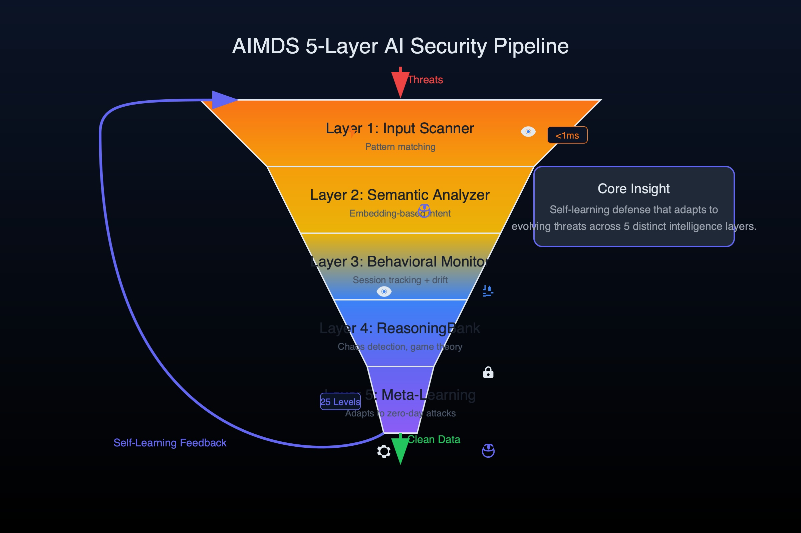
AIMDS: Security via Chaos Theory
3-layer pipeline. Lyapunov chaos detection. Mathematical certainty, not heuristics.
LAYER 1: DETECTION
LAYER 2: ANALYSIS
LAYER 3: RESPONSE
0.06ms
80ms
<50ms
50+ detection patterns
Aho-Corasick matching
Real-time stream processing
Lyapunov chaos detection
LTL policy verification
Behavioral divergence
7 adaptive strategies
25-level strange-loop
Real-time mitigation
Lyapunov Chaos Detection
Positive Lyapunov exponent = system diverging from expected behavior = adversarial. Same mathematics that predicts weather chaos. Detects novel attacks without pattern libraries.
782KB
>12K/s
<5%
0.06ms
Binary Size
Requests/Sec
False Positive
Detection Time

Slide 12
SONA + ReasoningBank: Real-Time Learning
Every decision makes the system smarter. Automatically. <1ms. $0.
SONA: Two-Tier LoRA
Traditional Fine-Tuning
MicroLoRA (rank-2, ~45µs): instant reactions
BaseLoRA (rank-16, ~500µs): deep learning
$0 cost, <1ms latency, zero downtime
EWC++ prevents catastrophic forgetting (45% less)
Days to weeks of training time
$1K-$100K per fine-tune cycle
Requires scheduled downtime
Catastrophic forgetting on new domains
ReasoningBank 4-Step Pipeline
1. RETRIEVE
▶
2. JUDGE
▶
3. DISTILL
▶
4. CONSOLIDATE
HNSW search for similar past decisions
Assign verdicts based on outcomes
Micro-LoRA pattern extraction
EWC++ prevents forgetting
300x
2,211/s
+55%
$0
Faster Retrieval
SIMD Ops/Sec
Quality Improvement
Learning Cost

Slide 13
RuVector: PostgreSQL-Native Vector Search
Not a separate vector database. A PostgreSQL extension. ACID transactions on vector operations.
Core Capabilities
RVCOW: Multi-Tenant Economics
290+ SQL functions in-process
HNSW indexing (61µs search latency)
Drop-in pgvector replacement
ACID transactions on vector ops
Joins vectors with relational data
80+ Rust crates for extensions
Progressive indexing (L0/L1/L2)
512MB parent + 1,000 tenants = ~2.5MB/tenant
Approach | Storage | Cost
Full Copy | 512GB | $51,200/mo
RVCOW | ~2.5GB | $250/mo
Savings | 200x | 99.5%
COW branch creation: 2.6ms
CowMap cluster lookup: 28ns
61µs
8,000x
290+
200x
HNSW Search
vs Pinecone
SQL Functions
COW Savings

Slide 14
Graph Analytics: MinCut + GNN + HNSW
Stoer-Wagner algorithm. 448+ tests. Production graph intelligence.
MinCut Applications
GNN on HNSW Topology
Finding architectural bottlenecks
Identifying weak points in distributed systems
Detecting natural module boundaries
Measuring attack surface
Swarm topology optimization
Anti-pattern detection via absence analysis
GCN, GAT, GraphSAGE implementations
GraphRoPE: hop-distance-aware embeddings
Louvain community detection
Spectral clustering (K-way)
Bridge/articulation point detection
Dynamic MinCut for real-time health
Industry Proof Points
Pinterest
Google Maps
Uber Eats
150% hit-rate improvement
50% better ETA
20%+ engagement
Graph-based recommendation
Graph routing optimization
Graph-ranked discovery
448+ tests

Slide 15
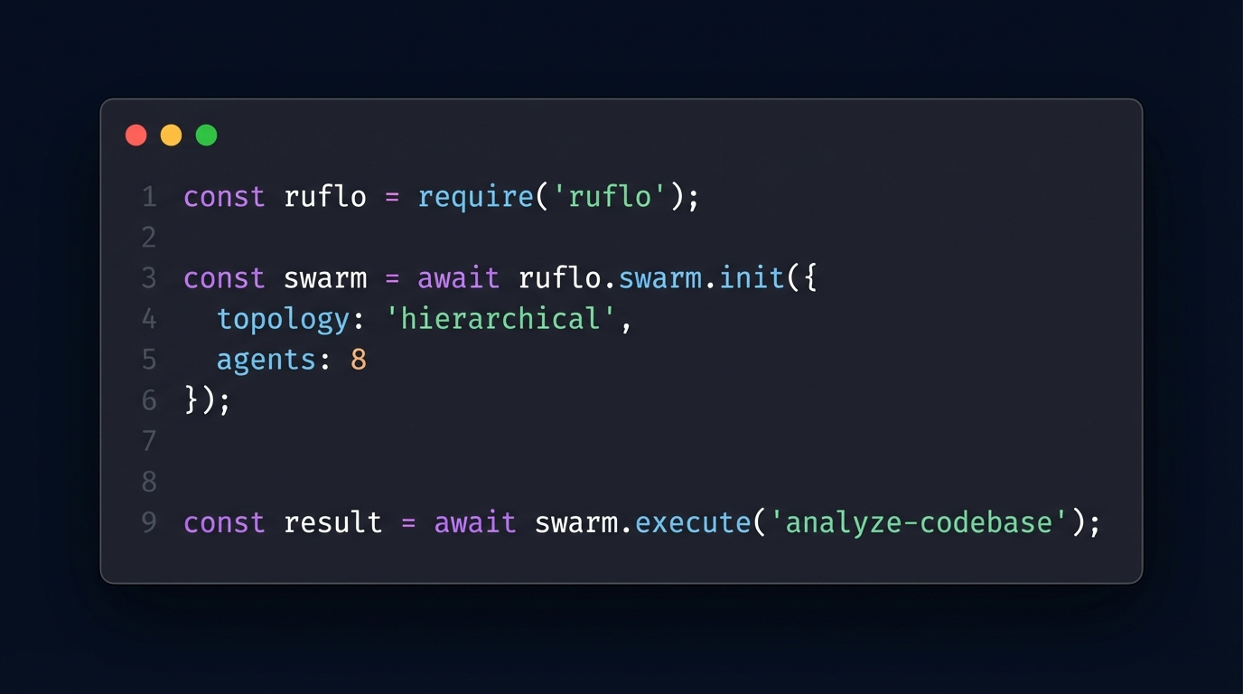
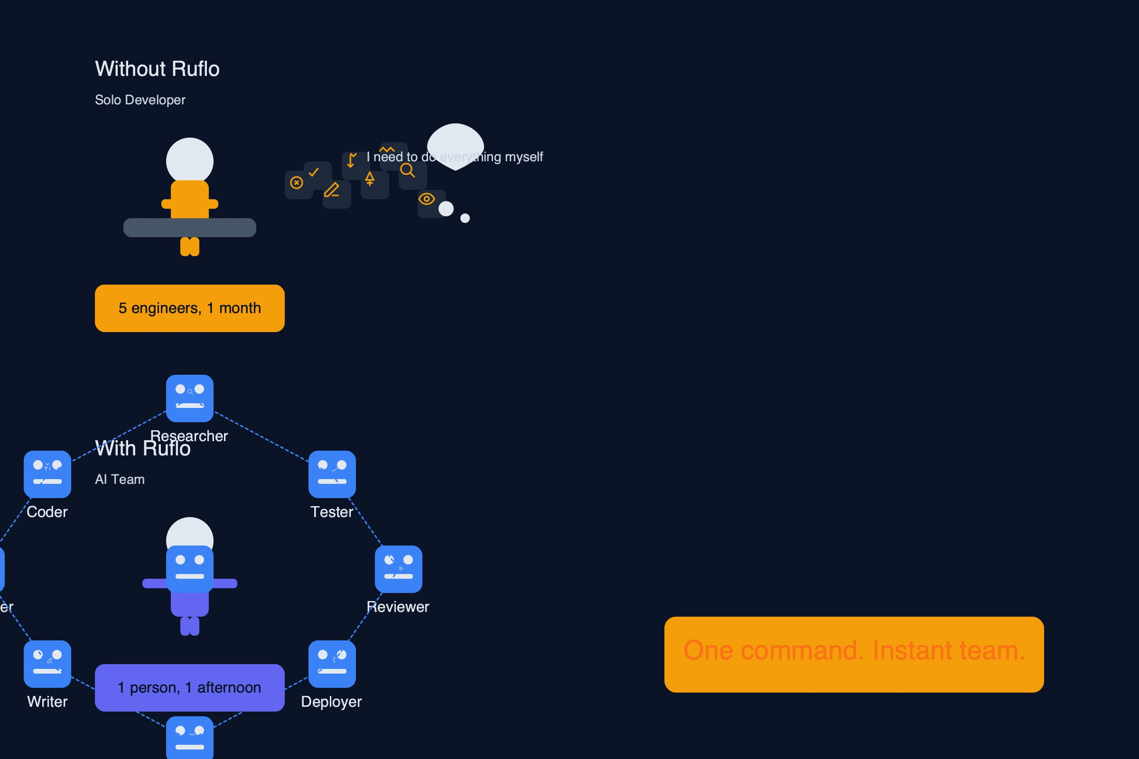
Ship It In 5 Lines
Production multi-agent swarms. Self-learning. Self-healing. One require statement.
const ruflo = require('ruflo');
// Initialize a self-healing agent swarm
const swarm = await ruflo.swarm.init({
topology: 'hierarchical', agents: 8, strategy: 'specialized'
});
// Deploy 51 autonomous agents in one command
const fleet = await swarm.deploy({
domains: ['billing', 'compliance', 'support'],
memory: 'persistent', // AgentDB - agents remember everything
security: 'aimds', // Chaos theory threat detection
runtime: 'rvf-wasm' // 5.5KB - runs anywhere
});
fleet.on('resolution', (data) => {
// SONA generates LoRA adapters automatically
// Your AI gets smarter. Zero cost. Zero effort.
});
Claude Code shipped sub-agents in March 2026. Ruflo shipped this in August 2025. 8 months earlier.

Slide 16
Performance Benchmarks
Measured results against best-in-class competitors.
Metric | RuvNet | Best Competitor | Advantage
HNSW Search | 61µs | 500ms+ (Pinecone) | 8,000x
Fox Flow QPS | 12.8M | 3K (Redis) | 4,000x
Detection Time | 0.06ms | ~10ms (rule-based) | 167x
WASM Runtime | 5.5KB | 100MB+ (containers) | 18,000x
Learning Latency | <1ms | Days-weeks | >86Mx
Agent Scale | 100K | ~10-50 | 2,000x+
SWE-Bench | 84.8% | 33.2% (GPT-4o) | 2.5x
8,000x
4,000x
167x
18,000x
Vector Search
Stream Processing
Threat Detection
Smaller Runtime

Slide 17
Integration Architecture
MCP protocol. PostgreSQL-native. Drop-in pgvector replacement.
MCP Protocol: 96 Tools
PostgreSQL-Native
Deferred loading for performance
Agent orchestration + memory + search
Task management + workflow engine
Security scanning + graph analytics
No separate vector database deployment
290+ SQL functions in-process
ACID transactions on vector ops
Drop-in pgvector migration
APIs, SDKs & Integration Points
REST API
Standard HTTP
gRPC
High-perf binary
TypeScript SDK
Full type safety
Python SDK
ML pipelines
WASM SDK
Client-side search
Webhooks
Event-driven
96 MCP Tools | 290+ SQL Functions | Drop-in pgvector | 49+ npm Packages

Slide 18
Implementation Roadmap
From zero to production in 3 months. Incremental value at every phase.
1: Foundation
2: Intelligence
3: Customize
4: Scale
Week 1-2
Week 3-4
Month 2
Month 3+
Core RuVector PostgreSQL extension
AIMDS security middleware
Basic agent deployment
HNSW index configuration
AgentDB memory (4 types)
ReasoningBank + SONA
Ruflo orchestration
MCP tool integration
Custom agent development
Domain-specific LoRA training
Graph analytics deployment
Performance tuning
Production scaling + monitoring
WASM edge deployment
Multi-tenant RVCOW
Advanced swarm topologies
Each phase delivers standalone value. No big-bang migration required.

Slide 19
RUVNET
Schedule a 30-Minute
Architecture Review
148+
14
80+
290+
Capabilities
Modules
Rust Crates
SQL Functions
39
9
5
24
Attention Mechanisms
RL Algorithms
Bio-Inspired Layers
RVF Segment Types
Two standard deviations beyond state of the art. Open source. Free.
ruvnet.com | hello@ruvnet.com

