Slide 1

LETOURNEAU UNIVERSITY EETC 3433 ELECTRICAL MACHINERY AND CONTROLS for JLNU Fall Semester 2024 Lesson 5: 20241101 Fri
By Judy WS Wong

Slide 2

Case study on Schematics / technical information – Precious Plastics
https://www.preciousplastic.com
Download the schematics and check them out
Although you might not be able to login (firebase restriction, so you can only use it when you have access with google), you do not need to login
https://community.preciousplastic.com/academy/build/shredderpro

Slide 3
Exercise (30 min)
Read on https://community.preciousplastic.com/academy/build/shredderpro
Create a 4 question Kahoot to make sure that your classmate read about the build description / schematic. You win if most of the students can’t find the answer (but you have to prove your answer can be found) (no true and false question)

Slide 4
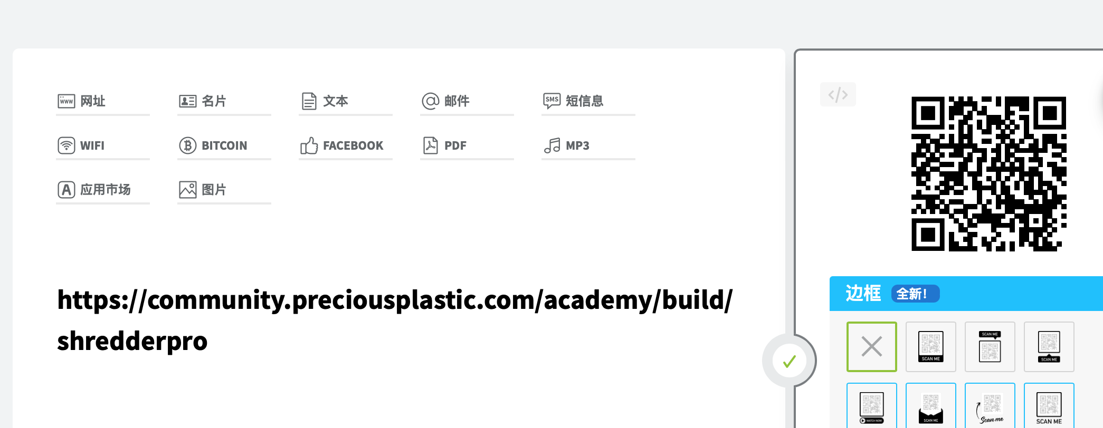
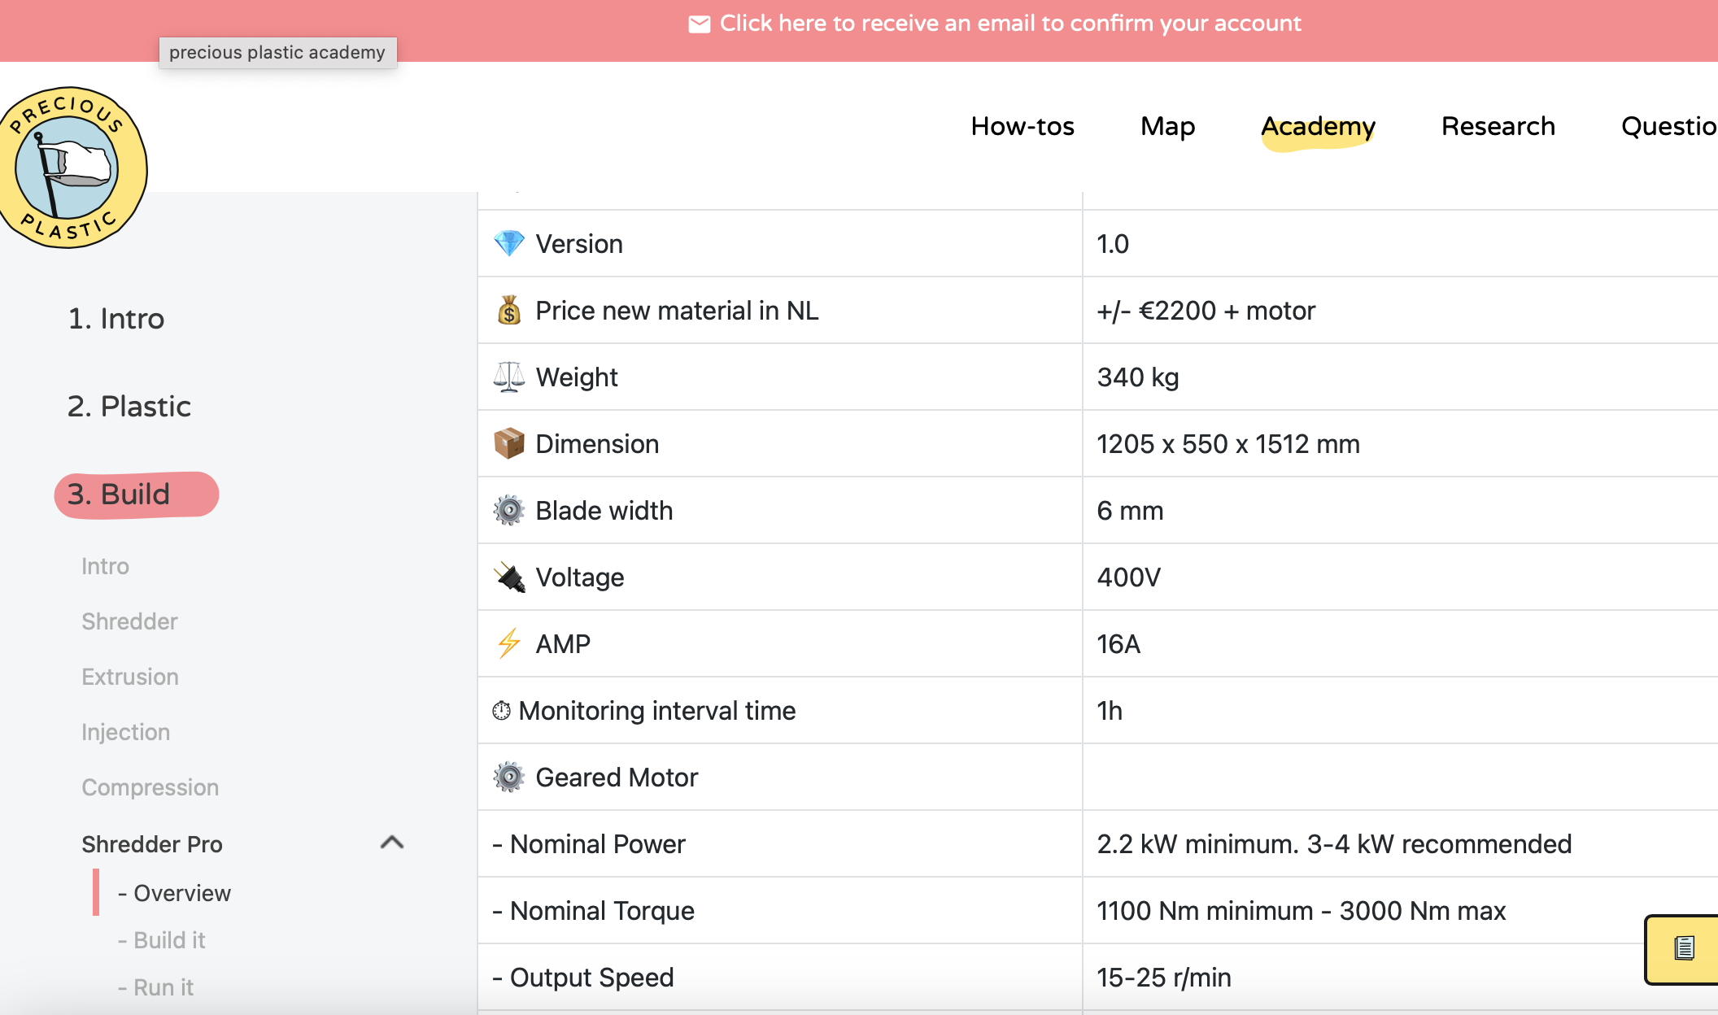

Slide 5
Kahoot time!
Random Kahoot until 4:50pm

Slide 6
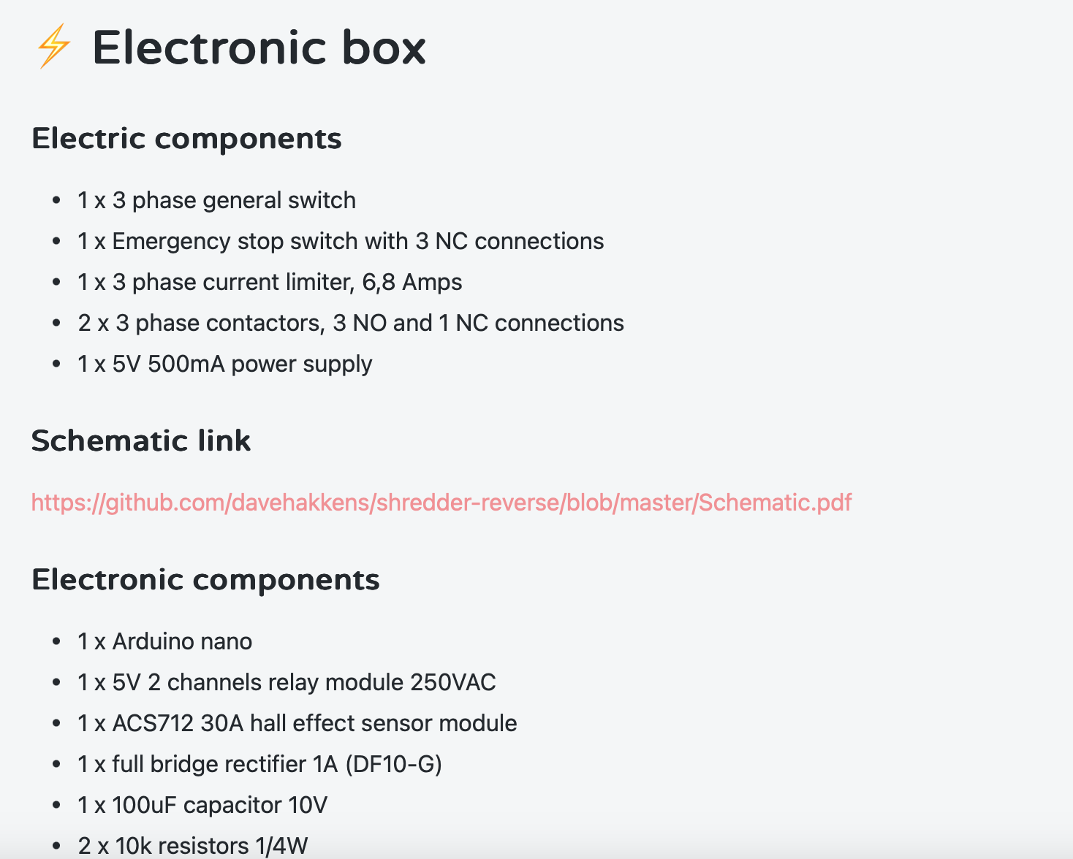
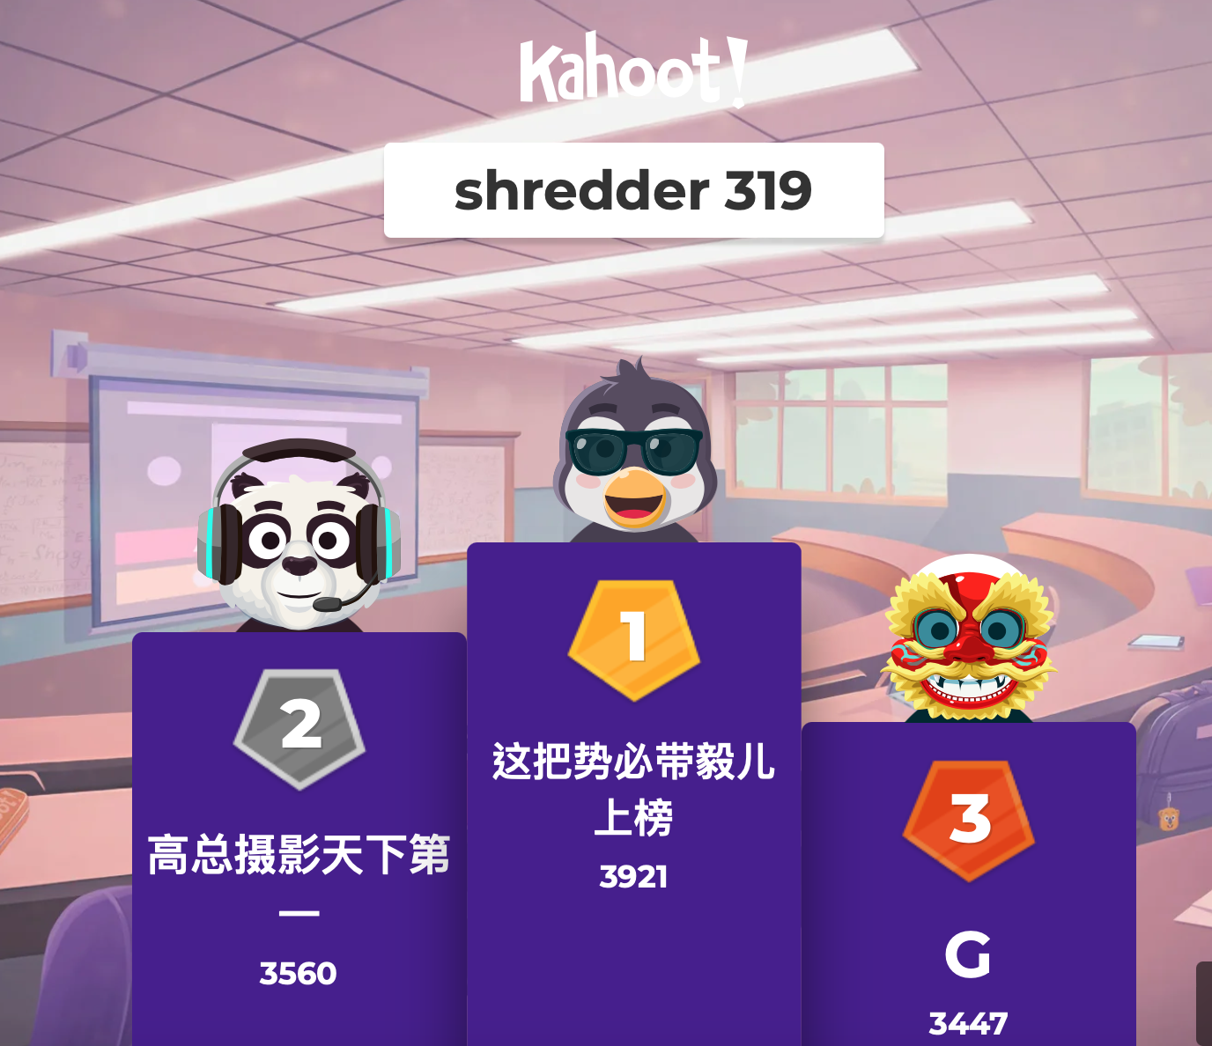
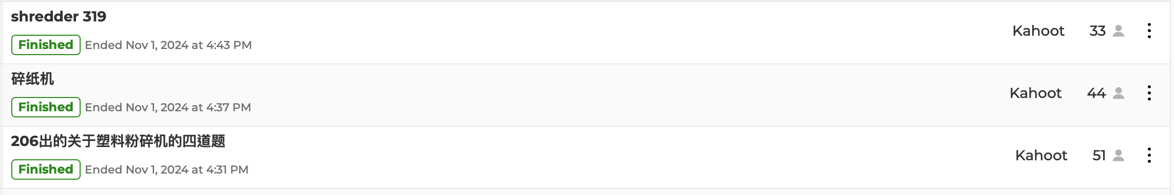
Summary

Slide 7
Exam question – the solution proposal
How much can you write it in 2 hours?
Question:
Based on the dual-axis shredder requirement, design a solution.
Exercise: just spend about 20 min to draft out what you will write if this is an exam

