Slide 1
LETOURNEAU UNIVERSITY EETC 3433 ELECTRICAL MACHINERY AND CONTROLS for JLNU Fall Semester 2024 Lesson 7: 20241105 Tue
By Judy WS Wong

Slide 2
Exam question – the solution proposal
How much can you write it in
1-2 hours?
Question:
Based on the dual-axis shredder requirement, design a solution.
Exercise: just spend about 20 min to draft out what you will write if this is an exam

Slide 3
How to hand up homework with github
Why am I going through all these trouble
For students to get familiarized with the “real working world”
Github App – have you downloaded?
Android / iOS
Web app – could submit binary file (image file)
(Demo)
Today to submit: https://classroom.github.com/a/a7w6QKNN

Slide 4
What have I written in the 20 min?
As said, there is no right or wrong answer. This is just an exercise. But you need to do it as a learning process - we aren’t ducks to be fed
I am sharing my sample version of the 20 min technical writing here. What difference do you see between yours and mine?
10 min exercise: Write down Miro, what do you see the major difference between your answer and the sample answer. Is it difference in the focus? What have you learn?

Slide 5
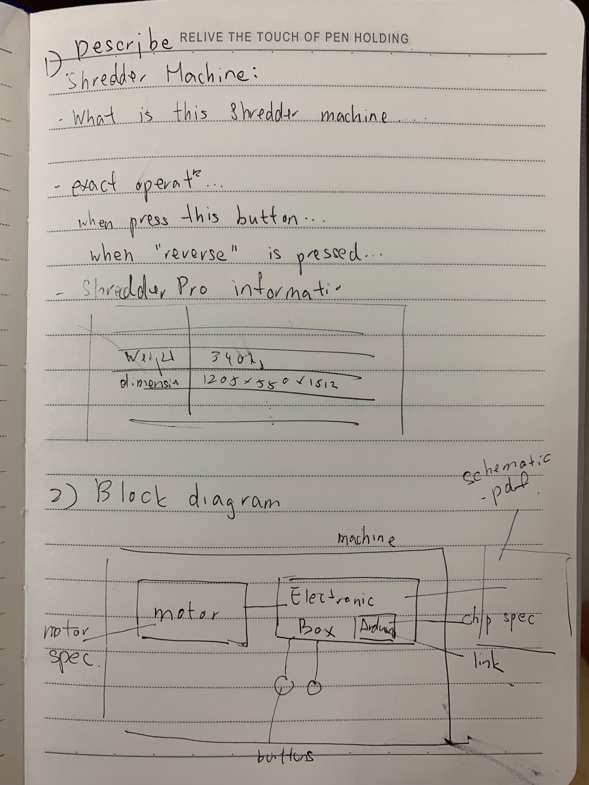
Sample Solution..
Nobody is prefect.. This is only a reference
Compare your answer to this sample:
https://miro.com/app/board/uXjVLNTuDhY=/
Submit to here:
https://classroom.github.com/a/J21YRYuh

Slide 6
Update on the discussion board – 10 min
https://miro.com/app/board/uXjVLNTuDhY=/
Find your old board with system
Add a photo (so I can tell who you are)
Paste a copy of your answer
Tell us what you think between your answer and the sample answer
Do a screen capture of this – will be submitting
(if this is too slow, you can do it on your own board)
https://classroom.github.com/a/J21YRYuh

Slide 7
Different Types of technical writings [5 min]
https://miro.com/app/board/uXjVLNTuDhY=/
Academic Paper
Technical specification
Patents
??
??

Slide 8
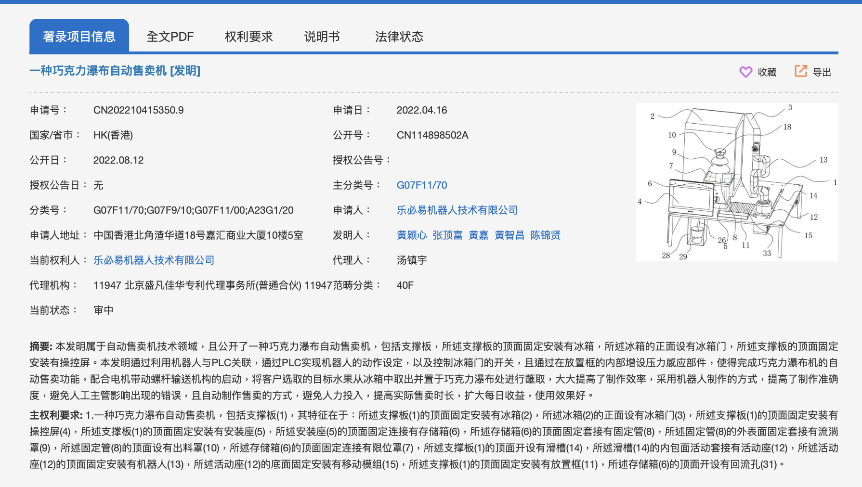
Patents
About Patent

Slide 9
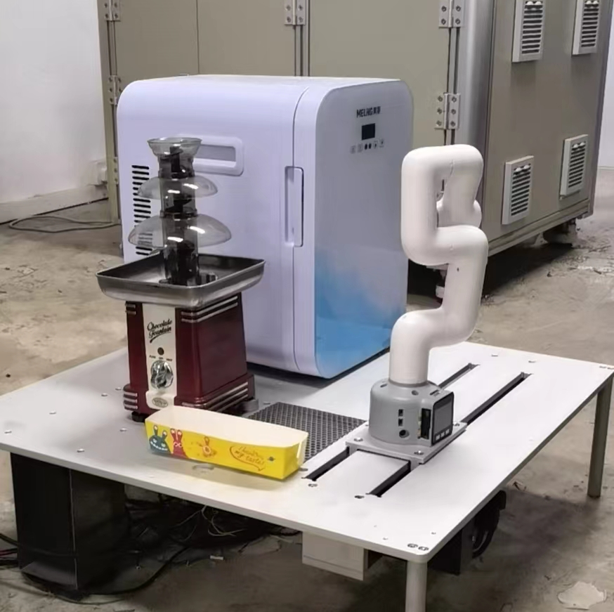
Next exercise
About the Chocolate fountain robot
(We will go back to the waffle machine after this… as that is way too complicated)

Slide 10
Back to Syllabus: PID controller
https://www.bilibili.com/video/BV1sVbseGEJz/
https://www.electricaltechnology.org/2015/10/what-is-pid-controller-how-it-works.html
Kahoot – Create a 10 question Kahoot! Based on the above information. No need to create teaching slides as these are all included.

