Slide 1

LETOURNEAU UNIVERSITY EETC 3433 ELECTRICAL MACHINERY AND CONTROLS for JLNU Fall Semester 2024 Lesson 3: 20241029 Tue
By Judy WS Wong

Slide 2
More Hands-on
Kahoot – everyone create their own quiz for 8-questions on Chapter 2.
Chapter 2: Advanced Applications of AC and DC Machines
Overview of AC and DC Machines: Key Differences and Similarities
Advanced Control Techniques for Both Machine Types
Applications in Robotics, Electric Vehicles, and Industrial Automation

Slide 3
孔子：古之学者为己，今之学者为人
我们不是填鸭， 填了你也不记得
We are here to learn, not to be fed. The purpose of being a university student – is to experience life, and to learn to learn.
Teachers are here to coach you, give you guidance. We give you a direction, and you should learn how to Baidu/google/search/AI the answer for yourself. (note: AI sometimes give you uncertain answers – so make sure you check the source and references)
Q: did you guys has syllabus about checking source and references for eg. Writing paper?

Slide 4
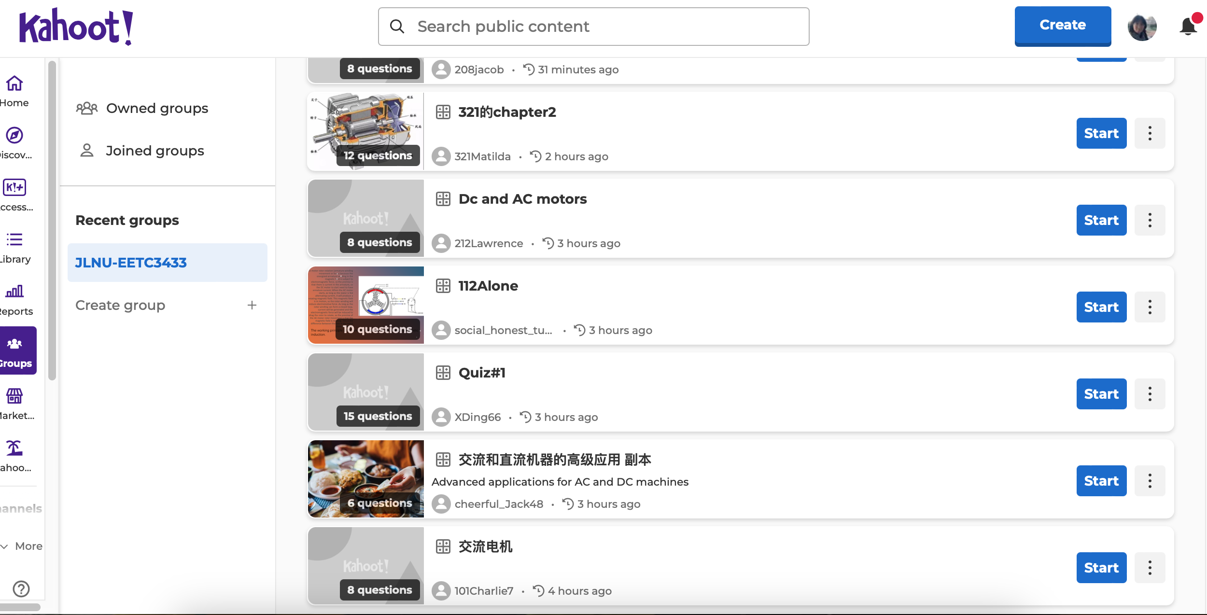
76/90 students have submitted their assignements on Kahoot!
https://create.kahoot.it/groups/058a7ac4-7fae-4738-ab54-50de7f4e0072/join?inviteCode=9f6e61rgbn4g7e5ap8vjf7ncf85o16484cfl1b24sv9mldaa5lkr6mcn55ls9tjd8rm0n58bo9uiu
If you haven’t, Please join the link above.

Slide 5
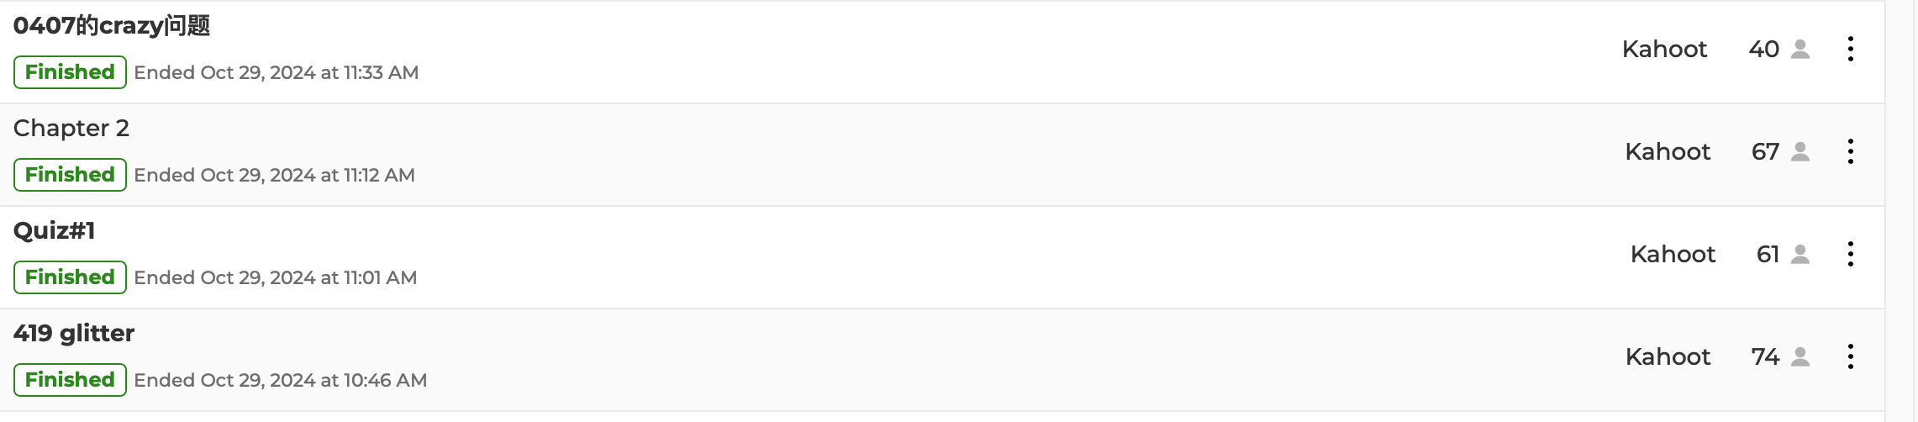
Summary
We played 4 games of Kahoot created by the teammates today.
Some of the good quiz done by teammates will be made as assignments for students to gain relevant knowledge.

