Slide 1

LETOURNEAU UNIVERSITY EETC 3433 ELECTRICAL MACHINERY AND CONTROLS for JLNU Fall Semester 2024 Lesson 2: 20241028
By Judy WS Wong

Slide 2
More Hands-on
Understand and Establish Github Account
What “what is github” on bilibili
Create the Github account with Shanshan while also working with Miro
Hands-on Miro and continue with the discussion in last lesson

Slide 3
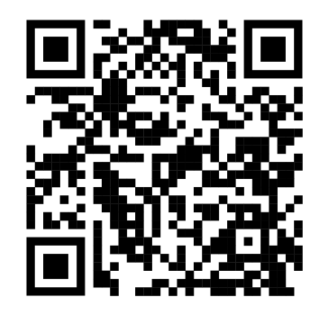
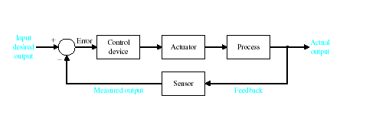
Miro
Stress test…
https://miro.com/app/board/uXjVLNTuDhY=/

Slide 4

GitHub Classroom
https://www.bilibili.com/video/BV15W41157up/?spm_id_from=333.337.search-card.all.click&vd_source=07361c8f42cb5e1f7ea4722ec4dc19f6
https://github.com
https://classroom.github.com/classrooms/186245921-jlnu-eetc3433-fall2024

Slide 5
Group discussion (10 min break/ preparation)
an example machine you would consider needed for motion control
~6-8 people in a group
I’ll randomly pick group to share this – just show a picture on screen here would be fine

Slide 6
Group discussion – class expectation
Discuss: What are you expecting in this control class - able to control an airplane? able to control a car? robot?
~6-8 people in a group
I’ll randomly pick group to share this – just show a picture on screen here would be fine

Slide 7
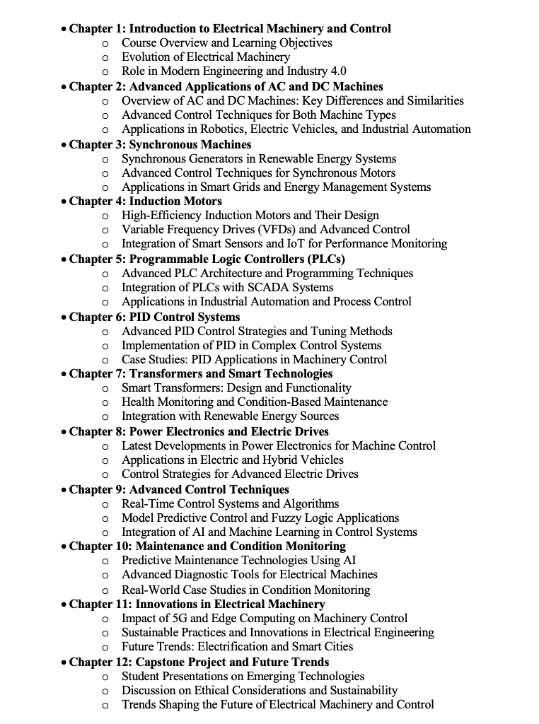
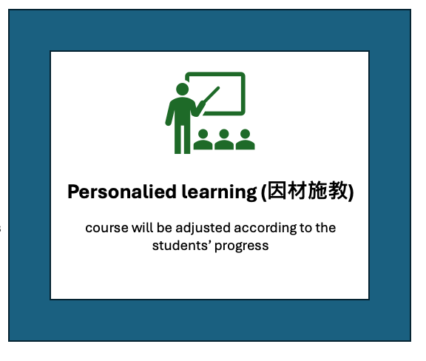
Syllabus
Comment on the syllabus on miro
designed

Slide 8
孔子：古之学者为己，今之学者为人
我们不是填鸭， 填了你也不记得
We are here to learn, not to be fed. The purpose of being a university student – is to experience life, and to learn to learn.
Teachers are here to coach you, give you guidance. We give you a direction, and you should learn how to Baidu/google/search/AI the answer for yourself. (note: AI sometimes give you uncertain answers – so make sure you check the source and references)
Q: did you guys has syllabus about checking source and references for eg. Writing paper?

Slide 9
Being a teacher yourself is the best way to learn
Being a teacher yourself is the best way to learn. So for topics, you are require to do this in class:
Discussion and material searching
Come out with a Kahoot! Game with 8 questions
Submit your Kahoot! (make sure it is public) Game link to the miro
Chapter 2: Advanced Applications of AC and DC Machines
Overview of AC and DC Machines: Key Differences and Similarities
Advanced Control Techniques for Both Machine Types
Applications in Robotics, Electric Vehicles, and Industrial Automation

Slide 10


Let me get to know you guys

Slide 11
Key Takeaway for having an Exchange Tutor
Open Source / GitHub / making codes known to public
You learn most by contributing
Source references / eg. ChatGPT might not be reliable
CC (Creative Commons)
Interactive learning
stress test

Slide 12
Keep in touch - GitHub Classroom
https://github.com
https://classroom.github.com/classrooms/186245921-jlnu-eetc3433-fall2024

