Slide 1


LETOURNEAU UNIVERSITY EETC 3433 ELECTRICAL MACHINERY AND CONTROLS for JLNU Fall Semester 2024 Lesson 9: 20241107 Thu
By Judy WS Wong

Slide 2
Agenda
Before Break
Drafting out the block diagram
After Break
Random share 3-4 Block digram
Showing my sample Digram
Kahoot on PID (if have time)

Slide 3
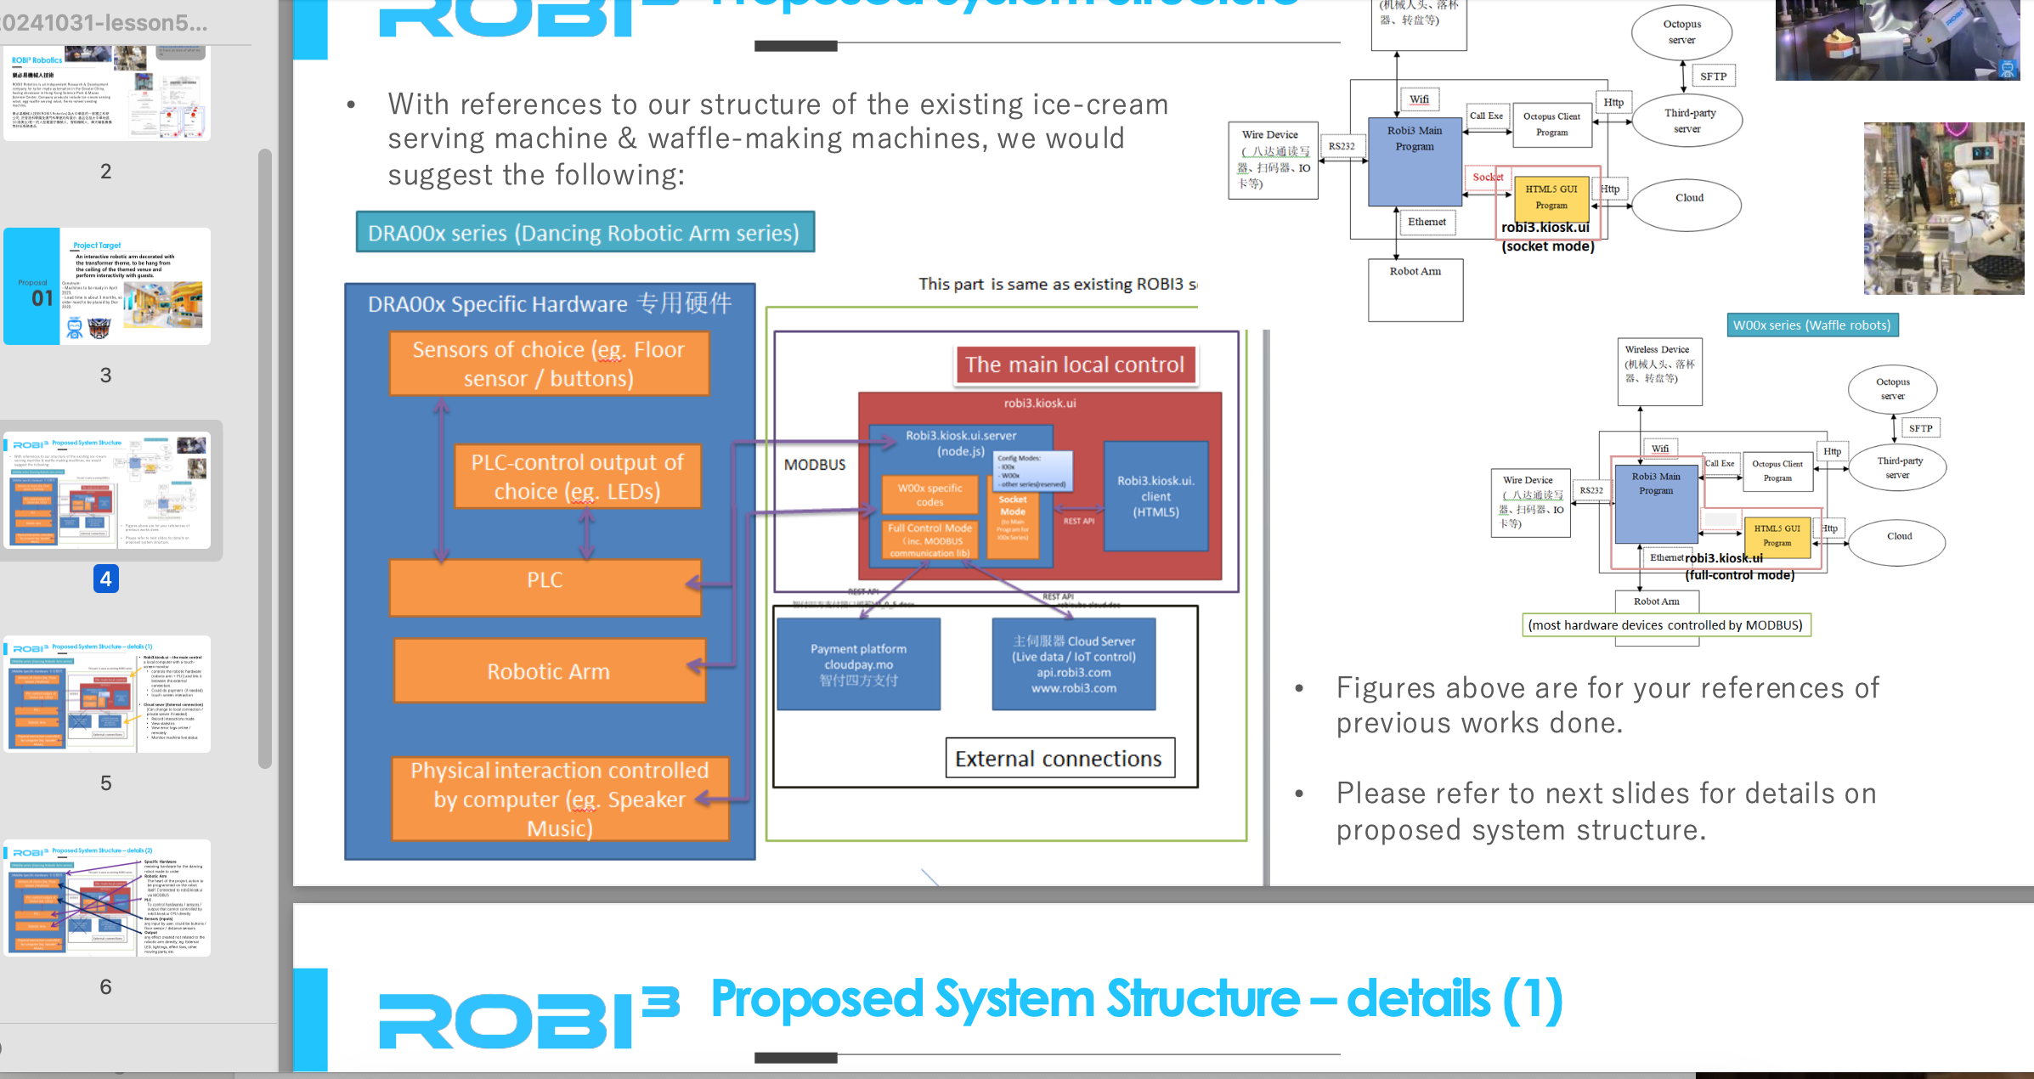
Note – there is no mid-term. This project is midterm
Please make sure you do it~~ We are spreading it into 2 classes…

Slide 4
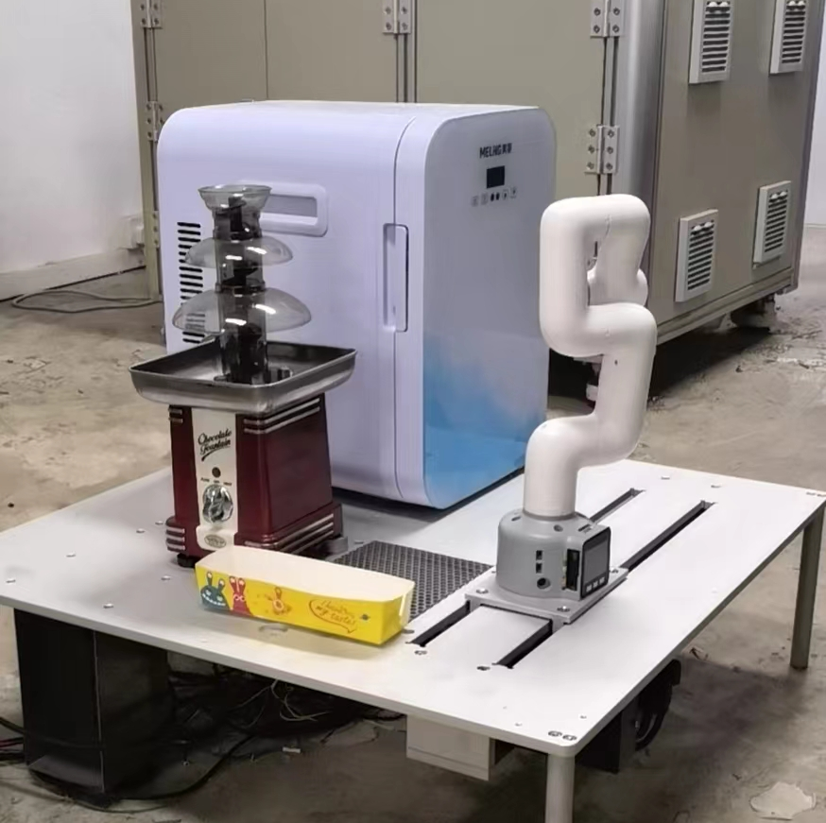
Writing the Block Diagram
About the Chocolate fountain robot
(We will go back to the waffle machine after this… as that is way too complicated)

Slide 5
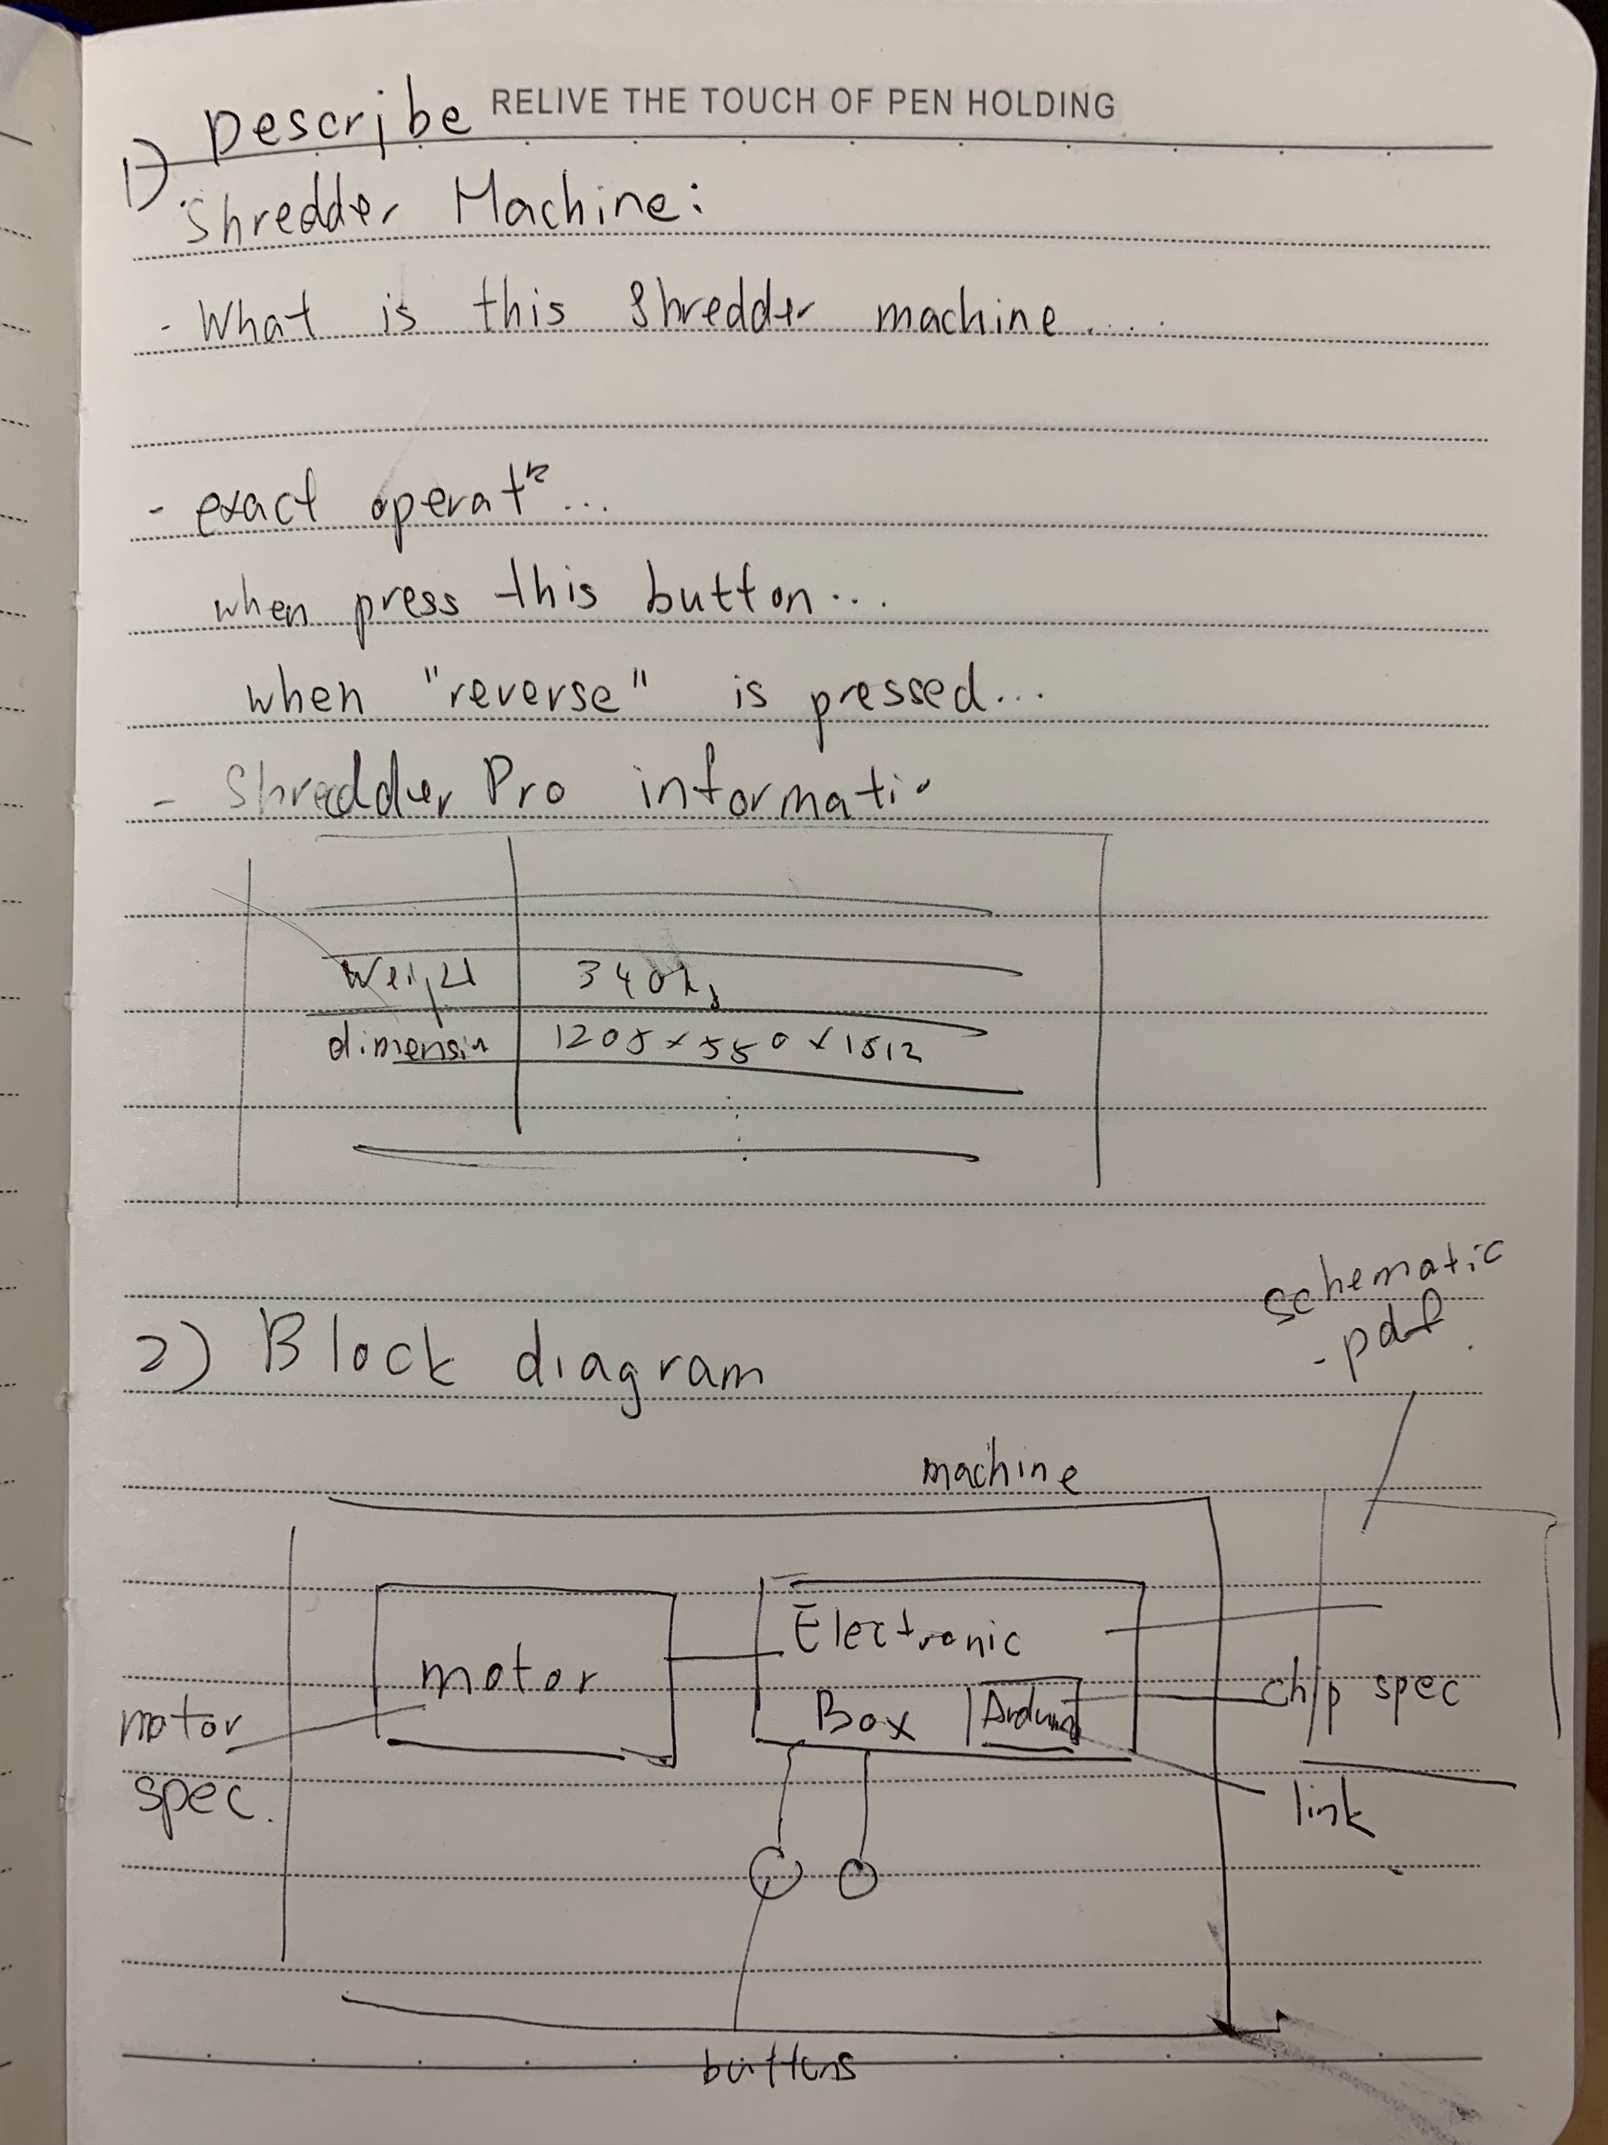
Work it out on your Miro board (1st part of lesson)
In group of Max 3 students, try drafting out the block digram you see.

